Slide 1
Automatic subtitling
Time has come to consider the possibilities of automatic subtitling
Gion Linder, Head of subtitling SWISS TXT

Slide 2


Automatic subtitling
Gion Linder, Head of subtitling SWISS TXT

Slide 3
Automatic subtitling
What is automatic subtitling?
Automatic speech recognition
+
Creation of the subtitles
=
Automatic subtitling

Slide 4
Automatic subtitling
Three different services
for live programs
with subsequent correction by a subtitler
alignment service

Slide 5
Automatic subtitling
Suppliers
EML (D-Heidelberg)
Cedat 85 (I-Rome)
Linguatec (D-München)
Pervoice (I-Trento)
Savas
Sempre Sole (NL-Nieuw Vennep)
Vocapia (F-Paris)

Slide 6
Automatic subtitling
What is automatic subtitling?
Automatic subtitling
+
Subsequent correction
<
classic subtitling

Slide 7

Automatic subtitling
Example

Slide 8
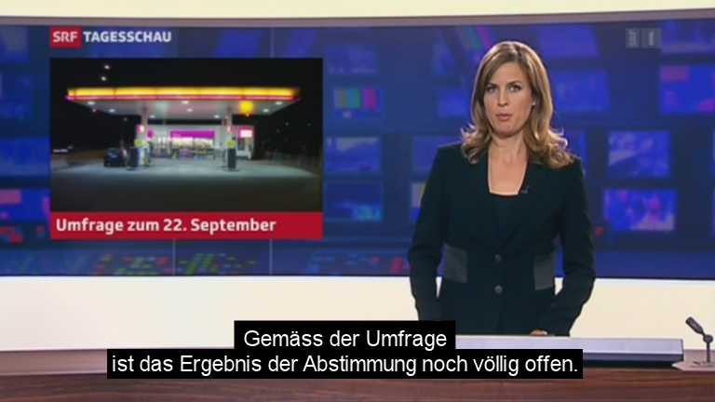
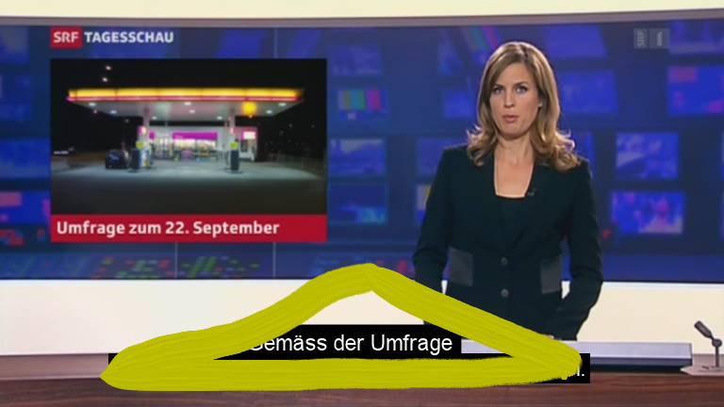
Automatic subtitling
Example
• Text too short on screen
• Bad segmentation
• “Pyramid rule”

Slide 9

Automatic subtitling
Example

Slide 10

Automatic subtitling
Example
• Spoken vs. written language
• Different from standard language
• Background music / noise
• Big variation within a program
• Wrong recognized words

Slide 11
Automatic subtitling
Results

Slide 12
Automatic subtitling
Recommendations for a broadcaster
Not all kind of programs suit
• Standard language
• without spontaneous speech
• homogenous program format
• noise and background sound standardized

Slide 13
Automatic subtitling
Recommendations for a broadcaster
How to find the best provider
• Test! Test! Test!
• Offer them your own contents
• Try find a deal
How will we go on?
Test! Test! Test!
Offer the ASR as an additional service
Establish as a service on HbbTV

Slide 14
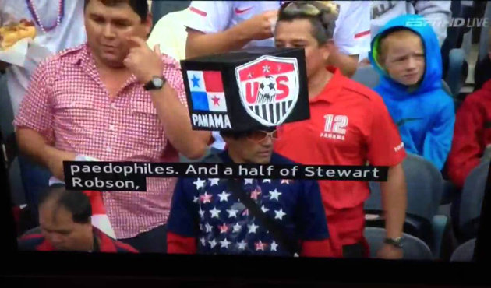
Automatic subtitling
Recommendations for a broadcaster
Consider a certain risk

Slide 15
Automatic subtitling
Thank you!
gion.linder@swisstxt.ch
Follow me on Twitter:
@accessserv

