Slide 1

Green Systems: Wet Demonstrator
Stephen Lentz
Director of Network Development

Slide 2
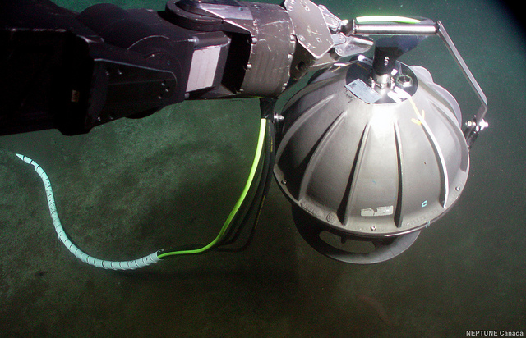
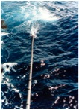
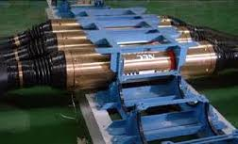
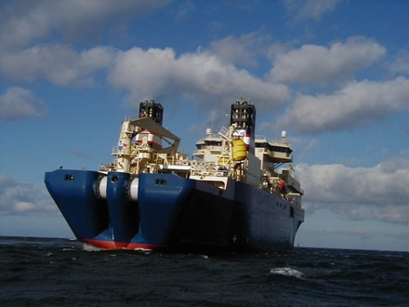
Green Systems: Wet Demonstrator
Sensor Selection
Wet Demonstrator
First Application
General Availability
Confidential and Proprietary
Notes:
This is my perspective, based on experience in and around telecom cable industry and accepting the skepticism of cable owners
Incorporates input and feedback received during review of Functional Requirements and Wet Demonstrator papers
I don’t expect this to be popular, it may even be offensive to some, but the intent is to spur discussion
Any obstacle can be overcome with sufficient willpower
At least three and maybe five stages from where we are today to where we want to be. Wet Demonstrator, First Application, General Availability.
Suggest we start work on sensors with smaller budget
Could be a fifth stage between Wet Demonstrator and First Application if we want Suppliers to have finished product ready before an order is placed

Slide 3
Wet Demonstrator
Objectives
Principles
Design
Success Criteria
Cost Estimate
Alternatives

Slide 4
Wet Demonstrator Objectives
Show That Sensors Can Be Installed as Part of a Submarine Cable System
Ensure Sensors Produce Useful Data When Installed as Part of a Submarine Cable System
Provide Reference Data Regarding Sensor Performance
Notes:
More than a field trial, less than a qualification test, really a “Proof of Concept”

Slide 5
Wet Demonstrator Principles
Mechanical Design Must Represent Expected Green System Design
Power and Communications May Use Off-the-Shelf Components
Deployment by Cable Ship Using Conventional Handling Methods
Connected to Cabled Observatory
Six to Eighteen Month Initial Evaluation Period
Notes:
We are not trying to integrate the power and comms into a working system; suppliers have indicated this is normal development work which can be completed without undue risk, providing funding is available
Would also consider using an Out of Service Shore End
Initial Operation Period – call it successful if it works this long
Would like to leave in place permanently

Slide 6
Wet Demonstrator Design
Minimum of Three Sensor Sets
Minimum Separation 3x Water Depth
Greater Separation Preferred, up to 50km

Slide 7
Criteria for Success
All Sensors Function Properly Upon Deployment
99% Operational Availability
No More Than One Sensor Failure During Evaluation Period
Data Validation (Criteria to be Agreed)

Slide 8
Cost Estimate
Low End: US$4,500,000
High End: US$13,000,000
Variables:
  Quantity of Cable
  Cost and Number of Sensor Sets
  Cost of System Assembly
  Vessel Mobilization & Demobilization
  Supplier’s Engineering Services

Slide 9
Alternatives
Shock, Vibration and Temperature Testing
Optical Line Testing
Individual Instrument Deployment
Notes:
First two don’t add much value, since sensors are spec’ed and qualified by their manufacturers, and this is not about the optical link performance, we take that for granted
Individual instrument deployment would have some value because it would allow us to:
Address Data Storage Format and Metadata Requirements
Develop Reference Driver Software
Provide Baseline Data for Wet Demonstrator
Near Term, Low Cost
Need Interested PI with Modest Funding

Slide 10
Thank You!

Slide 11
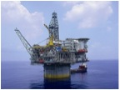
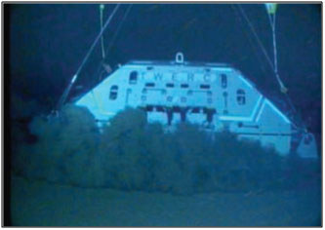
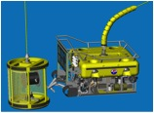
Ocean Specialists, Inc
A Project Development Company providing Full Life Cycle Submarine Network Services: Planning, Design, Implementation & Operation
Commercial Telecom Submarine Networks
Offshore Oil & Gas Networks
Ocean Observing Systems
Technology
Development & Partnerships
Notes:
OSI is a Network Development Company providing Full Life Cycle Services for the Planning, Design, Implementation & Operation of fiberoptic cables
We focus on broadband fiberoptic submarine cable projects in the commercial telecoms, offshore oil & gas and scientific research markets
We also support the industry by creating technology and products where opportunities exist to develop better solutions for the industries in which we’re involved

