Slide 1
Green Systems: Science & Engineering
Stephen Lentz
Director of Network Development

Slide 2
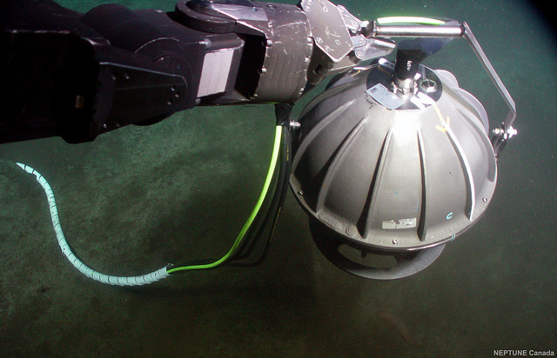
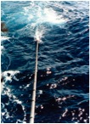
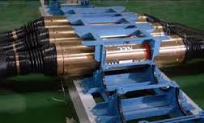
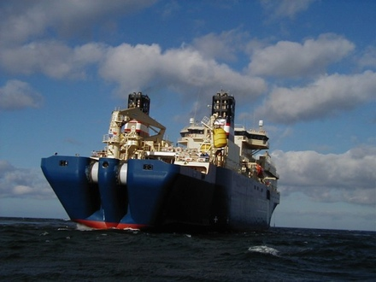
Green Systems: Science and Engineering
Sensor Requirements
Wet Demonstrator
First Application
General Availability
Confidential and Proprietary
Notes:
Proposed Next Step is to develop a wet demonstrator project
The requirements for this have been defined in two separate Documents
Commissioned by Joint Task Force
Authored by Peter Phibbs (Mallin Associates) and Steve Lentz (OSI)

Slide 3
Topics
Joint Task Force Initiative
Science Objectives
Science Challenges
Engineering Objectives
Engineering Challenges
Action Plan

Slide 4
Joint Task Force Initiative
Increased Reliability and Integrity of Global Tsunami Warning Network
Sustained Climate-Quality Data from the Deep Oceans

Slide 5
Science Requirements
Three Sensor Types
Temperature, Pressure, Three Axis Acceleration
State-of-the-Art Performance
Reliability
Long Term Stability
Alternatively, Ongoing Calibration

Slide 6
Science Challenges
Usefulness of Sensor Data when Surface Laid
Coupling of Seismic Signals Impaired?
Usefulness of Sensor Data when Buried
Temperature or Pressure Measurements Impaired?
Notes:
Things we can’t engineer away; for example, you can’t plough bury a repeater at 4000 meters. Likewise, you probably shouldn’t surface lay a cable in 200m...

Slide 7
Engineering Challenges
Sensor Technology
System Design
Data and Metadata Storage
Notes:
Sensor technology is the biggest open issue, particularly with regards to longevity and stability.
System design and data storage requirements are solvable problems

Slide 8
Action Plan to Address These Requirements
Requirements Definition
Sensor Performance Requirements
General Features of a Green System
Data and Metadata Requirements
Wet Demonstrator Project
Three or More Sensor Sets Connected to an Ocean Observatory
Installed As If Part of a Submarine Cable System
Show that Sensors Can Produce Meaningful Data When Deployed as Part of a Cable System
Notes:
Functional Requirments
Facilitate Continued Discussion of All Aspects of Green Systems
Permit Evaluation of Requirements by Interested Parties
Set Clearly Defined Objectives
Promote Standardization
Wet Demonstrator
Prove the Concept
Physical Evidence of Functionality
Experience with Real Data
Baseline Sensor Performance
Current Status
Draft Documents Have Been Prepared
Currently Under Peer Review

Slide 9
Moving Forward
Small Scale Sensor Trials
Funding of Wet Demonstrator
Increased Industry Participation
Candidate Systems for First Application
Notes:
Small scale trials if Wet Demonstrator funding not forthcoming
Wet Demonstrator 1-3 years
Industry participation 2-4 years
First Application 3-5 years

Slide 10
Thank You!

Slide 11
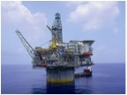
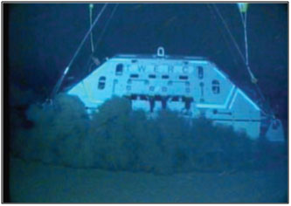
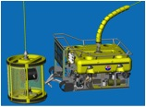
Ocean Specialists, Inc.
A Project Development Company providing Full Life Cycle Submarine Network Services: Planning, Design, Implementation & Operation
Commercial Telecom Submarine Networks
Offshore Oil & Gas Networks
Ocean Observing Systems
Technology
Development & Partnerships
Notes:
OSI is a Network Development Company providing Full Life Cycle Services for the Planning, Design, Implementation & Operation of fiberoptic cables
We focus on broadband fiberoptic submarine cable projects in the commercial telecoms, offshore oil & gas and scientific research markets
We also support the industry by creating technology and products where opportunities exist to develop better solutions for the industries in which we’re involved

