Slide 1
Nexans experience in deployment of sensors in subsea cable systems
Merete Caubet
Sales Manager, Submarine Fibre Solutions
Hybrid Underwater Cables Division

Slide 2
Presentation overview
LoVe project
Project overview
System Overview
Cable Condition Monitoring Solutions
DTS
DRS

Slide 3
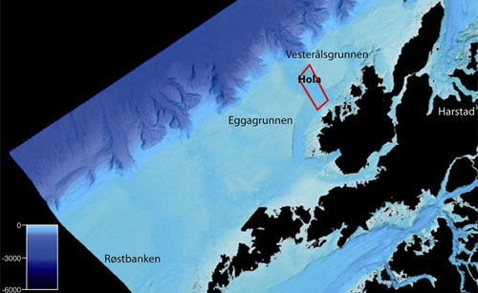
LoVe Environmental Surveillance Cable System
Ocean Observatory on the seabed approx. 16 km off the coast of Lofoten Vesterålen, Northern Norway
Water depth at the area for the infrastructure: 250-280m
An electro optical umbilical with a Subsea Distribution Unit (SDU) to enable quick and reliable connection between the umbilical and auxiliary sub-sea equipment by means of wet-mate connectors

Slide 4
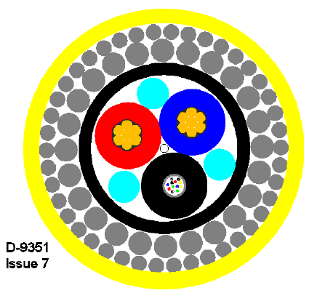
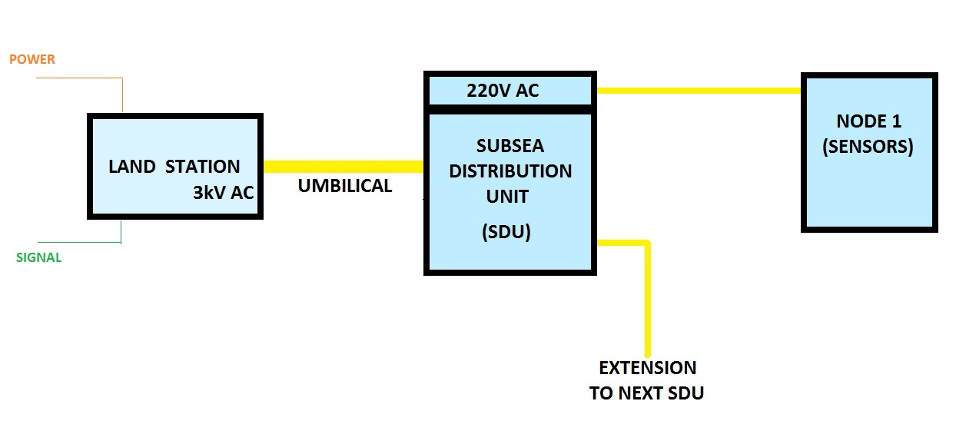
LoVe project - System overview
The Umbilical provides power and signal to sensor systems placed on the sea floor for marine life and oceanographic observations to be performed remotely from universities and other research centers.

Slide 5
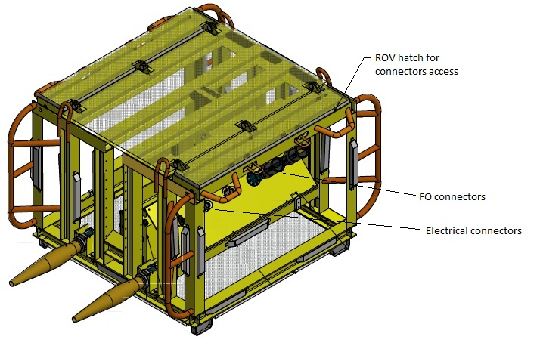
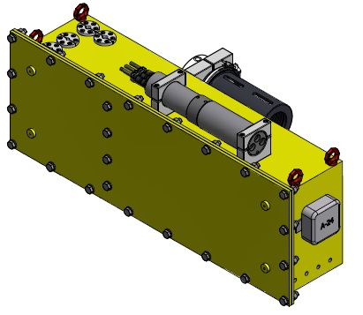
LoVe project - System overview
The SDU are provided with both electrical and optical wet mate connectors and a transformer to convert the voltage down from 3000 V AC to 220 V AC. Furthermore, the SDU is provided with a 500 m cable tail for future extensions to other fields.
Oil Filled Box (OFB) inside the Subsea Distribution Unit (SDU)
Umbilical Termination
Pressure Compensated
Transformer inside 3kV / 220V
SDU (Subsea Distribution Unit)

Slide 6
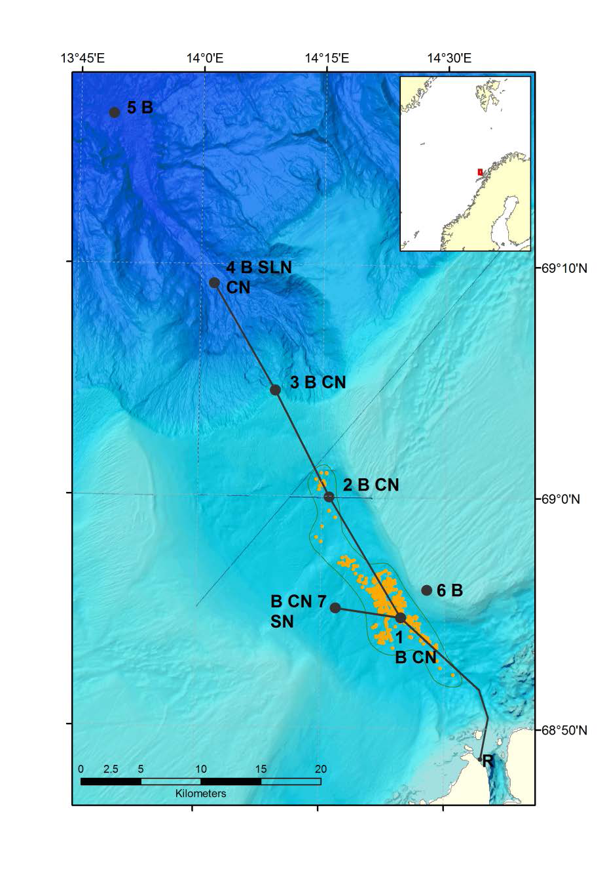
LoVe Environmental Surveillance Cable System
Cable system used for monitoring of the marine life (coral reef, fish, etc) in an area with rich marine life (and with potential Oil & Gas explorations in the near future).
Ecosystems
Marine Resources
Biological Processes
Geological Processes
Chemical Processes
Climate
Early warning systems for geo-hazards
Webcamera:
http://love.statoil.com/RealTime?locationId=HOVDEN

Slide 7
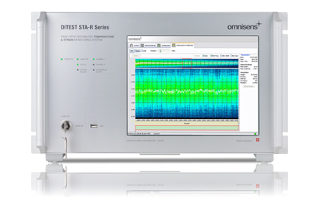
CCMS Cable Condition Monitoring Solutions

Slide 8
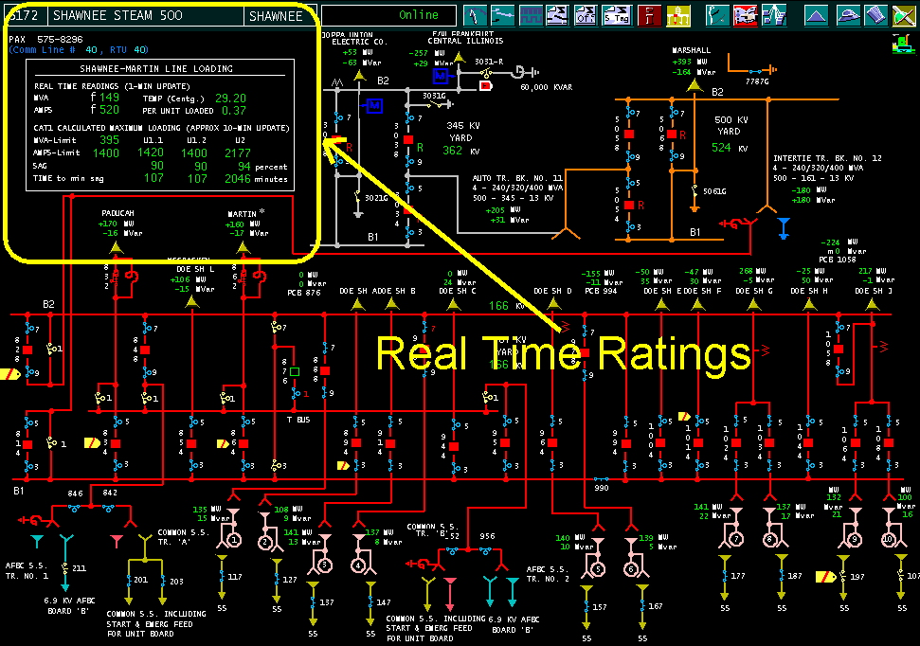
DTS, DRS & RTTR
Temperature monitoring - using DTS (Distributed Temperature Sensing)
Strain monitoring
Power monitoring using - RTTR (Real Time Temperature Rating)
From Sensor to the Control Room

Slide 9
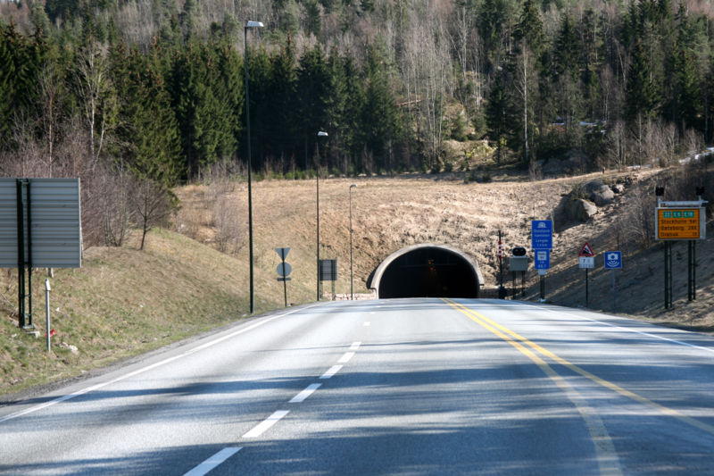
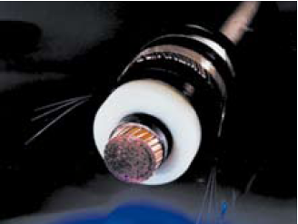
DTS - Distributed Temperature Sensing system
The fibre sensor is applied along a structure that we want to monitor; power cables, pipelines, tunnels, bridges, etc.
One fibre sensor replaces thousands of discrete sensors
Measures back-scattered laser signal present in all optical fibres, and calculates temperature (changes) in the sensor
Warning and Alarm levels can be pre-defined
Fire/ avalanche of tunnels, roads, railroads
Temperature in HV cables

Slide 10
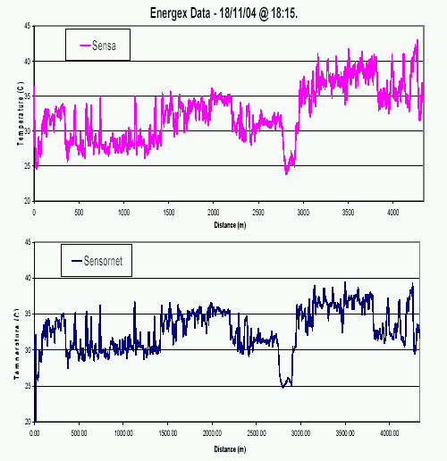
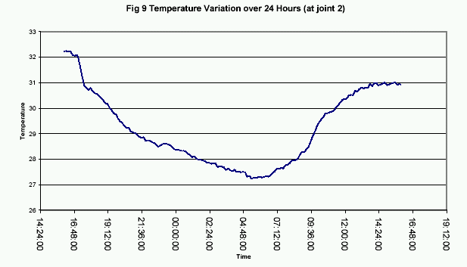
Performance for typical DTS-system
Range:
up to 75 km
Temperature resolution:
down to 1 – 2 K
Spatial resolution:
typically 1 – 3 m
Measuring time:
15 s – 40 min (depending on fibre length and spatial resolution)
typically 10 – 15 min
Temperature is presented graphically as temperature vs. Distance - Two examples:
Temperature at one point with fluctuating load over time, of an HV cable
River crossing
Road crossing
Real-time over total length
or
One point over time

Slide 11
DRS - Dynamic Rating System
System used for calculation of “real” temperature in the metallic core of a power cable – what the user really wants to know
Input-data;
temperature profiles from a DTS system,
mathematical model of “thermal transfer function” – must be elaborated for each specific cable design and application,
continuous current- and voltage information for each cable.
May also be used for calculating permissible short-term overload based on additional “historical information” (provide information to external power control systems)
Nexans DRS is purpose-built for each project by Nexans

Slide 12
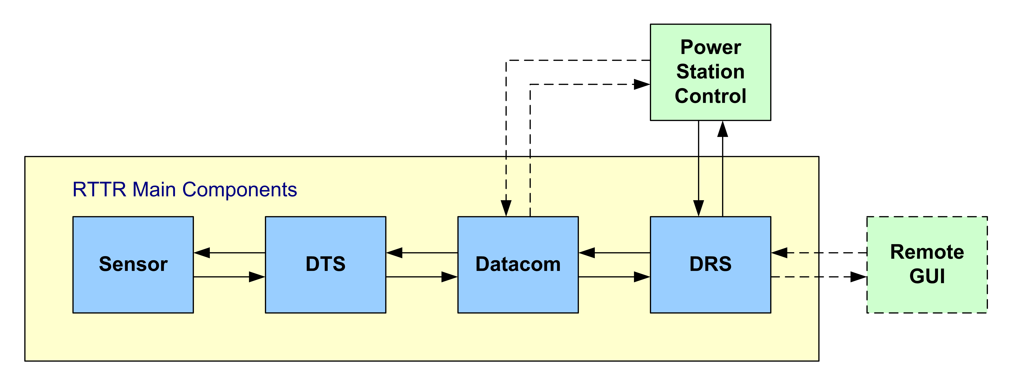
Briefly about RTTR/ CLPS
Real-Time Temperature Rating (RTTR), also sometimes called Cable Load Prediction System (CLPS), is a complete concept with four main components: Sensor, DTS, data communication, and DRS

Slide 13
Nexans proved field experience in converting offshore technology into environmental surveillance
Extensive experience in use of fibre sensor for temperature monitoring
Technological development mainly driven by demands from the Oil & Gas industry and use of smart grids

Slide 14
Thank you for your attention

