Slide 1
Green cable systems: Open Data and Open Standards Crucial for Warning
Ken Gledhill
GeoNet Project Director
Chair, Intergovernmental Coordination Group, Pacific Tsunami Warning and Mitigation System
GNS Science, New Zealand
GNS Science, New Zealand

Slide 2
Outline
New Zealand Situation
Open data exchange and data handling practice
Pacific Tsunami Warning and Mitigation System (PTWS) and the use of forecast models

Slide 3
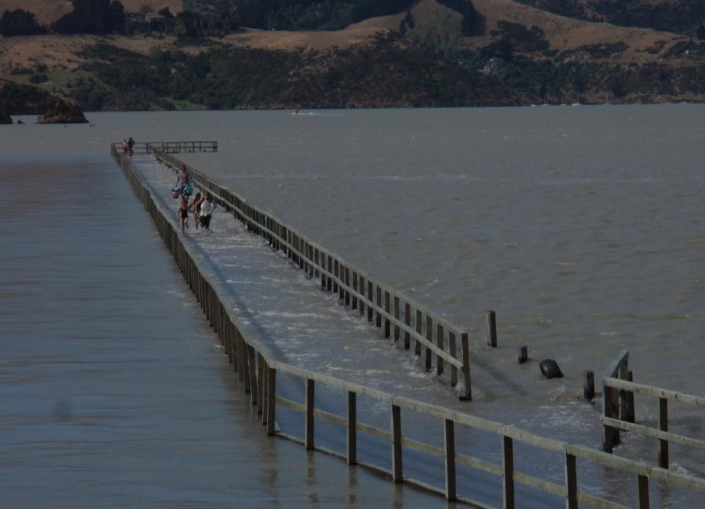
Events During the Last Few Years ….
2009 (July): Dusky Sound Earthquake (M_{W} 7.6)
2009 (September): Samoan Islands Tsunami
2010 (February): Chile Tsunami
2010 (September): Darfield Earthquake (M_{W} 7.1)
2011 (February): Christchurch Earthquake (M_{W} 6.2)
2011 (March): Japan Tsunami
2011 (June): Canterbury Earthquake (M_{W} 6.0)
2011 (December): Canterbury Earthquakes (M_{W} 5.8, 5.9)
2012 (August, November): Tongariro Eruptions
2013 (July, August): Cook Strait Earthquakes (M_{W} 6.5, 6.6)
2014 (January): Eketahuna Earthquake (M_{W} 6.2)

Slide 4
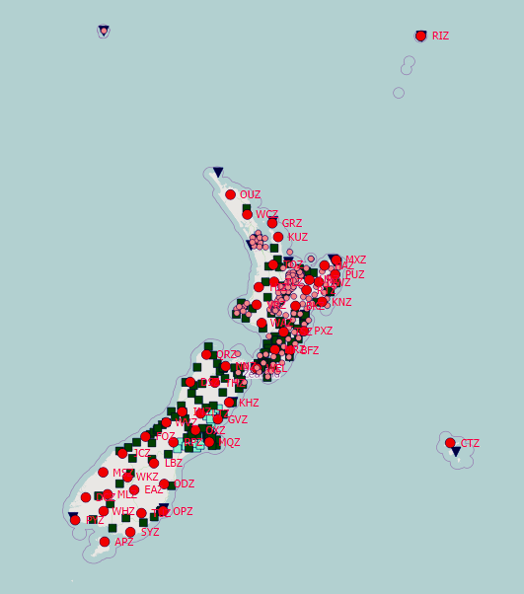
NZ GeoNet:
New Zealand’s geological hazards monitoring system
Seismic and Tsunami Sea Level stations

Slide 5
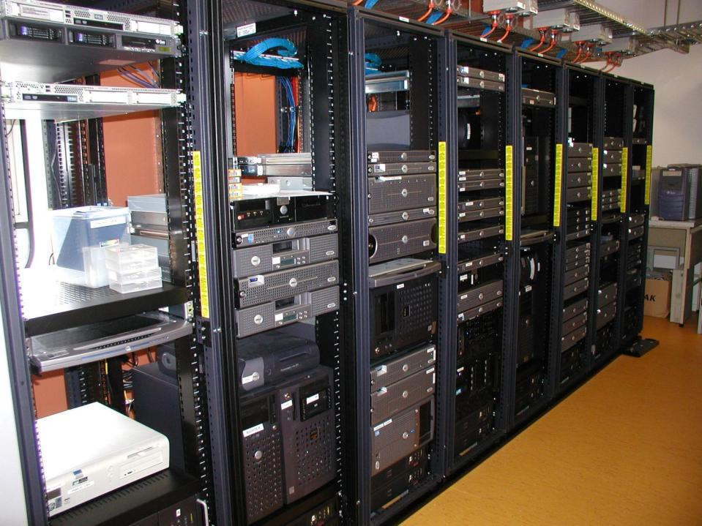
Open Source
Open Data
Open Standards
The Cloud
ALL NZ GeoNet Data is Open

Slide 6
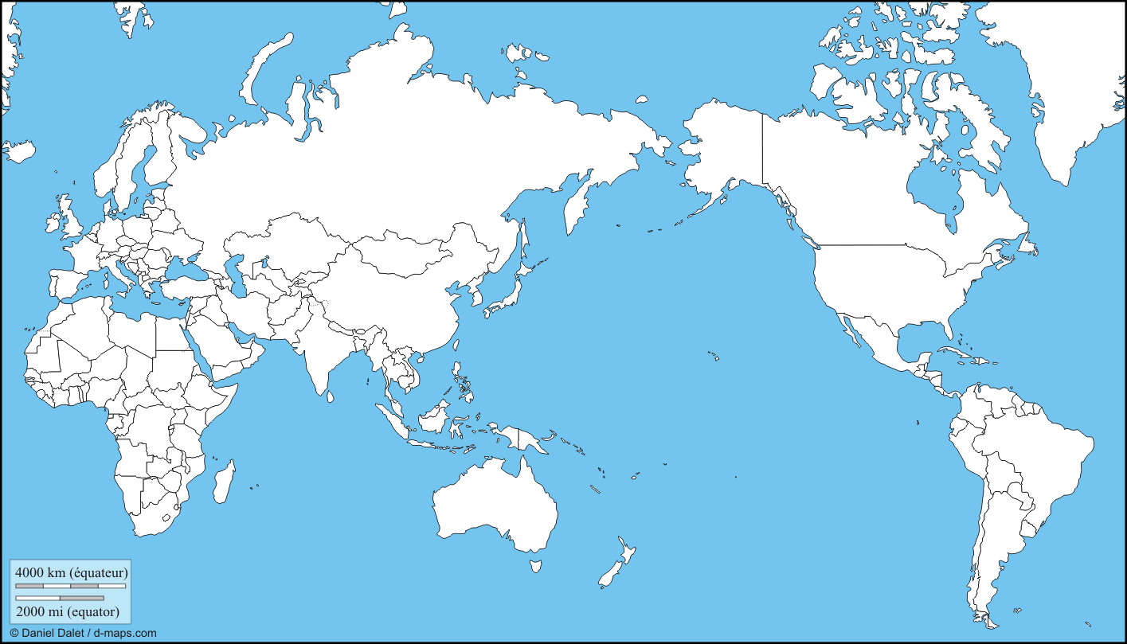
Real-time Data Sharing with Other Major Data and Warning Centres
Europe
GFZ IOC CTBTO
USA
Japan
WC/ATWC PTWC NEIC IRIS IGS
JAMSTEC
VanuatuNC
Australia
Seismic
GNSS (GPS)
Sea Level
GA BoM

Slide 7
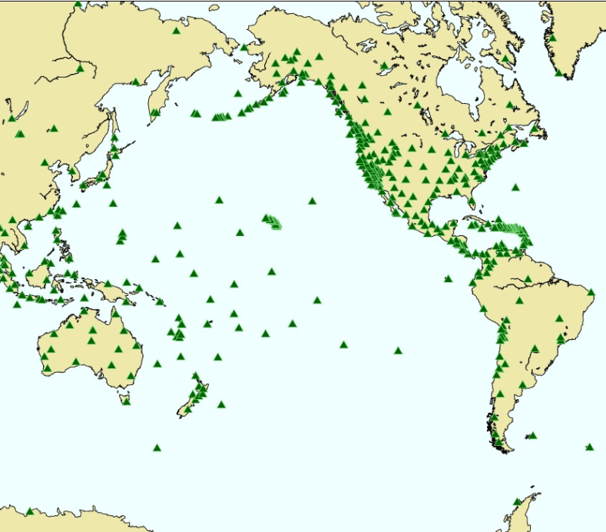
Pacific Seismic stations
used by PTWC

Slide 8
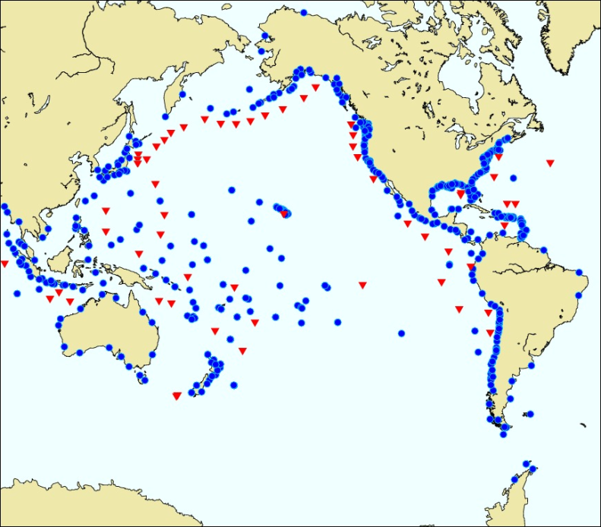
Sea Level stations used by
PTWC

Slide 9
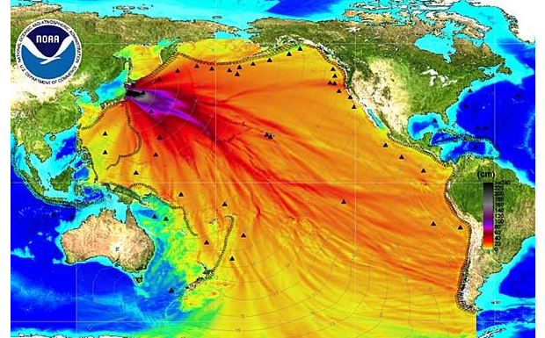
Deep Ocean Amplitude Model for the March 2011 Japan Tsunami

Slide 11
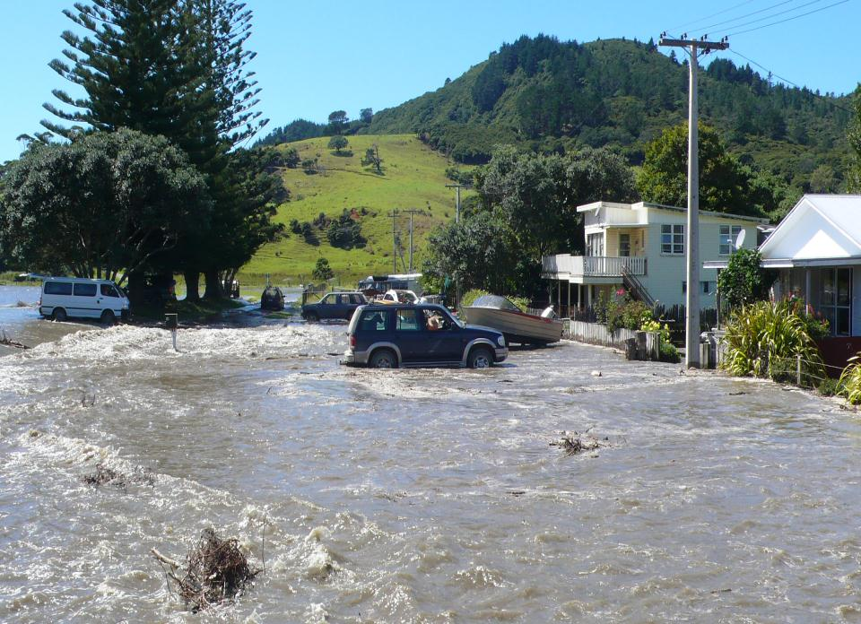
Sea level

Slide 12
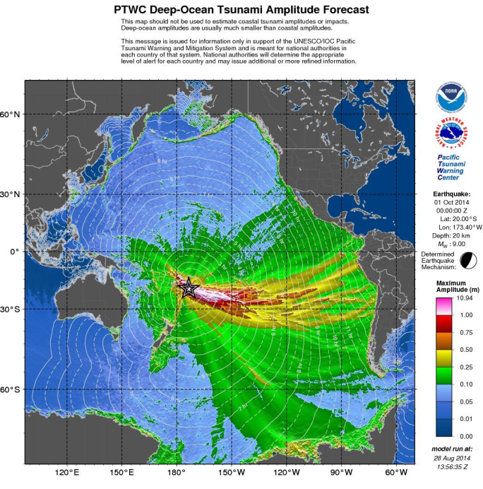
PTWS:
Data allows forecast models to provide information on likely impacts
(Enhanced PTWC messaging)

Slide 13
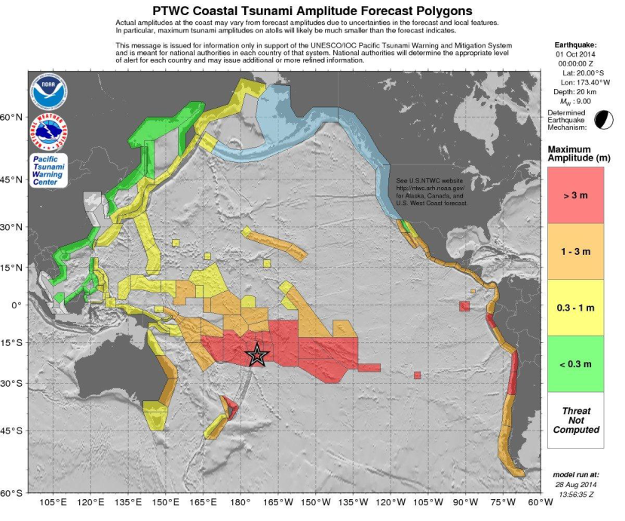

Slide 14
Conclusions
Warning centres are now capable of providing reliable data-driven forecast models for natural hazards such as tsunami
Observations are crucial to the calculation and verification of forecasts
Open data standards allow fast and effective sharing of observational data in near-real-time
Timely and open data availability is crucial for natural hazard characterisation and warning
New Zealand demonstrates what is possible

