Slide 1
International efforts towards a common definition and standardized measures of driver distraction Johan Engström Volvo Group Trucks Technology Advanced Technology and Research Intelligent transportation systems in emerging markets – drivers for safe and sustainable growth Geneva, 2013-06-27

Slide 2
Driver distraction and road crashes
Treat et al. (1977)
Recognition errors contributed to 56% of all the crashes investigated.
Four principal forms of recognition errors were identified: Improper lookout (23%), Inattention (15%), External distraction (4%), Drowsiness/fatigue (2%).
Wang et al., (1996)
25.5% of tow-away crashes involved inattention as a contributing factor.
The main sub-categories were: Distracted (13.2%), Looked by did not see (9.7%), Sleepy/fell asleep (2.6%)
Dingus et al. (2006)
78% of all crashes and near-crashes in the 100-car naturalistic driving study involved inattention
NHTSA (2012)
9% of fatal crashes and 18% of injury crashes during 2010 were distraction-affected

Slide 3
Many different concepts related to driver distraction but little agreement on their precise meaning
Attention
Arousal
Drowsiness
Inattention
Fatigue
Alertness
Vigilance
Cognitive load
Distraction
Mental effort
Looked-but-did-not-see
Mental workload
Inattentional blindness
Change blindness

Slide 4
Key issues
What is driver distraction?
How can is driver distraction best measured for purposes of in-vehicle HMI evaluation?
Need for international agreement on these issues in order to effectively tackle the driver distraction issue

Slide 5
Defining driver distraction

Slide 6
Why work towards international agreement on a definition of driver distraction?
Facilitate comparison of accident statistics
Facilitate intepretation and comparison of research results (experimental, naturalistic driving)
Facilitate international standardisation of driver distraction measurement

Slide 7
The US-EU Driver Distraction and HMI WG
Part of the US-EU Bilateral Task Force on ITS
General objective
Identify opportunities for research collaboration, align research and to identify differences
Members:
US: Chris Monk (NHTSA, WG leader), David Yang (FHWA), Dan McGehee (U. Iowa)
EU: Johan Engström (Volvo, WG leader), Wolfgang Höfs (EC), Alan Stevens (TRL), Andreas Keinath (BMW), Marko Tuukkanen (Nokia)
Japan (observers): Saturo Nakajo (MRI)/Aiko Hosaka (Highway Industry Development Organisation)
Main focus so far: Development of a common conceptual basis for driver distraction and inattention

Slide 8
The Focus Group on driver distraction
Held April 28, 2010 in Berlin
Aims:
Agree on a general definition of driver distraction
Define top-10 research needs
Invited experts:
Report available at http://ec.europa.eu/information_society/activities/esafety/intlcoop/eu_us/index_en.htm

Slide 9
Several issues left open...
What are ”activities critical for safe driving” – hindsight bias problem
What is a ”competing activity”
What about diversion of attention to other safety-critical activities (e.g., mirror checks, visual scanning for other vehicles)?
Does driver distraction necessarily lead to adverse consequences?
Need for more comprehensive activity –> The Inattention Taxonomy project

Slide 10
The US-EU inattention taxonomy project
Objective: Define a common taxonomy of driver inattention
Time frame: June 2011 – May 2013
Contributors: Johan Engström (Volvo), Chris Monk (NHTSA), Rich Hanowski (Virginia Tech), Bill Horrey (Liberty Mutual), John Lee (University of Wisconsin), Dan McGehee (University of Iowa), Mike Regan (University of New South Wales, Australia), Alan Stevens (TRL), Eric Traube (NHTSA), Marko Tuukkanen (Nokia), Trent Victor (AB Volvo), David Yang (FHWA)

Slide 11
Key concepts agreed upon
Driver attention = the allocation of resources (actuator, sensory, perceptual, motor, cognitive) to activities
Driver inattention = mismatch between the current allocation of resources and those resources demanded by activities critical for safe driving
Activities critical for safe driving = activities required for the control of safety margins
Driver distraction is a subset of inattention…

Slide 12
Driver distraction
Definition: When the driver allocates resources to a non-safety critical activity while the resources allocated to activities critical for safe driving do not match the demands of these activities
Vehicle-internal
distraction
Vehicle-external
distraction

Slide 13
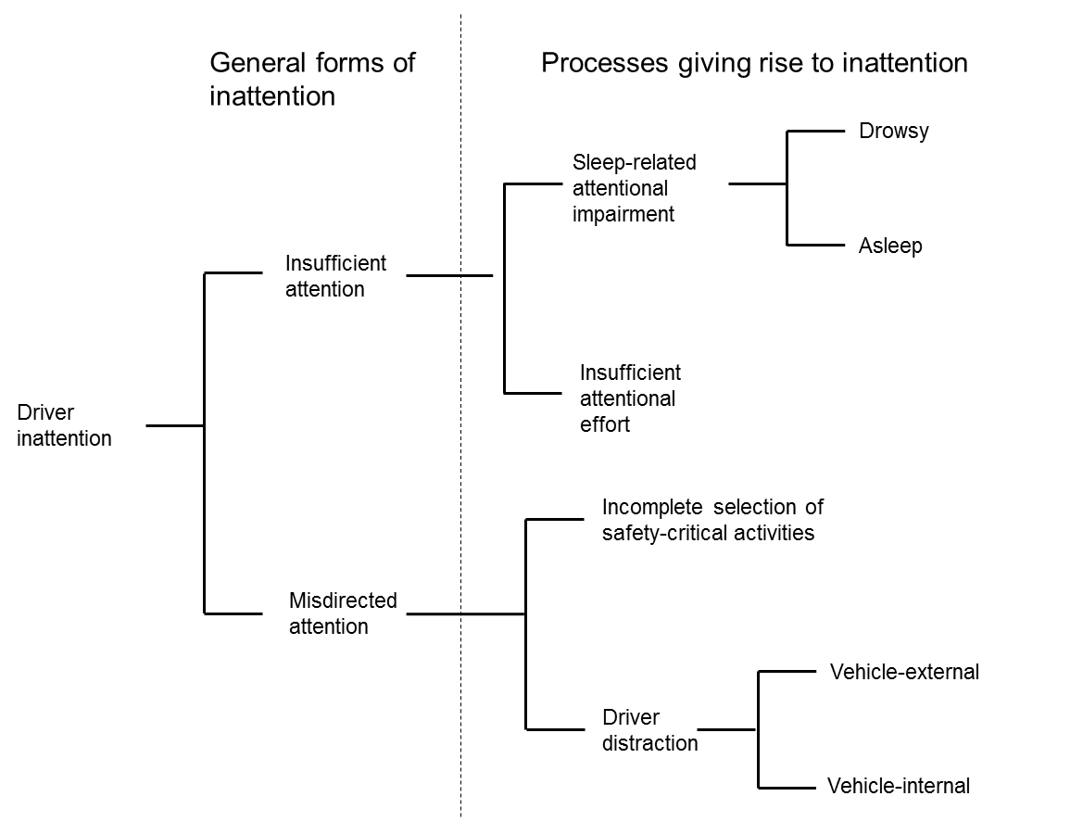
Proposed taxonomy of driver inattention

Slide 14
Standardizing the measurement of driver distraction

Slide 15
Why standardising driver distraction measurement?
Driver distraction is hot topic -> Many studies using a wide variety of metrics and methodologies
Difficult to compare results without standardised measurement
Basis for performance-based in-vehicle HMI guidelines (e.g., NHTSA distraction guidelines)
However, standards should define measures and procedures, not set evaluation criteria!

Slide 16
Existing/targeted ISO standards on driver distraction assessment
Visual distraction
Visual behaviour based on eye movement measurement
ISO 15007-1 Definitions and parameters
ISO 15007-2 Equipment and procedures (TS)
NHTSA (Phase 1) Visual-manual distraction guidelines
Visual occlusion
ISO 16673/ NHTSA Phase 1 guidelines
Cognitive distraction
Detection Response Task
ISO WD 17488 Detection Response Task
NHTSA Phase 3 Auditory-vocal distraction guidelines
“Overall” distraction
ISO 26022 Lane Change Test
International standard
currently under revision
International standard
In progress
International standard

Slide 17
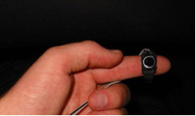
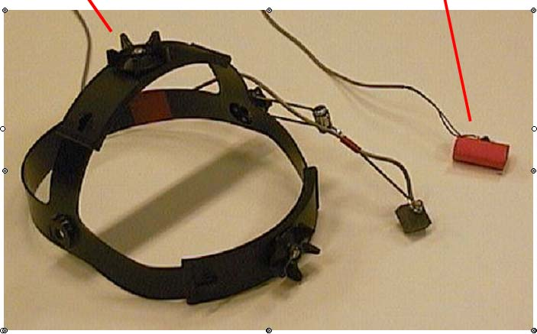
The Detection Response Task (DRT)
Mainly targeted towards cognitive distraction (e.g., auditory-vocal interfaces)
10 countries actively involved in TF
Based on conceptual framework partly based on US-EU Inattention Taxonomy
NHTSA considers using the DRT as the main method in their Phase 3 auditory-vocal Driver Distraction Guidelines
DRT standardisation supported by a set of international coordinated studies
Currently 10 different labs involved
6 countries (France, Germany, UK Sweden, USA, Canada, Malaysia)
Headmounted DRT (HDRT)
Tactile DRT (TDRT)

Slide 18
Conclusions
Need for internationally agreed definitions and standardised measurements of driver distraction
The US-EU Inattention Taxonomy a first step towards a clearer terminology of driver distraction and inattention in general
ISO TC22/SC13/WG8 is the main existing forum for international standardisation of driver distraction measurement
Upcoming: EU-US expert workshop on cognitive load (September 2013)

Slide 19
Thank you for your attention!

