Slide 1
The role of community-based Driving Assistants in road safety
Joint ITU/UNECE Workshop on
« Intelligent transportation systems in emerging markets »
Jean-Marc Van Laethem
Chief Innovation Officer & co-founder
jean-marc@coyotesystems.com
COYOTE SYSTEM
5-7 rue Salomon de Rothschild
92150 Suresnes FR
www.moncoyote.com

Slide 2
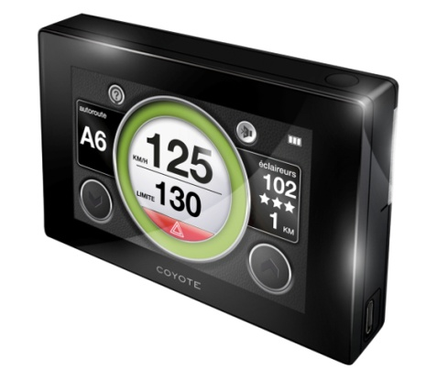
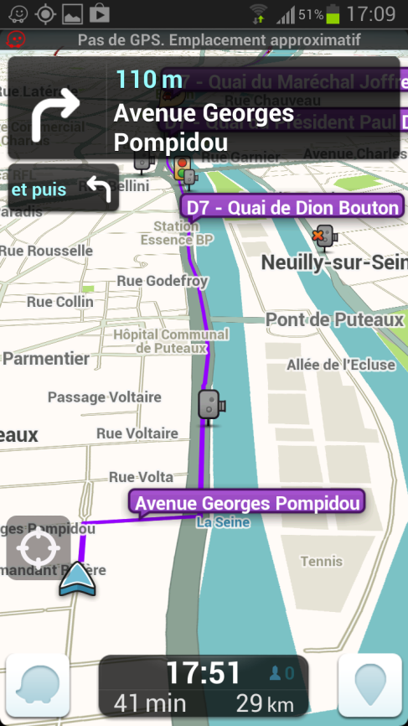
AFFTAC / Coyote System
What are Driving Assistants?
The power of communities
Examples of cooperation with road authorities
Need to standardize and share road-side information

Slide 3
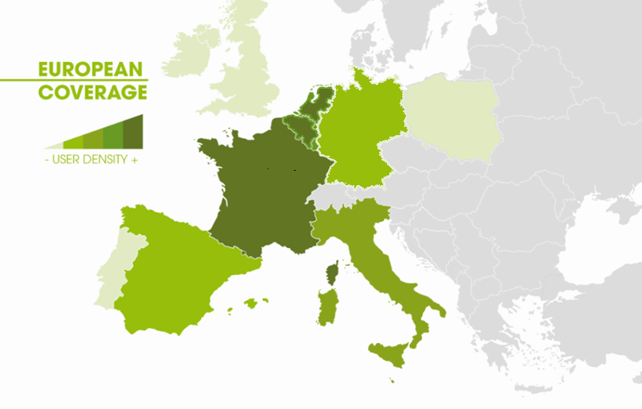
Who is Coyote System?
Coyote is a leader in real-time community-based driver Information
Started in 2005 near Paris, France, now 100 employees
Largest Driver Community in Europe, more than 2,2 M paid subscribers.
One of the most valued service for the connected car

Slide 4
What is AFFTAC?
French Professional Association of Suppliers and Users of Driving Assistant Technologies
Promotes the use of Driving Assistant technologies in Europe
Members: Navirad, Avertinoo, Coyote, Eco & Logic, Inforad, RoadPilot, Takara, Telmap, Wikango

Slide 5
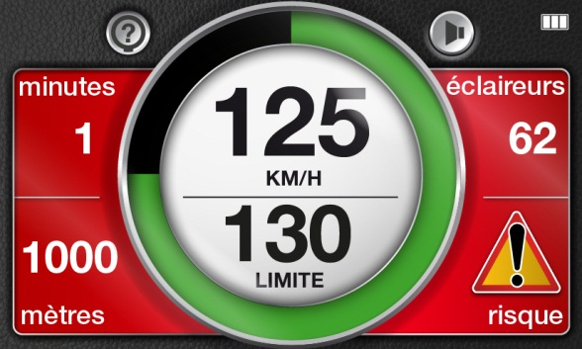
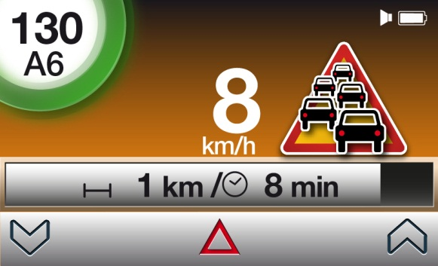
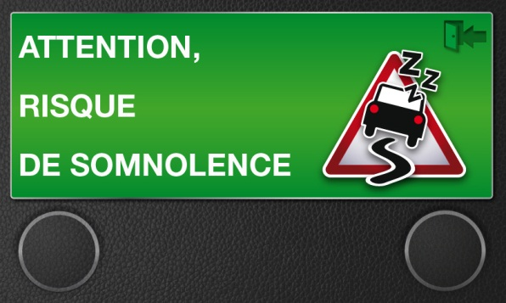
What service we provide?
Speed limits on all roads in Europe
Speed Camera locations
Community-observed traffic Incidents
Community presence and quality
Road Safety Services

Slide 6
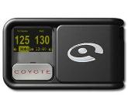
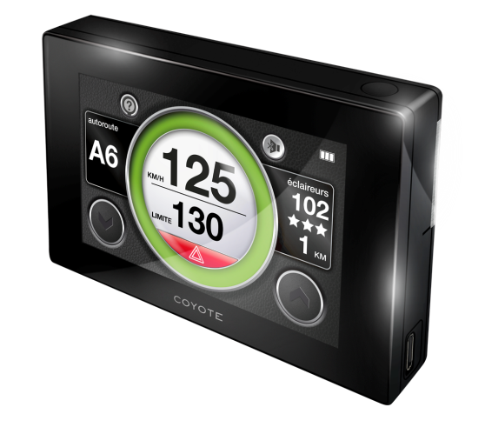
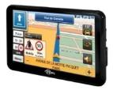
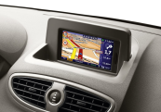
4 diferent platforms
Dedicated Devices
Mobile
Applications
Embedded in cars
Connected Personal Navigation Devices
One
Coyote Community

Slide 7
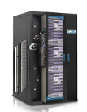
GPS + GSM Technologies
GPS
Partner’s
servers
Internet
Dedicated devices or Smartphones
Events reporting and
confirmation
GSM GPRS networks
Coyote Servers

Slide 8
Coyote Community
More that 2,2 M drivers in Europe
More that 50 M reports in 2012
Average use per day of product is 90 mn
Highly involved because of paying service

Slide 9
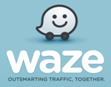
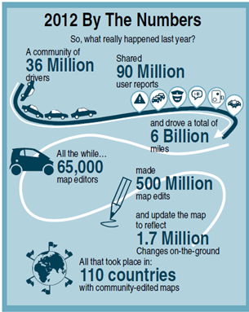
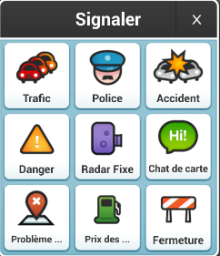
Largest world-wide community
Navigation and traffic application
Community of 50 million people in 110 countries
Free on Smartphones
Community exchanges info. on traffic conditions, accidents, police presence, danger zones
Company was bough by Google in June 2013

Slide 10
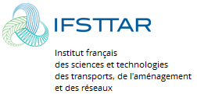
Science view of road social network
Survey of 3000 Coyote users:
76% of Coyote clients are more respectful of speed limits
92% slow down earlier before road congestions
44% of people use the service because of « road safety aspects » (especially for senior group)
94% say the impact of the participation is « weakly disturbing » (50%) or « a little disturbing » (44%). 0% found participation « very disturbing ».
Quotes
« Social networking in transport could be a powerful tool to contribute to drivers’ safety and comfort, by allowing quick widespread of critical information through « driver-generated content »
« road information coming from the social network are more trusted by drivers than any other sources of information » / « Information coming from the community is considered more reliable the one coming from variable message sign and from the radio » / « information on weather warnings coming from social network is efficient to make drivers changing behavior »
« mobile devices are primarily used for personal communication, while traditional road information channels are more impersonal, research shows that people remember better information that affects them personally »
« mobile devices can be considered as good candidate to display critical road information to drivers, with a positive context in terms of acceptability and motivation of use, even by senior drivers »
« Drivers’ needs and acceptability of a mobile road alert service base upon social networking », Annie Pauzié, Ifsttar / LESCOT, France & Manuela Quaresma, PUC-Rio University / LEUI, Brasil, december 2012

Slide 11
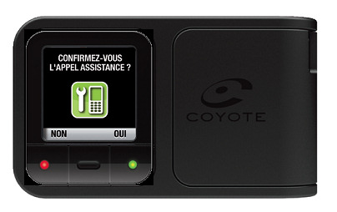
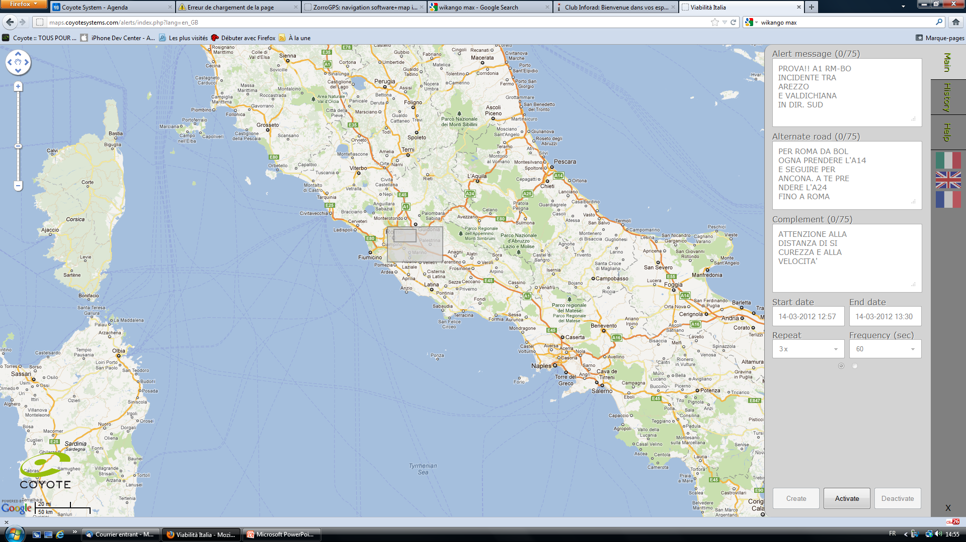
Example of current information exchange with road authorities
Location of Highway road patrols (France)
Portal to send Emergency Messages to Coyote users (France, Belgium Italy)

Slide 12
Potential future information exchanges
Contributions to
Provide results of Driving Drowsiness Study
Exchange real-time data on ghost driving

Slide 13
Why share information at this time?
Because informing drivers of accidents & dangerous zones … can prevent accidents and save lives
Because V2V and V2I is here to stay (smartphone style) before its time (car OEM style)
Because it is better to define a small set of information to share to prevent user interfaces to become distractors themselves

Slide 14
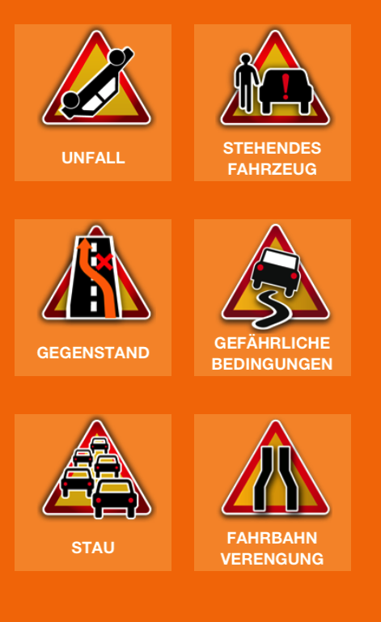
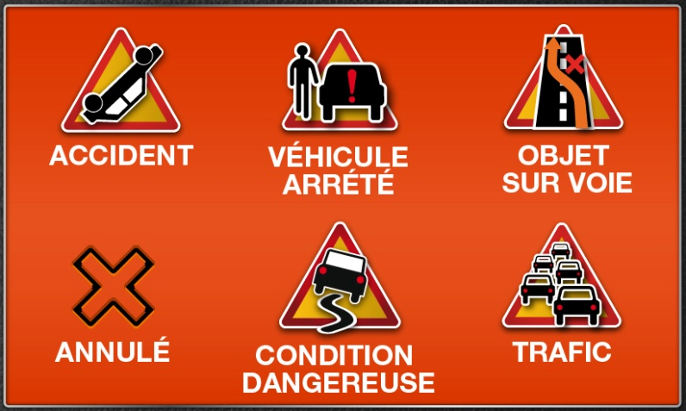
What information to exchange?
Start with small set:
Accident, traffic congestion
Typical month data:
Danger zone: 55%
Congestion : 32%
Narrowing road: 7%
Stopped car: 4%
Accident: 2%

