Slide 1



“Technological opportunities to improve efficiency and safety on the roads”
Joint ITU/UNECE Workshop on “Intelligent transport systems in emerging markets – drivers for safe and sustainable growth”
Roberto ARDITI, SINA
Geneva ,27 June 2013

Slide 2

AGENDA
THE INNOVATION OF ITS FOR ROAD OWNERS AND OPERATORS
OPPORTUNITY FOR ITS TO FACE FATALITIES IN TRANSITION COUNTRIES
ITS OPENS NEW OPPORTUNITIES FOR EMERGING COUNTRIES
UNECE PLATFORM AS A BRIDGE TO WORLDWIDE BEST PRACTICES

Slide 3
OPERATION
Traditional
Technological
Surveillance
Fee collection
Traffic Management
Patrolling
Equipment control
Monitoring, AID, etc.
E Fee collection
Real time information
Remote enforcement
Remote control
Operator has an increased efficiency and capability of action in time and space

Slide 4
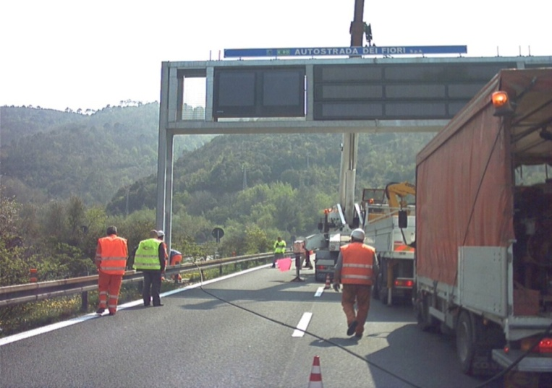
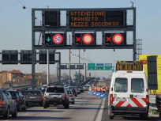
Intelligent transport systems:
THE INNOVATION OF ITS FOR MOTORWAY OPERATORS
Tools to improve traffic efficiency and safety.
Siim Kallas; Vice-President EC 15/05/2013:
ITS could reduce the number of
road fatalities by up to 7%, as
well as the number and severity of accidents, CO2 emissions and cost of infrastructure repairs.

Slide 5

The World
of ITS
Efficiency
Traffic
IN-VEHICLE
TECHNOLOGY
Safety
Mngm.
ROADSIDE
ICT
INFRASTR.
Logistics,
security
The World
of Trade
co-modality &

Slide 6
AGENDA
THE INNOVATION OF ITS FOR MOTORWAY OPERATORS
OPPORTUNITY FOR ITS TO FACE FATALITIES IN TRANSITION COUNTRIES
ITS OPENS NEW OPPORTUNITIES FOR EMERGING COUNTRIES
UNECE PLATFORM AS A BRIDGE TO WORLDWIDE BEST PRACTICES

Slide 7
  A WIDE RANGE OF INFRASTRUCTURE QUALITY

Slide 8
Different infrastructure …
But what about the traffic?
What about the operation?
How far can we face the
Operation even thanks to technologies?

Slide 9
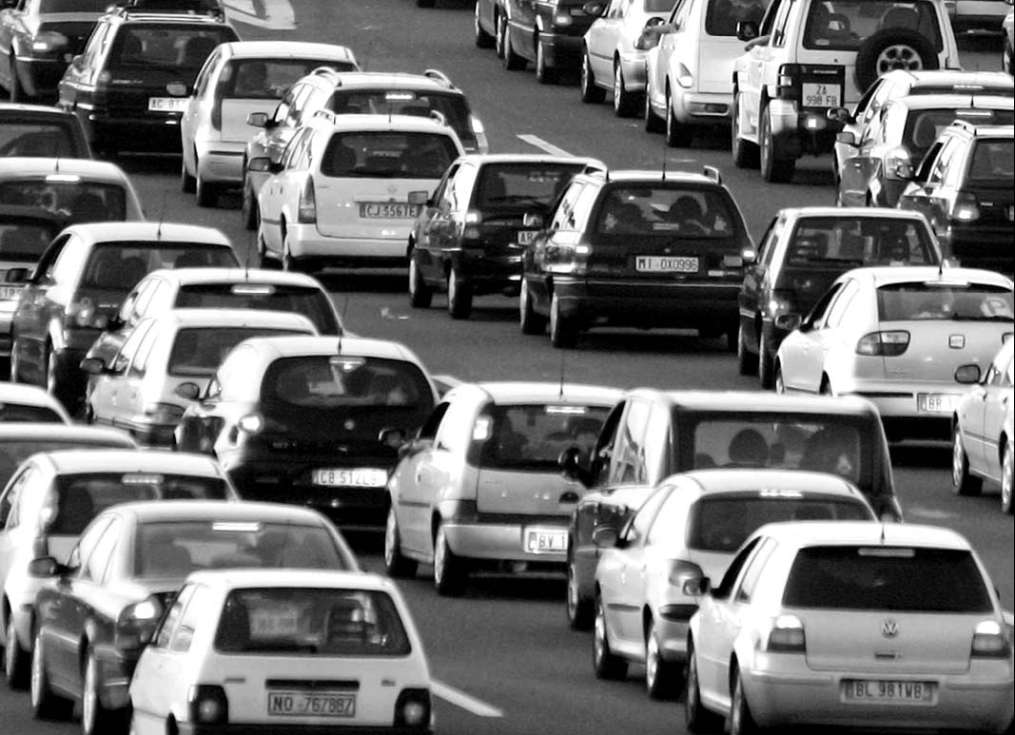
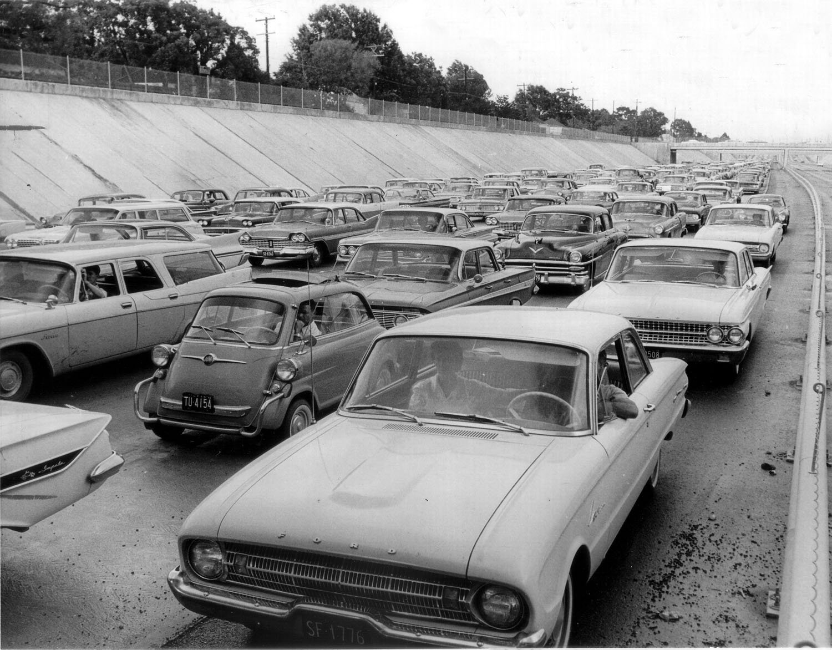
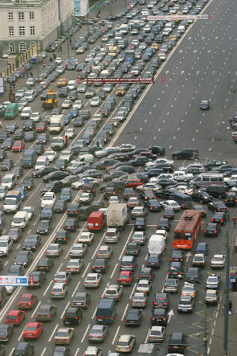
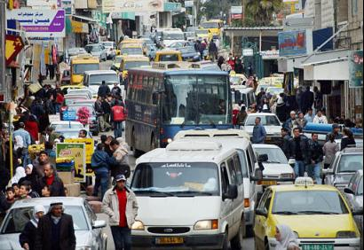
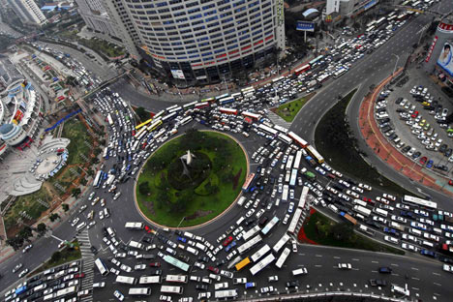
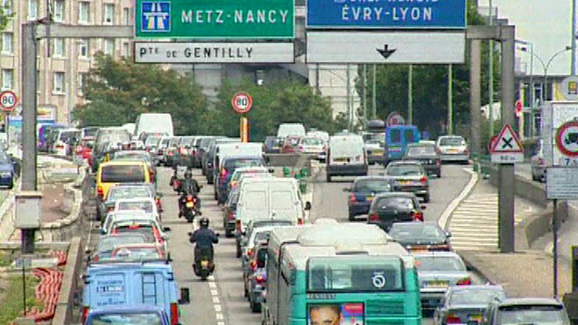
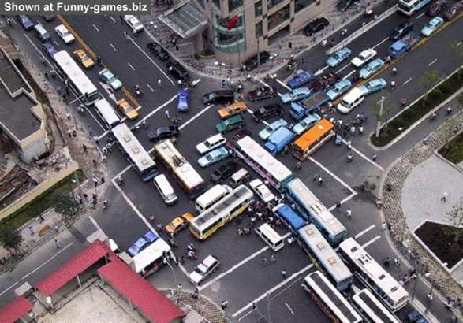
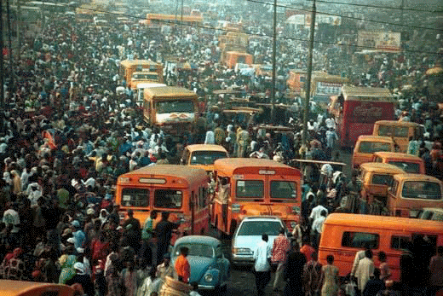
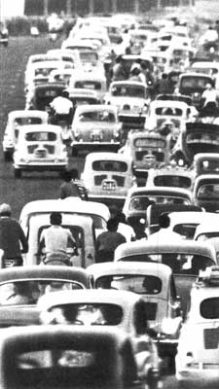
France
Israel
China
Australia
Congestion
Russia
Then, what way for ITS
to contribute to the
problem solving?
Italy
USA
Malaysia

Slide 10

A FEW FIGURES ON FATALITIES AND ISSUES IN TRANSITION COUNTRIES
Global status report of WHO
1.24 million of roads fatalities
each year.
What about low and middle income countries:
Over a third of road traffic deaths are among pedestrians and cyclists;
35% only of the countries have policies to protect these road users

Slide 11
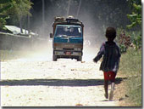
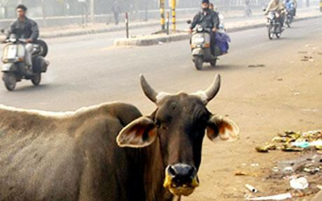
  A WIDE RANGE OF MOBILITY ISSUES
  RESULTS IN A WIDE RANGE OF SOLUTION
Infrastructure
Operation
Driver’s behavior
ITS can promote the best use of what is existing

Slide 12

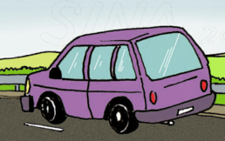
THE OPPORTUNITY/IMPACT OF ITS
INFORMATION
ADVANCED TECHNOLOGIES
(Driver assistance systems)
ENVIRONMENT
DRIVER
VEHICLE
CONVENTIONAL DRIVING

Slide 13
AGENDA
THE INNOVATION OF ITS FOR MOTORWAY OPERATORS
OPPORTUNITY FOR ITS TO FACE FATALITIES IN TRANSITION COUNTRIES
ITS OPENS NEW OPPORTUNITIES FOR EMERGING COUNTRIES
UNECE PLATFORM AS A BRIDGE TO BEST PRACTICES WORLDWIDE

Slide 14




Intermodal
in-vehicle services
Growth organization needs & capabilities
Growth performance required to ITS
cooperative systems
Growth added value of services
Growth complexity system
integrated
roadside services
stand-alone services
In-vehicle
services
Growth ICT deployment roadside and on board
Time

Slide 15
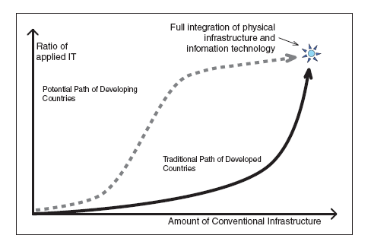
ITS OPENS NEW OPPORTUNITIES FOR EMERGING ECONOMIES
Emerging countries have the opportunity to leapfrog the structural hindrances moving directly to a state-of-the-art network.
Source: World Bank
Technical Note 1
ITS for Developing
Countries

Slide 16
AGENDA
THE INNOVATION OF ITS FOR MOTORWAY OPERATORS
OPPORTUNITY FOR ITS TO FACE FATALITIES IN TRANSITION COUNTRIES
ITS OPENS NEW OPPORTUNITIES FOR EMERGING COUNTRIES
UNECE PLATFORM AS A BRIDGE TO WORLDWIDE BEST PRACTICES

Slide 17

Institutional
consensus process
Feasibility
feedback
Member
States
Road
Operators
Priorities and programs
European
Institutions
Legal instruments
Industry
and services
Other UN
Regions
Interoperability
harmonization
Continental scale deployment

Slide 18
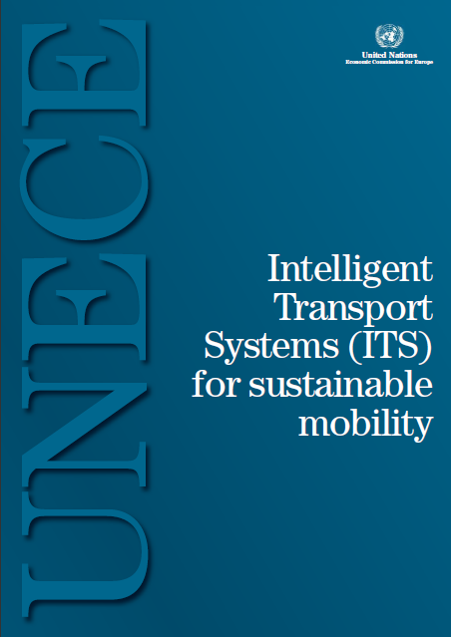
ITS OPENS NEW OPPORTUNITIES FOR EMERGING COUNTRIES
Authors:
UN-ECE Transport Division
Italian Ministry of Infrastructures and Transports.
German federal Ministry for Transports, Constructions and Urban development
ASTM/SIAS Group- SINA S.p.A.
http://www.unece.org/trans/publications/its_sustainable_mobility.html

Slide 19



ITS OPENS NEW OPPORTUNITIES FOR EMERGING COUNTRIES
The study is composed by three parts:
CONTAINS: A) SHYNTETIS OF THE ACTUAL TECHNOLOGIES B) COMPETENCES AND INSTITUTIONAL ACTIVITIES OF UNECE
SHOWING THE CURRENT ADDRESSES AND CONCERNS OF UNECE FOR ROAD TECHNOLOGY POLICY
CONTAINS THE CONCRETE ACTIONS CHOSEN TO ACHIEVE THE OBJECTIVES IN THE PREVIOUS SECTION

Slide 20


Thanks for your
kind attention
roberto.arditi @_sina.co.it
www.sina.co.it www.autostradafacendo.it

