Slide 1


Regulatory Framework for the Global Deployment of ITS – a Spectrum Perspective
Joint ITU/UNECE Workshop on
“Intelligent Transport Systems in Emerging Markets – drivers for safe and sustainable growth”
(Geneva, Switzerland, 27 June 2013)
Paul B. Najarian
ITU-R WP 5A Liaison Rapporteur
Collaboration on ITS Communication Standards
najarianpb@state.gov

Slide 2
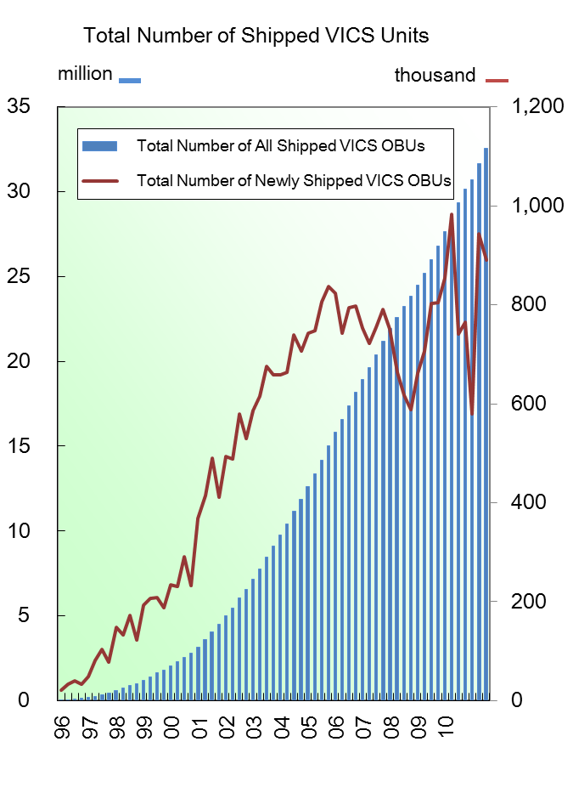
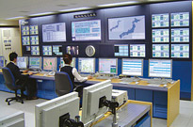
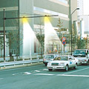


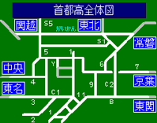
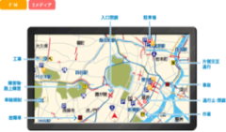

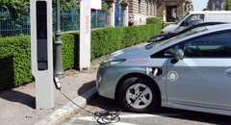
The VICS Example
Information
collection
Road Administrator
JARTIC
Prefectural police department
Information
processing
VICS Center
March.2013
37.6 million
Information
provision
Optical beacon
Radio beacon
FM multiplex broadcasting
Car navigation, etc.
Information utilization
Level I:
Text Information
Level II:
Simple Graphic Information
Level III:
Mapped Information
Battery Charging Station
Next Generation
VICS
- Example -
(Under development)
VICS is widely deployed in Japan. Drivers are receiving VICS information mainly through radio wave.

Slide 3
Can VICS be Deployed Globally?
Japan’s Vehicle Information and Communication System – as an example:
Data (or lack thereof)
  Including data quality and integrity
Network Infrastructure
Jurisdictional and Institutional Issues
  Including Data Privacy
Favorable Regulatory Environment
Business Model, inc. Private-Public Partnership
Etc..
Spectrum
  Lack of regional or global spectrum coordination
  Lack of spectrum strategy and planning
Geneva, Switzerland, 27 June 2013

Slide 4
ITS Telecommunications Deployment Philosophy and Strategy
ITS is an “Application” that rides on existing telecommunications network and infrastructure
Does not require its own network
  Except for Dedicated Short-Range Communications (DSRC) which is unique to ITS
  Although there is no globally-harmonized definition of DSRC
Operates in an unlicensed manner, and in unlicensed spectrum -- wherever available
  To the extent possible under the mobile service
  Although some applications (such as collision avoidance radar) are designed as safety applications, and not suitable under the mobile service
Geneva, Switzerland, 27 June 2013

Slide 5
ITS Radiocommunication Services
 | Spectrum | Service
VICS — Vehicle Information and Communications System | 76-90MHz (FM multiplex broadcasting) | ・ Traffic information
 | 2.5GHz (Radio beacon)
ETC -- Electronic Toll Collection | 5.8 GHz/ 5.9 GHz | ・Collect highway toll (Communication)
DSRC -- Dedicated Short Range Communication |  | ・Collect highway toll ・Provide various information (Communication, Broadcast)
Sub-millimeter, Millimeter wave system | 24/26GHz | ・Detect obstacles (Sensor)
 | 60/76GHz
 | 79GHz
Vehicle-to-Vehicle communications system | 5.8GHz | ・Safety information (Communications)
 | 700MHz
Geneva, Switzerland, 27 June 2013
Notes:
5

Slide 6
WRC-15 Agenda Item 1.18
Title of the Agenda Item at the ITU World Radiocommunication Conference (WRC-2015):
1.18 to consider a primary allocation to the radiolocation service for automotive applications in the 77.5-78.0 GHz frequency band in accordance with Resolution 654 (WRC 12)
Objective:
To fill a 500 MHz band in the 77.5 to 78 GHz band, in order to achieve global harmonization for ITS Collision Avoidance Radar operating in the 77 to 81 GHz band
To study other ITS safety-related applications that may benefit from global or regional harmonization
Geneva, Switzerland, 27 June 2013
Notes:
6

Slide 7
Background and Motivation
Distracted Driving epidemic
UN Road Safety Collaboration
ITU Council Resolution 1318 (Council 2010) on the role of ITS and ICTs in improving road safety
European Commission Directive: Directive 2010/40/EU on ITS
Manufacturing and private sector interest to benefit from economies of scale with global harmonization
Parts of the band (including 76 – 77 GHz) are already allocated for collision avoidance radar; and products are available in this band
Geneva, Switzerland, 27 June 2013
Notes:
7

Slide 8

Use case: 79GHz high-resolution radar
Braking
Braking
Braking
Alarm
Alarm
Use Case
79GHz High-Resolution Radar
Pedestrian detection at high-speed driving
(2) Pedestrians detection - turn right
Braking
Pedestrian detection
Motorcycle on the side！
Alarm
79GHz band High-resolution Radar
(Detect small obstacles in intersections)
Caution!
Pedestrians on right
(3) Detection of motorcycle driving at high-speed
(4) Pedestrians detection by Road Side Equipment
Source: MIC, Japan

Slide 9
77-81 GHz Spectrum Allocation
75
76
77
78
79
80
81
GHz
RLS: Radio Location Service
Additional Allocation: 77.5 – 78.0 GHz
Proposed
RLS: Radio Location Service
76 GHz Band Radar
79 GHz Band High-Resolution Radar
Amateur and Amateur Satellite Service
RAS: Radio Astronomy Service
Geneva, Switzerland, 27 June 2013
9

Slide 10
Another Area for Harmonization
Dedicated Short-Range Communications (DSRC):
Lack of harmonized Definition:
  Some limited to Data only
Harmonized Use
  Some include Vehicle-to-Vehicle (V2V)
Regulatory Variations
  Mostly unlicensed and secondary
  Primary allocation in North-America only
Spectrum
Geneva, Switzerland, 27 June 2013

Slide 11
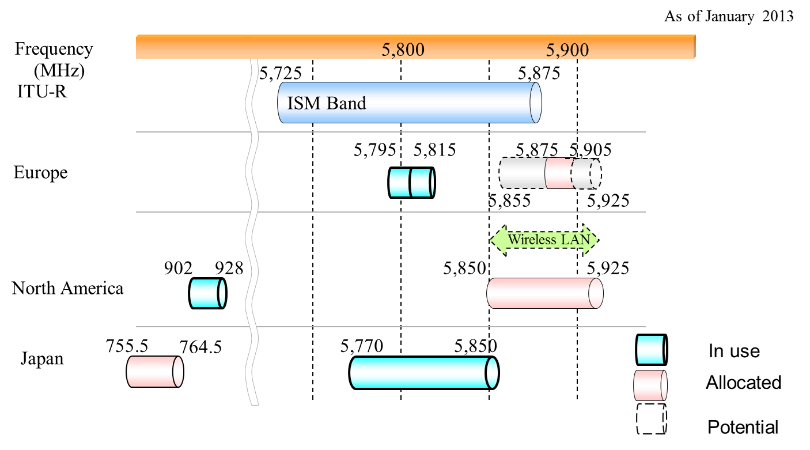
DSRC Spectrum Allocation
Geneva, Switzerland, 27 June 2013

Slide 12
Other/Future Consideration for DSRC
Potential consideration as a suitable candidate band for Mobile Broadband, under WRC-15 Agenda Item 1.1
  Some see it as a Threat; some see it as an Opportunity
  Extends 5 GHz WiFi technologies into the 5.9 GHz band
  Maximizes the use of Radio LAN technologies for in-vehicle applications
    Addresses the roadside infrastructure deployment dilemma
    Economies-of-scale
Some Administrations are considering a WRC-18/ (or 19) Agenda Item for global DSRC spectrum harmonization
Geneva, Switzerland, 27 June 2013

Slide 13
ITS Info-Communications System
ITS info
ＩＴＳ information
Existing network
GPS
Mobile communications
network
ITS information communications platform
Broadcasting
Roadside network
（Optical fiber, etc.)
Roadside network
（Optical fiber, etc.)
Portable phone, Satellite portable phone, MCA, Radio pager, etc.
FM multiplex broadcasting, Terrestrial digital broadcasting, Satellite digital broadcasting, etc.
Base station (antenna)
Base station (antenna)
ITS information
ITS information
Road-vehicle communications
DSRC
Inter-vehicle communications
Passenger vehicle
Truck
(Transport company)
Bus, Taxi
(Public transportation)
Pedestrian
On-board network (ITS data bus), sensors, collision avoidance radar, etc.
Reference: DSRC System Applications, Interim Report on the Status of the Study,
Telecommunications Technology Council, Japan (April 2000)

Slide 14
Conclusions and Recommendations
A Spectrum Regulatory Strategy must be integrated in any National ITS Deployment Plan:
  Taking into consideration Regional/Global Spectrum Harmonization, if necessary
The ITS Industry must Identify, Validate and Consolidate its Spectrum Requirements:
  Minimizes the “hodge-podge”, random approach for Deployment; based on any available network
  Maximizes Deployment Opportunities, and economies-of-scale at Regional/Global level
Keep in mind the lead-time required for WRC Spectrum Allocation or Identification Opportunities (i.e. WRC-2018 or 2019)
Compare such lead-time with product development cycle for a vehicle, as well as Telematics and Nomadic Devices
Geneva, Switzerland, 27 June 2013

Slide 15
