Slide 1
Data Governance to Unlock Smart Communities and Cities
Bettina Tratz-Ryan
Research VP
Smart City & Smart Ecosystem
@btratzryan
Notes:
Presentation Title
Presenter's Name
Presenter's Name

Slide 2
Data and Governance are essential to drive Smart City Context
Smart City Operating Governance Framework
City Operations = Efficiency
City Environment = Citizen Centric
Vision
Context
Information
Data
Measurements and Key Performance Indicators
Notes:
Smart city can be either on operational efficiency, like smart parking or intelligent lighting, or on citizen services such as e-services (drivers license, schooling, health, senior care), Smart cities can connect both strategies through the exchange of data and information in a contextualized way. The citizen‘s context is multiple profiles, eg. Mom, patient, commuter etc. Governance is the play book on how the processes are intertwined, data is being shared towards accomplishing objectives of smart city roadmap.

Slide 3
Smart Data
Data Governance
Privacy
Analytics
Security
Insights & Context
Exchange

Slide 4
Migration Path for Business Ecosystems Using IoT Data
Forward Looking Decisions
Aggregation of Scenarios
Convergence of Services
Level of Interaction
Management of Systems
Situational Awareness
Real time Corrections
Report and Acquisition
Operations Management
Projection and Simulation
Asset management
Efficiency
Telematics
Depth of Analytics

Slide 5
Filtered by Category:
Administration and Finance
Buildings
Community and Economic Impact
Health and Human Services
Sanitation
1317 Datasets
Datasets include:
Public officials and positions
Potholes fixed
Crime offenders
Building codes
Affordable Rental Housing
Maps

Slide 6
Needed: Data Governance-Attributes of Data
Data Attributes
Priority
Data Protection
Links
Time Sensitivity
Semantics
Integrity

Slide 7
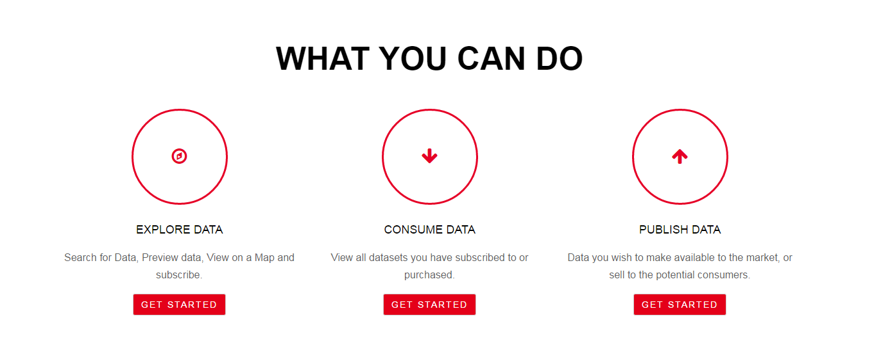
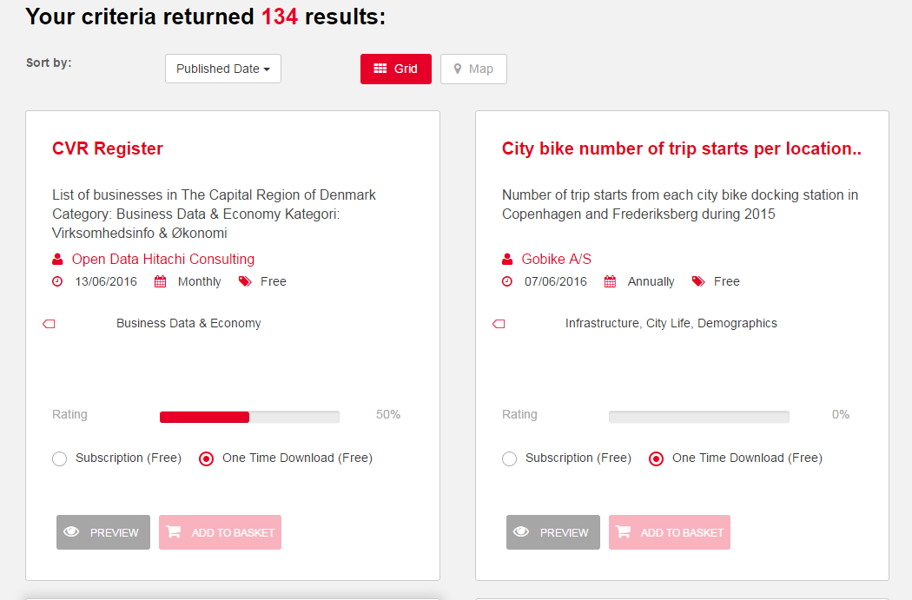
Copenhagen

Slide 8
Data Marketplace
Consumption of Data
City
Developers
Citizen
Industry
Contextualization
Business Model Plattform
Marketplace
Open Data Pool
Production of Data

Slide 9
Elements of Data Governance
Data Orchestration
Reviews the capabilities of data to information management, technology needed and Mode of Data Exchange
Data Value
Defining the clarity, structure, quality, linkage and origin of data
Data Management
Data Handling describes data ownership, production, data sharing, access management, as well as privacy, Ethics, security
Data Oversight
Defines the role of compliance, audit, policy, level of quality integration

Slide 10
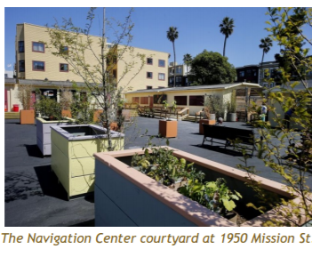
San Francisco: Serving the Homeless
San Francisco Navigation Center
The Navigation Center relies on coordination from a number of agencies, including the Department of Public Works (DPW), San Francisco Police Department (SFPD), San Francisco Homeless Outreach Team (SFHOT, a program of the Department of Public Health), Human Services Agency (HSA), Mayor’s Office of Housing Opportunity, Partnerships & Engagement (HOPE), Department of Technology (DT), and the Office of the Controller (Controller) in the public sector and Episcopal Community Services (ECS) and Mission Neighborhood Resource Center in the nonprofit sector
Collaboration between City, nonprofit and social services
Experditing services by new processes on healt benefits, social benefits and housing placement
Reduction of processes from 30 days to 10 days
Transparency in case management together with Human Services Agency
Collaboration to address psychological and social issue of the individual through different lenses and coordinate input
http://ecs-sf.org/_documents/Perspectives_NavCenter_Report3.pdf

Slide 11
Recommendations and Next Steps
Create a data culture focusing on meaningful data to drive context based business and urban services
Identify the data privacy and security issue and center communication with the community around it to create trust
Elect or assign an owner to the data life cycle as well as the oversight for the audits and compliance issues
Stresstest data governance against the impact of the proliferation of disruptive technology, analytics and transaction models to maintain agility and interactivity

