Slide 1



Synchronicity
Data Management Strategy
Sébastien Ziegler sziegler@mandint.org
Mandat International
ITU-T Rapporteur Q1/SG20

Slide 2
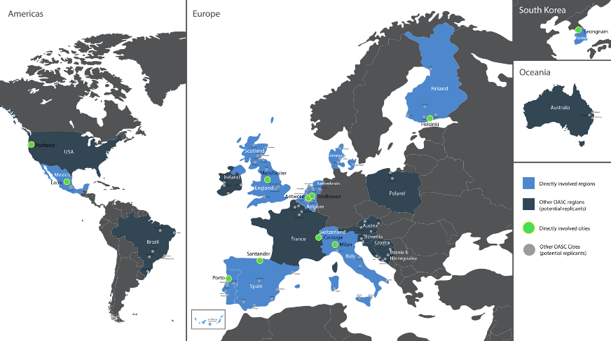




Synchronicity project is co-funded by the European Commission, Switzerland, Mexico and Korea

Slide 3

34 partners, 11 countries, 33 months.
Budget: 20m€ (15m€ EC) / 3m€ for open calls.
Core cities: Antwerp (BE), Eindhoven (NL), Helsinki (FI), Manchester (UK), Milan (IT), Porto (PT), Santander (ES), Carouge (CH).
Linked cities: Léon (Mexico), Seongnam (Korea), Portland (USA).
Leveraging: OASC, AIOTI, EIP-SCC, FIWARE, FIRE.

Slide 4
​​​​​Smart Cities Frameworks for IoT Integration
Building and
demonstrating
an interoperable
European framework
for IoT management
in smart cities
Synchronicity - Sébastien Ziegler

Slide 5
​​​​​Dual Strategy
Open Data & Interoperability
Privacy & Personal Data Protection
Open API &
Pre-Standardization
Close Monitoring & Innovative approaches
Synchronicity - Sébastien Ziegler

Slide 6
Protecting personal data in IoT Large Scale Pilots
Regulation 679/2016 (“GDPR”)
Directive 2002/58/EC, as amended by
Directive 2009/136/EC (“ePD”)
Obligation to:
Actively protect data subjects privacy and rights
Limit and secure personal data

Slide 7
General Data Protection Regulation (GDPR)
Art 83, al 5
“Infringements of the following provisions shall (…) be subject to administrative fines
up to 20 000 000 EUR,
or in the case of an undertaking,
up to 4 % of the total worldwide annual turnover of the preceding financial year, whichever is higher…”

Slide 8


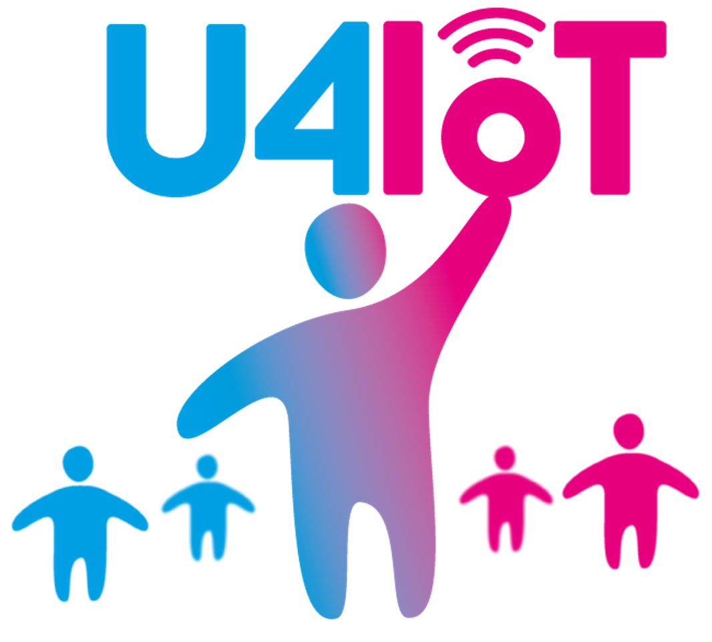
​​​​​Privacy Implementation Strategy
PIA
Privacy Impact Assessment
UPRAAM
(Euro Privacy)
Privacy Guidelines
PDPO
Education & User Awareness
Pilots
Synchronicity - Sébastien Ziegler

Slide 9







Privacy Flag
Methodology & Tools
ISO Standards
Privacy Flag
European Research Project
International Law on Privacy
Privacy Risk Area Assessment Methodology
EuroPrivacy
European Data Protection
Swiss Data Protection Law
www.europrivacy.org
Sébastien Ziegler

Slide 10
Towards Open and Interoperable Data
Stakeholder driven architecture and API
design, implementation, and validation
International dialogue and cooperation
Sharing results and learning experiences

Slide 11
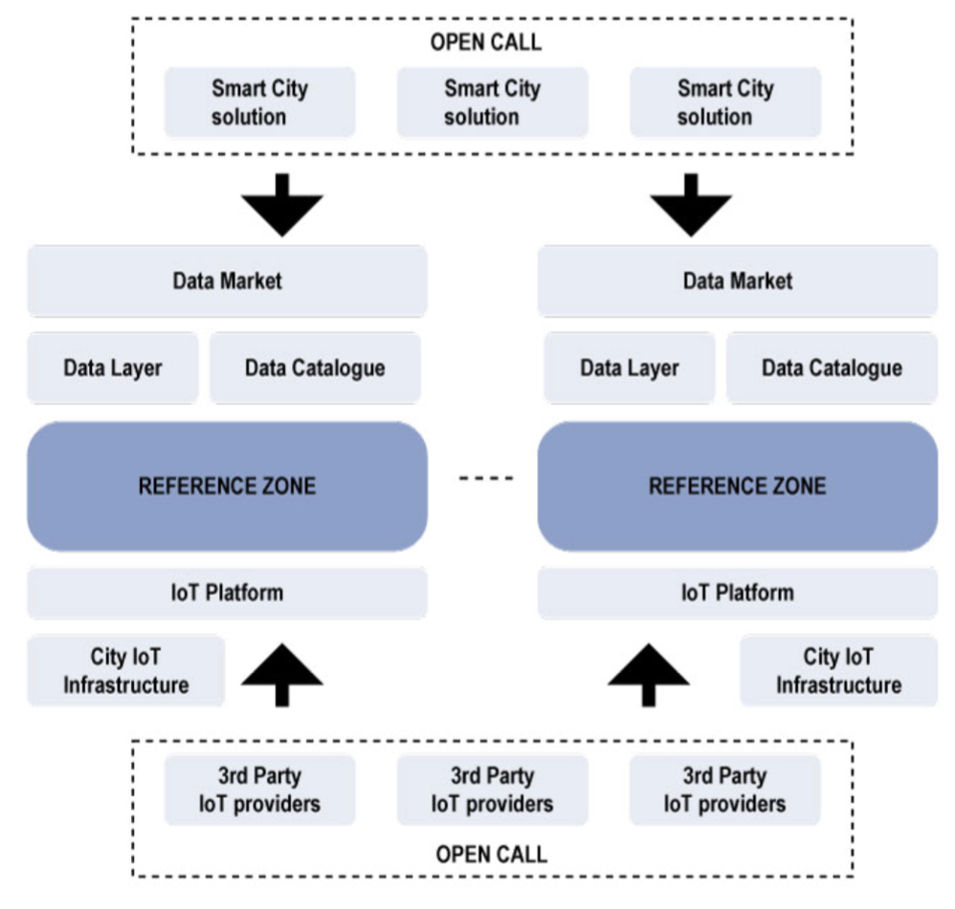
Interoperability Points & Market Place

Slide 12









​​​​​SDO Startegy
Synchronicity - Sébastien Ziegler

Slide 13
​​​​​ITU Work Plan & Strategy
ITU-T SG 20
Contributions and Support for the creation of a new Work Item
Develop a Recommendation on smart cities IoT systems interoperability and open data interfaces based on Synchronicity development
IoT Week 2017
Organizing a Workshop on Internet of Things and Smart Cities:
International IoT Frameworks & Initiatives Convergence (June 6 2017)
Sessions on IoT Interoperability, Identifiers
Organizing a session to support the
International Declaration on the Internet of Things for Sustainable Development
Synchronicity - Sébastien Ziegler

Slide 14








IoT Week 2017
June 6 - 9 2017
Geneva, Switzerland
www.iotforum.org
IoT & Sustainable Dev.
IoT Security & Privacy
and other tracks

Slide 15
Joint Workshop on
Internet of Things and Smart Cities
International IoT Frameworks for Smart Cities Convergence
June 6 2017, Geneva
Global IoT Identifiers and Data Analytics
SDG #11
Sustainable Cities & Communities
Synchronicity - Sébastien Ziegler

Slide 16
THANK YOU !
Sébastien Ziegler sziegler@mandint.org
+41 79 750 53 83
Sébastien Ziegler

