Slide 1
The IoT 5G Network Infrastructures and the IoT Data Store & Share Platform: challenges and opportunities
GRUPPO TELECOM ITALIA
Roberto Gavazzi – TIM Technology Innovation

Slide 2
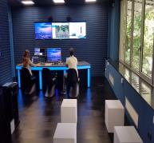
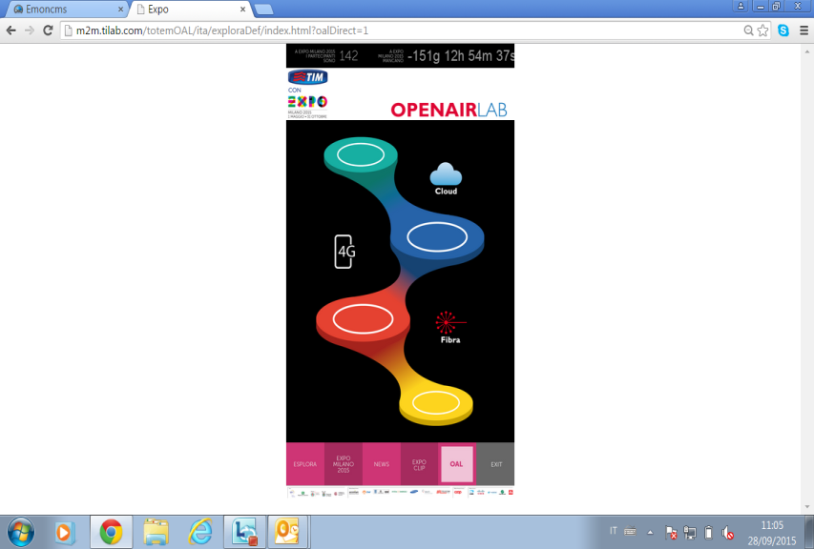


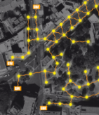


The IoT reference framework
VERTICAL APPLICATIONS
BIG DATA
CITY CONTROL AND
COMMAND CENTER
APPS
DATA USAGE AND ANALYTICS
APPLICATION LAYER
TelCo Domain
M2M & IOT CONNECTIVITY PLATFORMS
DATA STORE AND SHARE
DATA STORE AND SHARE
DATA AND INFORMATIONS
COORDINATION AND ACTIONS
IoT NETWORK INFRASTRUCTURE LAYER
SMART URBAN COMMUNICATION INFRASTRUCTURE AND CAPILLARY NETWORKS
DATA COLLECTION
SMART DEVICE
CONNECTED SENSORS AND DEVICES
5G and OneM2M

Slide 3
The 5G is mainly a platform to enable new ecosystems
It enables Innovations for new industrial partners
It overcomes the today solutions limits and fragmentation:
  Based on standard solutions;
  Guarantees global coverage;
  Custom performances (bandwidth, latency, reliability) for each use case family
  Open to new business opportunities
So 5G is the reference platform for every use case!
Incontro To 5G
Enrico Bagnasco, Technology - Innovation

Slide 4
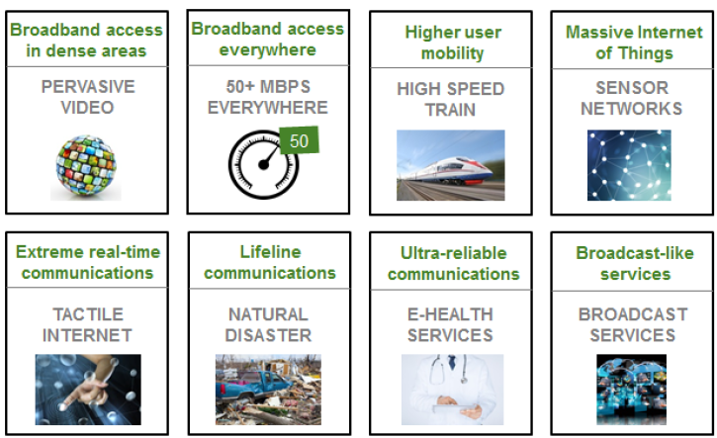
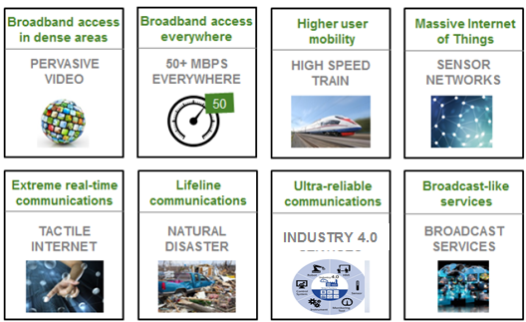
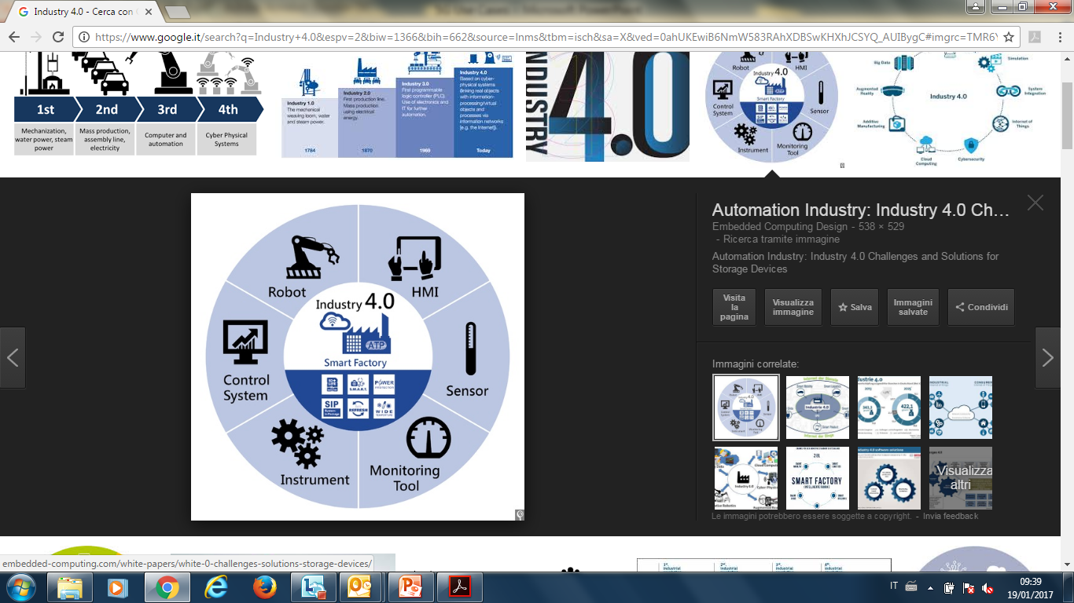

The 5G Use Cases categories and its applicability to IoT
  FROM:
  3GPP
  FROM:
  NGMN 5G Initiative White Paper” - NGMN Alliance - 17/2/2015
CriC (Critical Communications)
mIoT (Massive Internet of Things)
INDUSTRY 4.0
eMBB (Enanched Mobile Broadband)

Slide 5



ETSI and oneM2M standards as IoT Data analytics enablers
Horizontal service platform with REST resource approach enabling: data store&share, multi-service and multi-application support, abstraction of devices and applications, with constrained devices support.
Devices and applications are IP interconnected with interfaces (HTTP, CoAP) and standardized data models, application data are “opaque” for the horizontal service platform.
Resource approach implements Connected Object paradigm towards Internet of Things.
oneM2M widely extends ETSI M2M to new partners, new functionalities and new protocol bindings fully oriented to IoT world.
Next frontier: design and standardization of M2M/IoT data aggregation and semantics helping to effectively and efficiently deploy big data stored in M2M/IoT/cloud systems.
M2M Platform
External device and applications
Standard interfaces
External applications
Standard interfaces
Dev#1 & App#1
App#1
resources for: store&share, connected objects, IoT, …
Dev#2 & App#2
App#2
IP
Dev#3 & App#3
App#3

Slide 6
Demo and Video of IoT Open Air Lab Portal and Data
(It is possible also from remote)
Incontro To 5G
Enrico Bagnasco, Technology - Innovation

