Slide 1
Digital ROADS
From Data to Decisions
Presenter: Safder Nazir
Regional VP, Digital Industries

Slide 2


ICT Enables Transformation Towards a Digital Economy
National Digital Economy Strategies
ICT Drives Economic Transformation
A 10% improvement in mobile broadband penetration will increase GDP by 1.4% and productivity by 0.7%–4.2%.
The potential overall economic impact of IoT could be as high as 11% of the global economy.
A 20% growth in ICT investment will increase a country's GDP by 1%.
Internet Plus
Singapore
Smart Nation
AMP2.0
50+ Carriers Have Announced Gigabit Services
In 2015, FCC changed the definition of broadband by increasing minimum download speeds from 4 Mbit/s to 25Mbit/s.
VIVE Digital
Columbia 2014–2018
Digital Mexico
Connected
Kenya 2017
In 2015, Ofcom changed the definition of ultrafast speed from 100 Mbit/s+ to 300 Mbit/s+.
Source: Huawei GCI 2016
Sources: Boston Consulting Group, Huawei GCI
Notes:
Global IoT spending currently sits at US$700 billion, and is expected to reach US$1.3 trillion by 2019. source: Huawei GCI

Slide 3




Market Drivers – Digital Transformation
Employment
Job creation
enhance labor Productivity.
Economy Development
Healthcare & Education
Enrich people's life
Enhance people's happiness, Promote social stability.
Improve residents, health reduce the public expend
Promote GDP growth,
Improve National Competitiveness.
National Competitiveness
Public Service
Enterprise
Government efficiency and provide better serve to public
Erase the digital gap, Improve resources Utilization.
Improve work efficiency, saving cost.
Data Centralized management, enhance information security.
Reduce carbon emission, Increase business revenue.
Notes:
Source: ITU/World Bank
Global IoT spending currently sits at US$700 billion, and is expected to reach US$1.3 trillion by 2019. source: Huawei GCI

Slide 4
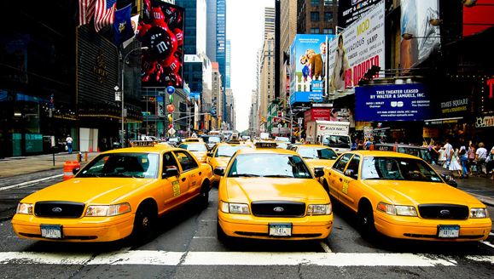
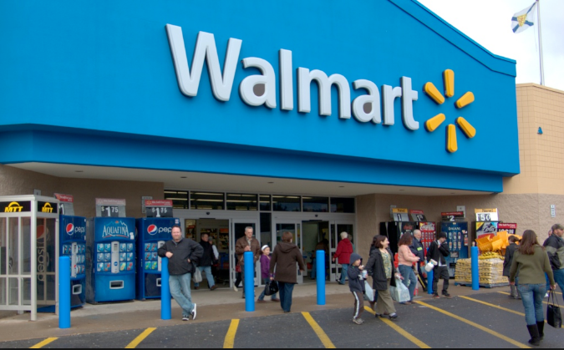


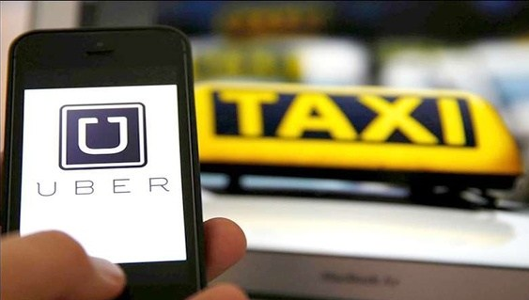
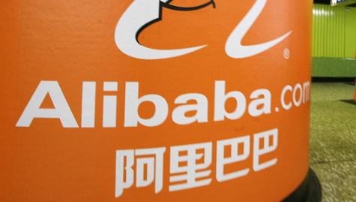

Industry Digital Transformation is Happening
World’s largest taxi company
World’s most valuable retailer
Largest accommodation provider
Notes:
Global IoT spending currently sits at US$700 billion, and is expected to reach US$1.3 trillion by 2019. source: Huawei GCI

Slide 5






Digital Dinosaur or Digitally Ready
Disruptive Market Drivers
Demand Matching
No Supply Constraint
So what?
Understand, predict, measure and
act on the impact of digital transformation in your industry
New Market Making
Demand
Supply
Hyper Scaling Platforms
New Value Propositions
Re-imagine Business Systems
*Source: McKinsey & Company
Notes:
Global IoT spending currently sits at US$700 billion, and is expected to reach US$1.3 trillion by 2019. source: Huawei GCI

Slide 6
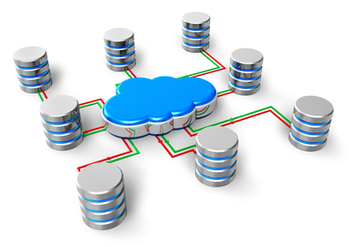
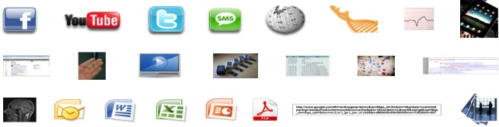
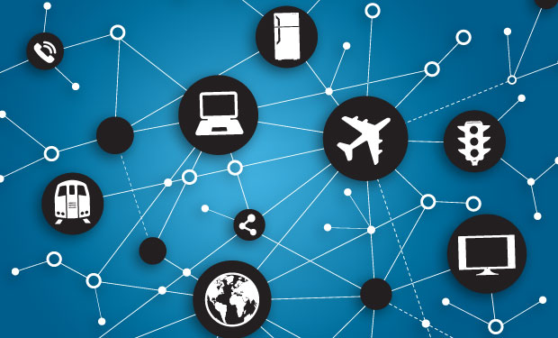

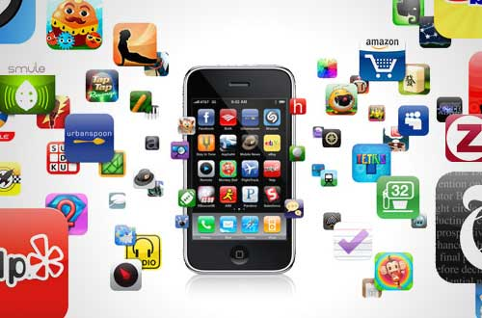
Technology Enablers – Digital Transformation
Cloud
Big Data
Internet of Things (IoT)
Social Media
/ Mobile Apps
Blockchain
Cloud Host、
Cloud Storage、
Cloud Network、
VDC
DR and Backup
Structured Data
Semi-Structured Data
Unstructured Data
IoT Connectivity
IoT Sensors
IoT Platform
Social Networks
Messaging/ chat apps
Decentralized Security
Reliable / Scalable
Notes:
Global IoT spending currently sits at US$700 billion, and is expected to reach US$1.3 trillion by 2019. source: Huawei GCI

Slide 7
Global IoT Market
$1,310
Trillion
$316Bn
$281Bn
$310Bn
$367Bn
Grid
Oil / Gas
$36Bn
Smart City
Traffic
Home
Source: Huawei GCI 2016
Notes:
Global IoT spending currently sits at US$700 billion, and is expected to reach US$1.3 trillion by 2019. source: Huawei GCI

Slide 8
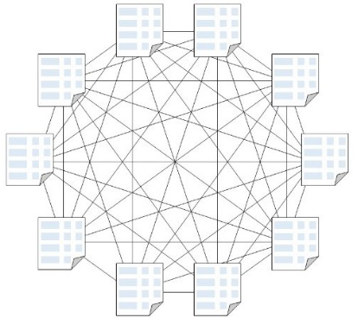
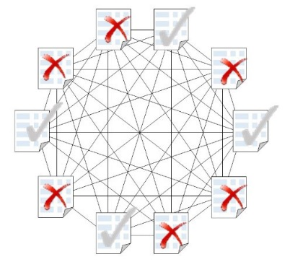
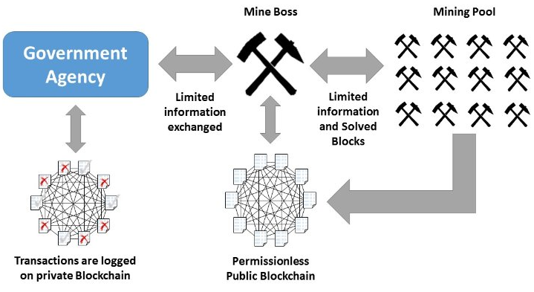
Blockchain
Challenges of using Blockchain in the public sector is how to adapt the open, public characteristics of Blockchain to the needs of government or specific need
Public Blockchain: everyone can read or write data. Some public blockchains limit the access to just reading or writing. Bitcoin, for example, uses an approach where any can write.
Private Blockchain: all the participants are known and trusted. This is useful when the Blockchain is used between companies that belong to the same legal mother entity.
Merged Blockchain: as per Adams T(2016) benefits of public chains while retaining the control of private blockchains is to develop a merged system.
Public Blockchain
Public Blockchain
Restricted Blockchain
Notes:
Global IoT spending currently sits at US$700 billion, and is expected to reach US$1.3 trillion by 2019. source: Huawei GCI

Slide 9
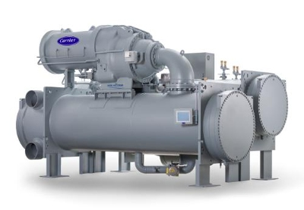
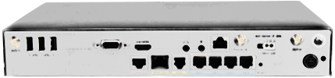

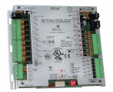
Blockchain Prototype in IoT
Illustrative Example
Configuration for Internal POC
Internet
x86 platform, support for 2 VM’s
Huawei IoT Gateway
shall run Niagara for BACnet Integration, Ethereum Wallet and Digital Contract
Chiller
Communicating
On Modbus RTU
Blockchain
Integration codes
with Cryptocurrency
Wallet
“A Blockchain is a public ledger shared by all participants in a given system of transactions that have ever been executed. It is constantly growing as 'completed' blocks are added to it with a new set of recordings. The blocks are added to the Blockchain in a linear, chronological order”
Modbus RTU RS 485 to BACnet/ IP Convertor

Slide 10








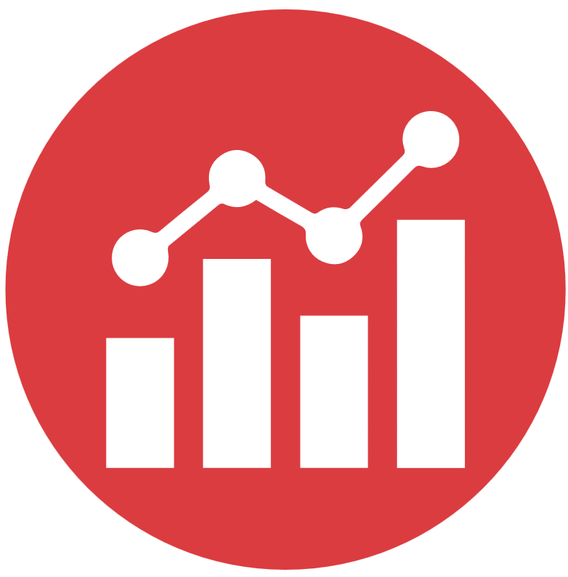
Data Governance
DATA GOVERNANCE OPERATIONAL
  Critical data identified
  Data compliance management
  Processes implemented
  Compliance monitoring
  Improvement change board
  KAVE: Analytics and Authorisation
INCREASED REVENUES
+20%
OPEX REDUCTION
-20%
IMAGE PR
++
Create a smart city data governance plan
++
SHARE HOLDER
VALUE
Build different user interfaces
QUALITY & FAN EXPERIENCE
+0,5 (1-10)
ZERO
EMISSION
CONTINUITY
Curate an open
innovation
and developer forum
Notes:
Data is an asset
Responsibilities over all critical data are defined and implemented;
Ownership of data is clearly established
Data management is centrally governed
Formal data governance structure exists on all levels in the organisation
Mission, vision, guiding principles and strategy are documented and formally agreed upon
There is a common understanding of data-related definitions and principles throughout the organisation
Data and data governance operations comply with relevant laws and regulations

