Slide 1
Challenges and Opportunities
in a Data-Driven World
GHAZI ATALLAH
NXN, CEO

Slide 2
Challenges: Information Overload
<
3.35BN
3.2BN
Active Users
POPULATION
Data creation is accelerating. More data has been created in the past two years than in the entire previous history of the human race.
50 BILLION
OVER
connected devices in the next 5 years
LESS THAN 0.5%
OF BIG DATA IS EVER ANALYSED
Source: Forbes.com
2￼

Slide 3
Challenges: Information Overload
Four V's of data
VOLUME
VELOCITY
VARIETY
VERACITY
DATA AT REST
DATA IN MOTION
DATA IN MANY FORMS
DATA IN DOUBT
Terabytes to exabytes of existing data to process
Streaming data, milliseconds to seconds to respond
Structured, unstructured, text, multimedia
Uncertainty due to data inconsistency & incompleteness, ambiguities, latency, deception, model approximations
Source: Datasciencecntral.com
3￼

Slide 4
Solutions: Reduced Technology Costs
There has been a 3x reduction in costs of storing and processing data over the last 10 years
$
Source: IDG United Kingdom
4￼

Slide 5
Solutions: New Big Data Technology
OLD
NEW
CHEAPER DISTRIBUTED DATA STORES
$ $ $
EXPENSIVE DATABASES
LIVE AVAILABLE DATA
PRIVATE ARCHIVES
5￼

Slide 6
Solutions: Changing Processes
OLD
NEW
SLOW PROCESSING
REAL-TIME ANALYTICS
MINE THE PAST
PREDICT THE FUTURE
6￼

Slide 7
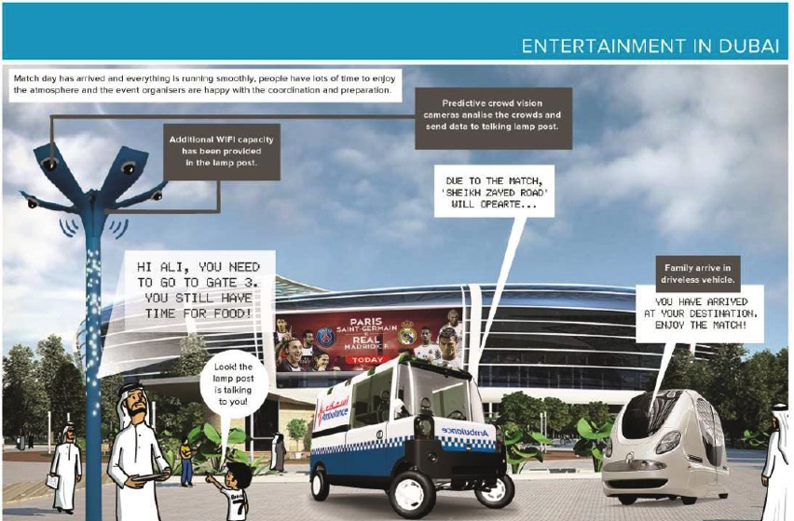
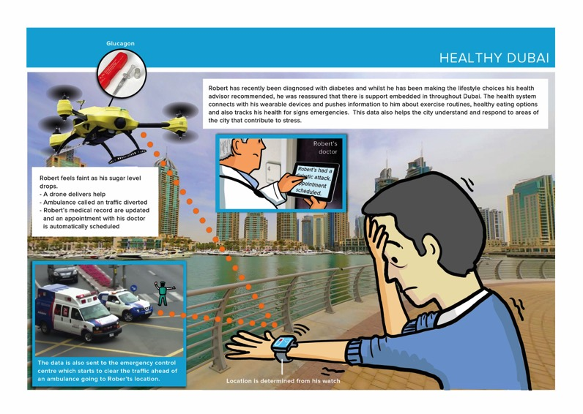
Opportunities: Drive Integration with Seamless Services

Slide 8
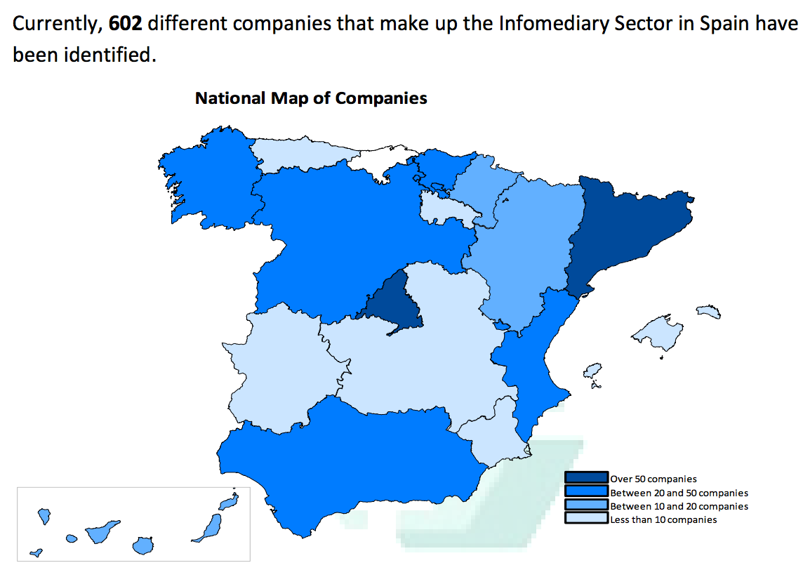
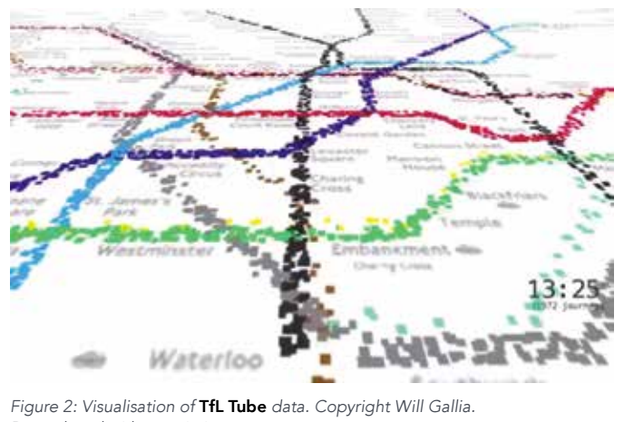
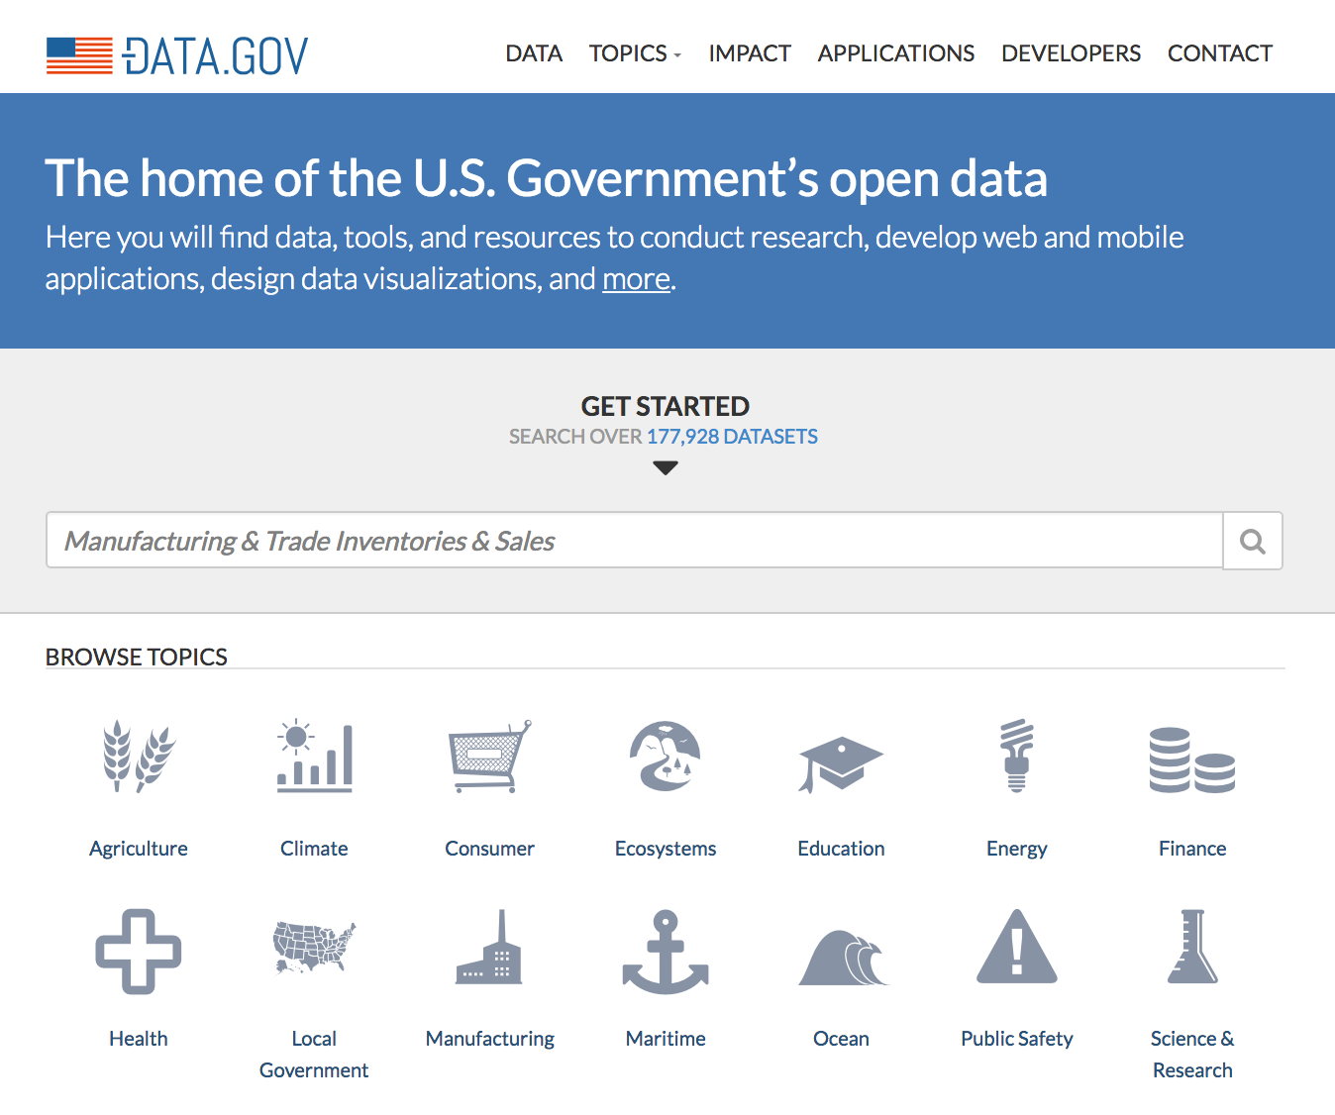
Opportunities: Drive Innovation with Open Data
UK:
Transport for London
5,000 Developers registered to use and transform TfL data
362 Smartphone apps using TfL data
4 Million app downloads
U.S.A.:
Estimated Impact of Open Data
$3-5 Trillion
Healthcare, Transportation, Education
SPAIN:
Infomediary Sector
600+ Companies
15,000 Jobs
1.5 – 2B Euros invested

Slide 9
Opportunities: Drive Innovation with Government as a Platform
Dashboard and Analytics tools
Digital ID services
Digital Payments
Platform as a Service (PaaS)
Real-Time / In Memory App Environment
Geo-location data support
OpEN & SHARED City Data Catalogue
IOT Management & Data Aggregation
9￼

Slide 10
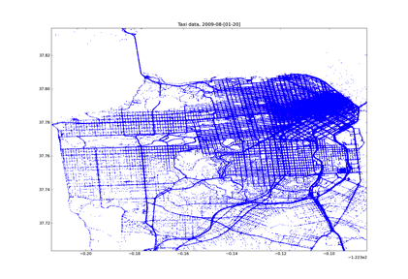
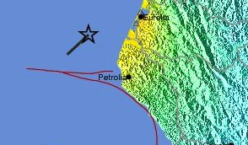
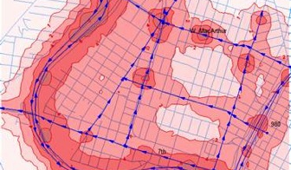
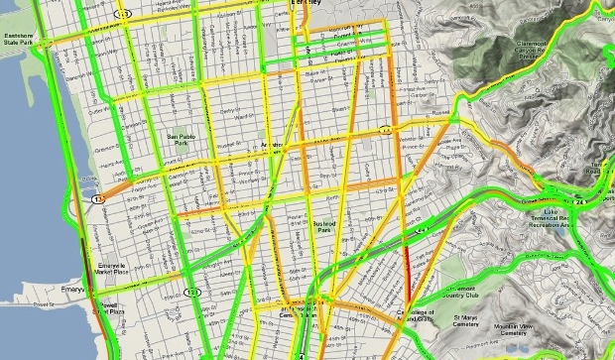
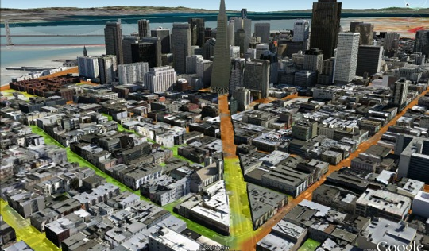
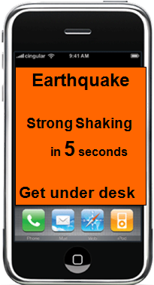
Opportunities: Drive Insights with Big Data and Rich Data
CROWD-SOURCING
SENSING
PHYSICAL MODELLING
DATA ASSIMILATION
Example: San Fransisco. Source: Alex Bayen, UCB
10￼

Slide 11
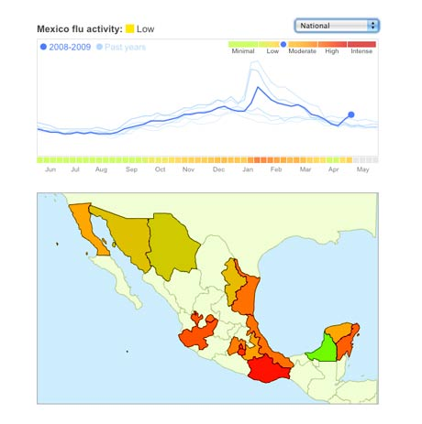
Opportunities: Drive Insights with Big Data and Rich Data
EXAMPLE
Google Flu Trends
Detecting outbreaks two weeks ahead of CDC data
New models are estimating which cities are most at risk for spread of the Ebola virus.
PREDICTIVE MODELING
11￼

Slide 12
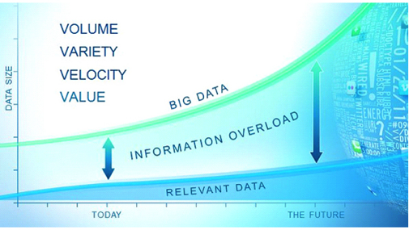
it is not just about Data being Big, collecting more and having more
It is about Data being Rich and Insightful
Sharing more: data must move
Understanding more: data must answer “Why?”
Using more: data must be actionable
Impacting more: data must matter

Slide 13
THANK YOU
Private & Confidental

