Slide 1
déjà vu in IoT?
Chong Chee Wah
CEO & Founder
TreeBox Solutions
Leading Secure Mobile Communications Company
www.treeboxsolutions.com

Slide 2
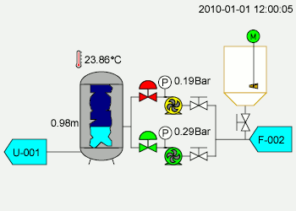
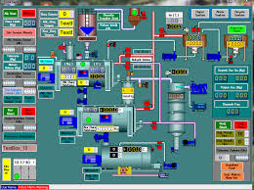
Have we seen this in SCADA? (Supervisory Control & Data Acquisition)
Notes:
First generation – mini computers to control the systems.
Second generation – local area network (LAN)
Third and fourth generation – “IoT SCADA”

Slide 3
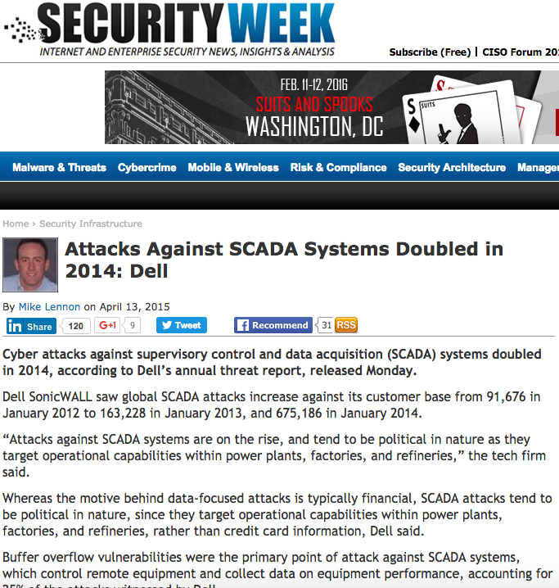
Notes:
Based on Dell 2015 Annual Security Report:
From 91k attacks in Jan 2012 to 675K attacks in Jan 2014
Power plants, factories, refineries
Increasing trends with no indications of drop in attacks

Slide 4
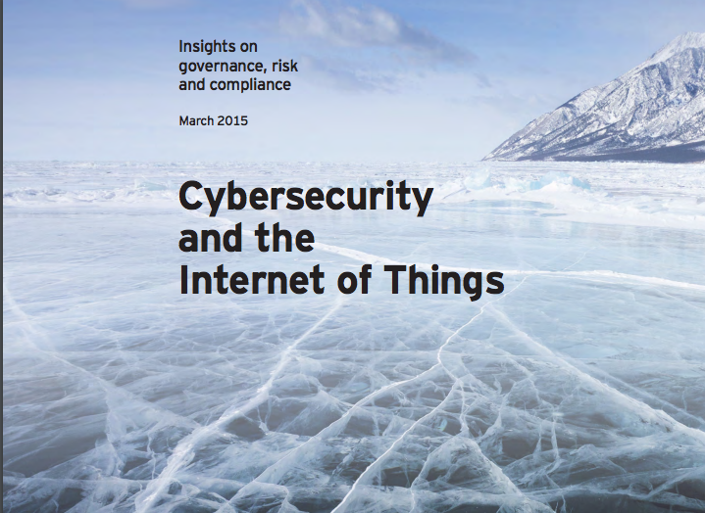
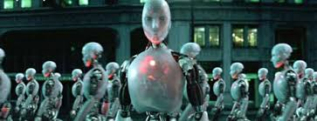

Slide 5
Security By Design:
Device Security
Protocol Security
Infrastructure Security

Slide 6
When you are thirsty, it is too late to think about digging a well. Japanese Proverb
Thank You

