Slide 1
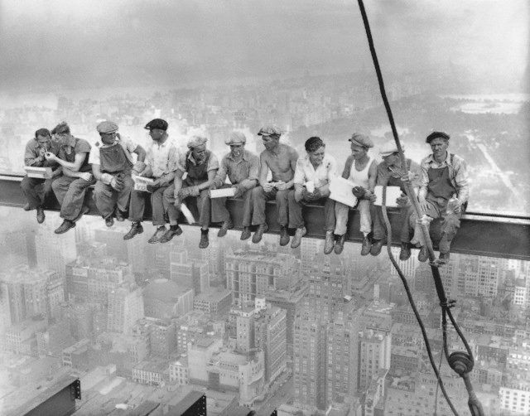
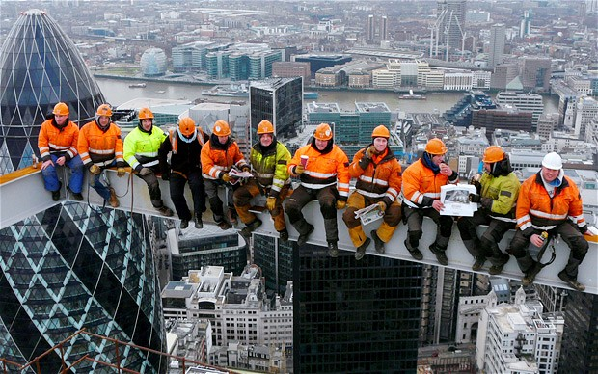
Forum on Internet of Things: Empowering the New Urban Agenda Geneva, Switzerland, 19 October 2015
Working for Urban Transformations: Considerations about Labour and Employment in Smart Cities
Edmundo Werna
International Labour Office
werna@ilo.org

Slide 2
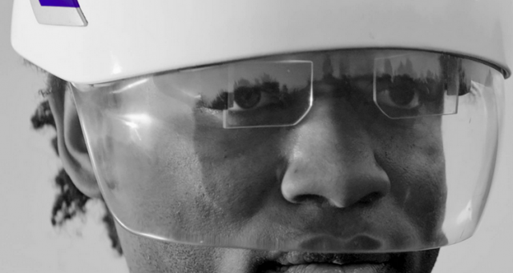
Who will actually provide the goods and services which are necessary for a smart city

Slide 3
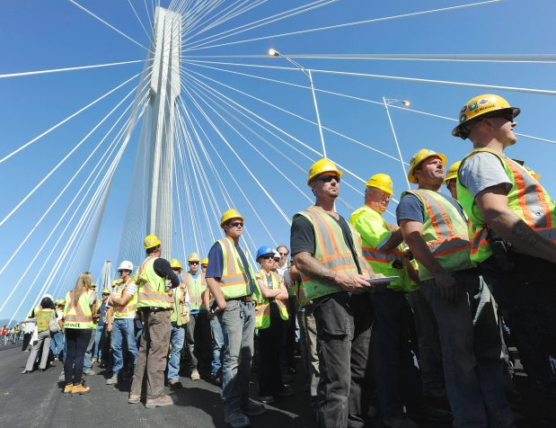
mutual impact
smart cities ←→ labour

Slide 4
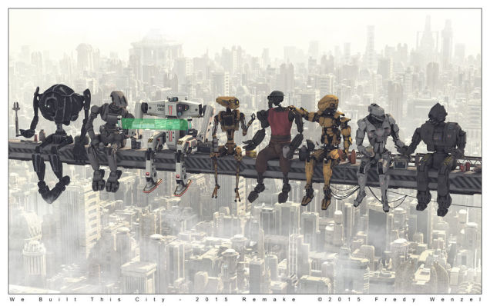
Trends
high ← (middle) → low skilled labour
increased globalization: digital taylorism
artisan economy and crowdworking
non-standard forms of work: e.g. informal & undeclared work, self-employment, temporary employment, part-time work, teleworking

Slide 5
Employment change
EFFECT | EXAMPLE
New job creation | ICT sectors
Elimination | Routine jobs (e.g. clerical work)
Substitution | Clerical work → ICT related work
Transformation | From driver to transport manager
5

Slide 6
Taking into account…
Skills training
Employment & reduction of inequalities
New forms of community and of workers’ organizations
Social protection
Notes:
1. Labour directly affects the possibilities of a city becoming smart (e.g. skills training) – many policies related to the education system, Vtinstitutes, private companies, and others
2. Technological change will impact on labour and this will revert back into facilitating or not the further development of smart cities: employment: how to transform elimination of work into new jobs – or/and to better distribute the wealth generated by smart cities – what could be the effect of polarization of a labour market if there is not a better distribution of wealth
POLICIES: - Helping workers to move from declining firms and sectors to growing ones – whilst providing income security.
- Assuring workers’ rights and seizing opportunities in growing ICT sectors.
- Strengthening labour market information systems and social dialogue for better understanding and strategizing.
sectors to growing ones – whilst providing income security.
Assuring workers’ rights and seizing opportunities in growing biosectors.
Strengthening labour market information systems and social dialogue for better understanding and strategizing.
3. Digital taylorism: the colleagues are elsewhere not physically here – already happening to some extent but will happen much more.
- Artisan economy and crowdworking: how to organize them – into cooperatives?
4. Social protection of non-standard forms of work – working for a company in another country but has to go to a medical doctor in the country and city where s/he lives
__________________________
The changes in ways cities unfold and changes in labour will require new thinking for the roles of local authorities, ministries of urban development, of telecommunications and of labour.
Perhaps with much more integration between cities in different countries.
Outsourcing: network of cities --- LED
Difficult to make a recipe for all the whole world but I leave here some ideas that we can discuss.

Slide 7
