Slide 1
Forum on Internet of Things: Empowering the New Urban Agenda Geneva, Switzerland, 19 October 2015
Promoting sustainable urban development through the UNECE/ITU Smart Sustainable City Indicators
Gulnara Roll
Head, UNECE Housing and Land Management Unit Email: Gulnara.Roll@unece.org

Slide 2
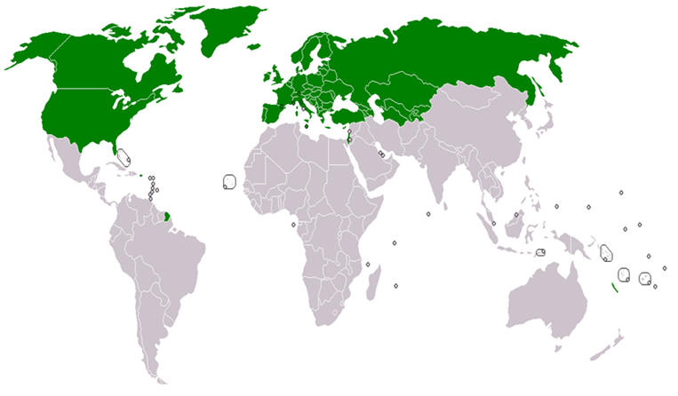
United Nations Economic Commission for Europe
56 member States in Europe, Central Asia and North America
One of the five ECOSOC Regional Commissions
An intergovernmental platform for policy dialogue and exchange of best practices
8 thematic subprogrammes:
Economic cooperation
Environment
Forestry
Housing and land management
Statistics
Sustainable Energy
Trade * Transport
Regional thematic studies

Slide 3
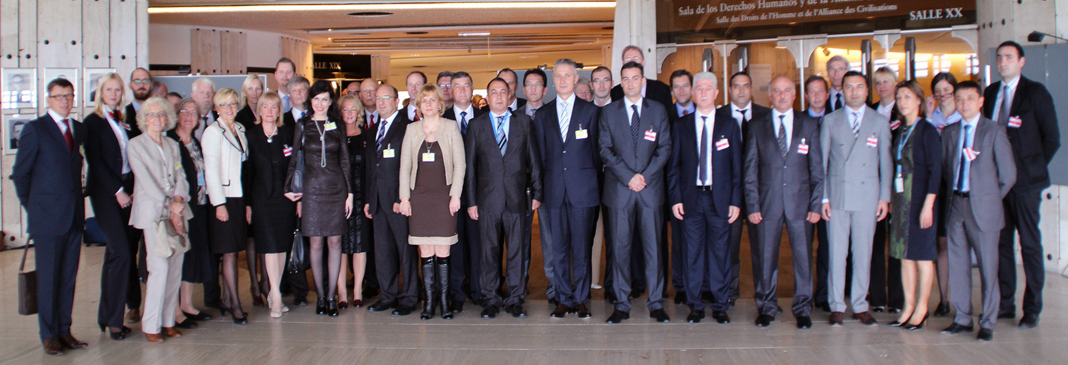
UNECE Committee on Housing and Land Management
Established in 1947 with a mandate to improve housing, urban and land governance and promote sustainable housing
In 2015, agreed on the Geneva UN Charter on Sustainable Housing aimed to ensure the access to decent, affordable and healthy housing in the ECE region
The Charter is based on four principles: Environmental protection, Economic effectiveness, Social inclusion and participation, Cultural adequacy

Slide 4
UNECE/ITU Smart Sustainable City definition
A smart sustainable city is an innovative city that uses information and communication technologies (ICTs) and other means to improve quality of life, efficiency of urban operation and services, and competitiveness, while ensuring that it meets the needs of present and future generations with respect to economic, social, cultural and environmental aspects”.

Slide 5
UNECE/ITU Smart Sustainable City Indicators
72 indicators developed based on the integrated approach, according to the areas of Economy, Environment, Society and Culture
Reflect the content of the adopted by the UN General Assembly Sustainable Development Goals (SDGs) and therefore will help cities to evaluate their performance against the SDGs.
Will be used to develop cities’ profiles and action plans
Will help capacity-building and good governance in countries
Will promote international cooperation and exchange of best practices, and overcoming the digital divide.

Slide 6
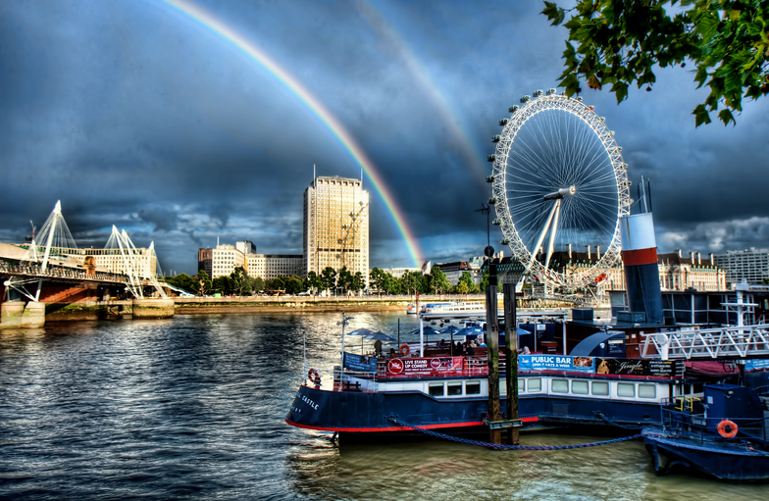
Title only layout
Input into the NEW URBAN AGENDA (to be adopted by HABITAT III – Global Conference on Urban Development and Housing)
Which will promote among others
An integrated approach to the development of cities and human settlements
Green, inclusive, healthy, compact and resilient cities

Slide 7
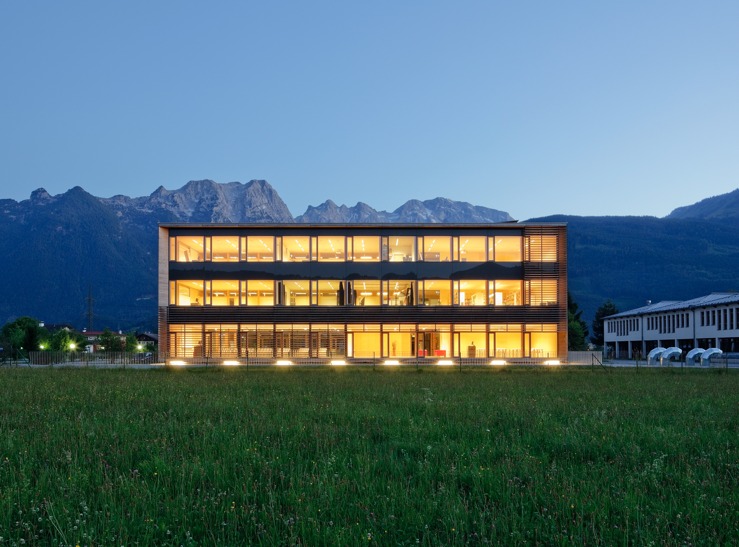
Thank you for your attention!
http://www.unece.org/housing.html

