Slide 1
Forum on Internet of Things: Empowering the New Urban Agenda Geneva, Switzerland, 19 October 2015
The Role of Regulators and Governments in realizing the promise of IoT & Smart Cities
Ankush Johar,
Director, Wireless Federation
aj@wirelessfederation.com
Notes:
The role of Mobile Operators, Regulators and Legislators in realizing the promise of IoT

Slide 2
Index
The compelling need for Smart Cities
A Pragmatic approach to achieving Smart Cities
Key Challenges & Roles of Regulators/Governments
Government & Regulatory Focus
Case Examples
Conclusions

Slide 3
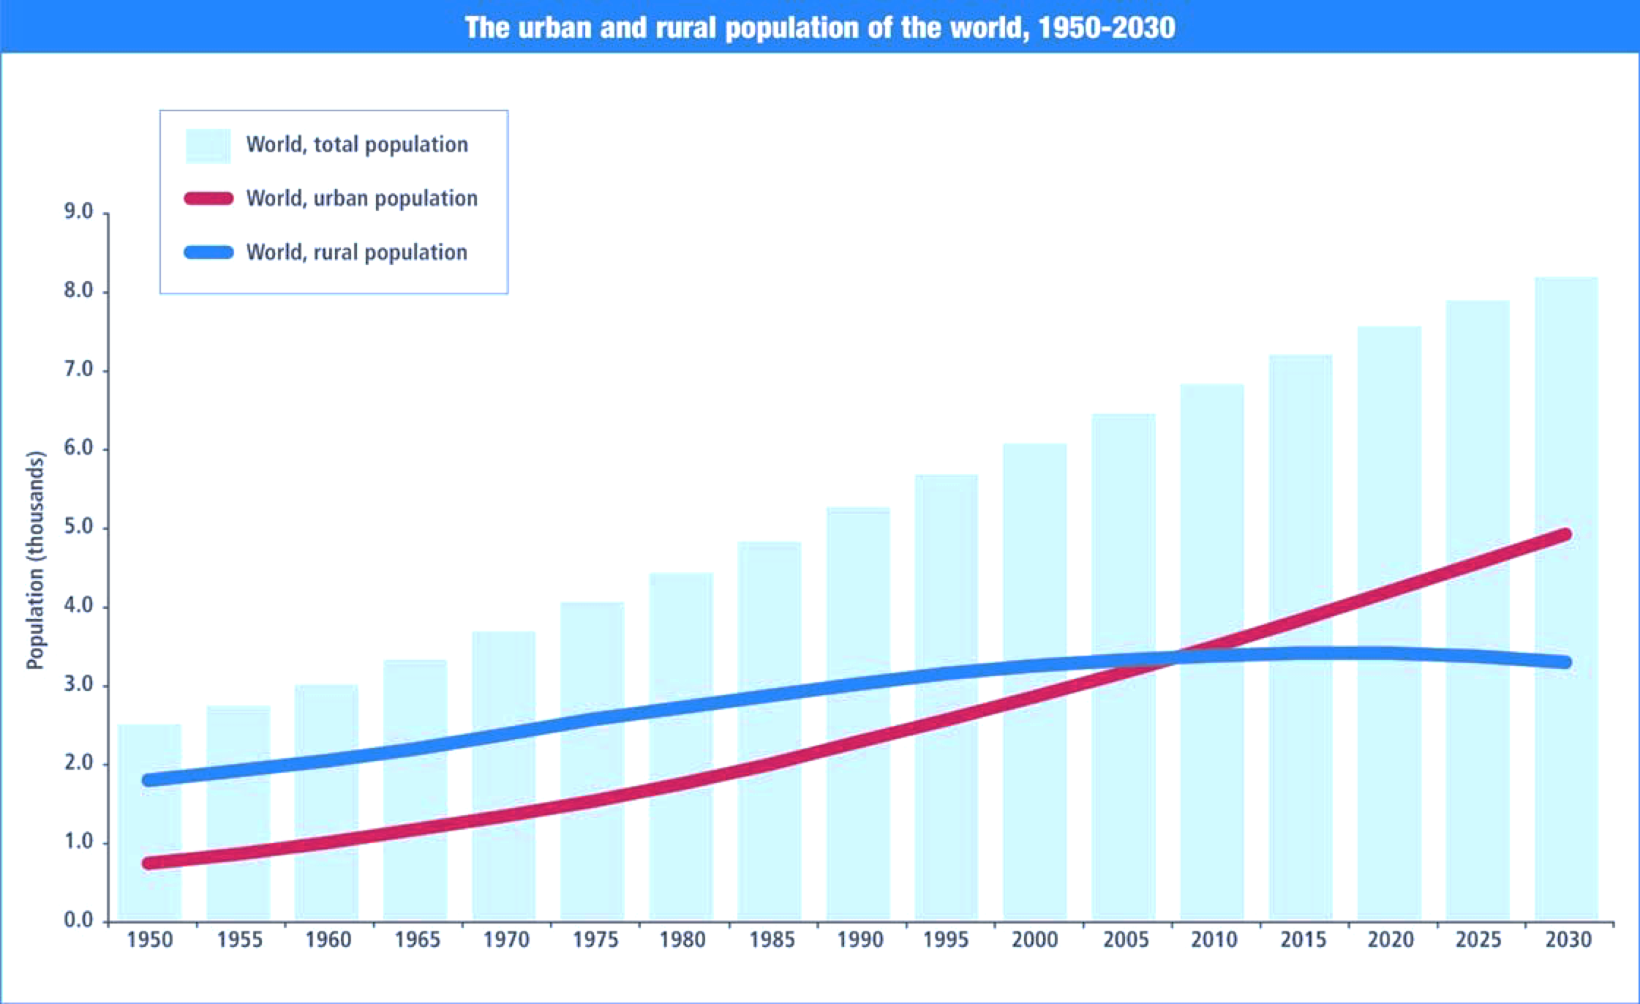
Need for Smart Cities
Urban Population is booming:
1950 - 30%
1990 - 43%
2014 - 54%
2050 - 66%
It was 746 million in 1950 to 3.9 billion in 2014. The world’s urban population is expected to surpass 6 billion by 2045
There is no choice but to have Smart Cities!
http://esa.un.org/unpd/wup/Highlights/WUP2014-Highlights.pdf

Slide 4
Pragmatic Approach to Smart Cities
WHAT TO DO?
FROM
TO
Nurture ‘Open Data’ platforms, that utilise ‘Smart Data’ as an asset in its own right, to create citizen centric innovations, driven & managed by ‘Smart City Stakeholder Groups’ can best address any city’s challenges and opportunities.
Closed & Un-connected vertical silos of functionally-oriented service providers
Innovative and Collaborative new models that connect these vertical silos.
GUIDING PRINCIPLES
ENERGY
TELECOM
WATER
TRANSPORT
HEALTH
HOUSING
ECONOMY
POLICING
EDUCATION
WASTE
ENVIRO SVCS
SOCIAL SVCS
ENERGY
TELECOM
WATER
TRANSPORT
HEALTH
HOUSING
ECONOMY
POLICING
EDUCATION
WASTE
ENVIRO SVCS
SOCIAL SVCS
SERVICE MANAGEMENT
Visionary
Citizen focussed
Digital
Open
Collaborative
BUSINESS MANAGEMENT
TECH. & DIGITAL ASSET MGMT.

Slide 5
Key Players in the IoT Ecosystem
Regulators/Government
Telecom Operators
Customers/Consumers
Standards Bodies/Industry Groups
Hardware Vendors
Software Vendors
Middleware Vendors
IT Service Vendors
Cloud Service Providers

Slide 6
Key Challenges & Roles for Regulators/Government
Security Risks
Studies Reveal 70% Of IOT Devices Are Vulnerable To Attack. Google’s Nest is hackable*!
Data Privacy
“Right To Be Forgotten” - European Commission Ruling
Data Sovereignty And Data Residency
With IOT, physical borders between countries have become porous
Govts. now need to subpoena data physically located in another country
Example: A large organisation had to setup a new Datacenter based out of Canada in response to data sovereignty issues
Spectrum Licensing
Dedicated Spectrum vs. Shared Spectrum framework based on requirements of IOT devices
Utilize Unused White Space Spectrum
Radio signals have propagation characteristics that make them suitable for travelling long distances and through buildings –apt for IOT deployments
Eg. Ofcom Approves White Space Spectrum For IOT Network

Slide 7
Key Challenges & Roles for Regulators/Government
Numbering Systems
No notable efforts yet to create a universal numbering system for IOT devices
If the number of IoT devices is to touch over 50Bn then there is an imminent need for this.
KYC Requirements
Removes the flexibility of selling pre-activated off-the-shelf IOT and M2M devices
KYC leniency is required from regulators for IOT device proliferation
Taxation Schemes
Impact of SIM Activation Tax - Reforms For IOT & M2M In Brazil & Turkey
How revenues from IOT services provided by international companies need to be taxed?
Permanent Roaming/ National Roaming
The ability to offer services globally is critical for many IOT verticals - including automotive and consumer electronics
Embedded/Soft SIMs and other disruptions are important considerations.

Slide 8
Government & Regulatory Focus
Promote Competition & Investment
Spectrum Licensing
Numbering Systems
KYC Requirements
Taxation Schemes
Permanent Roaming Regulations
Implement Standardization & Interoperability
Framework for IOT in the region
Empower & Protect the End User
Security Risks
Data Privacy
Data Sovereignty & Data Residency
Promote the Internal Market
Legislations that make certain connected services mandatory, eg. Smart Metering, Connected Cars, Traffic Management, Health, etc.

Slide 9
Examples Of Legislations That Create IOT Opportunities
Smart Energy & Metering legislations
UK’s Smart Metering Initiative: The initiative plans to cover every consumer and business in the UK by 2020 – this involves replacing over 53 million meters, and provide £6.2 billion in net benefits by 2030
Ontario’s Smart Metering Initiative
The key objective was to install new “smart” electricity meters throughout the province to measure both how much and when electricity is used – in order to introduce time-of-use (TOU) pricing to encourage consumers to shift their electricity use to times of lower demand and pricing
Connected Car legislations
EU’s eCall Initiative: eCall is an European Commission initiative, making mandatory the deployment of internet-connected sensors into cars that enable emergency services to be immediately contacted and requested automatically after a serious road incident within the EU
Smart Traffic Management legislations
Singapore’s Smart Mobility 2030 Initiative: The initiative covers a range of connected and interactive land transport services that are driven by legislations
Many more examples…

Slide 10
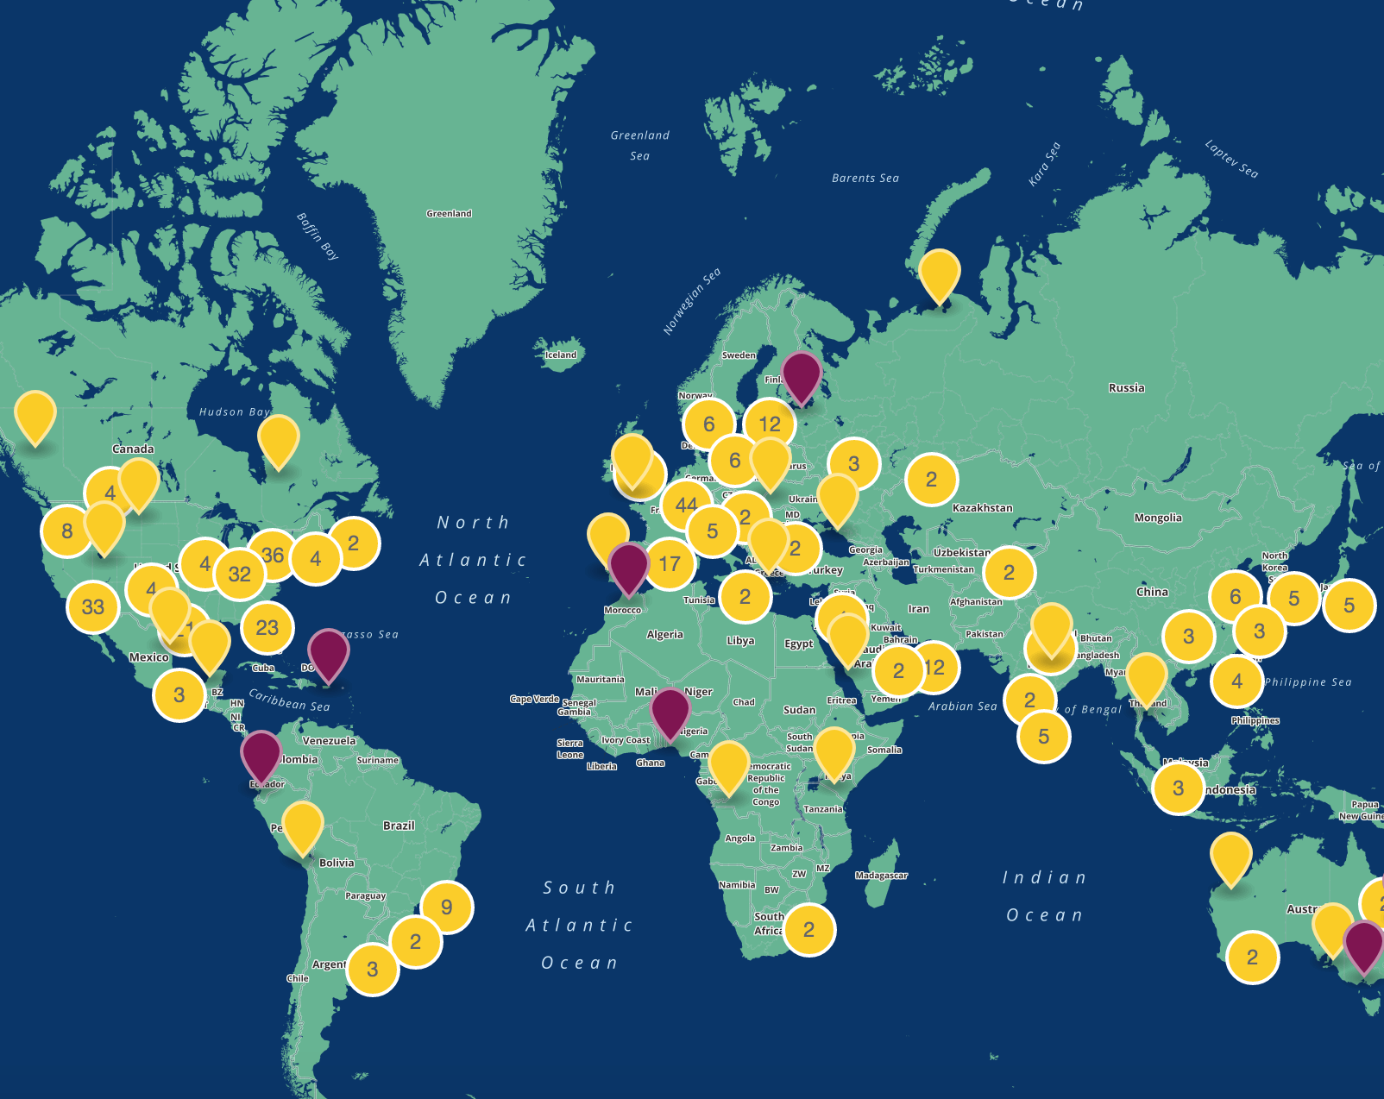
BARCELONA: $3.6 Bn Value Creation
Mobile collaboration: $1.6 Bn
Telework: $199 Mn
Smart Parking: $67 Mn
Smart Water: $56 Mn
Smart Lighting: $47 Mn
56,000 Jobs

