Slide 1
Forum on Internet of Things: Empowering the New Urban Agenda Geneva, Switzerland, 19 October 2015
Building IoT Network for Smart City
Dr. Ayman Elnashar
Sr. Director Wireless Broadband, Terminals & Performance
Emirates Integrated Telecommunications Co. (du)
ayman.elnashar@du.ae

Slide 2
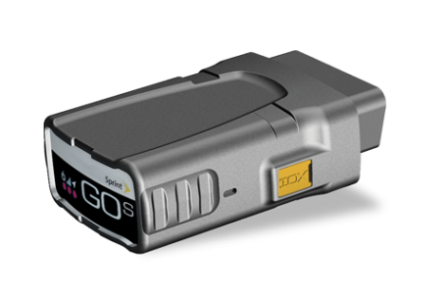
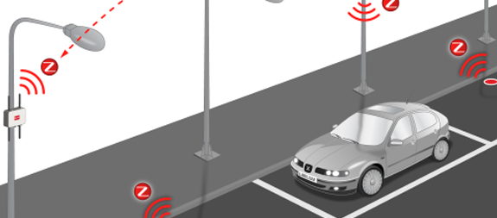
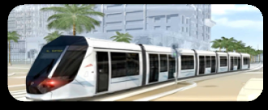
IoT Network Topology
Unified & Horizontal IoT Platform
Device Management/Cloud
2G/3G/LTE/WiFi/Fixed
Unlicensed LPWA Networks in ISM bands (+ other bands)
3GPP Licensed LPWA Network(s)
NB-IoT + EC-GSM
2G/3G/LTE
2G/3G/LTE/Fixed
+20dB Link budget gain
2G/3G
Concentrator
RF Mesh
Smart Meters
Smart Meter
Smart Building Management
Fleet Management
Smart Waste Management with battery-powered sensors
Smart Parking with battery-powered sensors

Slide 3
LPWA IoT Networks Classifications
✓ | Unlicensed Networks (Already Deployed) such as LoRaWAN, Sigfox and OnRamp wireless, Weightless -N & -P etc. Most of these networks take advantage of industrial, scientific, and medical – ISM – unlicensed frequency bands. These technologies are ready and already deployed and meet the 4 factors for LPWAN (long range, very low power, low data rate, and very low cost). Some are based on standards protocols supported by industry alliance like LoRaWAN Alliance and Weightless SIG, some are based on proprietary protocols and some are standards in-progress.
✓ | 3GPP Licensed Networks Evolution (Came later to the party) LTE MTC (machine type communication) evolution : based on amending the LTE to support MTC. The 1st version was released with 3GPP Rel 8 based on CAT 1 but it does not meet the IoT requirement (battery/cost/range) and a new release is released with R12 with Cat 0 and currently enhanced version (eMTC) is under evaluation in Rel 13 to meet LPWAN requirement (CAT M). NB-CIoT and NB-LTE (will be evolved into NB-IoT) as per latest 3GPP RAN meeting and is expected to be released with 3GPP Rel 13. GSM Evolution : upgrade of GSM by using one carrier for IoT and extending the coverage by (EC-GSM) is expected with 3GPP Rel 13.

Slide 4
Summary of Unlicensed non-3GPP LPWA IoT Networks
Source: Bryon Moyer, “Low Power, Wide Area A Survey of Longer-Range IoT Wireless Protocols,” Electronic Engineering Journal, Sept. 2015.
http://www.eejournal.com/archives/articles/20150907-lpwa/

Slide 5
3GPP MTC/LPWA IoT Releases
 | LTE Cat.1 |  | LTE Cat.0 | LTE Cat.M | EC-GSM | NB-LTE* | NB-CIoT
Spectrum | LTE In-Band, Greenfield |  |  |  | GSM In-Band, Greenfield | Greenfield | Greenfield
Release Date/Commercialization | 2009 |  | 2014 | 2015/2016 | 2016/2017 | 2016/2017 | 2016/2017
3GPP Release | Rel-8 |  | Rel-12 | Rel-13 | Rel-13 | Rel-13/14 | Rel-13/14
Peak Data Rate | DL: 10Mbps |  | DL: 1Mbps | DL: 1Mbps | DL: 74kbps | DL: 128kbps? | DL: 32kbps
 | UL: 5Mbps |  | UL: 1Mbps | UL: 1Mbps | UL: 74kbps | UL: 64kbps? | UL: 48/14.7kbps
System Bandwidth | 20MHz |  | 20MHz | 1.4MHz | 200kHz | 200kHz | 200kHz
LPWA Network | No |  | No | No | Yes | Yes
Link Budget Target | 140dB |  | 140dB | 155dB | 164dB | 164dB | 164dB
Network Upgrade | No Need |  | SW Upgrade | To be determined | Yes (HW/SW?) | Yes (HW/SW?) | New Network Clean Slate overlaid with GSM network
3GPP has recently adopted narrow band IoT (NB-IoT) feature to specify a new radio access for cellular IoT, based to a great extent on a non-backward-compatible variant of E-UTRA, that addresses improved indoor coverage, support for massive number of low throughput devices, low delay sensitivity, ultra low device cost, low device power consumption and (optimised) network architecture. So, NB-IoT is expected to be the main steam for 3GPP LPWAN replacing NB-LTE and NB-CIoT proposals.

Slide 6
Summary of 3GPP MTC/IoT Terminals
Terminal | 3GPP Release | Availability | Details
LTE CAT 1 | Rel 8 | Available | CAT1 devices have been launched for both data applications and VoLTE/voice applications. CAT1 will continue for VoLTE/voice application devices, i.e., not replaced by NB-IoT/CAT0/CAT-M CAT1 Single Rx also launched for certain application.
LTE CAT 0 | Rel 12 | 2H16/1H17 | Cat 0/Power Save Mode/Half Duplex/Extended ACB/1Rx CAT0 is used for replacing data application devices of CAT1, but cannot replace voice/VoLTE, CAT0 is the interim solution prior to CAT-M rollout, i.e., short lifecycle. It may be dropped and go direct to CAT-M
CAT-M | Rel 13 | 2017/1H18 | 1.4MHz BW, reduced power, Extended DRX, coverage enhancements CAT-M is used for replacing data application devices of CAT1/CAT0, but cannot support VoLTE either for sure.
NB-IoT | Rel 13/Rel14? | 2017/1H18 | Overlaps LTE, 1 PRB is used, reduced power, coverage enhancements, 200 Kbps. The differentiators of CAT-M and NB-IoT are “mobility” and throughput. CAT-M is still needed unless the evolution of NB-IoT will provide sufficient motility support.

Slide 7
3GPP NB-IoT Guidelines
NB-IOT shall support 3 different modes of operation:
‘Stand-alone operation’ utilizing for example the spectrum currently being used by GERAN systems as a replacement of one or more GSM carriers.
‘Guard band operation’ utilizing the unused resource blocks within a LTE carrier’s guard-band
‘In-band operation’ utilizing resource blocks within a normal LTE carrier
NB-IoT will support following features:
180 kHz UE RF bandwidth for both downlink and uplink.
OFDMA on the downlink with either 15KHz (with normal CP) or 3.75KHz subcarrier spacing.
For the uplink, two options will be considered: FDMA with GMSK modulation, and SC-FDMA (including single-tone transmission as a special case of SC-FDMA).
A single synchronization signal design for the different modes of operation, including techniques to handle overlap with legacy LTE signals.
MAC, RLC, PDCP and RRC procedures based on existing LTE procedures and protocols and relevant optimisations to support the selected physical layer.
Any enhancements to S1 interface to CN and related radio protocols is conducting on the systems aspects such as signalling reduction for small data transmissions.
Evaluation will be based on power consumption, latency, and capacity, this evaluation will assume use of Gb interface towards the core network.

Slide 8
Proposed IoT Strategy for Operators
✓ | offers multiple/hybrid technologies according to the use case/applications requirements including: throughput, coverage, power, latency, cost, and spectrum.
✓ | The existing networks (2G/3G/LTE/WiFi) will meet the applications that need long range and high data rates. (10% of IoT market volume)
✓ | Short range technologies such as ZigBee, RF Mesh (802.15.4), PLC, WiFi, etc.. will be used for short range applications such as smart meter, smart home, smart parking, etc…. A GW or aggregator can be used to aggregate and send the data to the IoT/M2M platform. (30% of IoT market volume)
✓ | Built additional carrier grade LPWA network to meet long range coverage, low power, low data rate and low cost of end device in unlicensed bands as an interim and complementary solution and to avoid niche deployment competition. (60% of IoT market volume) Introduce NB-IoT once standardized by 3GPP and complete eco-system is ready either in-band or guard band of LTE or by re-farming one or more of GSM carriers. This will be main stream for critical IoT application while the above network will be for non-critical application.
✓ | Adopt hybrid approach for LPWA IoT networks including unlicensed IoT network (supported by strong industry alliance) and licensed IoT (when finalized by 3GPP). This is almost similar to existing WiFi/LTE networks (unlicensed/licensed). This will allow operators to capture major part of the IoT/M2M verticals and compete with niche deployment in the unlicensed band.
✓ | Nevertheless, a unified/horizontal IoT/M2M platform will be able to manage all technologies and devices from different networks, different GWs, and different standards and protocols.

Slide 9
To be addressed
✓ | Licensed and unlicensed bands for LPWA IoT networks are mandatory for competitive markets AND TO and to motivate the development and innovation. Additional licensed and unlicensed bands are needed to address the demand of the IoT market.
✓ | Since the ISM bands was regulated for short range communications with low power and short range, new regulations are required to allow the LPWAN to work nicely in the ISM unlicensed bands to mange the interference. All LPWAN protocols should play nice using collision avoidance techniques to avoid interference. Any protocol that not respect these regulations should be banned by the regulators.
✓ | While 3GPP has recently adopted a unified feature for LPWA network termed NB-IoT in licensed bands, we need to set rules to allow different unlicensed LPWAN networks coexistence and also to have global roaming between these networks deployed at different countries.
✓ | IoT platform definition is vague and many vendors have declared IoT platforms, however there is no common or minimum specifications for the IoT platform. Considering the number of IoT protocols, the variety of IoT devices/GW and the different networks and use cases, minimum specifications need to be agreed for IoT platform.

