Slide 1
Forum on Internet of Things: Empowering the New Urban Agenda Geneva, Switzerland, 19 October 2015
Contextual Reflections
Wilfried Grommen
Chief Technologist, HP Enterprise
wilfried.grommen@hpe.com

Slide 2
Agenda
What‘s in a name
IoT as part of the digital enterprise
IoT as market
Challenges
Summary
IoT enabler of Smart Cities

Slide 3
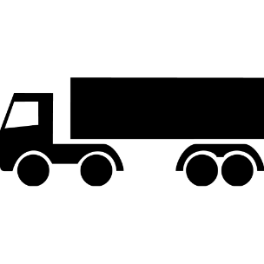
IoT Definition A living network of machines, data, and people. ( <10 words) Gartner:“The network of physical objects that contain embedded technology to communicate and sense or interact with their internal states or the external environment.”
Business Drivers:
Transform Offering to Customers
product → service
new services via connected products
predictive maintenance / support
customer behavior analytics
Optimize Operations / Processes
smart factories, smart cities, smart <stuff>
automated processes
analytics-driven control
surveillance & monitoring
Edge Networks - Sensors & Actuators
Real time actions
Gateways, Controllers, Data Acquisition
Operations & In-band Analytics
Long-term learning
Enterprise Systems & Out-of-band Analytics
IT (information technology
OT
(operations technology)

Slide 4
The “Digital Enterprise” - the Digital “government”
IoT is part of a broader re-focusing of information technology,
from the back office to the front office of the enterprise
Enterprise 1
support
functions
Enterprise 2
Enterprise 3
support
functions
support
functions
operations
SaaS
operations
operations
IoT

Slide 5
The “Digital Enterprise”
Front-office IT is more differentiating for the
Enterprise/organization, and more aligned with the business
Enterprise 1
support
functions
Enterprise 2
Enterprise 3
shift in
IT Enterprise/ organizational investment
support
functions
operations
SaaS
operations
operations
IoT

Slide 6
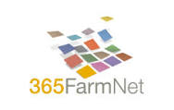
The Internet of Things (IoT) represents the next wave of the Internet
Leading to new sources of value creation and capture
Internet of Things
(Integration / Control)
Indexing & tracking
Control & connectivity
Autonomous operations
Internet of People
(Collaboration / Share)
Voice & Video collab.
Social media and docs
Web Logs / Boards
Internet of Services
(Participation / Trade)
E-Commerce
Productivity tools
Integrated chains
Internet of Content
(Distribution / Access)
Email
Information
Entertainment
Source: ETSI. 2014.

Slide 7
Landscape: IoT is a market of markets
Vertical Specialty
Horizontal
OT
hybrid / ISV
IT
vertical apps
IoT app platforms
analytics
data acquisition
& control
volume IT:
infrastructure
or services
distributed analytics
mgmt of things
mgmt platforms
security & mgmt
protocols
things
connectivity/
gateways
networks

Slide 8
The technology stack for IoT is broad and fragmented, and includes hardware, software and services elements, from the edge to network to core
xxx IT addressable
xxx Not addressable by IT
Services
Carrier services
Access networks - Backhaul networks - DC networks
Device
Ops. & Ctrl
Integration and support services
Systems integration - Support - Infrastructure (Cloud) and Business process services
Eco-system
Analytics services
Data management and analytics services
Applications & Platforms
Data integration platform - Analytics software - Applications development and deployment (use-case driven)
Software
Security SW
Embedded systems
Sensing
Signaling
Hub SW
Ops. mgmt.
Network systems
Connecting
Routing and Control
Core SW
Operations orchestration
Hub infrastructure
Compute, Storage
Core infrastructure
Compute, Storage
Security HW
Network components
Hardware
Edge
Network
Core

Slide 9
IoT adoption is driven by recent drastic improvements in technology cost & performance
Embedded / Edge device
Network (Access / Backhaul)
Core compute
Miniaturization of embedded systems
10x reduction in Auto Accelerometer size (mm²)
Source: Gartner. BofA-ML. 2014.
Lower costs for sensors
50 – 90% reduction in sensor costs ($)
Source: SIA. Goldman Sachs / BofA-ML. 2014.
Preferred connectivity standards
Preference for WiFi, Cellular, BLE and Zigbee (%)
Source: VDC Research. Goldman Sachs. 2014.
Lower carrier costs
150x reduction in bandwidth costs ($/Gbps)
Source: KPCB – Mary Meeker. Goldman Sachs. 2015.
Exponential advances in computation
100 – 1000x improvement in speed and power
Source: IEEE. Intel / AMD. 2012.
Reduction in cost of computation
5000x reduction in compute cost ($/MM transistor)
Source: KPCB – Mary Meeker. Goldman Sachs. 2015.
WiFi
10⁸
Transistors (K)
Bluetooth / BLE
10⁶
Frequency (MHz)
Cellular (3G / 4G)
10⁴
Zigbee
Power (W)
NFC
10²
Cores (#)
Infrared
10⁰
Radio (AM/FM)
Sensor
RFID Tag

Slide 10
IoT use cases vary by industry, but highest interest comes from manufacturing
Illustrative
IoT use cases | Manufacturing & Resources |  |  | Distribution & Services |  | Infrastructure |  | Fin. Svcs | Public Sector
 | Consumer Goods | Manufacturing | Construction | Transportation | Retail | Telecom & IT | Utilities | Financial Services | Government | Education | Health
Asset tracking
People tracking
Asset / Vehicle performance
Vehicle entertainment
Remote monitoring
Digital Signage
Augmented reality
Fleet tracking
Energy management
Security systems
Manufacturing processes
SC / Warehouse management
Product testing
Smart City
Agriculture processes
Industrial m/c maintenance
Payment systems
Remote asset control
Building management
Healthcare – Remote patient
Healthcare – Asset Mgmt
■ High interest / potential  Medium interest / potential  Low interest / potential
Source: IDC – Directions. March 2015.

Slide 11
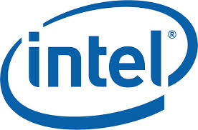
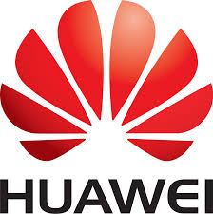
There are more than 800 companies playing across segments of IoT
xxx IT addressable
xxx Not addressable by IT
Services
Carrier services
Device
Integration and support services
Eco-system
Analytics services
Applications & Platforms
Software
Security SW
Embedded systems
Hub SW
Network systems
Core SW
Hub infrastructure
Core infrastructure
Security HW
Network components
Hardware
Edge
Network
Core

Slide 12
Most of these companies use an ecosystem of alliances to operate across segments
Technology standards alliance
Industry use-case alliance
Open technology alliance
Rationale:
Industry group for standards and reference architecture
Address uncertainty and risk around investments at scale
Example(s):
Rationale:
Industry-specific IoT solutions development
Showcase IoT benefits in the context of industry requirements and format
Example(s):
Rationale:
Exploratory collaboration on specific components in the IoT stack
Encourage developer ecosystem to test and create applications
Example(s):
IoT solutions for industrial systems
(Includes: HP, GE, Cisco, Intel, IBM, AT&T etc.)
IoT in the Home (Cisco – IoT infrastructure, ABB / Bosch – OT controls)
Embedded systems programming language
IoT device connectivity standards
(Includes: Freescale, Schneider, Bosch, NXP, Texas Instruments, ARM, Atmel etc.)
IoT in Buildings (Intel – IoT systems, Dell – Gateway, KMC – OT, PTC – implementation)
IoT device OS
IP networking protocol for IoT devices
(Includes: Nest, Freescale, Samsung, ARM)
IoT in Government / Cities (AT&T – IoT connectivity, IBM – IoT Platform and Apps)
IoT platform
IEEE standard for all IoT architecture
(Includes: Individuals – mostly engineers)
Android for automobiles (Renesas, Nvidia – SoC, Google – OS / Apps, CloudCar – Driver Experience Apps, VW, Ford - Automobiles)
IoT middleware and Cloud

Slide 13
IoT Reality: Many Issues
ROI: the real (IT) cost for many hyped IoT projects has not been factored in yet
Scale: numbers and remoteness of “things” create scale challenges for management / security processes
Edge Networks - Sensors & Actuators
Risk: newly-exposed vulnerabilities underscore the fact that today’s approach is “security-by-obscurity” (not acceptable)
Real time actions
Gateways, Controllers, Data Acquisition
Operations & In-band Analytics
Operations Technology: classic OT world is not IT-savvy
Enterprise Systems & Out-of-band Analytics
Cloud: physics and network cost & reliability issues force more computation to the edge

Slide 14
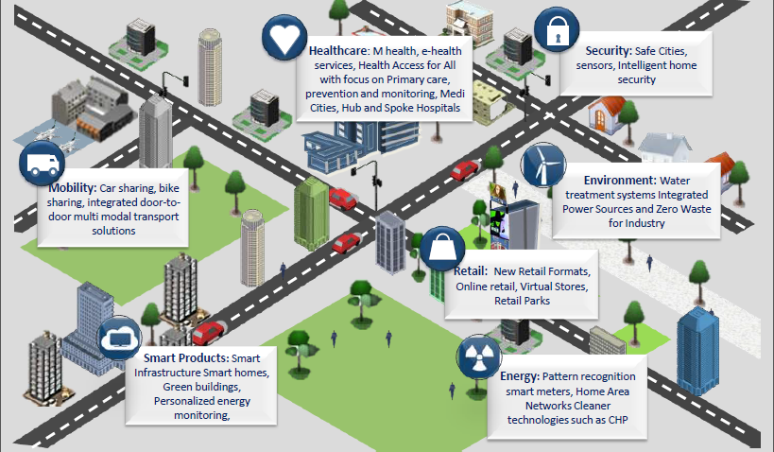
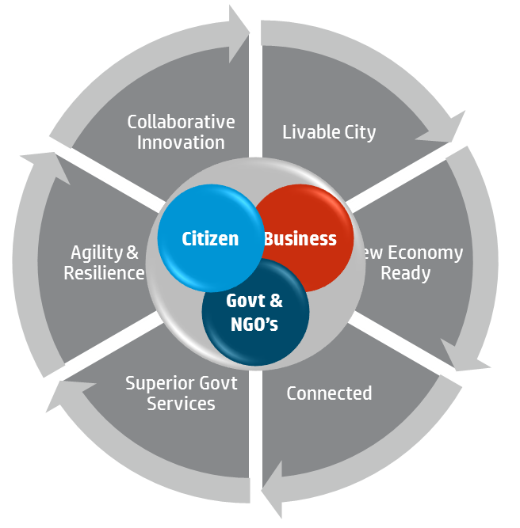
Smart cities are being empowered by IoT
Schools: Networked schools, content over the Cloud, remote teachers and experiments
Source: Frost & Sullivan, City as a Customer Strategy

Slide 15
Role of ITU
Definition of essential standards
Sharing of insights
Creation of ecosystem

Slide 16
Reflections
The Internet of Things is expected to be the next wave of evolution of the internet. The ecosystem of products and services around IoT is expected to growth with a 17% CAGR over 2015-2020
The IoT technology space is complex and fragmented, with both horizontal (product centered) and vertical (industry-focused) plays that are large and relevant
All major IT players are announcing large investment commitments to IoT. Mostly, they are creating solution-centric BU’s focused on IoT solutions with large commitments of people and investment dollars.
Given the fragmented nature of IoT, most large companies are forming an ecosystem of ambitious partnerships and alliances including IT companies, manufacturing giants (e.g.: GE, Siemens, Bosch, VW) traditional standard setters (e.g.: IEEE, IIA) or developer ecosystems (e.g.: around Arduino)
IoT is a key enabler of Smart Cities
Where can an organization like ITU act and contribute? Standardization – Sharing of insights – Building ecosystem.

Slide 17
Thank you
Wilfried.grommen@hpe.com
@wilgrom

