Slide 1
Forum on Internet of Things: Empowering the New Urban Agenda
Geneva, Switzerland, 19 October 2015
OPEN PLATFORMS FOR SMART CITIES
INTEROPERATIBILITY
Jesus Cañadas Fernandez
Head of Unit
Ministry of Industry, Energy and Tourism. Spain
jcanadas@minetur.es

Slide 2
BACKGROUND
Many services platforms/Scadas in the market
Interoperability should be considered
  Between Services
  Between Devices
  Between applications
Joint effort coodinated by M. of Industry:
  Municipalities (RECI)
  Industrial sector (Service and platform providers, etc.)
  Together with AENOR: CTN 178 (National Standardization Committee for Smart Cities)

Slide 3
REQUIREMENTS FOR PLATFORMS
Horizontality (according to ETSI criteria)
Scalability
OPEN PLATFORM based on OPEN STANDARS
Reliability
../..
INTEROPERABILITY

Slide 4
STRUCTURE OF UNE 178 104
UNE 178 104 is a set of rules developed by CTN 178:
  Functional approach
  Technological approach
  Metrica (under elaboration, and according to standars: OneM2M, ETSI an others)
  Coordinated with other CTN178 UNEs

Slide 5
INDEPENDENCE OF 3 DOMAINS
DOMAIN OF DATA ADQUISITION/CAPTURING
DOMAIN OF TELCO.
  Could you choose a Telco?
DOMAIN OF APLICATIONS: Type of platform

Slide 6
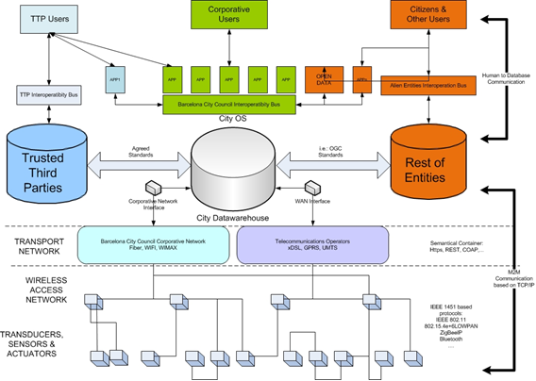
Architecture Model. Domains

Slide 7
STRUCTURE OF PNE 178 104

Slide 8

THANKS FOR YOUR ATTENTION
jcanadas@minetur.es

