Slide 1

Why Open Source Will Drive IoT Innovation
ITU Workshop on the “Internet of Things -
Trend and Challenges in Standardization”
(Geneva, Switzerland, 18 February 2014)
Ian Skerrett
VP of Marketing
Eclipse Foundation

Slide 2

Why Open Source Will Drive IoT Innovation
Ian Skerrett
VP of Marketing
Eclipse Foundation

Slide 3
Open Wins
Notes:
But my main point is that the previous 3 headlines did not occur. In fact the Internet was created on open standards and open source software. Hopefully it is not a too controversial statement that openness will always win over closed proprietary. This is especially true for technology that is expected to be broadly adopted.
There are enough cases studies and proof points that technology based on the principles of openness make it much easier and faster for technology to be adopted. It is the transactional costs of proprietary solutions, ex bi-lateral agreements, purchase costs, competitiveness that limit adoption of technology.

Slide 4


Notes:
There are lots of examples.
Does anyone believe the Internet would be as successful as it is today if Tim Berners-Lee has created a Silicon Valley start-up company to commercialize what he called the www. There were already many successful online communities, AOL and Compuserve, that were widely used. The WWW changed everything since anyone could participate and create something without asking for permissions or negotiating an agreement with Compuserve or AOL.

Slide 5

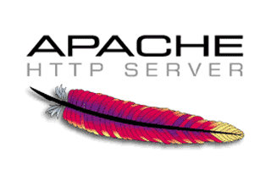

Open Wins
Notes:
In fact, the Internet is not run on open source software and open standards. Proprietary solutions still exist but it is clear who won.

Slide 6
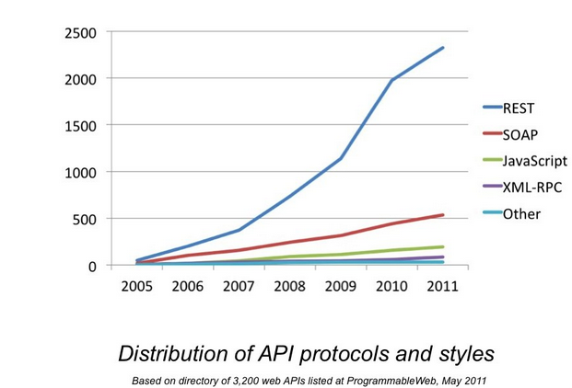
Open Wins
Notes:
Another example in the software developer area was the Web Services vs REST protocols and styles. Clearly REST has won over Web services.

Slide 7

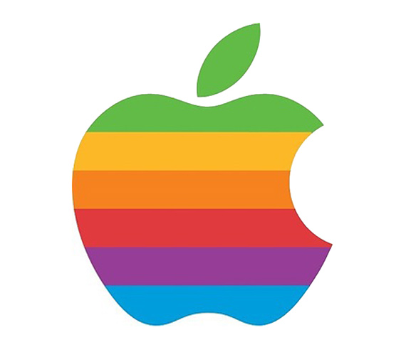
Notes:
Of course there are exceptions: Apple being a stellar example. However, I would submit that the Android ecosystem, which is definitely more open, is emerging as the dominate platform.

Slide 8

Notes:
There has been a very important trend in the last 5-10 years that can’t be ignored in any technology industry and that is the importance of developers. Gone are the days of the top-down sales and procurement approach to technology distribution. Developers have become incredibly important in determining the success of new technology. If a technology is embraced by a large developer community the adoption of the technology will increase.
A recent book by Stephen O’Grady documents the rise of the importance of the developer. His point is that developer are certainly the New Kingmakers for technology adoption.

Slide 9
Developers Build Cool Stuff
Notes:
A developer community will do a number of things for the technology:
Increase the usefulness of the technology through add-ons, applications, and information resources.
Source of innovation of how the technology can be used and applied.

Slide 10
Developers Tell Others About Cool Stuff
Notes:
Developers also excel at word of mouth promotion. The love to tell their colleagues about the next new great thing.

Slide 11
Open Wins Developers
Notes:
Key question: how do you engage a developer community?
One answer: openness. Developers have no money and the time they spend investigating new technology is often their free time. Therefore, their time is scarce too. Openness lowers the barriers for developers to experiment.

Slide 12
Open (Standards + Source) ->
Developers ->
Innovation
Notes:
Therefore, I would submit if the IoT industry wants to drive forward with innovation they need open standards and open source.

Slide 13

IoT Today
Notes:
Today IoT is not open and I don’t see much of a developer community.

Slide 14

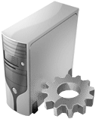


It Is Complicated!
Wireless Services
Backend Server
Devices
Vendor 2
Vendor 3
Vendor 1
?
Developer A
Machine
?
OEM
Developer B
?
ERP
?
Enterprise
Applications
Developer C
?

Slide 15

Notes:
Lots of proprietary silos. Proprietary SDKS, proprietary protocols, proprietary solutions

Slide 16

Open Ecosystem IoT
Third Party Ecosystem
Open IoT application
framework and runtimes
$ $
Open IoT communication protocols
Internet of
Things
…
Open IoT
development tools
$ $
$ $
Notes:
We need to get to an open ecosystem of IoT technology based on common frameworks, protocols and tools. Companies needs to make their money building value add solutions on top of these common technologies.
Openness does not mean no profit. A lot of profit has been made by using the common Internet technology. However, the profit has been made after a common set of Internet building blocks were in place. Ex. Apache Web Serve and Linux run the Internet.

Slide 17
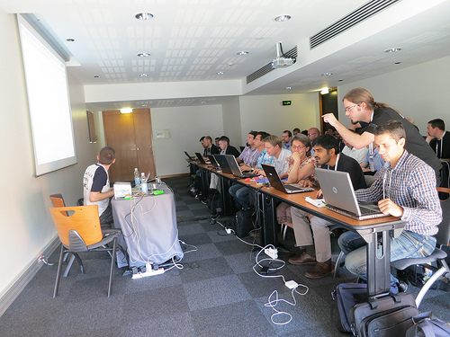
Developer Engagement
Notes:
Three trends I think will help drive an open IoT ecosystem:
1. Developers are getting engaged and they will select open solutions. IoT is fun for geeks but they don’t have the money or time to navigate proprietary SDKS or protocols. They won’t tolerate it. They will migrate to open solutions.

Slide 18

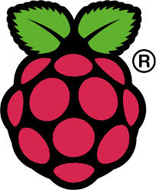

Open Hardware
Notes:
2. Open hardware has significantly lowered the barriers for developers to prototype and experiment. 5 years ago it was impossible to have an open source project that focused on IoT. There was no place to run the code. Developers would need to buy reasonably expensive hardware to just test their code.

Slide 19

Big Data Will Drive Standards
Notes:
3. ioT is a huge opportunity for the big data and traditional enterprise vendors. Companies like IBM, Oracle, SAP and others see the opportunity of IoT is in the data. They will want as much data as possible coming into their systems. They won’t have the resource to do proprietary solutions for different IoT vendors. They will drive and expect a common open standard.

Slide 20
frameworks
protocols
tools
Notes:
Eclipse M2M is initiative to create an open source community and collaboration that will enable an open ecosystem. 3 main open source project now that focus on frameworks, protocols and tools: mihini, paho and koneke.

Slide 21






CoAP
Californium
Lightweight
M2M
liblwm2m
OM2M
ETSi M2M
protocols
Notes:
Eclipse M2M is initiative to create an open source community and collaboration that will enable an open ecosystem. 3 main open source project now that focus on frameworks, protocols and tools: mihini, paho and koneke.

Slide 22





- Java and OSGi based framework for IoT and M2M Gateways
- Bridge between HTTP, MQTT and CoAP
- Java and OSGi based framework for building SCADA systems
- Java and OSGi based framework for home automation integration
- Lua based framework for building M2M gateways
frameworks
Notes:
Eclipse M2M is initiative to create an open source community and collaboration that will enable an open ecosystem. 3 main open source project now that focus on frameworks, protocols and tools: mihini, paho and koneke.

Slide 23







Open Ecosystem for IoT
Third Party Ecosystem
Open IoT application
framework and runtimes
Open IoT communication protocols
Internet of
Things
…
Open IoT
development tools
Notes:
Very important is the commercial ecosystem using the open source projects. There companies are building the open technology but also using it in their commercial products.

Slide 24
Learn From History
Open Wins Developers
Open Will Drive IoT Innovation

Slide 25
Thank you
http://iot.eclipse.org/
ian.skerrett@eclipse.org
@ianskerrett

Slide 26






unreliable networks
limited bandwidth
semantics
framework
protocols
tools
Notes:
Paho is the reference implementation of MQTT, a very simple publish-subscribe message protocol for M2M applications. MQTT is now being standardized at OASIS and the reference implementations will be at Eclipse.

Slide 27




develop
simulate
debug
deploy
framework
protocols
tools
Notes:
Koneki provides the tooling to make it very easy for a developer to develop, run, debug and deploy an M2M applications. It is focused on Lua and Mihini as the runtime. We will have work for Java in MTJ.

Slide 28
Project Pipeline
Concierge: lightweight, embeddable OSGi framework
Ponte: M2M to REST bridge
Kura: Java M2M framework
SCADA: Supervisory control and data acquisition for process automation
Eclipse Smart Home: Framework for integrating different smart home solutions and protocols.
…many more under discussion (home automation, additional protocols, etc.)
Notes:
Many more projects coming….

Slide 29




hardware abstraction
server communication
application container
scripting engine
framework
protocols
tools
Notes:
Mihini, is a Lua-based framework for m2m device gateways. It is attempting to hide a lot of the complexity involved in building M2M applications through abstraction.

