Slide 1

IEEE Standards Association (IEEE-SA) and the
Internet of Things
ITU Workshop on the “Internet of Things -
Trend and Challenges in Standardization”
(Geneva, Switzerland, 18 February 2014)
Joel Huloux
Director Standardization & Industry Alliances
STMicroelectronics
Joel.huloux@st.com

Slide 2






IEEE –Advancing Technology for Humanity
Our Global Reach
45
Technical Societies
415,000+
Members
160
Countries
Our Technical Breadth
1,200+
Annual Conferences
3,300,000+
Technical Documents
160+
Top-cited Periodicals

Slide 3



About the IEEE-SA
Globally recognized standards
Over 900 active standards
More than 500 standards under development
7,000 individual members
200 corporate members
Over 20,000 standards developers worldwide

Slide 4

Global Community
IEEE-SA works within a global community and the increasingly important intersection of economic, political and technology drivers
IEEE-SA embraces a globally inclusive and market-driven standards development paradigm to ensure strong integration, interoperability and increased synergies along the innovation chain and to benefit society

Slide 5
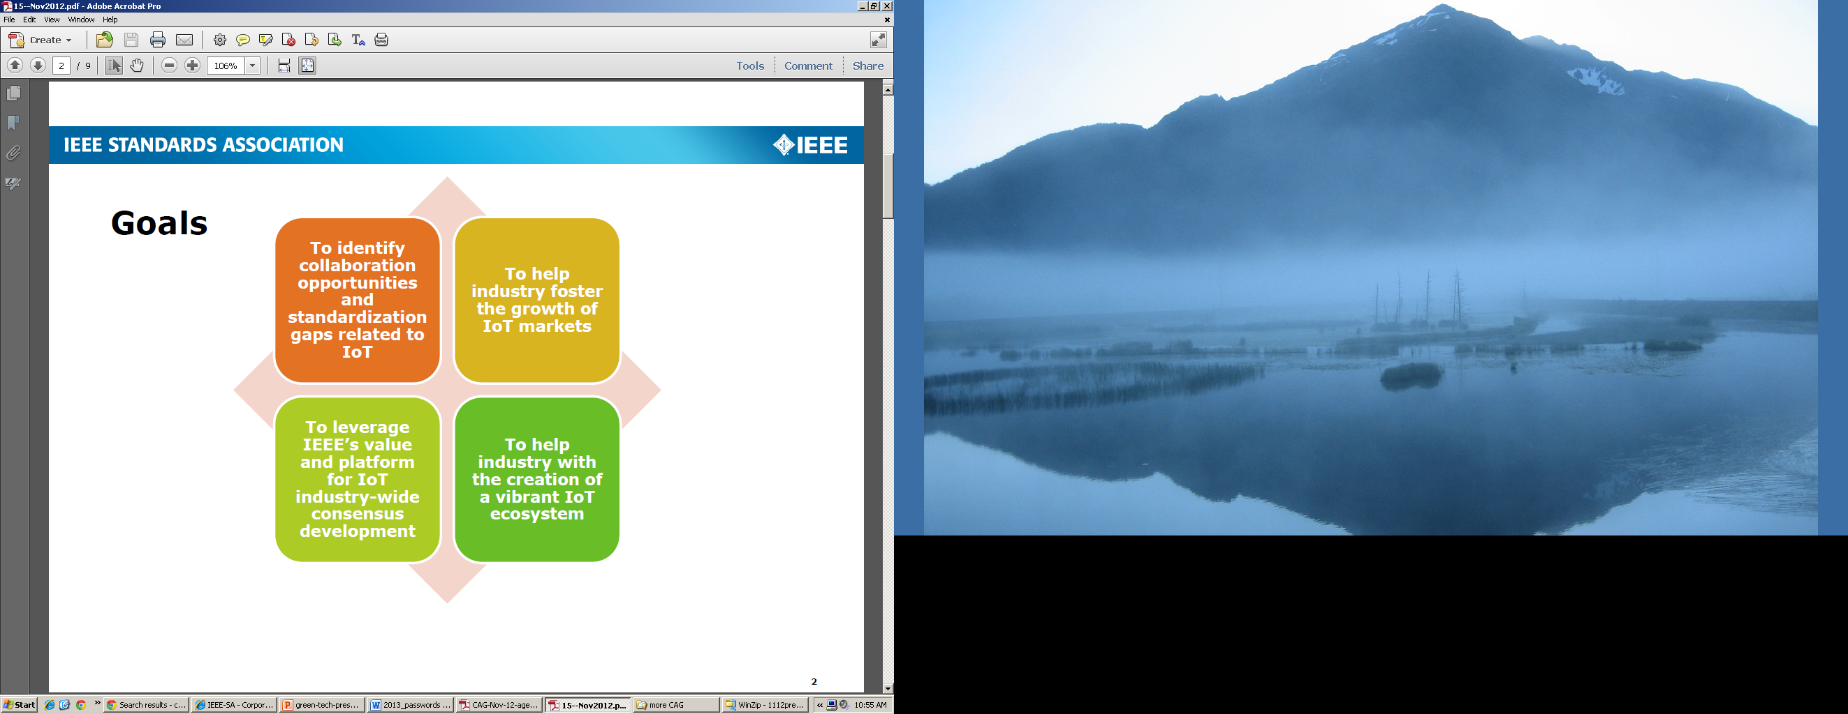
IEEE-SA Internet of Things: Activities
Worldwide IoT standards workshops
2012: Beijing, China and Milan, Italy
2013: Shenzhen, China and Mountain View, CA, USA
2014: IEEE IoT World Forum, Seoul, Korea (6-8 Mar) and two-day event in California in Fall
Hosting IoT industry roundtables
Hosted Webinar 23 October 2013
Creation of new IEEE-SA Industry Connections program: Convergence of Smart Home and Building Architectures
http://standards.ieee.org/develop/indconn/iccshba/index.html
Engagement with IEEE IoT Initiative
Broad-based initiative across all of IEEE focused on IoT
Covers IEEE conferences, publications, education programs and more
2012: Milan
2013: Korea and USA
More planned for 2014

Slide 6
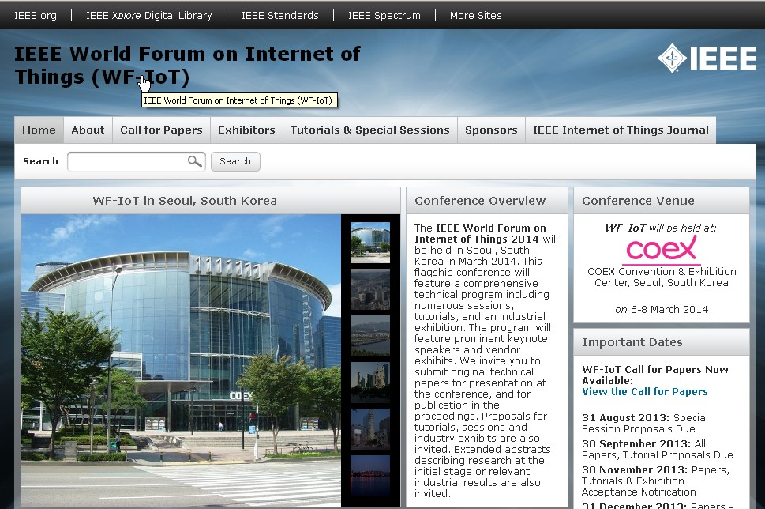
IEEE IoT World Forum
6-8 March 2014, Seoul
IEEE-wide event
One-day Standards Session on 7 March
http://sites.ieee.org/wf-iot/

Slide 7
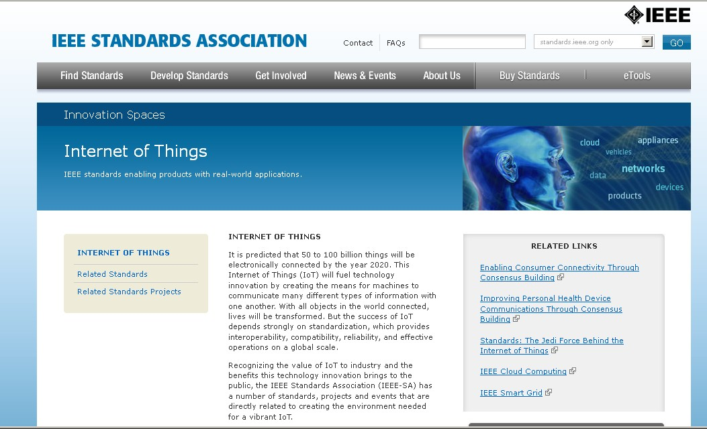
IEEE-SA Internet of Things:
Presence
Web area devoted to SA’s work in IoT
Highlights over 140 IEEE existing standards and projects that relate to the Internet of Things
Presents workshops and panel discussions
Includes information on related areas, such as e-health and augmented reality
http://standards.ieee.org/innovate/iot/

Slide 8
Questions/further information
Contact Mary Lynne Nielsen, Technology Initiatives Director, IEEE-SA
m.nielsen@ieee.org
Thank you!

