Slide 1
MOBILE PAYMENT INTEROPERABILITY IN NIGERIA: Plotting the Roadmap for Success
December 2014

Slide 2
The Company NIBSS Plc

Slide 3





















NIBSS Critical Stakeholder
NIBSS is owned by all the Banks in Nigeria and the Central bank of Nigeria.

Slide 4
NIBSS Mandate
Provides a shared service/infrastructure for the Nigeria financial system
A payments processing Company for payments schemes (local & international) in Nigeria, and act as a settlement Company for both inter-bank and inter-scheme payments
Initiates and develops an integrated nationwide network for the electronic or paperless funds transfer and settlement of transactions.
Provides framework for elevating the level of efficiency in funds transfer services generally
1
2
3
4
5
NIBSS commenced operation in June 1994.

Slide 5
NIBSS Value Proposition
NIBSS is the central utility for Nigeria Payments System
SHARED SERVICE INFRASTRUCTURE
OPERATOR OF THE NIGERIA AUTOMATED CLEARING SYSTEM (NACS)
NIBSS’S
VALUE PROPOSITION
OPERATOR OF THE NIGERIA CENTRAL SWITCH(NCS)
INTER-BANK PAYMENTS AND SETLEMENT SERVICES
E-PAYMENT AND ANCILLARY PRODUCTS & SERVICES
PAYMENTS TERMINAL SERVICES AGGREGATOR
NIBSS is a major driver of the Cash-Less Nigeria project and an enabler of e-payments. NIBSS has an established Training Institute.

Slide 6
The Nigeria Central Switch and Mobile Payment Interoperability

Slide 7
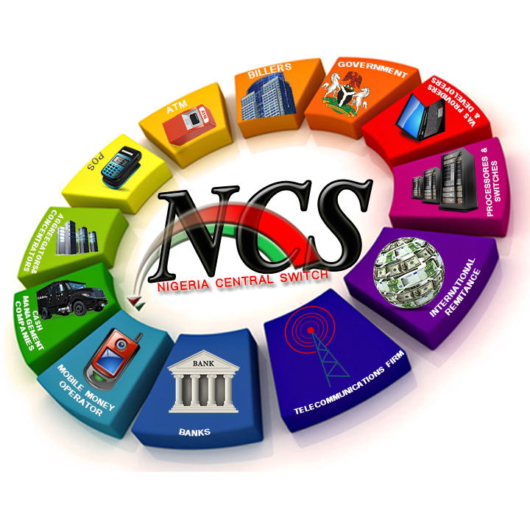
ARCHITECTURE OF THE NIGERIA CENTRAL SWITCH

Slide 8




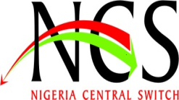
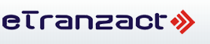
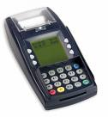


International Remittances
Banks
Mobile Money Service Providers
POS Terminals

Slide 9
Guideline on interoperability
INTEROPERABILITY - A situation in which payment instruments belonging to a given scheme may be used in systems installed by other schemes. - The BIS Red Book
The approved Regulatory Framework for Mobile Payment Services in Nigeria requires all Mobile Payment Schemes to be operable. All are required to connect to the NCS for this purpose.
NIBSS has responsibility to provide Interoperability among the licensed Mobile Payment Operators and is pursuing this with vigour

Slide 10
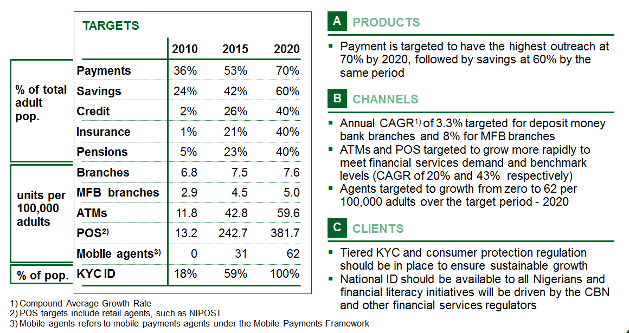
Overview of targets for achieving increased financial inclusion
Source: CBN National Financial Inclusion Strategy

Slide 11
MPO interoperability on NCS
18 of the 22 licensed MPOs are connected and operating live with the NCS
NIBSS operates a Mobile Payment Switch which facilitates real-time MPO to MPO, and MPO to DMB fund transfers.
NIBSS is working closely with licensed MPOs and their association, to grow mobile payment adoption in Nigeria

Slide 12
VALUE PROPOSITION
The connectivity of MPOs to the NCS provides the following benefits:
  MPO Interoperability
    Fund Transfer Instructions originating from the subscriber of one MPO for the benefit of a subscriber of another MPO
    Uniform Merchant codes, to promote purchase
  Cash-In / Cash-Load services
    Payment into mobile wallets from DMB customer accounts
  Cash-Out / Cash-Unload services
    Fund transfers from mobile wallets into DMB customer accounts
  Settlement Services
  Industry Payment Analytics
Integration of MPOs to the NCS has great potentials of growing mobile payment adoption

Slide 13
OTHER VALUE PROPOSITION
Mobile e-wallet / ATM integration for card-less cash withdrawal
Mobile e-wallet / POS integration for receipt printing
Cost-effective link of (multi-operator) Agents to Scheme Operators
Electronic Bulk Payments from DMBs into mobile wallets e.g. Salaries
Direct Debits for micro-credit operations
Shared Agency Network – NCS providing a Single platform or NCS making independent platforms interoperable
Facilitate Value-Added Services (e.g. Bill Payment) and other shared service opportunities among MPOs
Support for international remittances

Slide 14
THERE IS A STRONG COMMERCIAL CASE FOR INTEROPERABILITY
The Nigerian society is diverse
There is a large population
22 MMOs licensed
No single dominant MMO
Electronic payment adoption just picking up
Mobile Payment adoption is very low
MMO infrastructure is expensive, so is Agent recruitment
A setting such as this requires MMO Interoperability to grow mobile adoption, grow transaction volumes and revenue for investors in the industry.
Also MMOs need to explore and take advantage of other (non-compete) areas of collaboration to succeed – shared dispute resolution system, shared call center, collocation, etc.

Slide 15
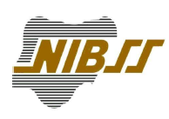

THANK YOU
Nigeria Inter-Bank Settlement System Plc
… Improving the Nigeria Payments System
1230b Ahmadu Bello Way Victoria Island,
Lagos, Nigeria
Tel: +234 1 2716071-4
www.nibss-plc.com
15
Notes:
15

