Slide 1
Interoperability as a Driver for Financial Inclusion

Slide 2
Growing an ECO system outside your comfort zone
Interoperability grows opportunity when understood
Mathematical Models help
Breaking down the competitive suspicion
Overcoming the barriers
A Proof point for the industry - Launched in Tanzania
Domestic Interoperability
International Interoperability
Smartphone OTT
Financial system Interoperability
Future Interoperability growth requires clearly identified regulatory focus
The role of telco regulators and financial service regulators needs to be clearly scoped

Slide 3

Metcalfe’s Law limited by Dunbar’s number
Metcalfe's law states that the value of a telecommunications network is proportional to the square of the number of connected users of the system
Case Study Metcalfe's theory is apparent in UK SMS volume growth which exploded when the transactions were allowed to cross networks
N*(N-1)/2 = V (value)
When n=2 players
2*(2-1)/2 => v=1
When n=5 players
5*(5-1)/2 =>v=20
When n=12 players
12*(12-1)/2 => v=66
Dunbar’s Number without scalable methods for collaboration and sharing, the potential of Metcalfe's law is limited in a closed ecosystem

Slide 4
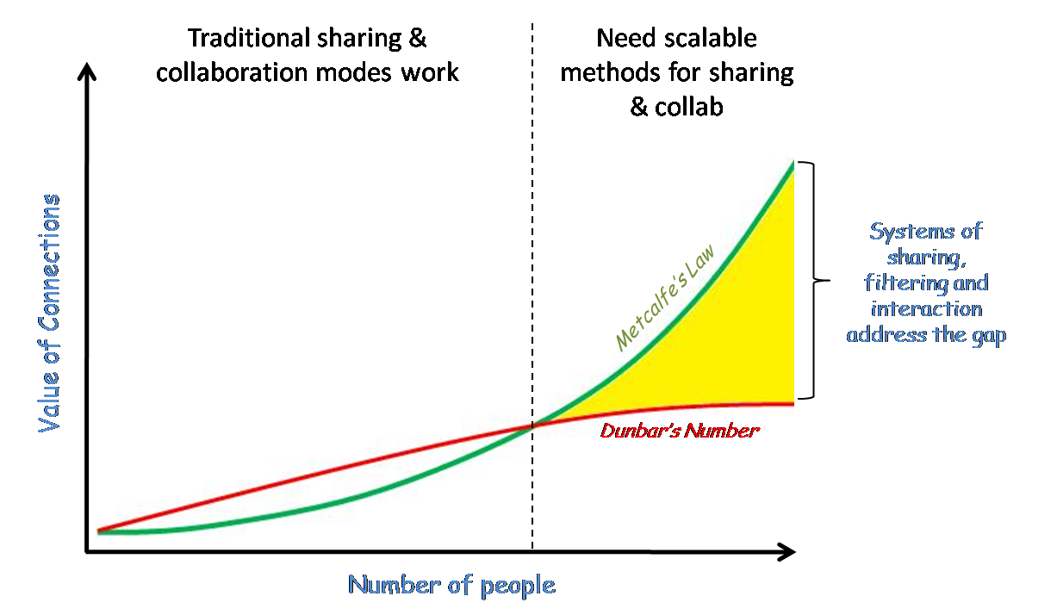
Value of the network
Notes:
National remittance, merchant

Slide 5
Interoperability – overcoming the barriers
Large investment required – Advantage of MFS is that it leverages unutilized capacity of existing network infrastructure, relative investment is low and can be executed with existing technology and functionality
Technology is complicated – We integrate with partners on a daily basis
Market leader looses competitive advantage – the MNO with the largest market share stands to gain the most. The gain for the market entrant is only greatest in relative terms
Market share gained / protected by not Interoperating - eventually MFS market share will approximate the mobile market share
Commercial will be complicated – the Super agent model already exists - Each operator simply becomes super agent of the other operators

Slide 6
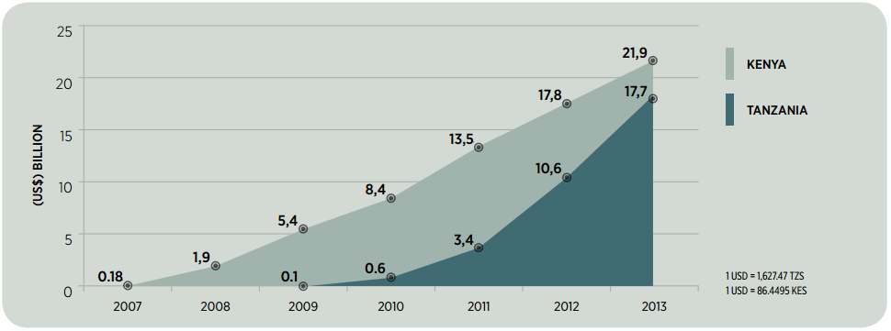
Mobile money in Tanzania – an overview

Slide 7
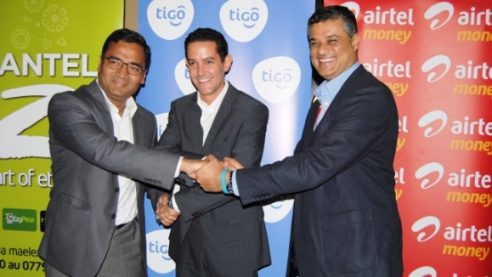
The timeline
  2008: Zantel launches EzyPesa (then Zpesa)
  2008: M-PESA is launched by Vodacom
  2010: Tigo Launches Tigo Pesa
  2011 Airtel re-launch as Airtel Money (previously Zap)
  In June 2014, Tigo, Zantel and Airtel made an announcement that agreements had been made between the three operators.
2012
2013
2014
  In November 2013 the first bilateral agreement between Airtel and Tigo was signed, that allowed them to test and start working on a pilot launch
  In August 2014, Tigo and Airtel launches W2W interoperability using ATL campaigns (Radio was the first mass media used)
  Tigo starts conversation about interoperability 2011/2012 with all operators in the market.
  2013 IFC, funded by the Bill and Melinda Gates Foundation starts working on rules around interoperability.
  In 2013 the Bank of Tanzania encouraged interoperability efforts by the operators.

Slide 8
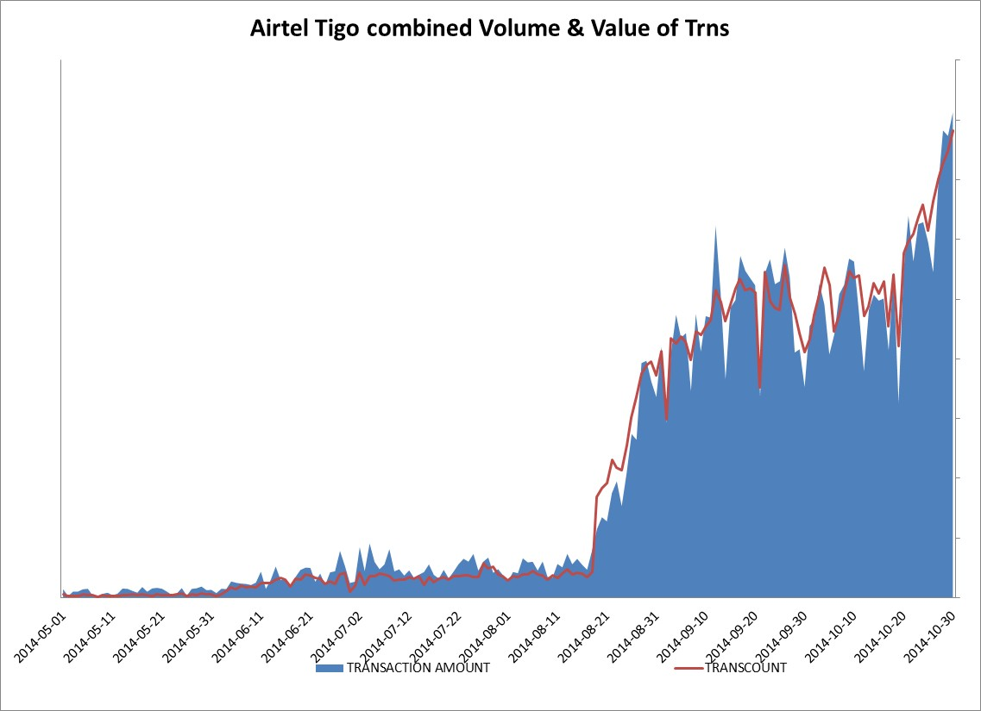
Initial results
Unilateral Tigo to Airtel Trns
  Moderate Success and transaction Usage
  Low visibility and awareness, organic growth slow
Bilateral Airtel Tigo Transactions
  Exponential Increase post launch
  Widespread acceptance and awareness
  High visibility due to press release
  Exponentially faster adoption that of Voucher transaction
Current Learnings
  Start slowly
  Find the technical and administrative bottlenecks and eliminate these before volumes grow
  Pilot phase prior to commercial launch very necessary
  Any marketing exponentially increases awareness & uptake
  One parties marketing assist volume in both directions

Slide 9
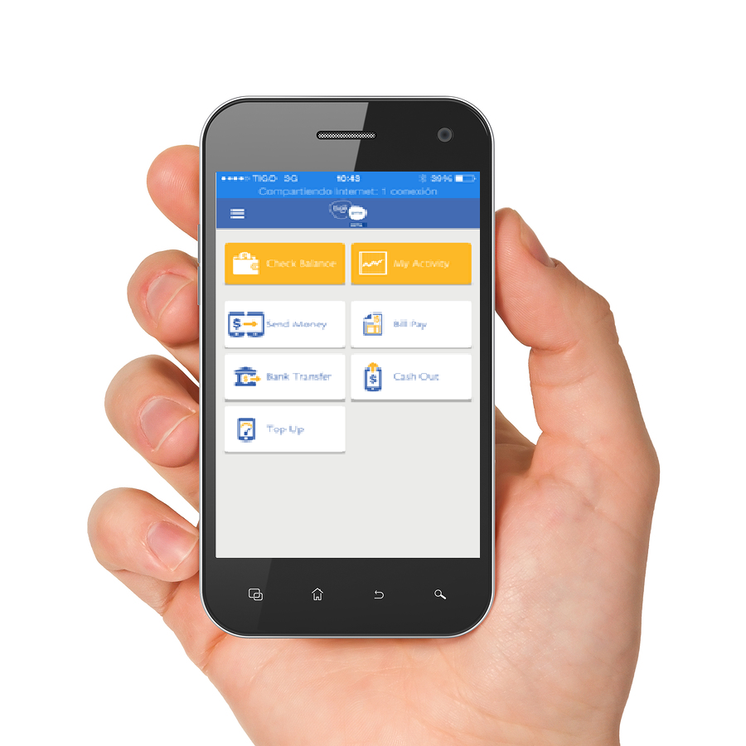
OTT Smartphone Access
Comes with Airtel and Zantel wallet to Wallet interoperability
Works on any network in Tanzania and El Salvador – customers of any network can have a Tigo Pesa account.
Interoperates with 17 banks in TZ – 80% of the market
Caters for Tigo-to-Tigo cross border remittance to Rwanda

Slide 10
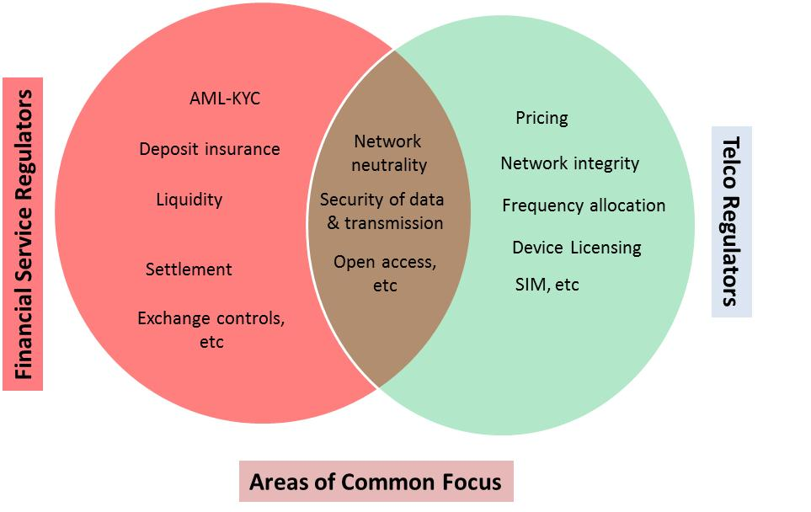
Regulatory scope and focus
Clear scope of regulatory focus will help both the regulators and the industry

Slide 11
Thank you

