Slide 1
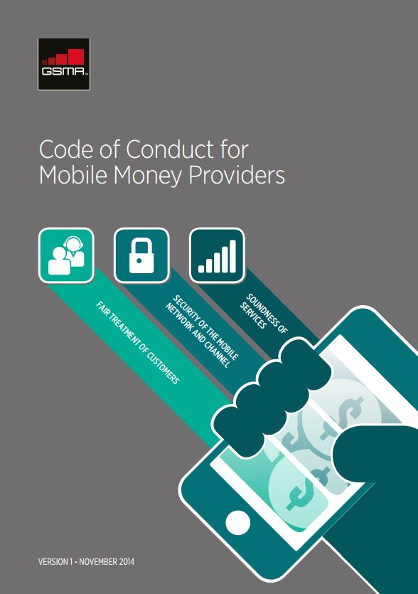






Code of Conduct for Mobile Money Providers
6 November 2014
All material © GSMA 2014. The policy advocacy and regulatory work of the GSMA Mobile Money team is supported by:

Slide 2
The GSMA Code of Conduct for Mobile Money Providers: the 8 Principles
Mobile money providers (“providers”) safeguard customer funds against risk of loss
Providers have in place effective, proportional risk-based mechanisms to prevent, detect, and report the misuse of services for the purpose of money laundering or terrorist financing (ML/TF)
Providers screen, train, and monitor staff, agents and entities providing outsourced services to ensure that they offer safe and reliable services and comply with all relevant operational and legal requirements
Providers have well-developed policies and processes and sufficient network and system capacity to ensure reliable service provision
Providers take robust steps to ensure the security of the mobile network and channel
Providers communicate clear, sufficient, and timely information in a manner that customers can understand so that customers can make informed decisions
Providers have in place mechanisms to ensure that complaints are effectively addressed and problems are resolved in a timely manner
Providers collect, process, and/or transmit personal data fairly and securely

Slide 3
Principle 1
Mobile money providers (“providers”) safeguard customer funds against risk of loss
Protection against loss due to failure of bank, provider, or other party
  Providers shall ensure that funds equal to the total value of outstanding mobile money liabilities are held in one or more custodial accounts on behalf of the mobile money users (“users”).
  Providers shall ensure that user funds are ring-fenced to prevent attachment from the creditors of the provider in the event of a provider’s insolvency.
  Providers shall take measures to mitigate risk of loss of funds due to bank insolvency.
  Providers shall take measures to mitigate risk of loss of funds due to bond issuer’s insolvency (if applicable).
Protection against settlement risk
  Where feasible, providers shall only authorize customer transactions in which the debiting and crediting of mobile money accounts is processed in real time.

Slide 4
Principle 2
Providers have in place effective, proportional risk-based mechanisms to prevent, detect, and report the misuse of services for the purpose of money laundering or terrorist financing
Effective policies and procedures
  Providers shall develop effective policies and procedures for Anti-Money Laundering and Combating the Financing of Terrorism (AML/CFT) compliance.
Senior management commitment
  Senior management shall demonstrate their commitment to AML/CFT compliance through proper oversight.
Appointed AML/CFT manager
  Providers shall appoint a qualified employee to promote and monitor compliance with AML/CFT-related obligations.
Software to monitor transactions
  Providers shall create a system to monitor transactions for AML/CFT purposes.

Slide 5
Principle 2 continued
Risk-based KYC requirements and transaction / balance limits
  Providers shall properly identify clients and may use a risk-based KYC approach if permitted by local laws and regulations.
  Providers shall place appropriate risk-based transaction and balance limits on accounts, depending upon the strength of customer identification and verification.
  Providers shall have the ability to block account transactions under certain circumstances.
  Providers shall screen accounts using domestic and international money laundering, terrorist financing, and sanctions watch lists.
Staff and agent AML/CFT training procedures
  Providers shall ensure that staff and agents are properly trained in AML/CFT procedures.
  Providers shall monitor staff and agent compliance with AML/CFT procedures.
  Providers shall develop clear policies and processes for addressing staff and agent AML/CFT violations.

Slide 6
Principle 3
Providers screen, train, and monitor staff, agents and entities providing outsourced services to ensure that they offer safe and reliable services and comply with all relevant operational and legal requirements
Due diligence policies and procedures
  Providers shall conduct proper due diligence on potential staff, agents and entities providing outsourced services.
Training
  Providers shall develop staff and agent training programs.
Contractual agreements
  Providers shall establish written agreements governing their relationship with agents and entities providing outsourced services.
Proper oversight of staff
  Providers shall develop policies and processes for ongoing staff management.
  Providers shall develop staff discipline processes.

Slide 7
Principle 3 continued
Proper oversight of agents and entities providing outsourced services
  Providers shall develop a comprehensive outsourcing risk management program.
  Providers shall take steps to ensure that outsourcing arrangements do not affect their ability to meet obligations to customers and regulators.
  Providers shall ensure that appropriate contingency and disaster recovery plans are in place.
  Providers shall ensure that confidential customer and provider data are properly secured.
Providers’ responsibility for actions of agents (and any sub-agents)
  Providers shall assume responsibility to regulators and customers for actions taken on their behalf by their agents (and any sub-agents) under the provider-agent contract.

Slide 8
Principle 4
Providers have well-developed policies and processes and sufficient network and system capacity to ensure reliable service provision
Board and senior management oversight
  Providers shall ensure that the Board of Directors and senior management establish effective management oversight.
Network and system capacity testing
  Providers shall conduct tests to ensure sufficient network and system capacity.
Robust back-end settlements
  Providers shall develop reliable processes for clearing and settlement.
Business continuity and contingency plans
  Providers shall develop effective business continuity and contingency plans.

Slide 9
Principle 5
Providers take robust steps to ensure the security of the mobile network and channel
Governance
  Providers shall develop, implement, and regularly review a formal security policy for mobile money services.
  Providers shall identify and assess security risks prior to offering mobile money services and shall continue to monitor such risks on an ongoing basis.
  Providers shall develop a process to identify, address, and monitor security incidents and security-related complaints.
Building a secure network, systems, and applications
  Providers shall use firewalls to protect customer data.
  Providers shall develop processes to ensure that systems and applications remain secure.
  Providers shall limit access to customer data on a “need to know” basis.

Slide 10
Principle 5 continued
  Providers shall limit logical and physical access to customer data.
  Providers shall properly identify and authenticate system users.
  Providers shall develop risk-based fraud detection/prevention systems to identify suspicious transactions.
Ongoing monitoring
  Providers shall ensure that stored customer data are protected.
  Providers shall ensure that systems are protected against malicious software.
  Providers shall develop processes to ensure that all transactions are logged with appropriate audit trails.
  Providers shall develop reliable methods to log and track user activities within the mobile money system.
  Providers shall regularly test security systems and processes.

Slide 11
Principle 6
Providers communicate clear, sufficient, and timely information in a manner that customers can understand so that customers can make informed decisions
Effective disclosure and transparency
  Providers shall ensure that users are provided with clear, prominent, and timely information regarding fees and terms and conditions.
Safety and security
  Providers shall educate customers on how to use mobile money services safely.

Slide 12
Principle 7
Providers have in place mechanisms to ensure that complaints are effectively addressed and problems are resolved in a timely manner
Policies and procedures to ensure efficient resolution of customer complaints
  Providers shall develop customer complaint policies and procedures.
  Providers shall inform customers of the existence of customer complaint policies and procedures.
  Providers shall develop specific policies for handling reversals.
Availability of customer service support
  Providers shall provide an appropriate mechanism for customers to address questions and problems.
External recourse mechanisms
  Providers shall specify how disputes can be resolved if internal resolution fails.

Slide 13
Principle 8
Providers collect, process, and/or transmit personal data fairly and securely
Governance
    Providers shall comply with good practices and relevant regulations governing customer data privacy.
Transparency and Notice
  Providers shall ensure that users are provided with clear, prominent, and timely information regarding their data privacy practices.
User Choice and Control
  Providers shall ensure that customers are informed of their rights and have opportunities to exercise meaningful choice and control over their personal information.
  Providers shall seek customer consent for any changes that materially affect the privacy of their personal information.
Minimization of Data Collection and Retention
  Providers shall limit the personal information that is collected from customers and is retained, used, or shared.

Slide 14
Frequently Asked Questions
Available online:
http://www.gsma.com/mobilefordevelopment/programmes/mobile-money-for-the-unbanked/code-of-conduct
Why have the GSMA and its members developed the Code of Conduct for Mobile Money Providers?
What topics does the Code of Conduct address?
How will the Code of Conduct impact customers?
How will the Code of Conduct contribute to financial inclusion goals?
Is endorsement of the Code of Conduct mandatory for GSMA members?
How is compliance with the Code of Conduct assessed?

Slide 15
Next Steps
Secure commitment from more providers
Develop Recommended Business Practices
Develop Self-Assessment Process and Certification Regime
Creation of external review panel
For further information:
  gsma.com/mmu
  http://www.gsma.com/mobilefordevelopment/programmes/mobile-money-for-the-unbanked/code-of-conduct
  mmu@gsma.com
  GSMA London Office - T +44 (0) 20 7356 0600

