Slide 1
AFI Network & Digital Financial Service Policies & Regulations
ITU Workshop on “Digital Financial Services and Financial Inclusion”
(Geneva, Switzerland, 4 December 2014)
John V Owens,
Senior Policy Advisor Digital Financial Services,
Alliance for Financial Inclusion (AFI), john.owens@afi-global.org

Slide 2
Overview of AFI
AFI is a global network of policymakers in developing and emerging countries
Founded in 2008, AFI’s goal is to support developing countries to develop and implement successful financial inclusion policies
The goal of the AFI network is to accelerate the adoption of innovative financial inclusion policy solutions, with the ultimate aim of making financial services more accessible to the billions of people who do not have access to the formal financial system.

Slide 3
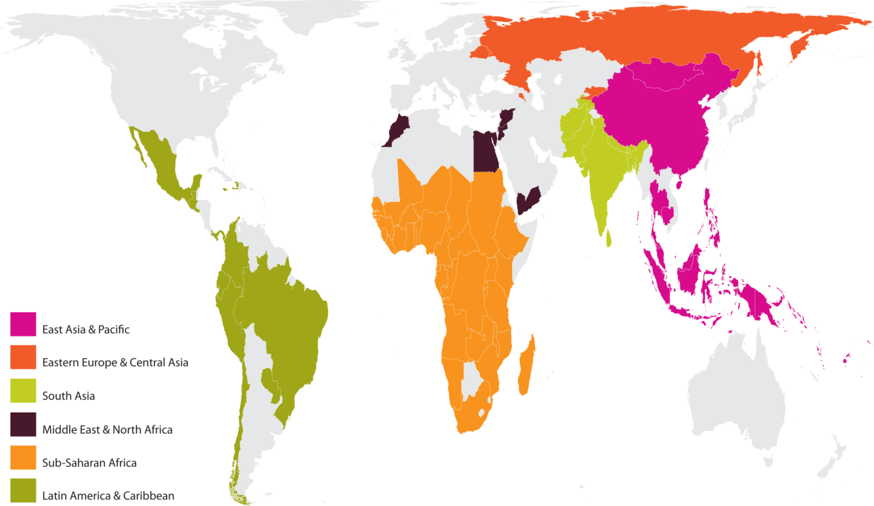
The AFI Timeline
Concept design
Building the Network
Activating the Network
Policy-Driving Network
Enhancing Network value
121 Institutions, 95 countries
Unique Peer Learning network (working groups)
G20 Implementing partner
Maya Declaration
71 tangible policy reforms

Slide 4
AFI Policy Areas
Consumer Empowerment
& Market Conduct
Financial Inclusion Data
Digital Financial Services
SME Finance
Global Standards & Proportionality
Financial Inclusion Strategy
Notes:
Member lead groups of policy experts from around the world
‘Communities of practice’ on key issues
Facilitating ongoing discussions and knowledge-sharing

Slide 5
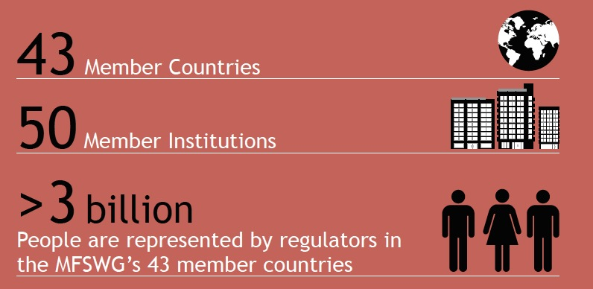
Digital financial services (DFSWG)
The DFSWG promotes the broad use of mobile and other digital financial services as key solutions for greater financial inclusion in developing countries. It encourages discussion and knowledge exchange to identify the risks associated with DFS business models and
determines appropriate
solutions to formulating
suitable regulatory and
supervisory practices.

Slide 6
DFS Main Policy and Regulatory Issues
Technological innovation to reduce cost of delivery and increase access on a large scale
Proportionate financial sector policy and regulation is critical enabling factor
Increased importance of data to make informed policy decisions
Quality aspects (consumer protection) of financial Inclusion
Coordinated national strategies for expansion of digital financial ecosystems leading to more inclusive environments

Slide 7
DFS- Main Policy Issues
Proportionate AML/CFT
– Tiered KYC Regulations
E-Money Regulations
Remote Account Opening Rules
Agent Regulations
Interoperability
Cross Border Remittances
Consumer Protection & Privacy
AFI | Alliance for Financial Inclusion

Slide 8
DFS Guideline Notes
Mobile Financial Services: Basic Terminology
Mobile Financial Services: Technology Risks
Mobile Financial Services: Regulatory Reporting
Mobile Financial Services: Indicators for Measuring Access and Usage
Mobile Financial Services: Supervision and Oversight

Slide 9
DFS Guideline Notes
Mobile Financial Services: Consumer Protection
Mobile-Enabled Cross-Border Payments (Remittances)
Accessing Levels of Interoperability (interconnectivity
Planned 2015
Updated Digital Financial Services Terminology (Inventory)
Development of National Retail Payment Systems

Slide 10
DFS Experiences in Tanzania
Create an enabling legal and regulatory environment
Support market development and encourage innovation
Proportionate regulation
Partnerships and cooperation
Partner with Telco Regulator
Encourage market cooperation (non-banks and banks)
Government Uptake of Usage of DFS
Revenue payments (Licenses and small taxes)
Adoption of DFS in National Financial Inclusion Strategies
Public and private sector adoption for national financial inclusion goals
Interoperability
Consider private sector initiatives enhancing or developing interoperability
AFI | Alliance for Financial Inclusion

Slide 11
DFS Experiences in Tanzania
2009
AFI | Alliance for Financial Inclusion

Slide 12
Thank you
John.owens@afi-global.org

