Slide 1
FINANCIAL SERVICES FOR THE POOR
ITU
David Lubinski, Senior Program Officer
Financial Services for the Poor

Slide 2
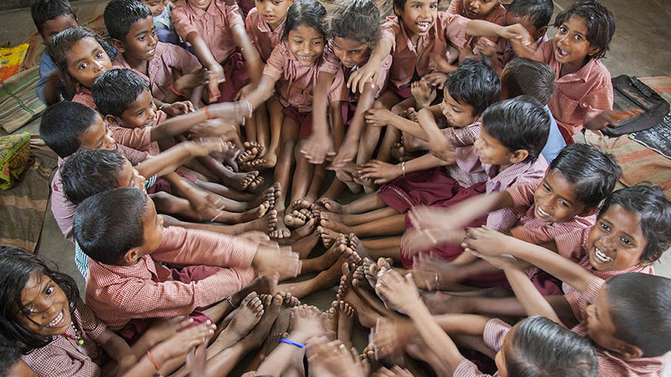


Slide 3
OUR GLOBAL Reach and Presence
1,200
2012 active grantees
Europe and
Middle East Office
Seattle
$3.4B
2012 grant payments
Washington, D.C.
China
India
Nigeria
Ethiopia
1,100
2012 employees worldwide
South Africa
Notes:
Headquarters : Seattle
Offices: Europe and Middle East Office (London) and Washington, D.C.
Country Offices: China and India
Country Representatives: Ethiopia, Nigeria, and South Africa
Total 2012 Grant Payments: $3.4 billion USD (figure includes other direct charitable contributions of $234 million USD)
Asset Trust Endowment: $36.4 billion USD (as of December 31, 2012)
Remaining Warren Buffet Pledge: $31.3 billion USD

Slide 4
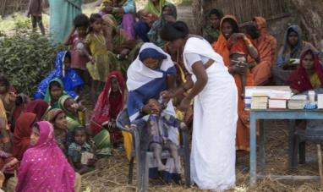
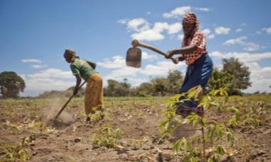

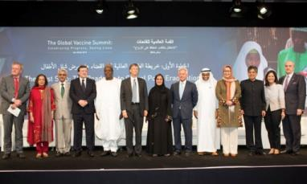
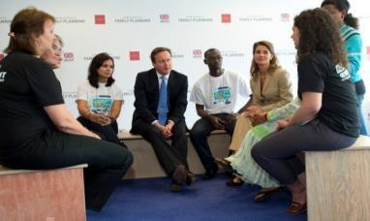
What we do
GLOBAL HEALTH
GLOBAL DEVELOPMENT
UNITED STATES PROGRAM
GLOBAL POLICY & ADVOCACY
COMMUNICATIONS

Slide 5
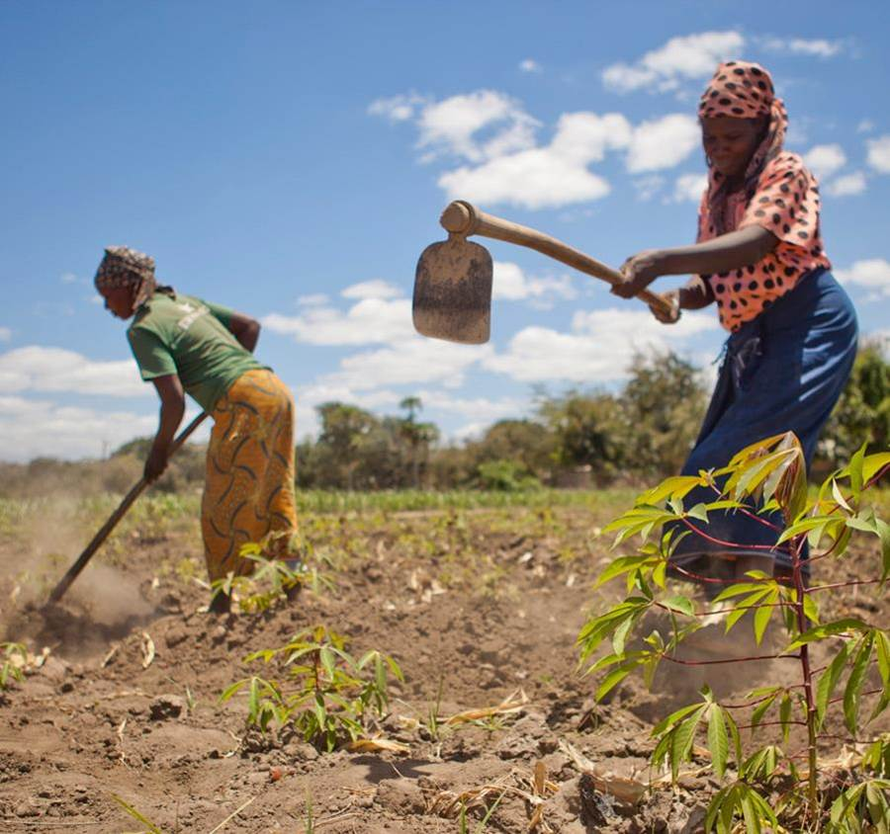
GLOBAL DEVELOPMENT
  Delivering health and development solutions that help people lift themselves out of poverty.
    Programs:
      Agricultural Development
      Emergency Response
      Family Planning
      Financial Services for the Poor
      Global Libraries
      Maternal, Neonatal & Child Health
      Nutrition
      Polio
      Water, Sanitation & Hygiene
Notes:
Photo shows farmers tending to their cassava crops in Tanzania.
Nearly 2.5 billion people worldwide live on less than $2 a day, and more than 1 billion suffer from chronic hunger. For these people, the basics of food, water, shelter, and sanitation are in short supply, and healthcare and education can be unaffordable luxuries. Our Global Development Division aims to identify and fund high-impact solutions that can help hundreds of millions of people lift themselves out of poverty and build better lives. We work closely with our partners to support innovative approaches and expand existing ones so they reach the people who are most in need.
Agricultural Development: We work to reduce hunger and poverty for millions of farming families in Sub-Saharan Africa and South Asia by helping them increase agricultural productivity in a sustainable way.
Emergency Response: We work to reduce suffering and save lives in regions affected by natural disasters and complex emergencies.
Family Planning: Voluntary family planning is one of the great public health advances of the past century. We are working to ensure that women and girls in developing countries have access to quality family planning information, services, and supplies.
Financial Services for the Poor: We are working to capitalize on rapid advances in mobile communications to connect poor households to affordable and reliable financial tools, which can help accelerate the rate at which they move out of poverty.
Global Libraries: We work to ensure that everyone has access to information through technology in public libraries, as well as the skills to navigate the Internet.
Maternal, Neonatal & Child Health: We work to ensure the delivery of interventions that prevent the deaths of women during pregnancy and childbirth and of babies during the first months of life.
Nutrition: We work to address poor nutrition among pregnant women and young children, which underlies many chronic and life-threatening health conditions.
Polio: In the past quarter-century, immunization efforts have reduced the global incidence of polio by more than 99 percent. Our goal is to eradicate polio worldwide.
Water, Sanitation & Hygiene: We aim to make better sanitation services universally available by supporting the development of new toilet technologies and encouraging new markets for sanitation products and services.

Slide 6
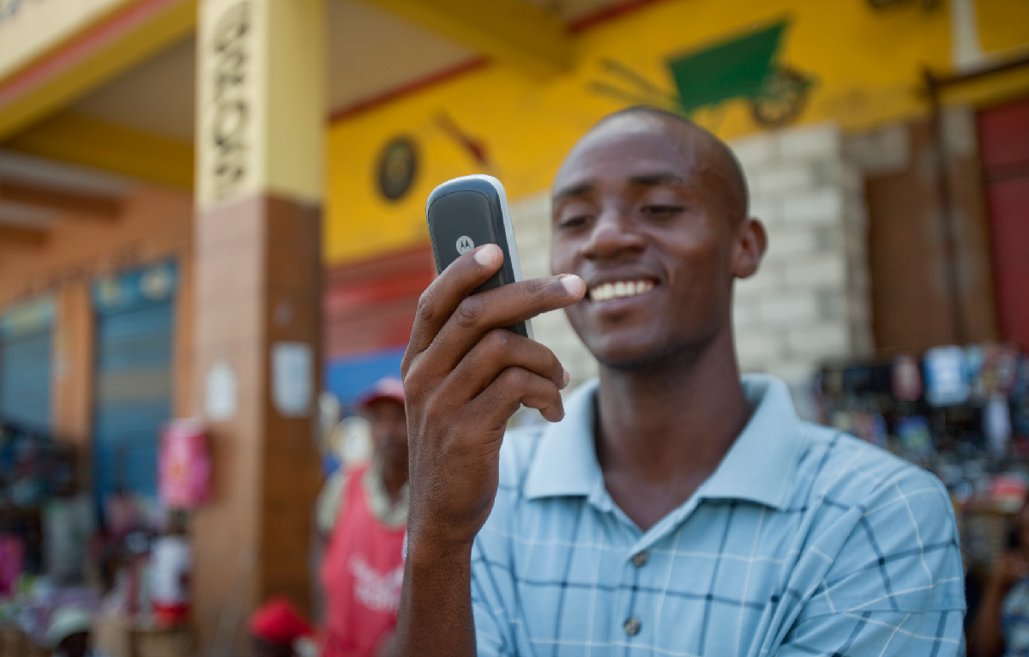
Financial Services for the poor
Our approach has three mutually reinforcing objectives:
Reducing the amount of time and money that poor people must spend to conduct financial transactions
Increasing poor people’s capacity to weather financial shocks and capture income-generating opportunities
Generating economy-wide efficiencies by digitally connecting large numbers of poor people to one another, to other consumers, to financial services providers, to government services, and to businesses.
Notes:
The Bill & Melinda Gates Foundation’s Financial Services for the Poor program aims to play a catalytic role in broadening the reach of digital payment systems, particularly in poor and rural areas, and expanding the range of services available on these systems. Until the infrastructure and customer base are well established, this might involve a combination of mobile money services that are accessible via cell phones and brick-and-mortar stores, where subscribers can convert cash they earn into digital money (and vice-versa).
Our approach has three mutually reinforcing objectives:
Reducing the amount of time and money that poor people must spend to conduct financial transactions
Increasing poor people’s capacity to weather financial shocks and capture income-generating opportunities
Generating economy-wide efficiencies by digitally connecting large numbers of poor people to one another, to other consumers, to financial services providers, to government services, and to businesses.
We believe that the combined effect of these interventions will accelerate the rate at which poor people transition out of poverty and decrease the rate at which they fall back into poverty. Our strategy also recognizes that countries are at different stages in developing an inclusive digital financial system, and that we must tailor our interventions accordingly.

Slide 7

THEORY OF CHANGE – FINANCIAL SERVICES FOR THE POOR
Outputs
Outcomes
Impact
Intervention areas
Expand the Digital Financial Infrastructure
Expand the digital financial infrastructure so that poor people can access digital money and use it to transact with their peers, businesses, and government
Accounts which can connect digitally to other accounts
Population within 5km of access point
Reduced transaction costs
Fewer people
fall into
poverty
Poor people manage their money digitally
By 2035, 80% of adults worldwide and 60% of <$2/day adults actively use a digital account to access at least one financial service beyond payments (credit, savings, insurance)
Drive Participation in the Digital Financial System
Create value that results in poor people joining the system because financial service providers design products to meet the needs of the poor and can offer them profitably
<$2/day adults use a digital account
Digital bulk payments
Number/type of financial products available digitally
Foster Regulations and Policy
Adapt regulations to enable poor people to open accounts, to allow providers to outsource distribution, and to protect users
Reforms adopted on e-money account issuing, KYC requirements, and distribution
More people
move out of
poverty faster
More people move out of poverty faster
Notes:
Poor people do not live in a static state of poverty. Every year, many millions of people transition out of poverty by successfully adopting new farming technologies, investing in new business opportunities, or finding new jobs. At the same time, large numbers of people fall back into poverty due to health problems, financial setbacks, and other shocks. However, it is costly to serve poor people with financial services, in part because most of their transactions are conducted in cash.

Slide 8
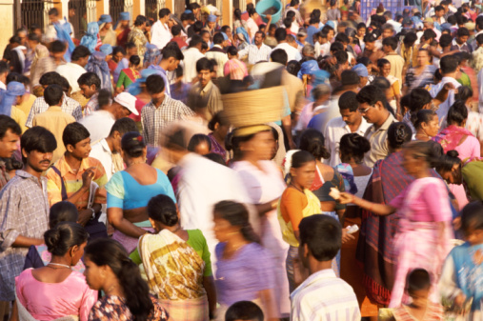
FSP STRATEGIC INITIATIVES
Four levers to accelerate and deepen penetration of digital financial services for the poor
1
2
3
4
Digital Payment Systems at Scale
Digital Financial Services at Scale
Global Partnerships
Technology and Innovation
Accelerate the propagation of digital payment systems into poor and rural communities in five countries with large numbers of poor people and adequate connectivity (i.e., Bangladesh, India, Indonesia, Nigeria, and Pakistan)
Accelerate and deepen the penetration of digital financial services beyond payments in three transition counties (i.e., Kenya, Tanzania, and Uganda)
Shape and accelerate efforts of governments, donors, global standard-setting bodies, and the private sector to maximize their collective impact on the poor’s access to digital financial services
Nurture innovations that could, in the medium- to long-term, create a step-change improvement in delivering digital financial services at scale
~35% of
resources
~35% of
resources
~15% of
resources
~15% of
resources

Slide 9
The Inclusive Digital Economy includes everyone
1
2
3
4
5

Slide 10

THANK YOU

