Slide 1


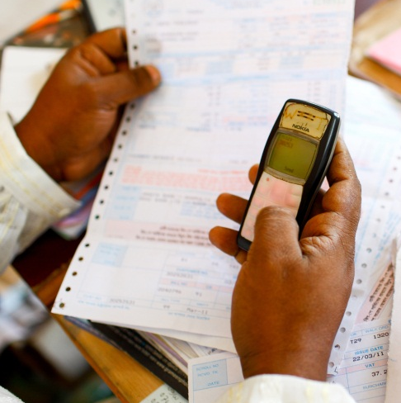


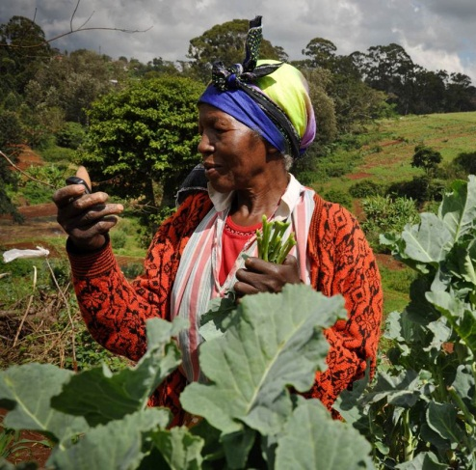
ITU workshop on “Digital Financial Services and Financial Inclusion
GSMA Mobile Money for digital financial inclusion and economic development
Simone di Castri
Geneva, 4 December 2014
All material © GSMA 2014. The policy advocacy and regulatory work of the GSMA Mobile Money team is supported by:

Slide 2

The GSMA unites nearly 800 of the world’s mobile operators from 219 countries, as well as more than 200 companies in the broader mobile ecosystem.
The Mobile Money programme equips GSMA members to sustainably participate in the development of a sound and inclusive digital ecosystem scaling mobile money services and implementing partnerships with other providers.

Slide 3












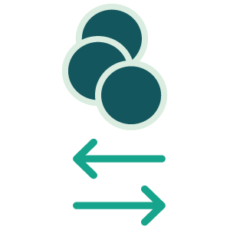












Achieve financial inclusion, enable innovation and build the digital economy leveraging mobile money
ECOSYSTEM
Mobile money providers implement wallet to wallet interoperability and offer other financial services
Other entities use mobile money platform to provide financial and non-financial (M4D) services
Merchants, governments and business are financially connected through mobile money platforms
MOBILE MONEY
Both banks and non banks are allowed to provide mobile money services sustainably and a functional and proportional regulatory framework
1.7b
HAVE A MOBILE
1.7b+

Slide 4
What we do
PUBLIC POLICY OBJECTIVE
Help providers and regulators to create and maintain policy environments that allow mobile the sustainable development of an inclusive digital ecosystem, providing a foundation for socio-economic development through mobile-based services
PUBLIC POLICY ACTIVITIES
Gather and analyse market data and commercial practices
Build evidence-based body of knowledge on enabling policy solutions
Create awareness among stakeholders (operators, policymakers, regulators, partners)
Build effective dialogue and collaboration between stakeholders
Advocate for reforms that support customer activation, the sustainable provision of mobile financial services and a scalable ecosystem
INDUSTRY CAPACITY BUILDING
Equip the industry to improve compliance and risk mitigation/management (Code of Conduct)

Slide 5
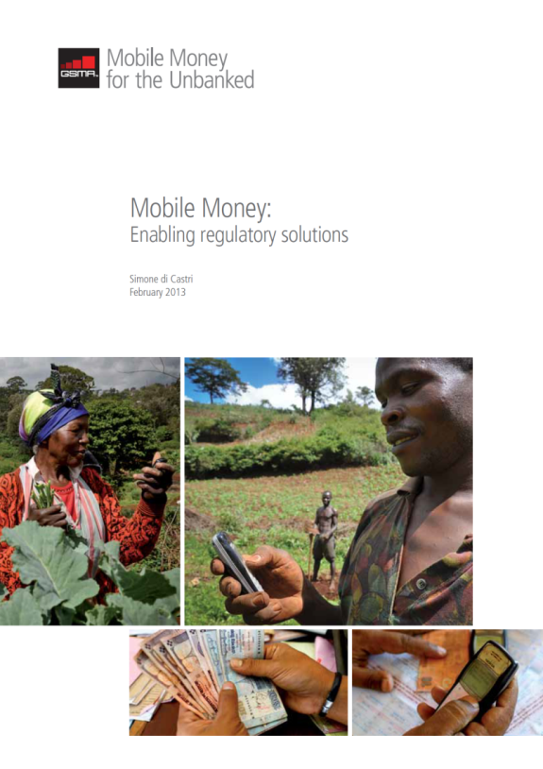
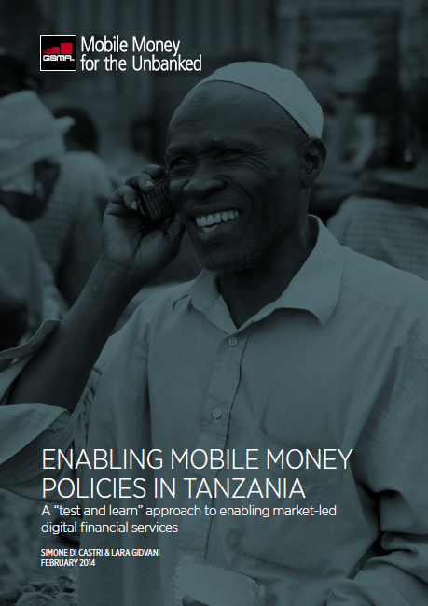
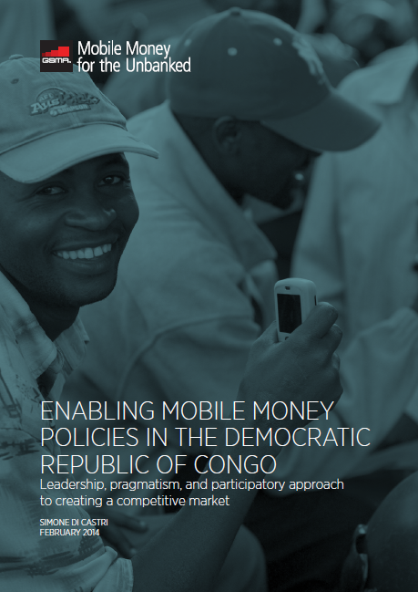
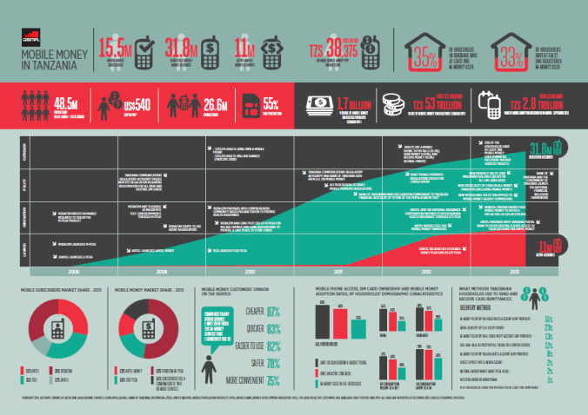
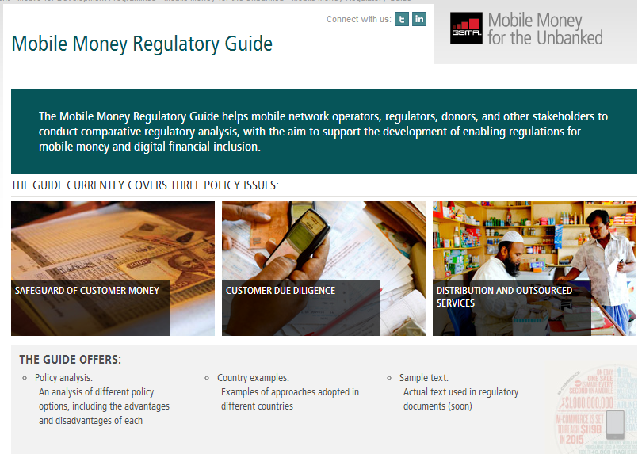
Activities and outputs
GLOBAL
Engagement with standard setters: BIS, FATF, ITU, ISO
Engagement with development partners: (WB, IFC, UNCDF, CGAP, AFI, etc.)
Events: Leadership Forum
Position papers & case studies
COUNTRY LEVEL ENGAGEMENTS
Work with regulators (BCEAO, Colombia, Liberia, etc.)
Position papers (India, Rwanda)
COMMUNICATION
Online tools: Mobile Money Regulatory Guide, etc.
CAPACITY BUILDING
Trainings and toolkits for operators and regulators

Slide 6
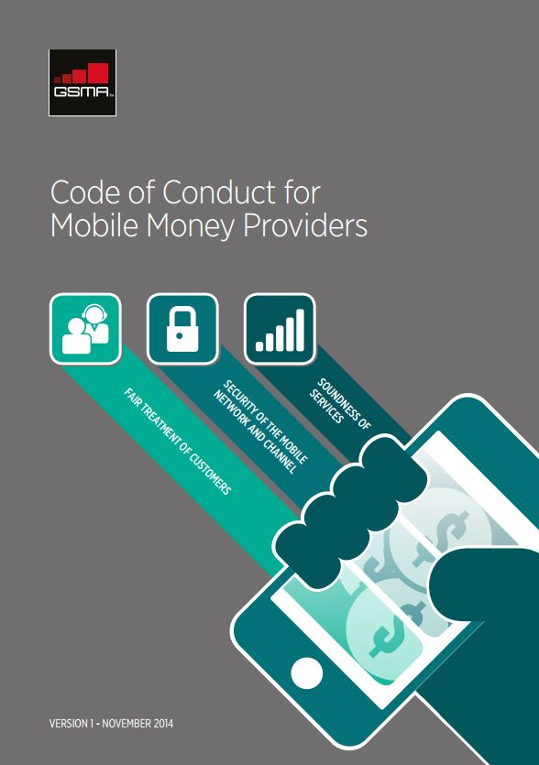
The GSMA Code of Conduct for Mobile Money Providers
Mobile money providers (“providers”) safeguard customer funds against risk of loss
Providers have in place effective, proportional risk-based mechanisms to prevent, detect, and report the misuse of services for the purpose of money laundering or terrorist financing (ML/TF)
Providers screen, train, and monitor staff, agents and entities providing outsourced services to ensure that they offer safe and reliable services and comply with all relevant operational and legal requirements
Providers have well-developed policies and processes and sufficient network and system capacity to ensure reliable service provision
Providers take robust steps to ensure the security of the mobile network and channel
Providers communicate clear, sufficient, and timely information in a manner that customers can understand so that customers can make informed decisions
Providers have in place mechanisms to ensure that complaints are effectively addressed and problems are resolved in a timely manner
Providers collect, process, and/or transmit personal data fairly and securely

Slide 7
Mobile money market analysis
MNO-operated services and MNO subsidiaries
Bank-operated services
Third parties provider
Slow growing services

Slide 8
Regulatory frameworks and financial access
Enabling regulation: open and level playing field
Non-banks, including MNOs, can provide the service
Cash-in and cash-out at agents is allowed
Non enabling regulation
Only banks, MFIs, or third parties allowed (no MNOs)
If MNOs allowed, CICO network not allowed
668,000,000
adults in 29 countries
2.6
billion adults
Mobile money agents
40%
62%
ACTIVE
458,724
AGENTS
1,940,000,000
adults in 27 countries
19%
42%
ACTIVE
427,688
AGENTS
Considering the countries with live mobile money deployments at July 2013, the enabling regulations prove to have a great impact on the provider’s willingness and capacity to build a functional distribution network to increase financial access
Notes:
CUSTOMERS
REGULATION NOT ENABLING
ENABLING REGULATION
Registered accounts
93.9m
109.1m
Active accounts
17.6m
43.1m
Adult population
1,944m
668m
AGENTS
REGULATION NOT ENABLING
REGULATION ENABLING
Registered agents
427,688
458,724
Active agents
180,132
284,339
% of Active Agents
42%
62%

Slide 9
Regulatory frameworks and financial inclusion/integrity
The importance of getting customers active at registration
668,000,000
adults in 29 countries
1,940,000,000
adults in 27 countries
Considering the fast growing providers at July 2013, the enabling KYC requirements prove to have great impact on customer activation and on the provider’s capacity to build a sustainable business
Notes:
CUSTOMERS
REGULATION NOT ENABLING
ENABLING REGULATION
Registered accounts
93.9m
109.1m
Active accounts
17.6m
43.1m
Adult population
1,944m
668m
AGENTS
REGULATION NOT ENABLING
REGULATION ENABLING
Registered agents
427,688
458,724
Active agents
180,132
284,339
% of Active Agents
42%
62%

Slide 10
Key regulatory principles
Mobile money can effectively contribute to financial inclusion, stability, integrity, and consumer protection
It helps to reduce the vulnerability of the financial system and mitigate risks due to the widespread use of cash and informal financial services
OPEN AND LEVEL PLAYING FIELD
STORE OF VALUE AND
SAFEGUARD OF CUSTOMER MONEY
CUSTOMER DUE DILIGENCE
Regulations shall allow for a diversity of payment methods and broadness of scope for funds transfer and storage. To unleash the potential of mobile money, regulators must create an open and level playing field that allows both banks and non-bank providers to offer mobile money services – particularly MNOs, which are well suited to building sustainable services and extending the reach of the formal financial sector rapidly and soundly.
There exist a category of accounts, other than traditional deposit accounts, in which repayable funds can be held on behalf of the client for general purposes for a period beyond a short time frame. To safeguard funds entering the system, providers shall keep them in pooled ring-fenced accounts held in banks. This would mitigate the liquidity risks posed by licensed non-bank mobile money providers and allow them meet customer demand to cash out electronic value.
Mobile money reduces the risk of money laundering and terrorist financing since electronic transactions can be monitored and traced more easily than cash. Proportional AML/CFT regimes and simplified risk-based customer due diligence (CDD) requirements are crucial for customer adoption of mobile money. Regulations shall allow agents to register customers and remote account opening levering SIM registration records. Following customer identification accounts shall be activated without delay.
DISTRIBUTION AND OUTSOURCING
CONSUMER PROTECTION
INTEROPERABILITY
Regulations shall allow banks and non-banks to outsource customer registration, cash collection, and disbursement activities to third parties to lower the cost of financial services, expand their reach, and thereby increase financial inclusion. Building an efficient mobile money distribution network depends on proportional and cost-effective regulation.
Mobile money strikes a balance between creating innovative forms of financial access and offering an acceptable level of consumer protection. Tailored guidance from the regulator can help mobile money providers to improve transparency in their relationships with customers and prevent third party fraud.
Service providers and policymakers should work together to understand different types of interoperability, including the benefits, costs, and risks. Policymaker shall enable market-led solutions, ensuring that they interoperability brings value to the customer, makes commercial sense, is set up at the right time, and regulatory risks are identified and mitigated.

Slide 11














GSMA for interoperability
MNOs lead the operations of 147 mobile money services (60% of all mobile money services globally), and the vast majority of the most successful deployments
In April 2014 GSMA members gave mandate to the Mobile Money team to identify markets with potential and support implementation of wallet to wallet interoperability (select model, agree on rules, operationalize)
We aim at implementing interoperability for the whole ecosystem growth (therefore not only between operators)
GSMA criteria for identifying markets ready to move forward:
  Population size 6million +
  MNOs willing to interoperate
  No major regulatory hurdles
From 20 assessments GSMA members have committed in five markets:
  Myanmar, Pakistan (live), Rwanda (approved), Tanzania (live), Undisclosed
Notes:
Increase in the range of products that are available through mobile
MNOs are playing a lead role in creating a digital financial ecosystem, where other providers can offer their services in a more convenient, affordable and secure way, increasing the range of services which meet the financial needs of customers.
Mobile money platforms are benefiting the whole ecosystem. Through them, more traditional financial sector providers (e.g., MFIs and banks) are now offering their services more efficiently (e.g., CBA offering M-Shwari in Kenya).
Interoperability
The mobile money landscape is becoming increasingly competitive – 57 markets have 2 or more live mobile money services, 33 markets have 3 or more live mobile money services
Interoperability, where customers on different mobile networks can transact digitally with each other, has already been launched by mobile operators in Indonesia, Sri Lanka, Tanzania and Pakistan
GSMA is working with mobile network operators identify the right business models, commercial models, technical architecture, etc. to ensure interoperability can be implemented in the best possible way, which provides value to consumers and which is also commercially viable for all players. For interoperability to have the desired outcome of reaching more customers, it needs to be introduced at the right time and in the right way, and the private sector should have a close dialogue with regulators on how to do this – without regulators being prescriptive over when and how this should be done.
With the exception of Myanmar
On hold in this instance means identified markets where all or some operators have clearly stated interoperability is not a priority for the time being (e.g. Egypt, Cameroon, Ivory Coast…)
Commitments to date = 4, Tanzania, Rwanda, Pakistan and Myanmar.
We anticipate a further 4-7 commitments from the assessed countries coming from South America, Africa and Asia before March 2015

Slide 12
ITU Focus Group: some ideas for the agenda
PRIORITIES
Codification of digital finance terminology
Financial reconciliation: how to reconcile e-money in mobile money accounts with the trust accounts
Security: security of 3rd party connection, user accounts, etc.
Monitoring/Alerting: integration patterns for the rest of the Telco IT domains including customer relationship management (CRM), business intelligence (BI), enterprise resource planning (ERP) as well as the usual network elements
ADDITIONAL AREAS OF ATTENTION
Privacy: Protection of customer data from improper use from public authorities
Taxation v. development objectives
Notes:
Increase in the range of products that are available through mobile
MNOs are playing a lead role in creating a digital financial ecosystem, where other providers can offer their services in a more convenient, affordable and secure way, increasing the range of services which meet the financial needs of customers.
Mobile money platforms are benefiting the whole ecosystem. Through them, more traditional financial sector providers (e.g., MFIs and banks) are now offering their services more efficiently (e.g., CBA offering M-Shwari in Kenya).
Interoperability
The mobile money landscape is becoming increasingly competitive – 57 markets have 2 or more live mobile money services, 33 markets have 3 or more live mobile money services
Interoperability, where customers on different mobile networks can transact digitally with each other, has already been launched by mobile operators in Indonesia, Sri Lanka, Tanzania and Pakistan
GSMA is working with mobile network operators identify the right business models, commercial models, technical architecture, etc. to ensure interoperability can be implemented in the best possible way, which provides value to consumers and which is also commercially viable for all players. For interoperability to have the desired outcome of reaching more customers, it needs to be introduced at the right time and in the right way, and the private sector should have a close dialogue with regulators on how to do this – without regulators being prescriptive over when and how this should be done.
With the exception of Myanmar
On hold in this instance means identified markets where all or some operators have clearly stated interoperability is not a priority for the time being (e.g. Egypt, Cameroon, Ivory Coast…)
Commitments to date = 4, Tanzania, Rwanda, Pakistan and Myanmar.
We anticipate a further 4-7 commitments from the assessed countries coming from South America, Africa and Asia before March 2015

Slide 13
  Thank you

