Slide 1
Digital Financial Services (DFS) and Financial Inclusion: Kenya’s perspective
By
Francis Wangusi, MBS
Director General
3rd -5th December, 2014
ITU - Geneva Switzerland

Slide 2
Kenya the Home of 1st Mobile Money Service

Slide 3
Kenya’s 1st Mobile Money Service – Since 2007

Slide 4
Stakeholders in DFS
Regulators
CA/CBK
MNOs
GoK

Slide 5
Digital Financial Services (DFS)

Slide 6
Why DFS and Financial Inclusion
Benefit | June 2010 | June 2014
Financial Inclusion (Population Accessing Mobile Money Services) | 36% i.e approx. 13 million | 64% i.e 27 million
Employment Creation (Mobile Money Agents) | 31,900 | 120,800
Money Transacted on Mobile Money Platform | USD 653M | USD 23B
Kenya’s Overall Economic growth outlook (GDP) | Low income Economy | Middle income Economy. >31% of GDP channeled through Mobile money

Slide 7
Kenya’s Position in DFS and Financial Inclusion in the Region
Description | Position
Size of Mobile Market | Nigeria S. Africa Kenya
Position in Mobile Money Market | Kenya S. Africa Tanzania
Best providers for 2nd Generation Financial Services e.g micro-finance products | Kenya S. Africa Zambia

Slide 8
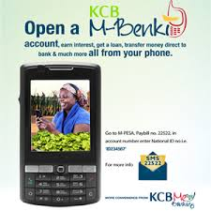
DFS Platforms for Financial Inclusion
Accessible Bank Saving & Lending Service
Flexible e-Banking on Mobile Platform
Easy & Fast Mobile Saving & Loaning Services

Slide 9
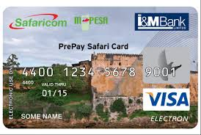
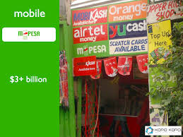
DFS Value Add Services

Slide 10
DFS for Ease of Doing Business & Employment creation
Over 30 Millions transaction per day
Over 120,000 Agents creating employment

Slide 11
DFS for e-Commerce
The highest no. of transactions take place within the mobile money markets, selling of goods and services, including cattle trade

Slide 12
Regulators Place in Digital Financial Services
Licensing Services
Promoting competition
Ensuring level playing field
Mitigating Risks through regulatory interventions
Addressing cyber-security concerns
Enforce compliance to the rules of engagement
Consumer Protection

Slide 13
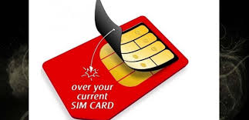
Challenges
Managing Competition
Dynamic Innovations requiring Dynamic Regulations
Unprecedented cases e.g Thin SIM for Mobile Money
Cyber Security Threats & Fraud

Slide 14
CONCLUSION
Digital Financial Services is accelerating our Achieve of Vision 2030 aspiration of Financial Inclusion by all Kenyans by the year 2030

Slide 15
Way-forward: Success of DFS & Financial Inclusion
Collaboration among Stakeholders
Enabling Environment
Enhancement of Security
DFS
Innovations
Financial Literacy Programmes

Slide 16
Thank You

