Slide 1
ITU Workshop on Digital Financial Services and Financial Inclusion 14 December 2015 Geneva, Switzerland
DFS & Financial Citizenship –
Overview of Brazilian Experience
Marusa Freire,
Deputy Head, Financial Education Department
Central Bank of Brazil
marusa.freire@bcb.gov.br

Slide 2
Technology is rapidly changing the face of financial services across the globe
Technology-enabled financial services (digital financial services)
empower customers to manage their financial lives
via a broad mix of products, providers and interfaces –
all at a time and place of their choosing.
Technology Enables Full Financial Inclusion – Center for Financial Inclusion – Accion. 2013

Slide 3
Promises of potential benefits
The development of DFS promises a number of potential benefits for consumers, as well as for government and financial services providers.
Samples:
Faster transactions and lower costs (provider and costumers)
Increasing financial inclusion (access to formal financial services - to underserved or financially excluded)
Transfers, payment and digital transactions are more transparent and less subject to corruption or “leakage” (government)
To make sure consumers can take full advantage of these benefits it is necessary to overcome a number of challenges related to both the supply and demand side of DFS provision.

Slide 4
Supply-side challenges and risks related to the development of DFS
Legal, regulatory and supervisory aspects
Enabling environment for inclusive payment services
Regulatory proportionality, neutrality and predictability
Physical and technological infrastructure
Interoperability and coverage
Accessibility
Efficiency and standardization
Safety and reliability
Risk management
IT security & fraud prevention
Reliability and business continuity
Business risk
Contractual relations and enforceability
Use of third-party agents as banking correspondents
Credit and liquidity risks
Financial integrity (AML/CFT)

Slide 5
Challenges for consumers in accessing and using DFS
Issues related to the protection of financial consumers (CP)
Transparency on terms, conditions, fees, and customer rights
Disclosure requirements
Liability for unauthorized transactions
Privacy of customer transactional and/or personal data
Protections and due process related to the seizure of a customer’s funds
Recourse and dispute resolution mechanisms
Issues related to consumer´s limited knowledge (FL)
Limited general literacy and numeracy
Limited general financial literacy
Limited general awareness and knowledge about financial services and relevant regulation
Limited specific awareness and knowledge of DFS

Slide 6
Policy measures
2013 – New law & regulation to pave the way for boosting digital financial services in Brazil
Law 12.865/2013; Resolutions (CMN): 4.282/2013 and 4.283/2013; and Circulares (BCB): 3.680/2013; 3.681/2013; 3.682/2013; 3.683/2013; 3.704/2014; 3.705/2014; 3.721/2014; 3.735 /2014 & 3.765/2015.
2012 - Area of Institutional Relations and Citizenship (Deputy Governor - sit in the Board) to address financial inclusion and financial education, through a coordinated and integrated approach. (3 Departments – Financial Education; Communication & Institutional Relations [complaints])
2013 - Conduct Supervision Department to supervise financial institutions compliance with the legislation pursuant to their relationship with their clients
Cooperation agreements - entities from the SNDC (National System of Consumer Protection) – Senacon & MPF & Procons

Slide 7
Regulation (1): Suitability / Transparency /Effective disclosure / Consumer empowerment
adequacy of products and services offered and recommended to the needs, interests and objectives of their clients (“suitability”);
integrity, reliability, security and confidentiality of transactions; authenticity of operations agreed and services provided;
provision of all information necessary for the decision-making process of clients;
opportune provision of contracts and documents related to operations and services;
use in contracts and other documents made available for the public of information written in clear, straightforward and adequate manner in regards to the type and complexity of the corresponding operation or service;
right to portability: transferring wage payment, client data, in addition to loan and leasing operations to other financial institutions;
standardization of fees names and descriptions related to the services more demanded by financial clients;

Slide 8
Regulation (2): Suitability / Transparency / Effective disclosure / Consumer empowerment
provision of pre-contractual information to clients, including:
Total Effective Cost (Custo Efetivo Total - "CET”) of credit and leasing operations, consisting of an annual percentage rate of charge, that takes into consideration the interest rate, fees, taxes, insurances and other expenses related to the operation;
Total Effective Value (Valor Efetivo Total - "VET”) of foreign exchange, in local currency, by unit of the foreign currency, which should include the exchange rate, taxes and all fees charged;
standardized form consisting of the most relevant information related to checking or payment accounts.
transparency of credit operation’s contracts, including the obligation of disclosing the charges expected through its regular course;
disclosure of information related to the services free-of-charge, fees, services bundles, as well as benefits and reward programs of credit cards, by each institution, in all their branches and internet homepage;
transparency of credit card statements, including the obligation to disclosure a list of key information.

Slide 9
Ombudsman component under the structure of financial service providers – Mediation of Conflicts
Financial institutions and other institutions authorized to operate by BACEN serving individuals or small businesses as clients must establish an ombudsman component (ouvidoria), in order to record complaints of clients and act as mediator of conflicts.
Additionally, Decree No. 6.523, of July 31, 2008, establishes rules related to the obligation of regulated service providers granting consumer access to customer service channel (Serviço de Atendimento ao Consumidor – “SAC”) through toll-free telephone numbers.

Slide 10
Financial Citizenship Program
The Central Bank of Brazil assumes that financial education, consumer protection and financial inclusion contribute to the improvement of financial citizenship and to the efficiency of the National Financial System, and to the maintenance of the country’s economic stability.
Financial Education
Consumer Protection
Financial Inclusion
Financial citizenship is a concept related to the citizens’ rights
and duties with respect to their financial life

Slide 11
Financial Education - Thematic Areas
1) Money management – focusing on saving and the “responsible” (“smart”) use of credit.
2) Citizen’s relationship with financial service providers – information about financial services and relevant regulation, redress mechanisms and dispute resolution channels, and about the role and functions of the financial system institutions.
3) Financial service providers’ relationship with financial consumers – induction of good financial education practices when offering financial services.

Slide 12
Research and Impact Assessment
1) Financial Inclusion Statistics – Periodic Financial Inclusion Report.
2) Impact assessment/evaluation/surveys – Citizen perspective.
3) Studies and research on the indebtedness of the population – for the purpose of comprehending the process of family indebtedness and the degree of consumers’ understanding
of the credit options available in the market.
Such studies also aim at monitoring the evolution of financial inclusion in Brazil and at identifying critical points
related to the adequacy of the regulation and the supply of financial products and services to suit the consumers’ needs.

Slide 13
Complaints
Regulated & Unregulated
Financeiros

Slide 14
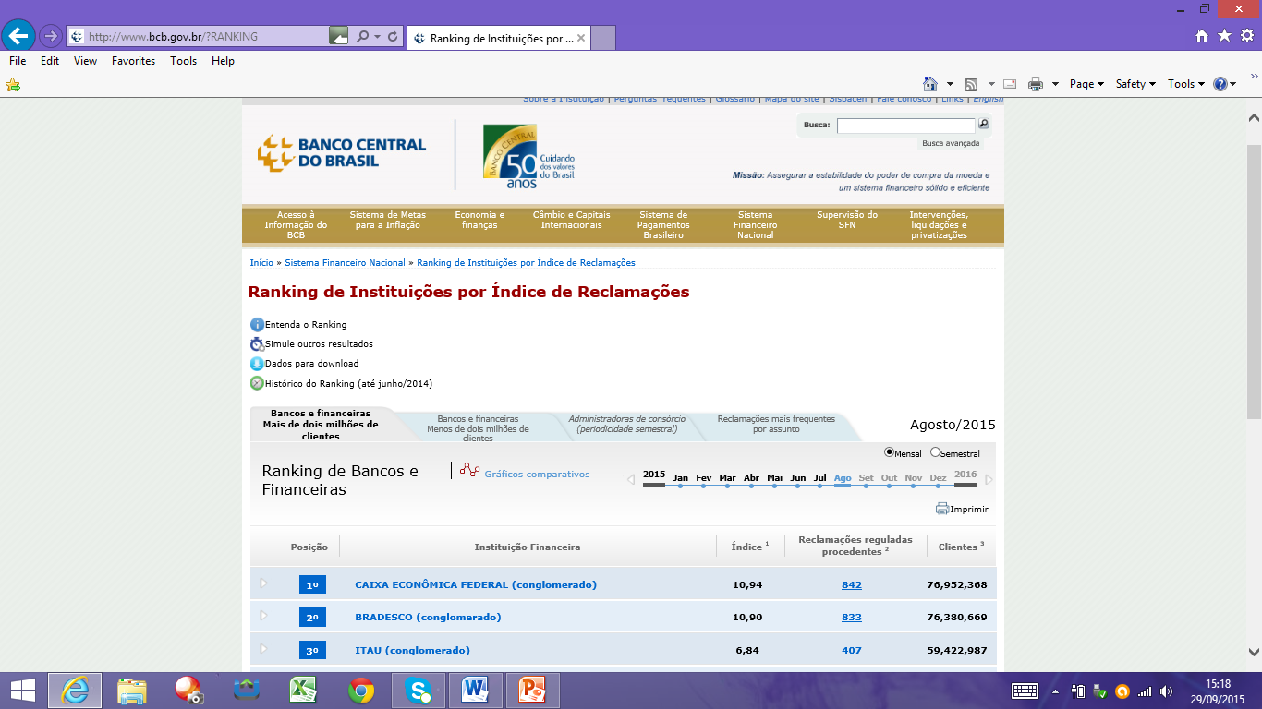
Publication of regular reports with statistics on complaints – Ranking at the BCB website

Slide 15
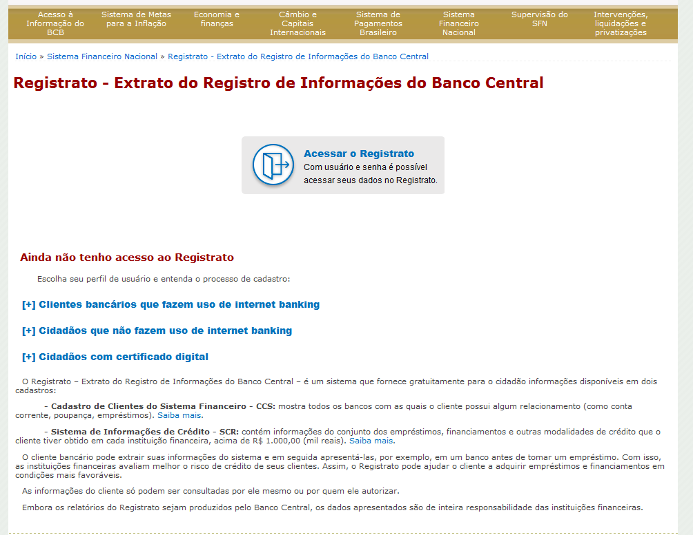
Enabling consumers to access, via Internet, personal information available in data bases managed by the BCB - Registrato

Slide 16
Ongoing work
Understanding financial consumers needs considering their skills, attitudes and behavior (demand side).
Improving financial education tools (3 thematic areas).
Using new digital technologies to delivery financial education tools and information on financial services and relevant regulation, redress mechanisms and dispute resolution channels, and about the role and functions of the financial system institutions.
Data collection and development of a methodology to measure impact – citizen/consumer perspective (PLANDEC) – as well as quality and effectiveness of financial inclusion & financial education efforts.

Slide 17
Thank You!
Marusa Freire
depef@bcb.gov.br
+55 61 3414-4020

