Slide 1
A Partnership to Support Financial Inclusion Through Expanded Payments Acceptance Networks
Merchant and consumer research insights from India
December 14, 2015

Slide 2
A confluence of factors are powering India on its journey toward universal financial inclusion
Jan Dhan Yojana
Aadhaar
Mobile
Cumulative accounts opened and RuPay cards issued under PMJDY
In crores, up to September 2015
Number of Aadhaar issued
In crores, up to 2015
Mobile phone subscription in India
In crore accounts, 2007-2015
18.5
84.7
Rural
Urban
As of April 2015, ~17 crore bank accounts were linked to Aadhar
14.7
63.2
+20%
6.9
34.3
17.9
0.7
Oct-14
Mar-15
Sep-15
May ’11
May ’12
May ’13
May ’14
May ’15
2007
2015E
RuPay cards issued
3.5
13.1
16.1
Source: PMJDY website, UIDAI Data Portal, TRAI, Expert interviews

Slide 3
USAID and the Government of India are partnering to drive the growth of digital payments acceptance networks
Over 20 partners are involved
Vision is an India where the digital payments ecosystem enables all to participate in a digital economy in ways that are simple, convenient, and low-cost.

Slide 4
The study aimed at understanding the five key dimensions of digital payments adoption
Awareness
Post - Awareness
Observability
Trialability
Value and Motivation
Ability
Compatibility
How can we increase awareness of digital payments?
How can we get more people to try out digital payments for the first time?
How can we design payment services that maximize value for users?
How can we design payment services that people can use given their levels of technical and financial ability?
How can we design payment services that are compatible with personal and professional routines of people?
And what common types of transactions do consumers and merchants perform to (1) obtain money, (2) store money, or (3) spend money?

Slide 5

The research was focused in 6 locations spanning the urban – rural spectrum
In-depth quantitative survey across 6 locations in 4 states, covering 2400 consumers and merchants…
Jaunpur, rural
Kota, small town
Mumbai, metro
… In-depth ethnographic research across 3 locations, in 3 states, covering 64 consumers and merchants
Vishakhapatnam, small town
Hyderabad, metro
Guntur, rural
Quantitative + Ethnographic research
Quantitative research

Slide 6
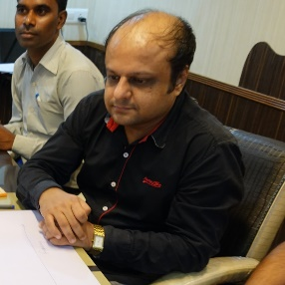
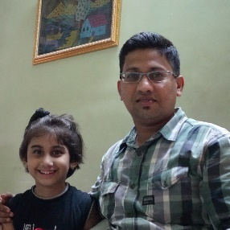

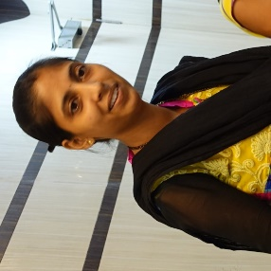
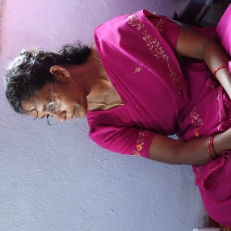
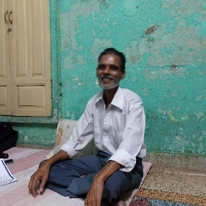
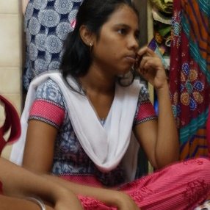
Based on field research, we developed seven consumer personas
Reflect the highest likelihood for adoption, and some may already be digital users
Can potentially move to digital payments, however need strong, targeted uses cases
Have limited disposable income, and are less likely to adopt digital payments
The frontrunner
The rising striver
The constrained explorer
Propensity to adopt digital payments
The scrappy saver
The family conformist
The survivor
The dependent

Slide 7





Key insights for consumers
Create opportunities for daily use
Micro-savings are a valuable hook
Communicate sharply defined use cases
Assisted first-time use is important
The payment instrument should match the purchase type

Slide 8
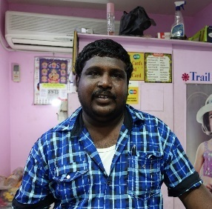
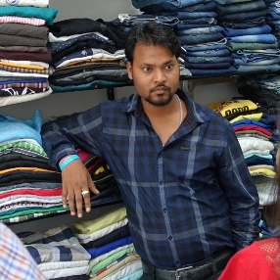
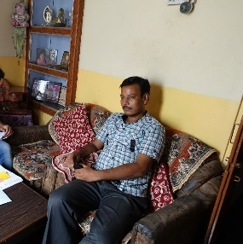
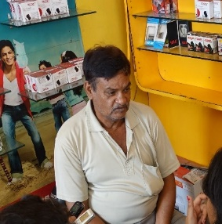
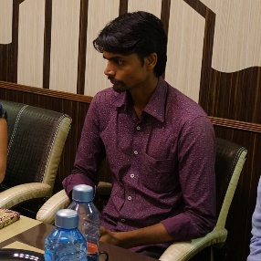
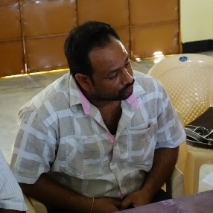
Similarly, we developed six merchant personas
Reflect the highest likelihood for adoption, and some may already be digital users
Can potentially move to digital payments, if they see a strong use case
Face the challenge of working in cash-rich ecosystems, and reflect low likelihood of transitioning
The modernist
The ambitious small timer
Propensity to adopt digital payments
The complacent laggard
The small traditionalist
The middleman
The islander

Slide 9






Key insights for merchants
No upfront costs can increase trials
Consumer demand is
the key
catalyst
Digital money + Physical proof
Slow digital can be quite valuable
Cash + Digital hybrids can be important

Slide 10
Where we go from here
These insights are just a preview of the full, in-depth body of research we sponsored through the India-U.S. partnership.
The full results of the research (as well as the methodology) will be published soon (see our website below) as a public good.
Already, private sector partners have begun to incorporate the research findings into pilots being implemented in India.
USAID strongly encourages organizations to invest in similar research.
For more information, please visit USAID.gov/digital-development.
Questions? Please contact Paul Nelson: pnelson@usaid.gov.

