Slide 1
4th meeting of ITU-T Focus Group Digital Financial Services
December 15-16, 2015
ITU Headquarters, Geneva

Slide 2
Executive Director
“If we were building a financial system from scratch today, we would do it on a digital platform”
--Bill Gates, 2013 AFI Global Policy Forum

Slide 3
Terminology

Slide 4
Terminology
Interoperability
The possibility of payment instruments belonging to a particular scheme or business model to be used in other systems and installed by other schemes
Requires technical compatibility between systems, but can only take effect when commercial interconnectivity agreements have been concluded
Interconnectivity
The ability to enable a technical connection between two or more schemes or business models, such as a bank or payment services provider to an international or regional payment network
DFSWG and Interoperability

Slide 5
Terminology
Practical Interconnection
Interoperable systems are actually connected and reach a particular level of technical capacity.
Even when complete technical interoperability is achieved suboptimal interconnection can coexist.
Interoperability is a necessary, but insufficient condition for interconnection.
A fully developed payment system that fosters financial inclusion should be both interoperable and fully interconnected
DFSWG and Interoperability

Slide 6
MFS and Consumer Protection

Slide 7
Mobile Financial Services & Consumer Protection
Marketing Stage
Registration Stage
-Insufficient agent training
-Lack of client knowledge & risk awareness
-Inadequate data security platforms
-Disclosure of information
-Understandable language
-Consumer education
-Consumer complaints mechanism
Transaction Stage
-Limited access of information
-Shared Usage of mobile phones
-Transactions by agents
Customers’ interface
-Disclosure of information
-Accessible information
-Consumer education
-Reduce risk
-Lack of client understanding of new MFS provider
-Misperception about risks of service usage
-Requirement that MFSP provide accurate information
-‘key facts’ about registration, transaction and service features
Vulnerabilities
Regulatory Implications
DFSWG and MFS Consumer Protection

Slide 8
Telco Regulators Role in
E –Money Services Provision
Some Examples

Slide 9
Kenya
National Payment System Act (NPSA)
Mobile Payment Service Provider (MPSP) submits license from Communications Authority of Kenya (CAK) to Central Bank of Kenya (CBK)
CBK authorizes MPSP to offer mobile payment services
Revocation of license by CAK results in suspension of mobile payment services authorization by CBK
Latest Figures (March 2014)
Agents: 116,196
Mobile Money Accounts: 26.2 million
Transactions performed 2013 (in USD): 21.9 billion
Examples of Telco Regulators Role in E-Money Services Provision

Slide 10
Tanzania
Memorandum of Understanding on MFS regulatory framework: Tanzania Communications Regulatory Authority (TCRA) and Bank of Tanzania (BOT), 2011
BOT advised MNOs to partner with one commercial bank to offer mobile money services
allowed BOT to issue ‘letters of no objection’ to the partner bank
granted the MNOs the legitimacy to implement mobile money services
mobile money deployments are subject to BOT oversight
TCRA (2015): Introduction of a new Telecommunications Traffic Monitoring System to gather consistent statistics on mobile money transactions
Latest Figures (December 2013)
Agents: 153,369
Mobile Money Accounts: 31.8 million (total)
Active Accounts: 11 million
Mobile Money penetration: 35% households
SIM penetration: 55% adults
Transactions performed 2013: 27.1 BUS$
Average P2P transaction: 24.49 US$
Examples of Telco Regulators Role in E-Money Services Provision

Slide 11
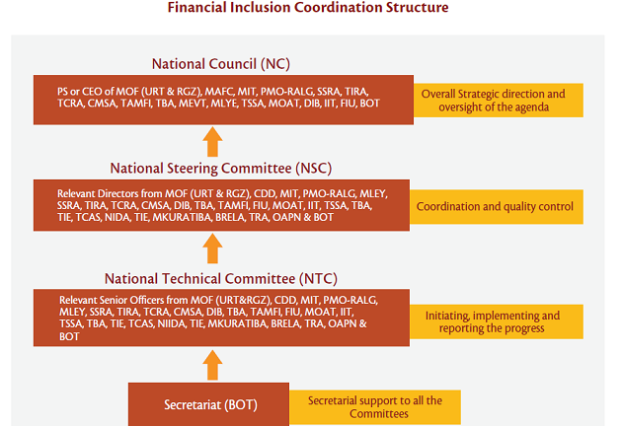
Tanzania cont.
Examples of Telco Regulators Role in E-Money Services Provision
Notes:
National Council: Chaired by Bank of Tanzania (BOT) governor, with a membership of 19 secretaries/heads of government ministries and regulators (e.g. finance, trade, education, agriculture and coperatives, local government, labor, social security, insurance, communications, capital market, deposit insurance, financial intelligence, youth) and practitioners associations (e.g. bankers, microfinance institions, mobile operators, insurance institute, social security association)
National Steering Committee: Chaired by BOT, with a membership of 27 directors/commissioners from government ministries, regulators and practitioners (in addition to above: ID authority, consumer society, education institutem revenue authority, postal network, business registration)
National Technical Committee: Chaired by BOT, with membership of 27 senior officers from above
government agencies, regulators and practitioners associations
BOT is secretariat to all of the above.

Slide 12
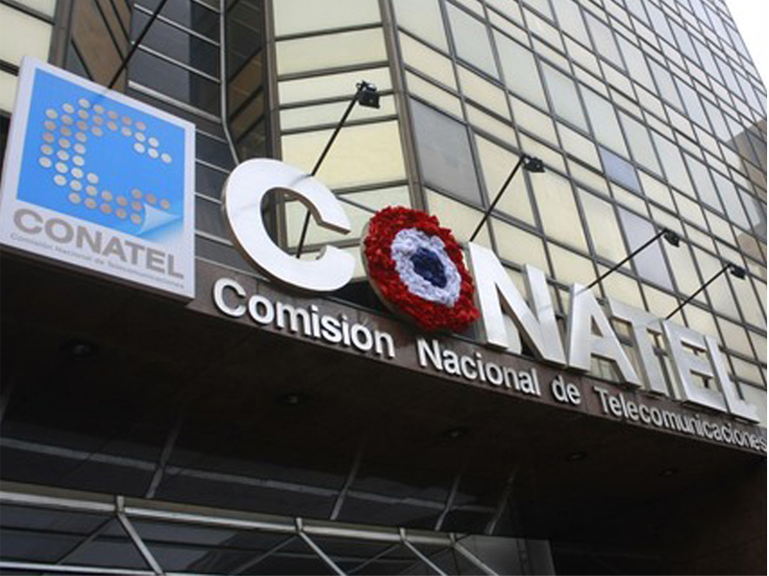
Paraguay
Telco regulator has a role in the licencing of the provision of mobile money services
Obtain license: interested party to get an approval from Comisión Nacional de Telecomunicaciones (CONATEL) subject to the soundness of technology of mobile money platform
CONATEL reports that compliance challenges have resulted in delays in the licencing process
Latest Figures (December 2014)
Agents: 4,572
Mobile Money Accounts: 1.47 million (exceeding the total number of bank accounts)
Transactions performed 2013 (in USD): not available
Examples of Telco Regulators Role in E-Money Services Provision
Notes:
Include 2013 figures??

Slide 13
National Financial Inclusion Strategies

Slide 14
National strategies and financial inclusion
AFI members with national strategies increased financial inclusion by 12.7 ppts, compared to 8.5 ppts for those without national strategies
N members with strat. = 12
N members without strat = 22
*Angola N/A
Increase in % of adults with accounts from 2011-2014 (ppt)
Source: Data from World Bank Global Findex, compiled by AFI; AFI Maya Declaration Report 2014
National strategies and financial inclusion

Slide 15
National strategies and financial inclusion
Effective strategy formulation & implementation involves a continuous feedback cycle
Data Collection and Diagnostic
Activities:
Collection of supply-side data
Collection of demand-side
data
Data Analysis
(b) Strategy Formulation
Agreement of definition and vision for financial inclusion
Consultation with public & private sector stakeholders
Development of action plan and targets
….
Data Collection
And Diagnostic
Strategy
Formulation
(d) Monitoring & Evaluation
Tracking progress against
core indicators
Identifying if strategy is on
track and any responses
needed
Strategy
Implementation
(c) Strategy Implementation
Policy Reforms
Private Sector Response
Establishment of architecture
for implementation
(e.g. National Council or
Taskforce)
Monitoring & Evaluation
National strategies and financial inclusion

Slide 16
Drivers of financial inclusion?

Slide 17
E-money and financial inclusion
AFI members with e-money increased financial inclusion by 11.3 ppts, compared to 7.9 ppts for those without e-money
N members with e-money = 25
N members without e-money = 9
Increase in % of adults with accounts 2011-2014
Source: Data from World Bank Global Findex and and AFI Policy Profiles, compiled by AFI
Policy interventions and financial inclusion

Slide 18
Agent banking and financial inclusion
AFI members permitting agent banking increased financial inclusion by 10.6 ppts, compared to 8.1 ppts for those without agent banking
N members with agent banking= 31
N members without agent banking = 3
Increase in % of adults with accounts 2011-2014
Source: Data from World Bank Global Findex and and AFI Policy Profiles, compiled by AFI
Policy interventions and financial inclusion

Slide 19
Financial literacy and financial inclusion
AFI members with financial literacy programs increased financial inclusion by 10.6 ppts, compared to 4.4 ppts for those without financial literacy
N members involved = 34
N members not involved = 1
Increase in % of adults with accounts 2011-2014
Source: Data from World Bank Global Findex and and AFI Policy Profiles, compiled by AFI
Policy interventions and financial inclusion

Slide 20
AFI’s work

Slide 21
AFI’s Strategic Vision: A Dynamic Growth Path
Grant-Making Facility
Policy Driving Network
Policy Leadership Alliance
Learning & Exchange Platform
Level of Member Engagement
2016
2012
2008
Time

Slide 22
AFI’s Strategic Vision: A Dynamic Growth Path
Grant-Making Facility
Policy Driving Network
Policy Leadership Alliance
Learning & Exchange Platform
Level of Member Engagement
2016
2012
Grants
2008
Time

Slide 23
AFI’s Strategic Vision: A Dynamic Growth Path
Grant-Making Facility
Policy Driving Network
Policy Leadership Alliance
Learning & Exchange Platform
Level of Member Engagement
2016
2012
Global Policy Forum
Working Groups
2008
Time

Slide 24
AFI’s Strategic Vision: A Dynamic Growth Path
Grant-Making Facility
Policy Driving Network
Policy Leadership Alliance
Learning & Exchange Platform
Level of Member Engagement
2016
2012
Global agenda (SSBs, GPFI)
Maya Declaration
Public-private Dialogue
Regional Initiatives
2008
Time

Slide 25
AFI’s Strategic Vision: A Dynamic Growth Path
Grant-Making Facility
Policy Driving Network
Policy Leadership Alliance
Learning & Exchange Platform
Level of Member Engagement
2016
2012
Capacity Building
Technical Assistance
Stakeholder Alignment
2008
Time

Slide 26
AFI Services
Effective financial inclusion policy reforms
National & Global Policy Coordination
High-level Commitment
Improved Knowledge
& Institutional Capacity
Global Advocacy
G20 GPFI
SSBs Peer Learning on Global Standards
Global Policy Forum
National Progress
Maya Declaration
Capacity Building
Grants
Working Groups
Knowledge Exchanges
Peer Advisory
Trainings & Workshops
Joint Learning Programs
Knowledge Products
Community & Partnership Building
Regional Initiatives
Public Private Dialogue
Global Policy Forum
Online Member Zone

Slide 27
info@afi-global.org
www.afi-global.org

