Slide 1
Facilitate our IT Access, You’ll see your Own Success
ITU Workshop on
“ICT Innovations in Emerging Economies”
(Tunis, Tunisia, 28 January 2014)
Lobna SMIDA,
Administrator, Presidential Palace
roselobna@hotmail.com

Slide 2
DEFINITION OF THE INFORMATION
Facts provided or learned about something or someone
What is conveyed or represented by a particular arrangement or sequence of things
[Oxford dictionary]

Slide 3
DEFINITION OF TECHNOLOGY
The application of scientific knowledge for practical purposes, especially in industry.
[Oxford dictionary]
Tunis, Tunisia, 28 January 2014
Notes:
3

Slide 4
ROLE OF THE COMBINATION OF INFORMATIONAL TECHNOLOGY “IT”
It facilitates the transmision of an information
The information itself makes the value of the role of technology
We cannot find a container without the containt and vice versa
They complete each other : we cannot perceive a technology without information and we cannot conceive a piece of information without technology
They are both intertwined to raise awareness of what is going around.

Slide 5
THE SERVICES OF IT DEVICES
Informational technologies are to provide the e-services of the government to facilitate some formal papers for people with reduced mobility as well as those who live in rural zones.
Monitory services
Cultural services
Social services
News

Slide 6
MEANS OF ENTERTAINMENT
Smart phones can enable people with motor disability to play football, handball, or formula1 and many other games… as if it were them who are moving.
ITs create a non-describable joy, they help people who are visually impaired to read the screen, write messages and receive calls, it could be also a guide for the visually impaired persons.

Slide 7
MEANS OF ENTERTAINMENT
Deaf people are also in bad need to have something that reformulates their inconceivable utterances...etc.
I may venture to call these services "Therapeutic sessions."

Slide 8
TECHNOLOGY IS A MEANS OF CONNECTING PEOPLE
Information becomes in a press of a caption
Skype, Oovoo, Viber , What's app... etc. are all bridges to whom we love and sometimes they could be the cause to know people that we have never been able to meet in reality

Slide 9
TECHNOLOGY IS A MEANS OF CONNECTING PEOPLE
Instead of an ecologic laptop, we rather need an accessible one that matches the situations of persons with disabilities.

Slide 10
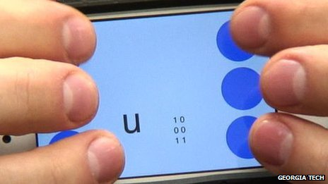
TECHNOLOGY IS A MEANS OF CONNECTING PEOPLE
Some smart phones are the outlets for some people to travel abroad and see the world without the pain of taking any means of transportation

Slide 11
TECHNOLOGY IS A MEANS OF CONNECTING PEOPLE
The expression "connecting people" is valuable, so try to make it sound logic
Life is love and care, let us in your innovation see your solution to insure our welfare.

Slide 12
Conclusions and recommondations
We can deduce that the IT services are of a paramount importance as we are living in an amalgamation of two worlds that become more and more yoked up.
We have emails, e-books, e-services… etc. This prefix “e” that specially we—people with disabilities— loved, and still admire. So, how can we ignore the role of the ITs’ devices in paving our way towards more inclusion and integration with these inventions?

Slide 13
Conclusions and recommondations
Thanks for everybody here or abroad who made through his/her invention our “disabilities” discarded as a barrier and “e”nabled us to be active and participants through one’s career.

Slide 14
THANKS FOR YOUR ATTENTION

