Slide 1


e-Health Systems:
Innovative Services in the Emerging Economies
& Standardization Activities
(case of Tunisie Telecom)
ITU Workshop on
“ICT Innovations in Emerging Economies”
(Tunis, Tunisia, 28 January 2014)
Rim Belhassine-Cherif, Ph.D
Executive Director of Products and Services, Tunisie Telecom
rim.belhassine-cherif@tunisietelecom.tn

Slide 2

Introduction
It is obvious nowadays that the use of ICT technologies in the health care field is moving forward especially with the numerous social and economic benefits provided by e-Health
Aware of the e-Health potential, many developing countries are investing in developing innovative e-Health, and especially m-Health, applications and services, in a way to find some solutions to the health care problems they are currently facing
However, in order to make developing countries fully benefit from the e-Health advantages, a specific focus on standardization of e-Health solutions and technologies should be given especially by international organizations

Slide 3
Agenda
1. e-Health advantages & Opportunities for innovation
2. Examples of e-Health innovative applications in the developing countries
3. e-Health standardization
4. Case study : Tunisie Telecom
5. Conclusion & Recommendations

Slide 4
Agenda
1. e-Health advantages & Opportunities for innovation
2. Examples of e-Health innovative applications in the developing countries
3. e-Health standardization
4. Case study : Tunisie Telecom
5. Conclusion & Recommendations

Slide 5

e-Health Advantages for health care stakeholders
1
e-Health have positive impacts on many health care stakeholders
Individuals
Enhanced personal health and life quality
Improved access to healthcare services /providers
Less waiting time
More autonomy in health management
…
(patients, relatives, etc.)
Healthcare Providers and suppliers
Health Care
Governments
NGOs/IGOs
Source : The Socio-Economic Impact of Mobile Health, April 2012

Slide 6

e-Health Advantages for health care stakeholders
2
Individuals
Better service providing quality
Improved health care efficiency and accuracy
Reduced need for Health care workforce
Updated data and knowledge sharing
Reduced costs per patient
…
Healthcare Providers and suppliers
Health Care
(Doctors, HC workers, etc.)
Governments
NGOs/IGOs
Source : The Socio-Economic Impact of Mobile Health, April 2012

Slide 7




e-Health Advantages for health care stakeholders
3
Help to reach MDG
Ensure regional equity in healthcare services providing
Reduce health care cost per capita
Reduce pollution and energy consumption (minimize patient transport,…)
Healthier workforce
➔ increase productivity
Citizens satisfaction
…
Individuals
Healthcare Providers and suppliers
Health Care
Governments
NGOs/IGOs
Source : The Socio-Economic Impact of Mobile Health, April 2012

Slide 8




e-Health Advantages for health care stakeholders
4
Provide healthcare institutions with necessary infrastructure
Increase the reach of Health care services
Enhance data collection and sharing
Make healthcare more affordable
Better promote own health agenda/targets
…
Individuals
Healthcare Providers and suppliers
Health Care
Governments
NGOs/IGOs
Source : The Socio-Economic Impact of Mobile Health, April 2012

Slide 9




e-Health Advantages
Some Key Findings
Pakistan
75,000
Annually saved mothers and children lives thanks to the use of maternal information services
Thailand
40,000
Cured cases of tuberculosis thanks to the use of SMS treatment compliances
Serbia
40,000
Annually saved hospital nights by the use of remote treatment
Sweden
2.4
Billion Euro
Annually reduced elderly care costs by the use of remote monitoring
Source : The Socio-Economic Impact of Mobile Health, April 2012

Slide 10
e-health
Innovation Opportunities
9 different systems categories
E-Health Systems
Electronic health record
Pharmacy information
Patient registration or scheduling
Monitoring, evaluation and patient tracking
Clinical decision support
Patient reminder
Research/data collection
Laboratory information management
Telemedicine
Source : Evaluations of the Impact of e-Health Technologies in Developing Countries: A Systematic Review, July 2008

Slide 11
Agenda
1. e-Health advantages & Opportunities for innovation
2. Examples of e-Health innovative applications in the developing countries
3. e-Health standardization
4. Case study : Tunisie Telecom
5. Conclusion & Recommendations

Slide 12
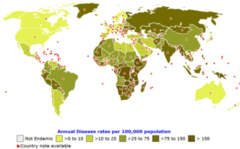
Health Care Issues in the developing countries
e-Health applications are developed in order to help finding solutions to health care issues in the developing countries
High child and maternal mortality Rates
Lack of access to safe water supply and insufficient sanitation facilities
Infectious Diseases spread (HIV/AIDS, Tuberculosis,…)
Critical occupational health and environmental pollution
Strained national Finances, vulnerable administrative abilities and inadequate systems
Lack of personnel, institutions and medications in public health and medical systems
Difficult access to health care institutions
…
Tuberculosis Distribution Map 2013
(source: GEDEON Informatics)
Source : Introduction The Issues of Public Health and Medical Systems in Developing Countries
Tunis, Tunisia, 28 January 2014

Slide 13
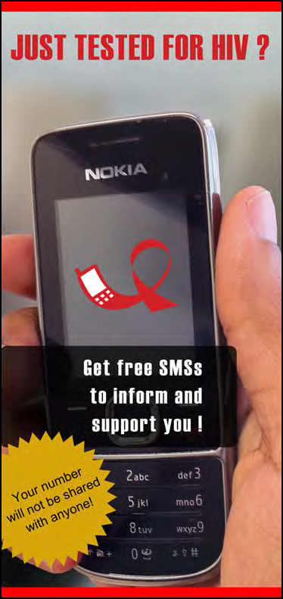
Examples of e-Health Innovative
Applications in the D.C.
JustTested (South Africa, May 2012)
1
Objective : Giving support and information to people who has just tested (regardless of whether they test HIV positive or negative)
The service sends 39 messages over the course of three months on the topics of healthy living and addressing HIV and AIDS related issues
Source : m-HEALTH COMPENDIUM, VOL(2), Technical report, Mai 2012
Tunis, Tunisia, 28 January 2014

Slide 14

Examples of e-Health Innovative
Applications in the D.C.
Aponjon (Bangladesh, September 2011)
2
Objective: reducing maternal and child mortality
The service sends messages twice a week in either SMS or IVR format to subscribed pregnant women, new mothers and their families
Reduced cost: 0.025 USD per message
Results: Over 52,000 mothers and guardians have subscribed until H1 2012 with prediction to reach 2 million subscribers in 2015
Source : m-HEALTH COMPENDIUM, Vol(2), Technical report, May 2012
Tunis, Tunisia, 28 January 2014

Slide 15
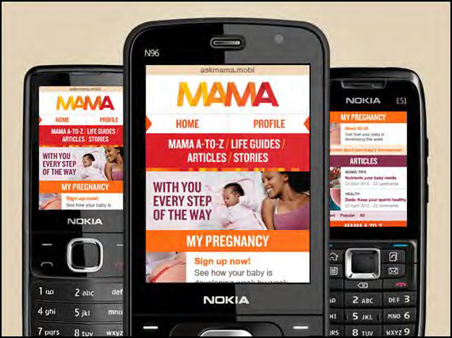
Examples of e-Health Innovative
Applications in the D.C.
MAMA (South Africa, May 2013)
3
Objective : provides support and information to pregnant women and new mothers through 3 mobile channels:
  Channel1: SMS text messaging twice a week (with further information for HIV+ mothers)
  Channel2: Mobile web-based community portal (askmama.mobi)
  Channel3: USSD interactive quizzes twice a week
Two further channels
  educational portal through the MXit social networking platform
  Pre-recorded weekly voicemail messages
  Results : 377,971 subscribers in November 2013
Source : http://www.mobilemamaalliance.org
Tunis, Tunisia, 28 January 2014

Slide 16

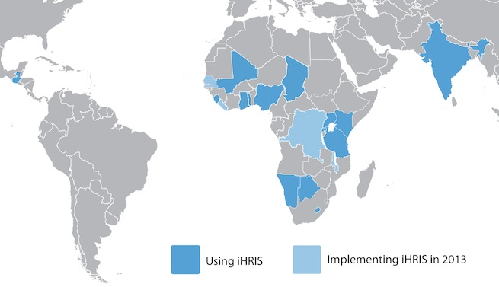
Examples of e-Health Innovative
Applications in the D.C. iHRIS (Uganda, 2007)
4
Objective : iHRIS is a free and open source software for managing health workforce information
The iHRIS Mobile Reference Dictionary was developed in 2012 to protect patients from individuals posing as health professionals
Results:
  Currently, 15 countries are using iHRIS with 4 more in the pipeline
  More than worldwide 675,000 health worker records are supported
iHRS global implementation
Tunis, Tunisia, 28 January 2014
Source : http://www.ihris.org/

Slide 17
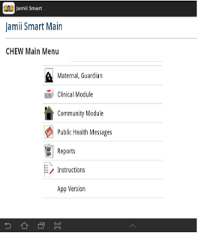
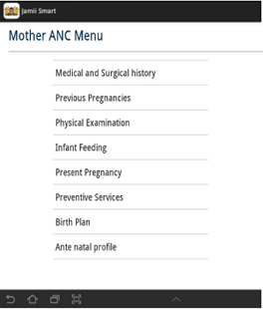
Examples of e-Health Innovative
Applications in the D.C.
Jamii Smart (Kenya)
5
Scope :
  collecting maternal and child health data on an android application
  aggregating the data on the government’s cloud-based Information Systems
  sending alerts, reminders and tips to mothers and community health workers
  Phase 2 : “Linda Jamii”
  a medical micro-insurance product by Safaricom and partners, and mVouchers to facilitate transportation to health facilities
Tunis, Tunisia, 28 January 2014
Source : Analysing Progress on Commitments to the Global Strategy for Women’s and Children’s Health

Slide 18
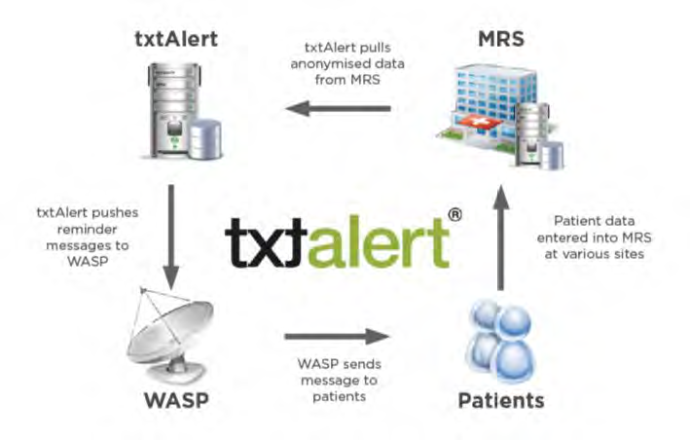
Examples of e-Health Innovative
Applications in the D.C.
TXTALERT (South Africa, 2007)
6
Scope :
  appointment reminder
  facility for patients to reschedule or confirm an appointment (with no additional cost)
  4 different variants : for simple patient, for HIV patient, for pregnant women and for TB patients
Encouraging results : (example of Theba Lethu clinic)
  Missed appointments decrease: 30% to 4%
  loss to follow decrease: 27% to 4%
Source : m-HEALTH COMPENDIUM, Vol(2), Technical report, May 2012
Tunis, Tunisia, 28 January 2014

Slide 19

e-Health Innovation Initiatives
AfDB e-Health competition
1
Objectives:
  encourage the production and sharing of knowledge on e-Health solutions
  provide added value through the sharing of lessons learnt in e-health and m-health
Awards were distributed in Tunisia on September 2013
10 awarded solutions (among 40 submitted and 116 received) belonging to 4 different categories
 | Category | Winner | Proposal Name
1 | Access to health information | Ghana Health Service | District Health Information Management System 2 (DHIMS 2)
 |  | World Health Organization and Ministry of Public Health of Cameroon | The application of Information Technology and Communication to improve early detection and rapid response to epidemics in Cameroon
 |  | UNICEF and Ministry of Health of Uganda | mTrac: Real Time Monitoring and Evaluation Of Disease Surveillance, ACT Drug Stock And Health Service Delivery
Tunis, Tunisia, 28 January 2014
Source : http://www.afdb.org

Slide 20
e-Health Innovation Initiatives
AfDB e-Health competition
2
 | Category | Winner | Proposal Name
2 | Empowering the health workforce | African Medical and Research Foundation (AMREF) | Upgrading nurses in Kenya using eLearning
 |  | Ghana Health Service | Mobile Technology for Community Health (MOTECH)
 |  | Geneva University Hospitals and Bamako University | RAFT, an African-wide telemedicine and distance education network
3 | Health education for the public | World Health Organization, Ministry of Basic and Secondary Education and Ministry of Health and Social Welfare of Gambia | WHO Health Academy Project: using ICT to promote health in schools
4 | Delivering Health Services | Ministry of Health and Sanitation of Sierra Leone, Centre for Global Health Trinity College Dublin and World Vision | Supporting and strengthening maternal, neonatal, and child health services using mobile phones: the impact on community health worker programs
 |  | GIZ and Ministry of Health of Kenya | Mobile inventory management system (MIMS):Improving Family Planning Commodity Security through ICT
 |  | FHI360 | Mobile for Reproductive Health (m4RH)
Tunis, Tunisia, 28 January 2014
Source : http://www.afdb.org

Slide 21
Agenda
1. e-Health advantages & Opportunities for innovation
2. Examples of e-Health innovative applications in the developing countries
3. e-Health standardization
4. Case study : Tunisie Telecom
5. Conclusion & Recommendations

Slide 22

e-Health Standardization standardization benefits
Ensure interoperability among healthcare systems
  facilitate information exchange
  avoid single vendor lock-in
Decrease the risks related to new technologies development
Minimize costs by stimulating market competition and eliminating expensive and personalized solutions
Widen the spread of solutions’ adoption
Address specific concerns about e-Health issues (privacy, security, patient recognition,...)
Source: Standards and eHealth
ITU-T Technology Watch Report -January 2011
Tunis, Tunisia, 28 January 2014

Slide 23

e-Health Standardization main challenges
many stakeholders :
  Patients
  Hospitals
  Pharmacies
  primary care physicians
  administrative entities…
Different technologies, information systems, and medical devices often based on proprietary specifications
Difficulty of technical integration
privacy protections, quality assurance, and security of information
Very strict national regulations
Reluctance of health practitioners to adopt the new technologies
Source: Standards and eHealth
ITU-T Technology Watch Report -January 2011
Tunis, Tunisia, 28 January 2014

Slide 24
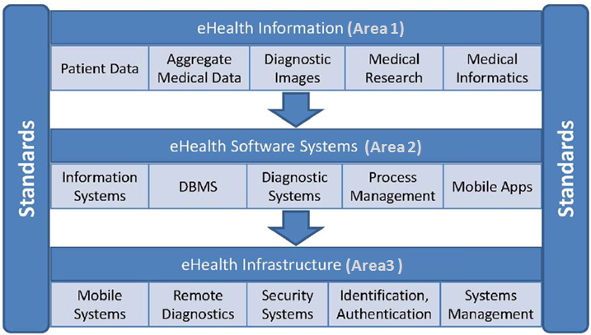
e-Health Standardization standards areas
e-Health standards focus on 3 main areas
Source: Standards and eHealth
ITU-T Technology Watch Report -January 2011
Tunis, Tunisia, 28 January 2014

Slide 25





e-Health Standardization standardization initiatives
A number of standardization initiatives were launched, among which:
Initiative | Description
epSOS (European Patients Smart Open Services) | A pilot initiative that focuses on creating an interoperable electronic health record system across Europe
DICOM (Digital Imaging and Communications in Medicine) | A set of specifications dedicated to the standardization of medical images under the responsibility of the U.S. National Electrical Manufacturers Association
Medical / Health Device Communication Standards (ISO/IEEE 11073) | a set of joint ISO, IEEE, and CEN standards for medical device interoperability
Global Observatory for e-Health (World Health Organization) | an initiative dedicated to the study of eHealth—its evolution and impact on health
Tunis, Tunisia, 28 January 2014
Source : E-health Standards and Interoperability
ITU-T Technology Watch Report - April 2012

Slide 26




e-Health Standardization standardization institutions
Many institutions are currently active in e-Health standardization field, among which:
Institution | Description
Continua Health Alliance | A non-profit organization seeking to promote interoperability among personal e-health devices and systems
CEN/TC 251 | The Health Informatics Technical Committee of the European Committee for Standardization (CEN)
HL7 (Health Level Seven International) | A standards organization specifically devoted to the practice of developing standards related to the exchange, storage, and use of electronic health information
GS1 Healthcare | A global non-profit standards association that focuses on the supply chain and care delivery
ISO/TC 215 | ISO Technical Committee 215: “Health Informatics”
Tunis, Tunisia, 28 January 2014
Source : E-health Standards and Interoperability
ITU-T Technology Watch Report - April 2012

Slide 27

ITU Standardization Activities on e-Health
ITU-T SG16 – Q28
1
Multimedia Framework for e-Health Applications
  Inventory of existing e-Health and telemedicine standards
  Roadmap for e-Health/telemedicine standards (including identifying standardization items with priorities)
  Involvement in the e-Health Standardization Coordination Group (eHSCG) in order to promote stronger coordination amongst the key players in the e-Health Standardization arena
  Contributions to extensions and improvements of existing Recommendations on multimedia systems
  Development of new Recommendations if necessary
Main tasks
Tunis, Tunisia, 28 January 2014
Source: Standards and eHealth
ITU-T Technology Watch Report -January 2011

Slide 28
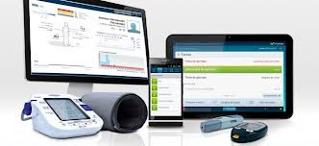
ITU Standardization Activities on e-Health
2
e-health standardization from the perspective of general ICT infrastructure :
  SG16–Q28 : Multimedia Framework for e-Health Applications
  SG13–Q2 : Requirements for NGN evolution and its capabilities including support of IoT and use of software-defined networking
  SG17–Q9 : Telebiometrics
  Further work items
  FG M2M : Requirements and specifications for a common Machine-to-Machine (M2M) Service Layer with the initial priority on e-Health
  IPTV and mobile application for e-health (Application Challenge on IPTV Apps for e-health, September 2012)
Tunis, Tunisia, 28 January 2014
Source: ITU-T Work on Standardizing e-Health

Slide 29


ITU Standardization Activities on e-Health main results
3
  ITU-T Rec. X.108x series on telebiometrics, including security, authentication, interfaces, API and protocols
  Y.2065 (draft) “Service and capability requirements for e-health monitoring services”
  HSTP.EHMSI (draft) “Multimedia Service and Interfaces for e-health ”
  ITU-T Technology Watch Report - January 2011 “Standards and eHealth”
  ITU-T Technology Watch Report – April 2012 “E-health Standards and Interoperability”
Tunis, Tunisia, 28 January 2014
Source: ITU-T Work on Standardizing e-Health

Slide 30
Agenda
1. e-Health advantages & Opportunities for innovation
2. Examples of e-Health innovative applications in the developing countries
3. e-Health standardization
4. Case study : Tunisie Telecom
5. Conclusion & Recommendations

Slide 31

TT Approach
  2008 (January): Positioning System for Ambulances «GPS Tracking »
  2008 (September): Pilot project (4 sites): Optical Fiber, MPLS, VoIP, Videoconferencing
  2008: TT has Invested in a mega e-Health project for the Ministry of the Public Health : 263 medical institutions (280 sites)
    ==> Upgrade of the National Health Network.
  The negotiations and the technical studies have started since 2008
  The project is performed on phases according to sites’ criticality
  The installation is on going : More than 60% of sites are installed.
LAN upgrading
WAN upgrading
Voice Migration
Tunis, Tunisia, 28 January 2014

Slide 32
TT Approach
All the sites will be connected to TT Next generation MPLS : High speed up to 100 Mbps, security, QoS aware network, High availability.
Legacy Telephony is migrating to Voice over IP, with a unique dial plan, and a local survivability for more than 28 000 users
Wi-Fi and audio conference are provided in many sites
Infrastructure is ready to host more Value Added Services
Tunis, Tunisia, 28 January 2014

Slide 33
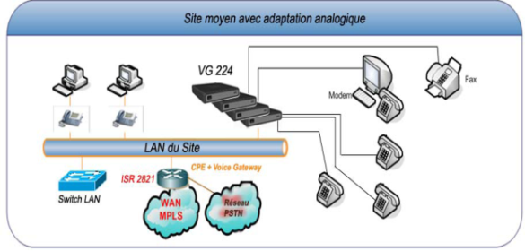


Unified Data & VoIP
Infrastructure
Redundant Call Manger Hosted in TT Data Center
PSTN/
PLMN
7609-S
Optical Fiber up to100 Mbps
Backbone IP/MPLS
7609-S
166 small sites : FULL IP Solution
7609-S
ADSL Backup
Copper 2 Mbps
13 critical sites
101 importants sites
Tunis, Tunisia, 28 January 2014

Slide 34

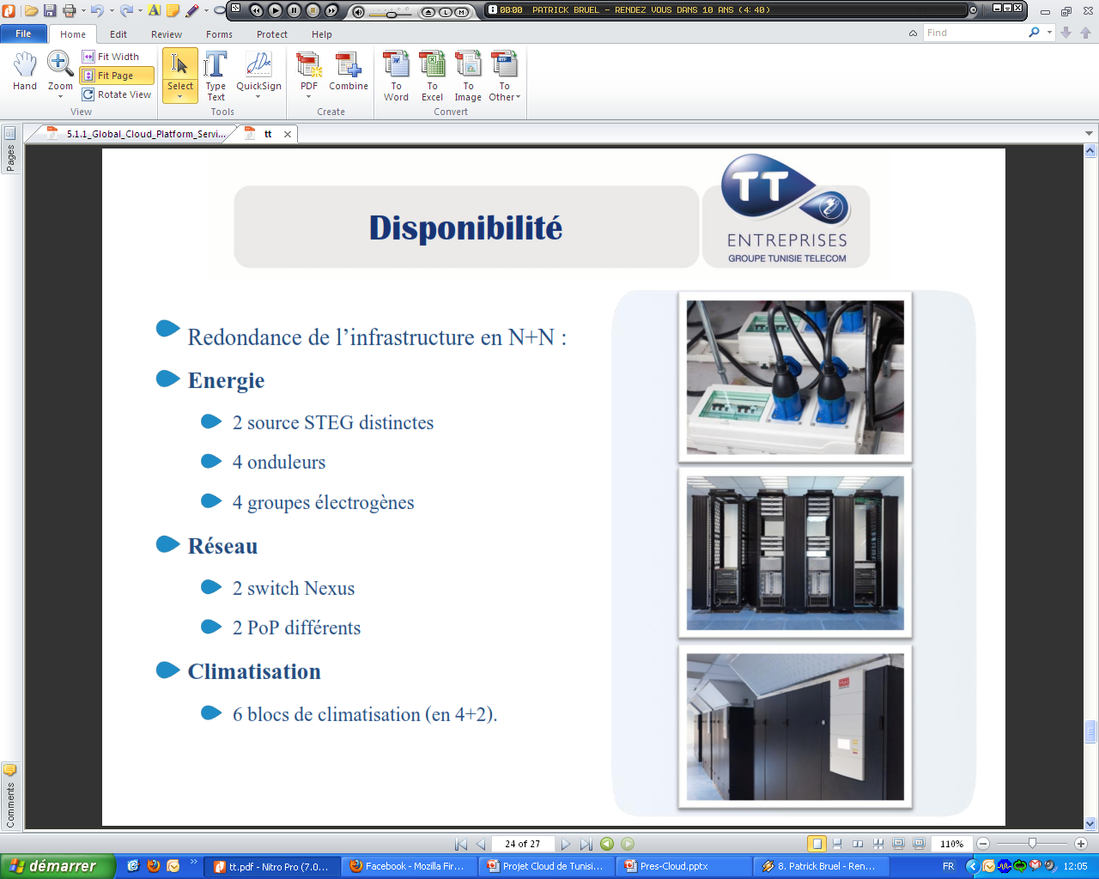
TT Data Centers
Tunisie Telecom has focused on the preparation of data centers to host many TT and customers’ platforms, according to TIA-942 Standard
  Kasbah Data Center (First TT DC )
    Area: 280 m², 92 42U Racks
    Redundant power and redundant air conditioning
    Hosts TT SaaS platform and Cloud Platform (nearly)
    Used for Corporate Housing TT offers
  Carthage Data Center
    A second Data Center (For load balancing) : Ready since October 2013
  Kairouan Data Center
    Data Center for «Disaster Recovery»
    Installation is in going
Tunis, Tunisia, 28 January 2014

Slide 35


Services Evolution
Many services are provided within the present solution:
  Voice supplementary services
  Directory
  Virtual mobility
  Wi-Fi
  Audioconference
  etc.
e-health solution scalable and able to support more VAS:
  One unified number
  Telepresence
  Webex for healthcare
  Audio and video Conference
  Collaboration services
    Presence
    Document sharing
    Instant messaging
  WiFi - RFID
Tunis, Tunisia, 28 January 2014

Slide 36



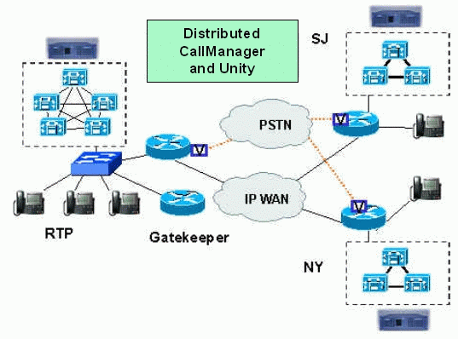

eHealth Mobility unified number
One Number to dial
Gives users the ability to receive calls from any selected device, such as desktop, cellular phones, etc.
Users can also transition active calls between desktop and mobile phone without interruption
Doctors are more available and emergency is better processed
The doctor is not in his office now. 7003 : 70000003
70000003
Call Manager
98000005
7003
The doctor answers on his mobile
7003 : 98000005
The nurse called the doctor unified number: 7003 without knowing his location
Tunis, Tunisia, 28 January 2014

Slide 37
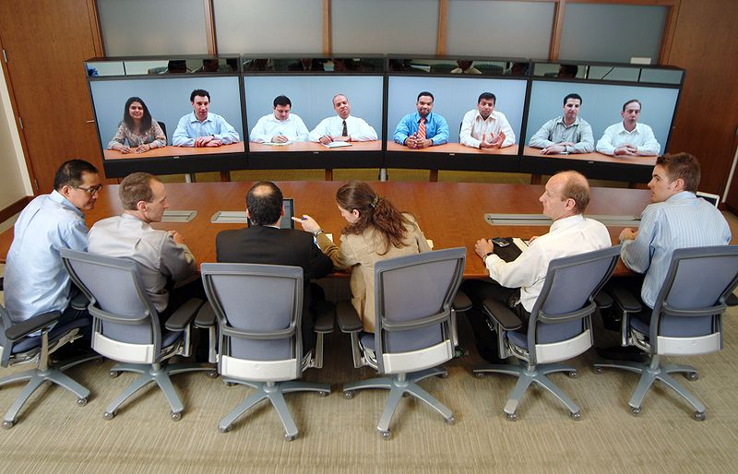
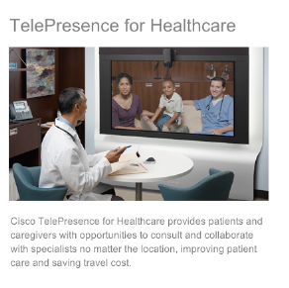
e-Health Telepresence
Provides patients and care providers with opportunities to consult and collaborate with specialists no matter the location
Make clinical decisions faster, improving patient care and outcomes
Reduce travel costs and time for patients, doctors and specialists
The infrastructure is ready, the service needs arrangement of Rooms. We highly recommend Hospitals to subscribe to telepresence service, for their benefit
Tunis, Tunisia, 28 January 2014

Slide 38


e-Health Webex
TT offers Webex service since 2012, Hospitals need only subscription.
Provides physicians and patients with a highly secure, centralized space to discuss care issues remotely through video conferencing and data sharing
Advantages:
  Increased physician to physician and physician to patient collaboration
  Higher physician productivity through less travel
  Lower costs
  Possibility to invite specialists to discussion session
Tunis Hospital
Gabes Hospital
Tunis, Tunisia, 28 January 2014

Slide 39
Agenda
1. e-Health advantages & Opportunities for innovation
2. Examples of e-Health innovative applications in the developing countries
3. e-Health standardization
4. Case study : Tunisie Telecom
5. Conclusion & Recommendations

Slide 40

Conclusion
1
The use of ICT in health care brings many advantages especially to individuals, health care providers and governments, allowing higher quality, safer, more equitable and more efficient health care system
e-Health, with its different categories, is a promising field to develop and propose innovative services and applications, mainly those accessible via mobile
The critical health care situation in Developing Countries urges national and international organizations and governments to intervene and invest in the development of innovative services that aims to solve, even partially, the main health issues in these countries (high child and maternal mortality, wide spread of diseases, difficult access to health care institutions,…)

Slide 41

Conclusion
2
In order to ensure more interoperability among Health care systems and reduce technology costs, many international organization have paid an important attention to e-Health standardization and launched some initiatives
Among these organizations, ITU is accomplishing several activities in the e-Health field, and that, mainly through its Study Groups and Focus Groups
  Tunisie Telecom, as an incumbent operator, is concerned with proposing services for social purposes and it is providing currently, through its mega e-Health project for the Ministry of the Public Health, a high available, secured and reliable infrastructure platform enabling many e-Health services such as: teleconsultation, telediagnosis, telepathology, teleradiology, Videoconferencing, telepresence, etc.

Slide 42

Recommendations
Developing countries should take advantage from the mobile telecommunications potential and focus more on the development of mobile health care applications since they are more accessible
Government in Developing countries should plan efficient strategies to promote e-Health and encourage industrials, service providers and suppliers to invest in the development of this field
Telecom Operators should catch the opportunities of innovative services offered in the e-Health field and find the most effective and convenient business models for e-Health services providing
In order to make the standardization initiatives more effective, a collaborative work between national and international organizations, local authorities and regulators should be established in addition to a strong willing from the health practitioners to adopt the new e-Health technologies

Slide 43
Thank you for your Attention
ITU Workshop on
“ICT Innovations in Emerging Economies”
(Tunis, Tunisia, 28 January 2014)
Rim Belhassine-Cherif, Ph.D
rim.belhassine-cherif@tunisietelecom.tn

