Slide 1
New Standardization Activities for ITU-T
Ramy A. Fathy, PhD
Vice-Chair FG Innovation
Director, Digital Services Policies & Planning
NTRA, Egypt

Slide 2
Outline
Introduction
Relationship with ITU-T SGs
Strategic Purpose and Proposed Deliverables
Proposals for New Standardization Activities for ITU-T SGs
Proposals for Linking Innovation to Standards
Conclusions
Notes:
Why are this FG proposes new standardization activities.. That emerge possibly from innovation..
As Ajay presented Main Objectives of FG
1- Document successful ICT innovations in developing countries
2- Assess their potential for standardization to enable their implementation in other parts of the world 3- Identify new standardization work items for ITU-T Study Groups

Slide 3
Standards Foreseen Impact
There is a close relationship between innovation and technical progress and their dissemination.
Dissemination can be proxied by the activity of standardization.
i.e. standardization (standards, technical documents, etc.) can be considered as a specific form of technology transfer.

Slide 4
Formal Model of Economic Growth - Solow‘s Growth Theory
1950s: American Robert M. Solow developed the first formal mathematical model of economic growth.
Economic growth within the USA could be described by three determinants:
an increase in capital (e.g. machinery and infrastructure),
an increase in labour, and
technical progress.

Slide 5
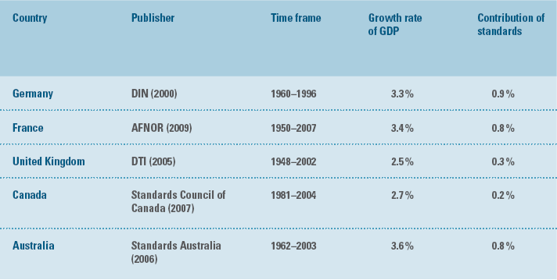
Stimulating Economic Growth: Role of Standards
Notes:
1- The role of standards in the dissemination and diffusion of technical knowledge and their resulting contribution to continual economic growth have already been demonstrated in numerous studies
2- Knowledge must be broadly disseminated so that many companies can make use of it.
3- Standardization does enable the global dissemination of innovations

Slide 6
Innovation Standardization Interaction
Innovation
Knowledge Creation
Economy
Standardization

Slide 7
Relationship with ITU-T SGs

Slide 8
Relationship with ITU-T SGs
FG
New ITU-T Standardization Activities Proposals
TSAG Approval
Innovations with Socio-Economic Impact
New Questions Formulation and Adoption
Study Groups Management

Slide 9
Strategic Purpose and Proposed Deliverables

Slide 10
Root Causes of Ineffective Participation in Std. Process
lack of technical and financial competences;
lack of drivers;
and\or lack of foundational ICT\industrial infrastructure.

Slide 11
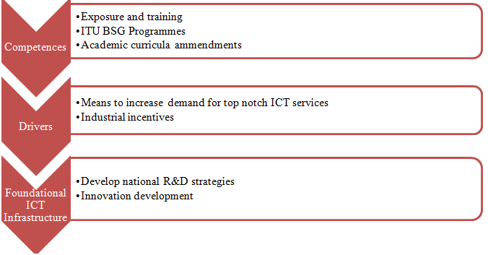
Multi-tiered Strategy for effective Stand. Activities Participation
(Ramy A. Fathy, innovation-i-0041, 2012)
Notes:
To overcome these obstacles, a multi-tiered strategy is proposed, where actions related to:
increasing the competency level on the individual and corporate levels are to be executed. Competency level actions include:
exposure and training on how to participate in the standardization process,
BSG programmes, and
amendments in academic curricula to include standardization related studies.
Enhancing drivers for the effective participation targets two main dimensions; first
developing means to increase demand for top notch ICT services, and
providing industrial incentives to develop national industries in the field of ICT.
Finally, actions targeting the enhancement of foundational ICT and industrial infrastructure are foreseen to be achieved through the development of
national R&D strategies and
developing innovation which have the utmost socio-economic impact on the community.

Slide 12
FG Innovation WG2 Deliverables
Proposals for New Standardization Activities for ITU-T SGs
Proposals for Linking Innovation to Standards

Slide 13
Proposals for New Standardization Activities for ITU-T SGs

Slide 14
Identified So Far Areas of Standardization
Area 1: Information Security related Standardization Activities
Area 2: Machine Intelligence related Standardization Activities
Area 3: Mobile Money Transfer and Mobile Payments Standardization Related Activities
Area 4: Sign Language Communication
Notes:
We will focus on two specific area in some details to illustrate the methodology of the deliverables formulation.

Slide 15
Identified So Far Areas of Standardization
Area 1: Information Security related Standardization Activities
Area 2: Machine Intelligence related Standardization Activities
Area 3: Mobile Money Transfer and Mobile Payments Standardization Related Activities
Area 4: Sign Language Communication

Slide 16
Area 1: Information Security related Standardization Activities
foundational aspect necessary for innovations development developing countries
comprised of five main services:
Authentication;
Access-Control;
Confidentiality;
Fidelity;
Availability;
and Non-Repudiation

Slide 17
Area 1: Information Security related Standardization Activities
Impact drivers for effective participation in the standardization process
Industrial incentives and drivers
Demand
Depends on:
levels of illiteracy, affordability, purchasing power parity, e-content
Depends on:
availability, content digitization, & Copyright protection

Slide 18
Area 1: Information Security related Standardization Activities
Proposed Question on Digital Rights Management (DRM) systems
What are the copyright protection ecosystems, and value chain that affects and/or is affected by underlying telecommunication infrastructure?
How should content developers and content producers secure their content, and maintain secured content distribution networks to protect their content against tampering?
What possible architectures of DRM systems that can be used to secure the licensing, distribution, and playback of digital content on consumer equipments?

Slide 19
Area 1: Information Security related Standardization Activities
Proposed Question on Digital Rights Management (DRM) systems
What are the specifications of DRM systems that can be used to secure the licensing, distribution, and playback of digital content on consumer equipments?
What are the security requirements that content, content distribution systems and architectures; telecommunication operators need to consider in the design, development and sharing of best practices in the copyright protection ecosystems ?

Slide 20
Identified So Far Areas of Standardization
Area 1: Information Security related Standardization Activities
Area 2: Machine Intelligence related Standardization Activities
Area 3: Mobile Money Transfer and Mobile Payments Standardization Related Activities
Area 4: Sign Language Communication
Notes:
We will focus on a specific area in some details to illustrate the methodology of the deliverables formulation.

Slide 21
Area 2: Machine Intelligence related Standardization Activities
Foundational technologies that will impact the ICT systems and devices for next 50 years
Major portion of innovations emerging from developing countries targets vertical markets → depend on underlying systems/hardware for being smart and intelligent

Slide 22
Area 2: Machine Intelligence: Cognitive Radio Case Study
Mitola 1999 first used the term Cognitive Radio (CR): “A radio that employs model based reasoning to achieve a specified level of competence in radio-related domains.”
In 2003, the IEEE USA offered another definition: “A radio frequency transmitter/receiver that is designed to intelligently detect whether a particular segment of the radio spectrum is currently in use, and to jump into (and out of, as necessary) the temporarily-unused spectrum very rapidly, without interfering with the transmissions of other authorized users.”

Slide 23
Area 2: Machine Intelligence: Cognitive Radio Case Study
In 2009, WRC 2012 Agenda item 1.19, “to consider regulatory measures and their relevance, in order to enable the introduction of software-defined radio and cognitive radio systems, based on the results of ITU-R studies, in accordance with Resolution 956 (WRC-07)”, ITU-R Working Party 1B has developed definitions of Software Defined Radio (SDR) and Cognitive Radio System (CRS) to assist in the conduct of studies and related preparations for the second session of the Conference Preparatory Meeting for WRC-12.
Notes:
By September 2009, under the framework of World Radiocommunication Conference 2012 Agenda item 1.19, “to consider regulatory measures and their relevance, in order to enable the introduction of software-defined radio and cognitive radio systems, based on the results of ITU-R studies, in accordance with Resolution 956 (WRC-07)”,

Slide 24
Area 2: Machine Intelligence: Cognitive Radio Case Study
CR are finally formulated as QUESTION ITU-R 241-2/5, titled "Cognitive radio systems in the mobile service" which tackles the concept of CR from a single sided perspective.
Concept of cognition even from the linguistic perspective includes activities related to the faculty of knowing with all the underlying implications of knowledge representation and inference based on that knowledge.

Slide 25
Area 2: Machine Intelligence: Cognitive Radio Case Study
Recent technological advances in CR systems illustrates the use of Artificial Intelligence (AI) algorithms in major parts of the radio development
live example on the necessity of Machine Intelligence standardization activities in the ITU-T even though the technology itself is being considered from the perspective of its implications at the ITU Radio Sector.

Slide 26
Proposed Stand. Activities to SGs Mapping
Area 1: Information Security
Proposed Question on DRM systems
Supervised and Unsupervised learning
Area 2: Machine Intelligence
Area 3: Mobile Money Transfer and Mobile Payments
Area 4: Sign Language Communication
Knowledge Representation
Security in Mobile Payment
Definition
Security and Fraud Mitigation
Sign Language Encoding
Avatar Requirements
SG 17
SG 13
?
SG 2
SG 17
None

Slide 27
Proposals for Linking Innovation to Standards

Slide 28
ICT Innovation Panel
WTSA 12 - Resolution 44
Innovation Panel
Mandates to be transferred
FG
New ITU-T Standardization Activities Proposals
TSAG Approval
Innovations with Socio-Economic Impact
New Questions Formulation and Adoption
Study Groups Management

Slide 29
Standardization-Innovation Sustainability Model
must be standardized
Innovation
Knowledge Creation
Economy Wealth
Business Case
Foundational ICT Infrastructure
Socio-Economic Needs
Standardization
Innovation Panel
Demand
CSSA
Notes:
Standardization affects innovation directly through the dissemination/diffusion of technical knowledge which furthermore helps in the creation of new knowledge/innovations/products/services
Standardization affects innovation indirectly by:
Developing the wealth of any economy hence, develops the whole innovation eco-system on a macro level
Standardizing the innovation foundational ICT infrastructure, hence facilitating the process of innovation development and implementation
Standardizing demand stimulating technologies (like DRM) helps in developing standards that meet the users’ needs

Slide 30
Innovation Panel
Vehicle inside the ITU-T which reviews, assesses, and produces political, economical, technical and social innovation stimulation policies and strategies to be employed by the members affiliated to the ITU
A Mechanism that assists in bridging the standardization gap and in bridging the gap from innovation to standards
An innovation start-up facilitator and a standards incubator

Slide 31
Innovation Panel ToR
Identify, analyze and study best policies & practices that enable development of sustainable innovations for maximum societal benefits
Identify criteria of sustainable innovations, which have max impact on societies
Provide mechanism for innovators\entrepreneurs to introduce their innovations into the ITU standardization process
Conduct studies related to the role of innovation management in developing economies and bridging the standardization gap

Slide 32
Conclusions
Multi-tiered Strategy is necessary for effective Stand. Activities Participation
Innovation stimulation and innovation to standardization integrated policies are key for bridging the standardization gap
Proposing new standardization activities is foreseen to have its positive impact on the economies of developing countries

Slide 33
Questions
Email: rahmed@tra.gov.eg

