Slide 1
Open Innovation and Crowd Sourcing Platforms
Robert Shaw, Head, Innovation Division, ITU-D

Slide 2
“Open innovation is a paradigm that assumes that firms can and should use external ideas as well as internal ideas, and internal and external paths to market, as the firms look to advance their technology.”
- Henry Chesbrough (2003)

Slide 3
“Crowdsourcing is the practice of obtaining needed services, ideas, or content by soliciting contributions from a large group of people, and especially from an online community, rather than from traditional employees or suppliers.”
- Jeff Howe (2006)

Slide 4
“Statistically significant evidence that technology-enabled collaboration with external stakeholders helps organizations gain market share from the competition.”
- McKinsey Research

Slide 5
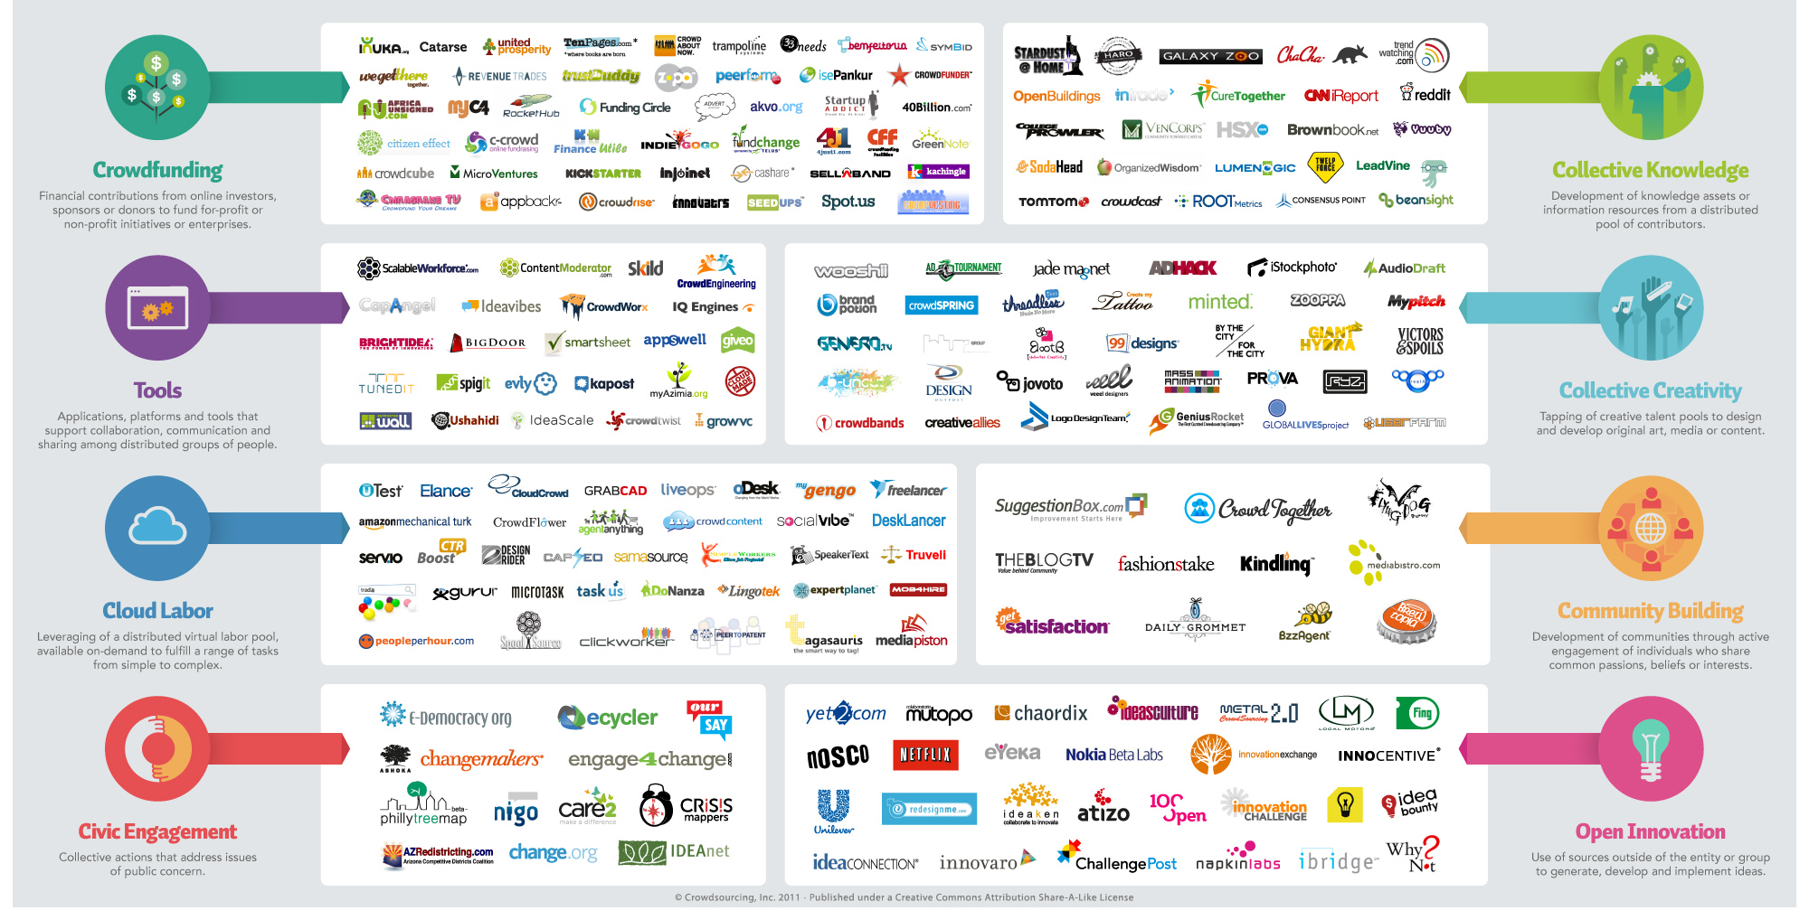
Many platforms & tools available

Slide 6
A Few Development Examples
Open innovation and crowdsourcing for development
1
Kiva
Crowdsourcing micro-enterprise & micro-development funding.
2
txteagle
Data collection and engagement platform that leverages mobile airtime compensation for data collection and customer engagement (e.g. disaster related).
3
World Bank
Crowdsourcing ideas to co-create smarter solutions to development problems, with a focus on Rwanda.
4
OpenIDEO
Open innovation platform where community solves problems for social good – toolkits, nice platform
5
Gates Foundation
Grand Challenges in Global Health: US$100 million to encourage scientists to "expand the pipeline of ideas" to fight the world's greatest health challenges.

Slide 7
Case Study: How we used crowd sourcing for the Global Youth Summit, 9-11 September 2013, Costa Rica

Slide 8
Global Youth Summit BYND2015
Some numbers
600 participants from 68 countries
4000 joining from globally dispersed 50 hubs
1000 ideas generated on our crowdsourcing platform, 15,000 votes, 12,000 comments
Tens of thousands joined conversation on social media
Education, health and access to ICTs ranked as highest trending topics

Slide 9
The Crowdsourcing Project
Step-by-Step
Began with a face-to-face “Design Thinking” Millennials Jam to seed ideas for the crowdsourcing platform with 40 young people
Objective was to create a set of “How might we…” questions…
Millennials Jam

Slide 10
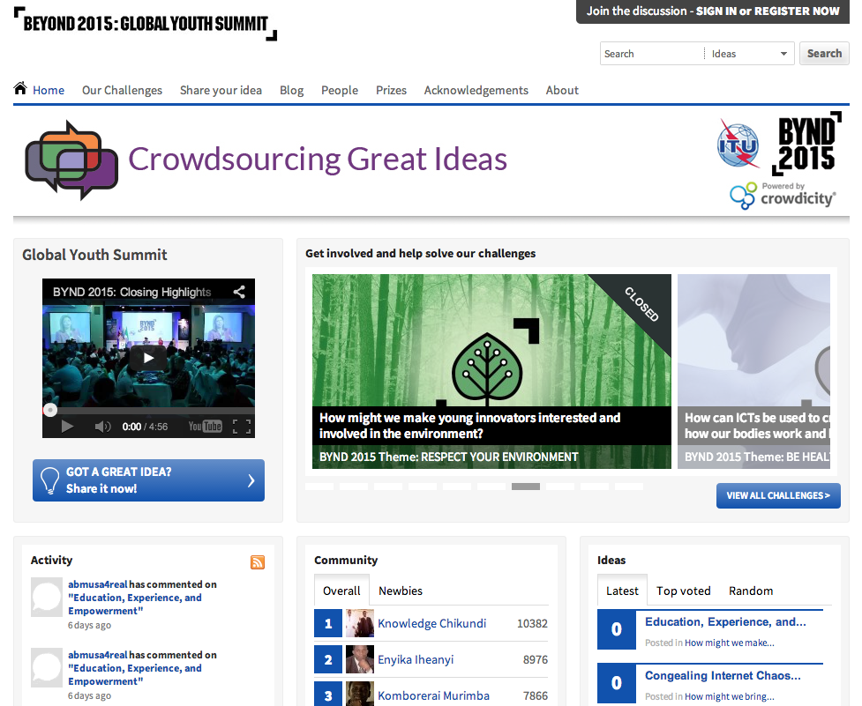
The Crowdsourcing Project
Experiences
10 “How might we…” challenges were posted on the Crowd Sourcing Platform
http://ideas.itu.int

Slide 11
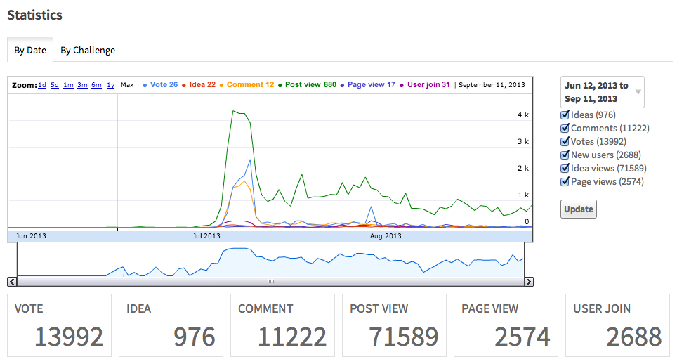
#BYND2015 Crowdsourcing Project
Statistics

Slide 12
#BYND2015 Crowdsourcing Project
Some lessons learned
Need well-articulated challenges to focus debate
Managing a well-defined group (e.g., staff, internal consultation) is much more manageable than managing open to all group
If latter, don’t underestimate need for “adult supervision”
If latter, single sign-on using logins through other social media registrations reduces barrier to user management

Slide 13
#BYND2015 Crowdsourcing Project
Some lessons learned cont’d
Incentive system is helpful and builds community
Support for “funnel process pipelines” to stage phases of contributions very important – move forward only useful ideas
Leaderboards derived from user activity are interesting but participants may try to “game the system” – activity ≠ substance
Constant feedback on process stages important
Stage 1
Stage 2
Stage 3
Stage 4
Stage 5
Final Stage

Slide 14
Thanks. More info at innovation.itu.int
Robert Shaw <robert.shaw@itu.int>

