Slide 1
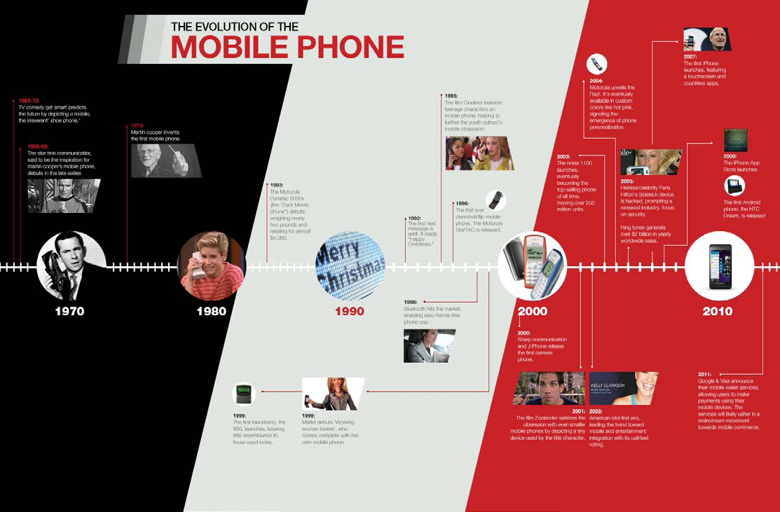
92’ – 1st Text Message
Merry Christmas
96’ – 1st Flip Phone by Moto
Debut by Motorola in 80’s weighing 2 pounds & costing in excess of $4k
2007
1st iphone Launched
2005
Ring Tones added $2Trillion
Martin Cooper Invention in 70’s Inspired by Star Trek’s
Communicator
2013
BB10 Launched
2008
iApp Store + Android 1st Phone
2003 – Revolutionary Nokia 1100 Launched in India – 200 Million Phones Shipped

Slide 2
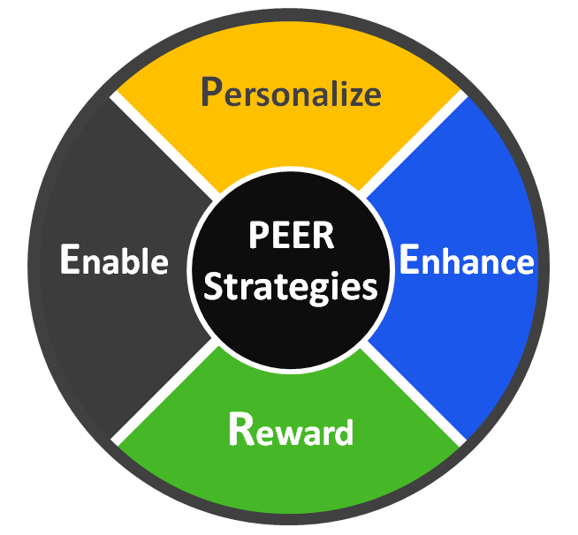
Engaging Consumers with Peer Strategies
Learn & Adapt
Surprise & Delight
Remove Frictions
Reinforce
Notes:
From any technology oriented product point of view, the engagement of consumers happening through peer strategy goes through 4 fundamental processes.. i.e. Personalize, Enhance, Reward and Enable. Functionally all these processes have basic characteristics as mentioned along. We will look for behaviors in each process in detail in next slide.

Slide 3
Personalize
Leverage data about “consumer needs” and their context to increase the relevance, timeliness and value of communications, offers and customer experiences
Enhance
Help customers complete tasks and accomplish their goals by minimizing the risk, time, and effort as they shop, compare, purchase and use your products
Reward
Surprise and delight customers by anticipating and helping them fulfil functional requirements, emotional needs and aspirations
Enable
Using feedback, encouragement, rewards and social influence, reinforce customers as they engage in behaviours that are mutually beneficial
Notes:
Against each process is mentioned the behavior of the brand. We will look at examples in every process behavior from next slides

Slide 4
Personalize
Leverage data about “consumer needs” and their context to increase the relevance, timeliness and value of communications, offers and customer experiences
Nokia 1100 – Introduction of Torch – “Made for India” – “Har Jeb mei Rang”
Color Phones contribute to 94% of the overall market. Innovated and Invented in India,
this phone did 200+ Million units shipment world wide
Anti Slip Grip - “Mobile Phones are Virtual Shops”, remain in hand for 80% of work time
Poor Power Situation in India - Solar Charged Phones from Samsung
Long Battery Life in feature Phones – 30 day standby, Micromax, Indian Brand
Dual Sims – Dual Identity – Dual Lives – 60% of the market, Indian Brands
Key Pads to Touch and Key Pad to Full Touch – 98% of market is TOUCH
Ambit of Indian Chinese Brands – 300+ Brands – 40% of Value Market
Apps as per need of everyone – Different People, Different Needs
Notes:
Examples against each behavior

Slide 5
Enhance
Help customers complete tasks and accomplish their goals by minimizing the risk, time, and effort as they shop, compare, purchase and use products
Operators focus
Mobile Traffic Data is @ 1.2 Exabyte's/month from 0.6 in 2012
India is 3rd Largest Internet Base with 120 million consumers
69% of SP Consumers use their Mobiles to Access Internet
80% of device market is now with 3G capability
Dual-Core / Quad Core Devices
Services like MAPS, India is the largest Navigation market in world
Processing Speed of Devices will define SP usage
Massive HD Screens
Touch Screen is predominant form factor
5’ inch is acceptable, Tablets
Millions (and Billions) of Apps
Gaming, Imaging, Music Stores, Fashion, Cartoons, Entertainment, SNS
Platform Consolidation
Android >70% of the market both in Volume and Value
Notes:
Examples against each behavior

Slide 6
Reward
Surprise and delight customers by anticipating and helping them fulfil functional requirements, emotional needs and aspirations
Sony - Water and Dust Resistant Phones
Security Related Phones for Specific Targets to School Kids and Elderly
Consumer Finance Offers – Affordability.
Initiated by Apple, EMI is a industry norm
Women Dedicated Phones – Bling from Micromax
Apps dedicated for Women like
Calorie Meter, Health Tips, Fashion tips , etc
Enterprise Need – Push emails from Blackberry
Notes:
Examples against each behavior

Slide 7
Enable
Using feedback, encouragement, rewards and social influence, reinforce customers as they engage in behaviours that are mutually beneficial
Consumer Finance Offers – Affordability
Initiated by Apple, Equated Monthly Installment is a industry norm
Buy Back Offers has become a World Phenomena
Vodafone – Blackberry Boys Ads – Institutionalized and
Generated curiosity consumer community beyond Enterprise
Reviews and Opinions
Lead Management Strategy – OLX – Free Listing and Trading
Brand Recommendation Strategy SnapDeal (Coupons), Flipkart, Jabong etc
Retail Recommendation Strategy
E-Commerce
India has 10 million Online Shoppers and growing @ 30% p.a.
$14B market opportunity
Integration of After Sale Service Networks
Common Platforms for Multiple brands
Distribution – B2B, B2C, C2C – All In Ones, Zonal Distribution. Regional Partners, National Partners
Notes:
Examples against each behavior

