Slide 1
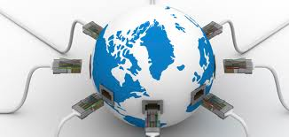
ICT Innovations for Health
Dr Rahul Kohli
M.B.B.S, DNB (Ortho)
Consultant – Fortis Hospital, New Delhi

Slide 2
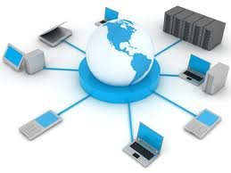
Target of ICT
To reduce health care gaps between developed and developing countries .
Strategies for improving the quality of care using information systems in resource poor settings.
Promote collaborative efforts of government, planner, health professionals and other agencies along with international organizations for creating a reliable ,timely ,high quality and affordable health care and health information systems.
Promoting continuous medical training , education, and research through the use of ICT.

Slide 3
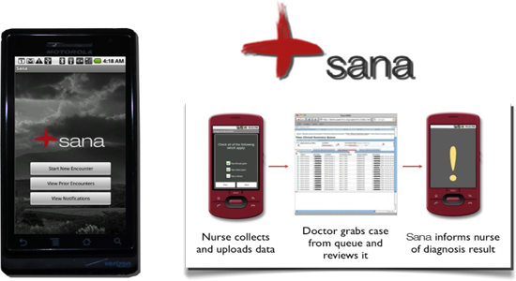
SANA Philippines
Cell phone base telemedicine system use for treatment of hypertension .
It’s a open source system that supports audio, images, location based data ,text .
Software is downloaded to the phone so decision support is available even when connection is poor or non-existent.

Slide 4
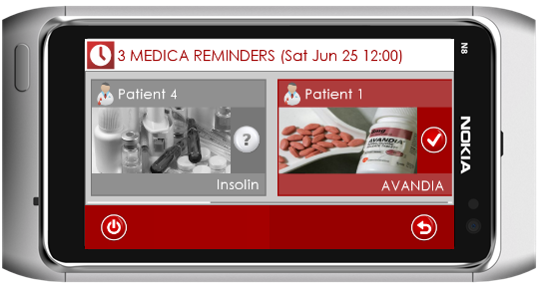
Medica Egypt
It is a multimedia prescription manager and medication reminder.
Users can store and manage as many prescriptions as they wish, each with multiple medications.
The application also reminds patients to attend treatment sessions and follow-ups.
Users can record audio messages from doctors and attach the audio to the prescription, so as to recall the doctor’s face-to-face instructions.

Slide 5
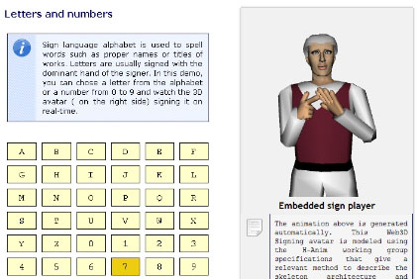
MMS Sign Tunisia
To make cell phones accessible to deaf
The project consists of a new service which converts SMS to MMS: the deaf person receives the MMS containing a translation of the initial textual message into a 3D Computer-Generated- sign language Image

Slide 6
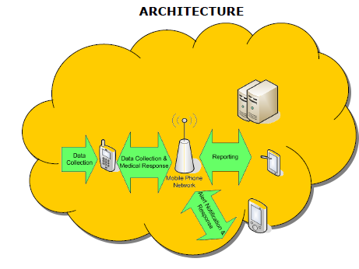
Mobile-based Health Management System Trinidad and Tobago
For improving self-care management of patients with chronic diseases (diabetes and cardio-vascular disease ).
Bluetooth-enabled measuring devices such as a blood glucose meter provide feedback/informational on patient mobile phone, based on the current and historical readings it recommends a certain course of action.
In critical situations, the software may notify the patient’s doctor or caregiver.

Slide 7
Spider Tanzania
To facilitating antenatal and postnatal care.
The project is to develop a hybrid (web/mobile) system that would improve the access to health data on pregnant mothers and the children under the age of five and to improve the education and communication between pregnant mothers (and mothers of children under the age of five), community health workers, traditional birth attendants and facility health workers.

Slide 8
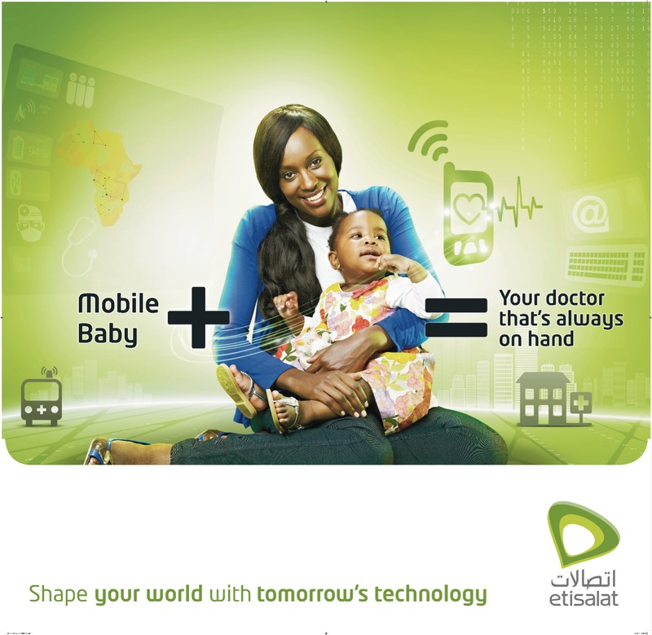
Mobile Baby UAE ,Nigeria and Saudi Arabia
Maternal Health program
Remotely monitor pregnancy evolution using ultrasound.
Identify and report danger signs during labour and delivery.
Pay for emergency transportation using money on the phone.
Communicate with the referral facility for emergency transfer and requirements on arrival.

Slide 9
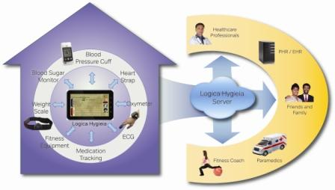
Logica Hygieia In India
It is a two -way communication ,for doing real time monitoring of patients with chronic diseases or patients at high health risk such as coronary illnesses, diabetes and strokes
Doctor types a prescription which is transmitted directly to the intelligent Hygieia server, which then forms a daily planner for the patient and sends it to his mobile device acting as a patient’s personal assistant.
Hygieia also interacts with external medical devices, like Pulse Oximeter , Glucometer , B P monitor, etc.

Slide 10
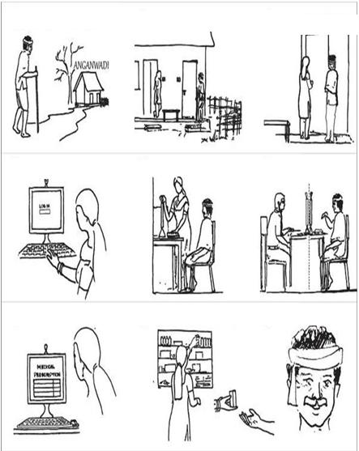
iKure (WHIMS ) wireless health incident monitoring system for rural India
medically trained Health workers (including midwives) takes relevant information from patient and connects, using normal broadband/data card lines, to an enlisted doctor at hospital.
Record symptoms of patients (using graphical symptom recorder).
The doctor advises relevant clinical tests (ECG, Blood Sugar, etc.).
Upload patient reports
suggest a treatment plans to patients

Slide 11
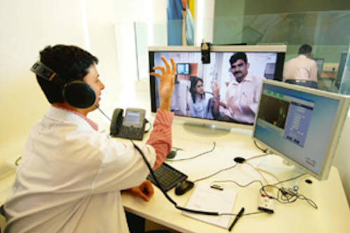
ReMeDi (Remote Medical Diagnostics)
Places where people are mostly treated by un/semi-qualified personnel diseases are detected late .
Software can measure basic parameters like ECG, temp, BP, oxygen saturation, and heart & lung sounds and provide patient’s vital information to a remote doctor for preliminary diagnosis .
With video conferencing between doctors and patients and images taken using a normal web camera, doctors can provide Eye care, Dermatology and ENT service.

Slide 12
ICT Innovations in Orthopedics
Video assisted operations at tertiary center .
Computer assisted TKR(Navigation Tech)
Live surgeries demos.
Audio visual conferences (throughout the world)
Advantage: Knowledge and latest techniques sharing
Docs can discuss on same panel at the same time
Operations in remote places village/ video/voice call .
You-Tube is quite helpful.

Slide 13
What are we looking for from ICT world
Broadband – everywhere & unlimited bandwidth.
High resolution mobile devices.
May be a medical phone with a stand , so that we don’t have to search places/options to keep it upright! (e.g. photo frame).
Longer battery power/ solar charging
More medical friendly phones, with medical dictionaries where people can understand what is what in different continents (language convertor).
Field specific phones with comprehensive textbooks .

Slide 14
THANK YOU

