Slide 1
Innovations in Mobile Money
ITU Workshop on
“ICT Innovations in Emerging Countries”
(New Delhi, India, 14 March 2013)
Vijay Mauree,
Programme Coordinator, ITU
Vijay.mauree@itu.int

Slide 2
Overview of Presentation
ICT Innovations Repository
Mobile Money Financial Services
Types of Mobile Financial Services
Mobile Proximity Payments
Mobile Payments : Financial Inclusion
Standardization

Slide 3
ICT Innovations Repository
The Innovations Repository contains non-exhaustive information about activities on ICT innovations in emerging economies globally.
212 ICT Innovations
Repository hyperlink:
http://www.itu.int/en/ITU-T/focusgroups/innovation/Documents/repository-innovation-v2-may2012.docx

Slide 4
Various Sectors in which ICT Innovations are being implemented
e-Health
e-Education
e-Banking
e-Agriculture
Mobile Payment / Mobile Financial Services
e-Environment
e-Commerce/Trade
e-Governance
e-Journalism
Rural Mobile Connectivity
Providing electricity in Remote areas
e-Transport

Slide 5
Mobile Money Technology Watch Report
Analysis published under Technology Watch Report on Mobile Money
Report is in two parts
NFC Mobile Payments
Enabler for financial inclusion

Slide 6
Mobile Financial Services
No universal definition for the term mobile money
Mobile money refers to financial transactions and services that can be carried out using a mobile device such as a mobile phone or tablet.
These financial transactions and services are sometimes referred to as mobile financial services and may or may not be linked directly to a bank account

Slide 7
Mobile Financial Services
Lack of global standards
Interoperability
Regulatory issues

Slide 8
Types of Mobile Financial Services
Mobile Payments (P2P, B2C/C2B)
Proximity Mobile Payments
Remote Payments
Mobile Money Transfer (P2P)
Domestic
International
Mobile Banking

Slide 9
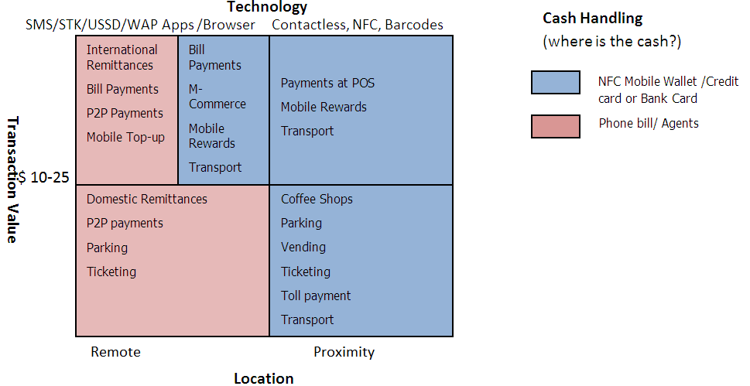
Spectrum of Mobile Payments

Slide 10
Mobile Proximity Payments
Mobile Wallets
Google Wallet
ISIS Wallet
Mastercard
Visa
Mobile Phone as a PoS
Square
Verifone
Cloud
YesPay, Mobito

Slide 11
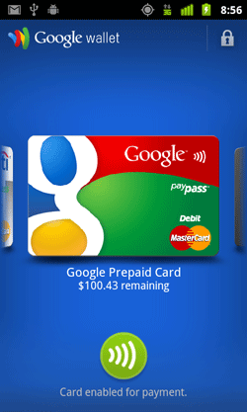
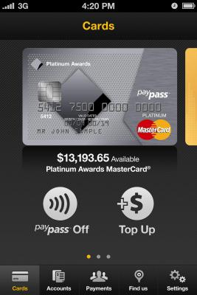
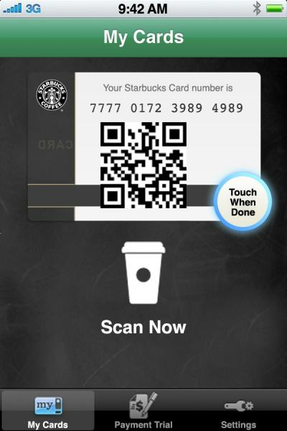
Mobile Wallets

Slide 12
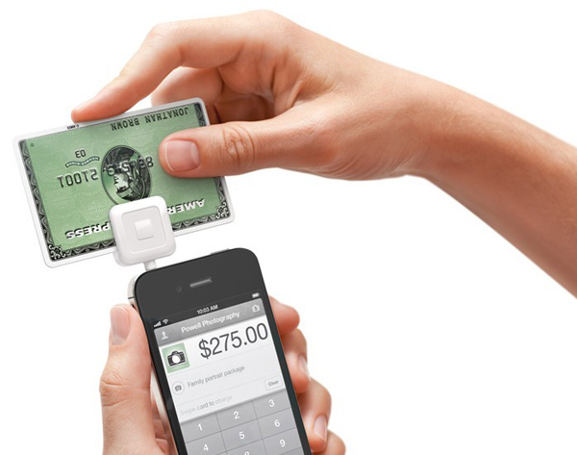
Mobile as POS

Slide 13
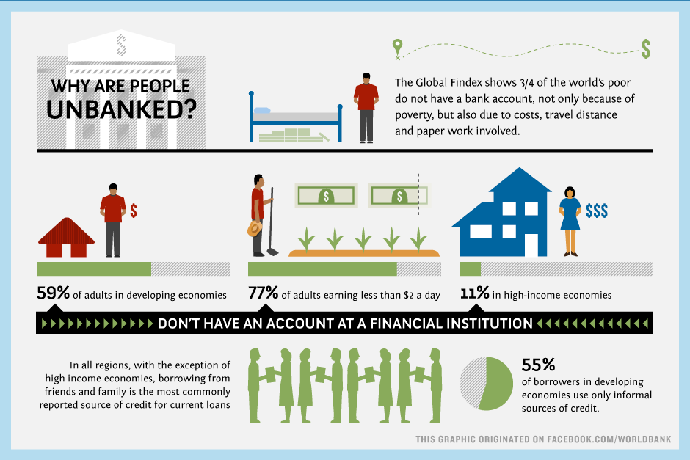
Mobile Payments : Financial Inclusion

Slide 14
Mobile Money : Financial Inclusion
Applications of Mobile Money in Emerging Economies
P2P Transfers
G2P payments
Bill Payments
Banking Services
Airtime Recharge

Slide 15
Mobile Money Transfer
Technologies used
USSD
Secure STK
WAP
Application

Slide 16
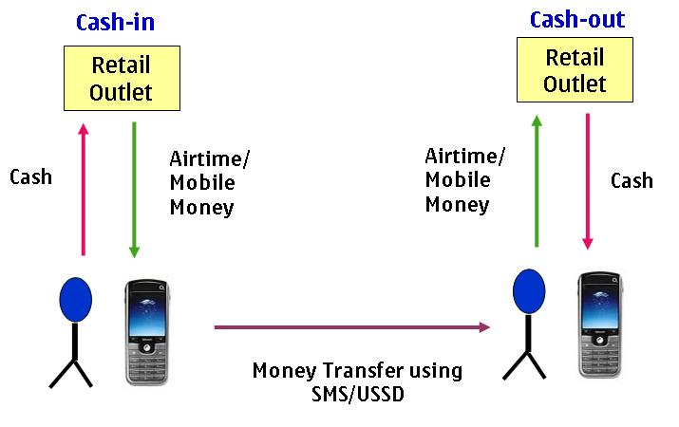
Mobile Money Transfer

Slide 17
Mobile Payments : Ecosystem
Bank Centric
MNO Centric
Partnership

Slide 18
Standardization
ITU
ISO
Global Platform
NFC Forum
GSMA
Smart Card Alliance

Slide 19
Standardization
Areas to consider
Security of transactions
Mobile Payment architecture
Proximity NFC payments
Cloud based payment
Interoperability for smartphone applications
Mobile Money Focus Group

Slide 20
Thank You

