Slide 1
Solution for smart utility connectivity solutions
ITU Workshop on
“ICT as an Enabler for Smart Water Management”
(Luxor, Egypt, 14-15 April 2013)
Paolo Gemma,
WP3/5 chairman
Senior Expert, Huawei paolo.gemma@huawei.com

Slide 2
Change The World-Four Megatrends
Developed Countries’ Labor Forces Substantially Age and Decline
Population Growth Increasingly Concentrated in Emerging Countries
Economic Power Shifts to Developing Nations
World’s Population Becomes Urbanized
The world around us is undergoing a major transition, those environmental impacts of this massive urbanisation are significant.

Slide 3
City Promotion-Urbanisation Calls for Smart City Solutions
_{Food Safety}
_{Increasing}
_{Population}
…
_{Security}
Smart City
_{Pollution}
…
_{Traffic}
_{Congestion}
…
_{Health &}
_{Education}
_{Natural}
_{Disasters}
D₄
“The strategic and economic policies of the 20th century are obsolete, and it is time to find new ones.”

Slide 4
Our Vision - Four Fields Of Smart City
Safe City
Banking
Monitor
Health
Emerngy
Smart City
Efficient
Gov.
Happy Life
Park
City
Admin
Tourism
Hotline
Green Industry
Succesful Smart City Development Relies on
Standardization
Planning
Innovative
Coordination
Build a completion set of Information standards
Adopt right constructure model
Establish a clearly-defined city innovation mechanism
Well-managed and coordinated city operations

Slide 5
Creating a Sensing System-Pattern of Smart City
Sense and activities of an smart city
Intelligent Traffic Solution
Urban Emergency Solution
Digital City Management Solution
e-Health Solution
….
Activities Service applications
Information Processing
Intelligent Analysis
Brain Platform layer
Information Convergence
Application Convergence
Brain of a smart city: ECP and IDC
Nerve Network of a smart city: communications network, Internet, and Internet of Things
Neuron of a smart city: M2M terminals and gateways
Nerve Ending of a smart : wireless sensing network (WSN),IVS
Nerve network Network layer
Internet of Things
Internet
Communications Network
Body and Five senses Sense layer
Sight
Hearing
Touch
Taste
Smell

Slide 6
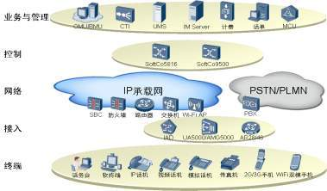
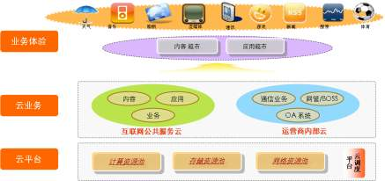
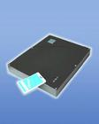
t Layer Perspective – Anatomize Smart City Solution
Application Layer
Efficient Government
Safe city
Green Industry
Happy Life
Platform Layer
eSpace Collaboration Platform
IT Engine
CT Engine
M2M Engine
App Integration
IDC
Network Layer
Communication Network
Internet
M2M network
Sensor Layer
PC
Mobile
RFID Reader
Camera
Information collect terminal
Sensor network terminal

Slide 7
Comparison of Various Communication Technologies
Wired
Technology
Grid Carrier Cable (PLC/BPLC), Field Bus (RS232/485), Special Audio Line (PCM)
Poor stability and interference issues
Unable to support data collection and video surveillance
Industry Ethernet Network
Middle capacity to support data service
High initial costs, difficult deployment in some scenarios
Fiber xPON
Large capacity to support data service
High initial costs, difficult deployment in some scenarios
Wireless
Technology
Specialized 230Mhz Microwave Communication
Narrowband technology
Unable to support data collection and video surveillance
Public GPRS/CDMA/EDGE
Low bandwidth and high time delay, and bad security
Uplink bandwidth not to support video surveillance
Private LTE Network
Additional costs for frequency bands
High bandwidth and low time delay, and high security to effectively support distribution
Private LTE Network is of great advantage in building an efficient, real-time, reliable and economical grid
Notes:
In existing technologies, there are 2 technology, that is wired and wireless technology.
有线技术：
窄带、数据业务
某些场景部署困难成本高
In wired technology, whether cable, Ethernet or fiber xpon, can only provide limited data services, and furthermore,in some scenarios they cause difficult deployment and high costs.
无线技术：
Existing wireless technologies in grid market include microwave, 2G,3G and 4G.
微波：窄带、无数据业务
2G/3G公网：低带宽、高时延、安全性差
LTE专网：高带宽、低时延、高安全性，
however the frequency band need be achieved.
常用的无线通信方式及各无线技术的应用场景及对比分析如下所示：
Since we have known the importance of communication system, let’s have a look at the benefit of wireless communication system.
Compared with cable network, which is now widely used in grid, the wireless network is fit for wide range coverage, where the deployment of cable is difficult, both for the feasibility and the cost.
Compared with the public wireless network, which will result in a continued lease, the establishment of a private communication network will make high value of money.
Besides this , a private network is also more reliable, both for the information security and for the structure of network, such as redundancy for boards and NEs.
Data collection, video surveilance,PTT ,all these services can be used during the production process. These services cause a large data stream which needs broadband communciation.
As we’ve talked, communciation system can help to improve the production effiency, dedicated wireless network is more fit than cable network or public network, a broadband system is necessary for the multi services.
As a conclusion, huawei eLTE solution can meet the requirement of distribution in grid.
3G public network can’t guarantee enough bandwidth to provide stable service; LTE can simultaneously support voice, video and other broadband services, and is becoming final choice of all the vertical industry customers in the future.

Slide 8
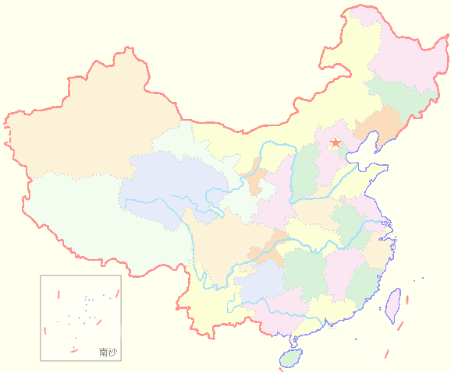
China’s Comprehensive Data Dispatch Network Grid
China
A Plane
The world’s largest power grid backbone network
5 Region core nodes, 25 provincial core nodes
99.999% reliability
Enough bandwidth to meet requirements for 10 years
Northeast Bureau
North China Bureau
Northwest Bureau
East China Bureau
B Plane
Central China Bureau
Notes:
Here is our successful stories, the first one is Strong Power Communication Network for State Grid of China, we help our customer to build a comprehensive dispatch data network, it achieves unified management of services and operation, and also the centralized dispatch to cut OPEX and consolidate the reliability of network, bring great benefits for our customers

Slide 9
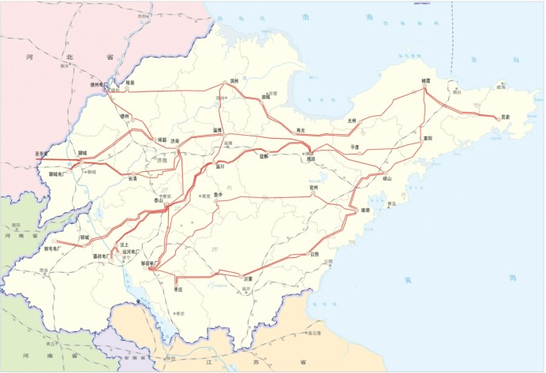
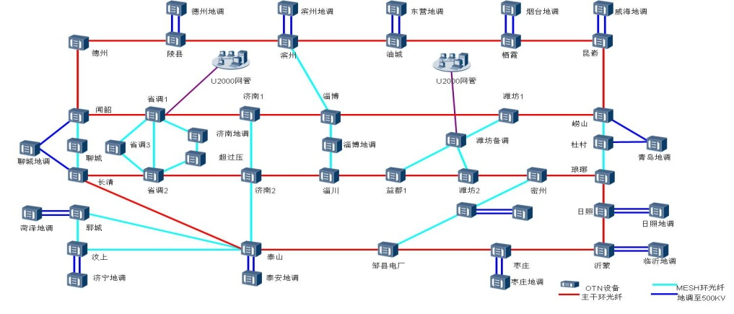
Most Reliable OTN Transmission Network
China · Shandong
World’s 1st provincial OTN
40*10 G — enough bandwidth to meet requirements for 5 years
Coverage for multiple points of failure
Notes:
The next one is our fist distribution LTE network for China Southern Power Grid), as we know, the security, adaptability and reliability is the most critical requirements of distribution network, for some areas that is difficult to deploy wired network, Huawei provide a flexible LET wireless solution. In this project, Huawei LTE network can adopt all kind of xTU in different terrain, and it provides the ability to fast deployment, flexible service expansion and secure and high rate data transmission. It reduces the TCO significantly.

Slide 10
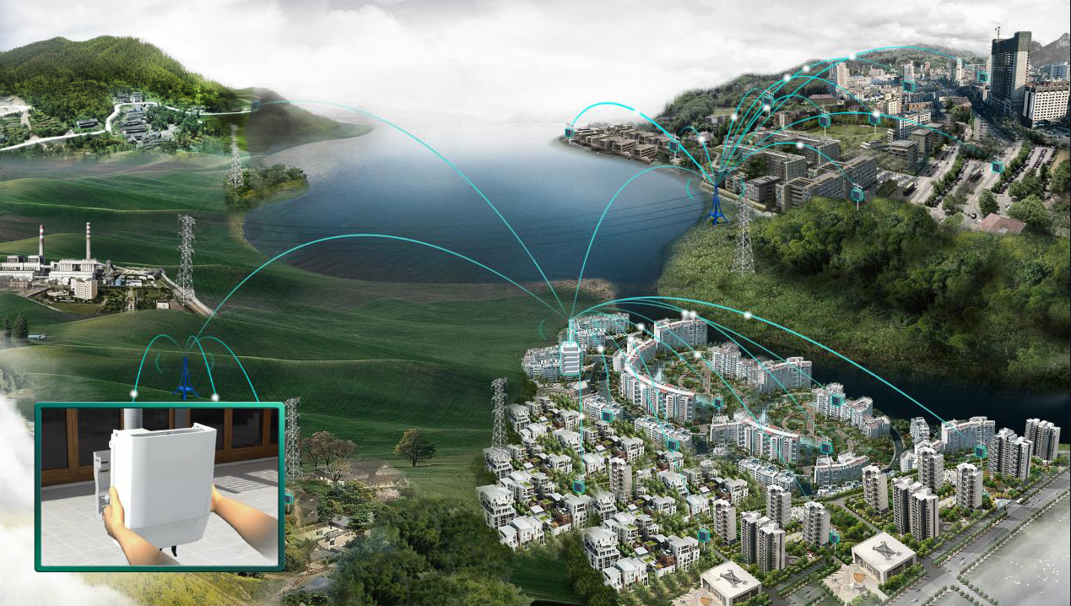
Advanced DA Communication Network – Zhuhai Bureau
China · Zhuhai
World’s 1st LTE network for the DA communication network industry
<100 ms latency, supports DA service
Construction period 60 days
Notes:
The next one is our fist distribution LTE network for China Southern Power Grid), as we know, the security, adaptability and reliability is the most critical requirements of distribution network, for some areas that is difficult to deploy wired network, Huawei provide a flexible LET wireless solution. In this project, Huawei LTE network can adopt all kind of xTU in different terrain, and it provides the ability to fast deployment, flexible service expansion and secure and high rate data transmission. It reduces the TCO significantly.

Slide 11
Distribution Automation Solution: First campus LTE distribution network
Benefits
OLT
ODN
ONU
① Wireless and fiber-optics
provide 100% coverage
Guarantees tele-command, telemetry, and tele-signalling services
Reduces costs by 20%
Reduces fault response time from 30min to 60sec
eNodeB
CPE
② Access delay <100 ms
eNodeB
CPE
DA terminal
MSTP/IP
③ 10 M wireless bandwidth
Master station
eNodeB
CPE
Bank payment
terminal
Emergency command
④ Improved efficiency and safety with video surveillance
Substation
OLT
ODN
ONU
Notes:
30min是指主要依赖人工定位故障点
60sec 是指从配电故障点发生到确认故障类型，地点的时间

Slide 12
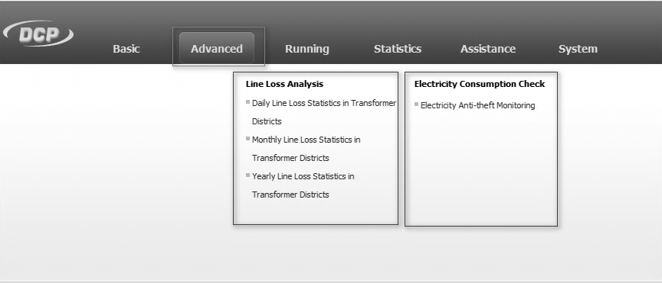
AMI Solution: Reduces Line Loss, Improves Efficiency
① DLMS Complied Remote Collection
Benefits
②Single Remote Collection Success Rate up from 70% to 99%
③ Intelligent alarm & line loss
abnormality analysis
GPRS
Improves meter reading efficiency
Reduces line loss to 9%
Unifies access for distribution & consumption, improving utilities’ efficiency
GPRS Direct Connection Meter
Interfaces
Residential consumers
eNodeB
Data Collection Platform
LTE
Billing
Pre-pay
SCADA
Call Center
High Accuracy Meter
DCU
Industrial and commercial consumers
xPON/Ethernet
Single / Three-Phase Meter
④Seamless integration with SCADA supports pre-pay
Water meter
In-home display
PLC

Slide 13
Constructing a Strong Backbone Communication Network – Transmission and Transformation Communication Solution
Benefits
① E-PTN carries both TDM and IP services
② 380 km per span without relays
Reduces investment
99.999% reliability with ASON
Enough bandwidth to meet requirements for 10 years
OA
Substation
③Leading ASON technology
Relay protection
Substation
HD conference
④ 10 G bandwidth, evolves easily to 40 G
Video conference

