Slide 1
Overview of
ITU-T Study Group 5
“Environment and Climate Change”
Paolo Gemma
Chairman of Working Party 3 of ITU-T Study Group 5

Slide 2
ITU-T Resolution 73 on ICTs, the Environment and Climate Change Revised and consented at World Telecommunication Standardization Assembly (Dubai, 2012)
Recognizes that ICTs play a vital role in tackling environmental challenges;
Resolves to promote the use of ICTs as cross-cutting tool to assess and reduce GHG emissions, optimize energy and water consumption, minimize e-waste and improve its management;
Supports studies on, inter alia, green data centers, smart buildings, green ICT procurement, cloud computing, energy efficiency, smart transportation, smart logistics, smart grids, water management, adaptation to climate change and disaster preparedness, and reduction of GHG emissions;
Encourages internal and external collaboration to move forward the environmental global agenda.

Slide 3
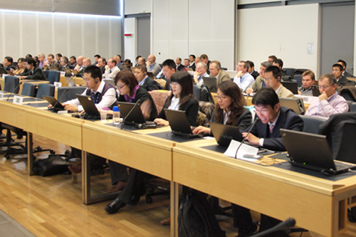
ITU-T Study Group 5

Slide 4
Terms of Reference
Study Group 5 is responsible for studies:
on ICT environmental aspects of electromagnetic phenomena and climate change;
related to electromagnetic compatibility (EMC), to safety and to health effects connected with electromagnetic fields produced by telecommunication installations and devices, including cellular phones.
Responsible for studies relating to protection of telecommunication networks and equipment from interference and lightning
Study Group 5 is lead SG for:
Environment and climate change
Electromagnetic compatibility and electromagnetic effects

Slide 5
Structure of ITU-T Study Group 5
ITU-T SG5
“Environment and climate change”
Q 12 Terminology
WP1/5
Damage prevention and safety
WP2/5
Electromagnetic fields: emission, immunity and human exposure
WP3/5
ICT and climate change
5 Questions
6 Questions
7 Questions

Slide 6
Overview of
Working Party 3/5 “ICT and climate change”

Slide 7
Working Party 3/5 “ICT and climate change”
WP3/5 is responsible for studies relating to ICT, environment and climate change, development of methodologies for evaluating the ICT effects on climate change and publishing guidelines for using ICTs in an eco-friendly way.
Work areas:
Q13/5 - Environmental impact reduction including e-waste
Q14/5 - Setting up a low cost sustainable telecommunication infrastructure for rural communications in developing countries
Q15/5 - ICTs and adaptation to the effects of climate change
Q16/5 - Leveraging and enhancing the ICT Environmental sustainability
Q17/5 - Energy efficiency for the ICT sector and harmonization of environmental standards
Q18/5 - Methodologies for the assessment of environmental impact of ICT
Q19/5 - Power feeding systems

Slide 8
Egypt & Smart Water Management
Ancient Egyptians practiced a form of water management called: the "Basin Irrigation", a productive adaptation of the natural rise and fall of the river.
Indirectly, the Basin Irrigation practice, provided the Ancient Egyptians with an efficient domestic wastewater treatment and disposal system.
The wastewater percolates into the Soil. Soil “anaerobic” bacteria breaks down “digest” any nutrients before the wastewater reaches the water streams.

Slide 9
ICT for Smart Water Management
First civilizations developed around water, which was and still is the catalyst for economic growth and basic services.
Ensuring continuity of water supply in cities is imperative.
Cities cannot be sustainable without ensuring reliable access to safe drinking water and adequate sanitation.
Over-exploitation of water resources.
Pollution of the ground-and surface water resources.
Leakage-loss in urban distribution systems.
Serious health problems.
Water-related disasters such as floods and droughts.
CHALLENGES

Slide 10
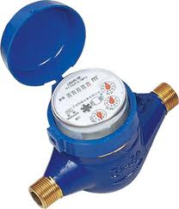
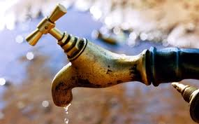
ICT for Smart Water Management (cont’d)
ICT can bring enormous benefits to water authorities in mapping and monitoring natural water resources, as well as in forecasting river flows and giving advance warning of water-related emergencies such as flooding.
Smart metering technologies enable:
the measurement of water consumption in real time, identifying leaks at the consumer level and making consumers more conscious about their water usage.
More accurately usage tracking at consumer level for water utility companies, and the implementation of water-pricing plans to encourage water conservation.
Water use in manufacturing plants can also be managed more efficiently using ICT:
Proper operation of the cooling system is needed to minimize the impact of total operational costs related to water and energy consumption, chemicals and wastewater discharge.
SOLUTIONS

Slide 11
Question 15/5 ICTs and adaptation to the effects of climate change

Slide 12
Question 15/5 ICTs and adaptation to the effects of climate change
Brief Description
Main Tasks
Using ICT to better enable countries to adapt to climate change
Establishing a robust telecommunications infrastructure for extreme climate conditions
Helping countries adapt to the negative effects of climate change using ICT
Establishing links at regional and national levels
work program
Drafting deliverables (See next slide)
Establishing requirements via questionnaires and analysis
Seeking cooperation with expert groups
Encouraging ICT industry involvement in climate change adaptation

Slide 13
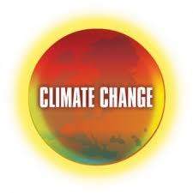
Question 15/5 (cont’d)
Examples of deliverables:
ITU-T L.adaptation and infrastructure
Adapting the ICT sector and infrastructure to the impacts of climate change
Best practices for countries to use ICT in adapting to the effects of climate change
ITU-T L.Repeater
Best practices for submarine repeaters in the dual role of communications and environmental monitoring services
Report on Portal requirements
Specifying requirements and initial content for a new ITU-T portal on ICT and adaptation to climate change

Slide 14
ITU Events in Italy
8th Symposium on ICTs, the Environment and Climate Change
6-7 May 2013 – Turin, Italy
jointly organized with the Italian Ministry of Economic Development and hosted by Telecom Italia
1st Meeting of Focus Group on Smart Sustainable Cities
8 May 2013 – Turin, Italy
Workshop on Human Exposure to Electromagnetic Fields (EMFs)
9 May 2013 – Turin, Italy
jointly organized with the Italian Ministry of Economic Development and hosted by Telecom Italia

Slide 15
Lead with vision
build a green economy promoting the implementation of products and services based on international standards that are developed on a life cycle assessment of water footprint, and raise awareness of the water footprint of commonly used products and services
ITU-T SG5 stands ready to help in this effort.

Slide 16
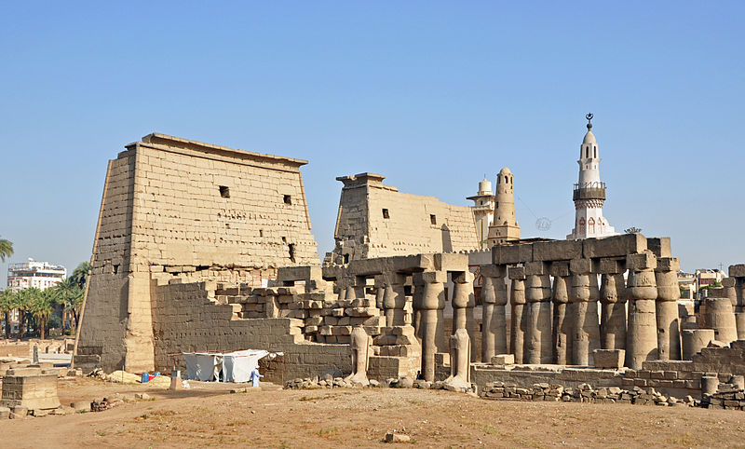
Thank YOU
greenstandard@itu.int

Slide 17
Additional slides

Slide 18
Overview of upcoming symposiums, events and workshops

Slide 19
ITU Events in Italy
8th Symposium on ICTs, the Environment and Climate Change
6-7 May 2013 – Turin, Italy
jointly organized with the Italian Ministry of Economic Development and hosted by Telecom Italia
1st Meeting of Focus Group on Smart Sustainable Cities
8 May 2013 – Turin, Italy
Workshop on Human Exposure to Electromagnetic Fields (EMFs)
9 May 2013 – Turin, Italy
jointly organized with the Italian Ministry of Economic Development and hosted by Telecom Italia

Slide 20
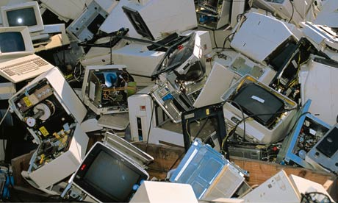
Environmentally sound management of e-waste: emerging issues, challenges and opportunities 14 May 2013, from 11:00 to 12:45 at WSIS forum
Overview of best practices on policies, regulations and international standards for improving e-waste management
How WEEE has a negative impact on the environment and human health
How WEEE can provide opportunities to
create green jobs
curb health problems
cut greenhouse gas emissions
recover valuable metals from redundant, excessive or end-of-life ICTs

Slide 21
3rd ITU Green Standards Week
To bring together leading specialists in the field, from top policy-makers to engineers, designers, planners, government officials, regulators, standards experts and others.
To raise awareness of the importance and opportunities of using ICT standards to build a green economy.
Programme:
16/09: ITU, UNEP, UNU, CEDARE Workshop on E-waste
17/09 (morning): Information Session on Green ICT Standards
17/09 (afternoon): High Level Segment on Smart Sustainable Cities
18/09: Meeting of the Focus Group on Smart Sustainable Cities
19/09: 3rd Workshop on Submarine Communications Networks For Climate Monitoring and Disaster Warning
20/09: Meeting of the ITU/WMO/UNESCO -IOC Joint Task Force on Submarine Communications Networks For Climate Monitoring and Disaster Warning
SEE YOU IN MADRID, on 16-20 September 2013

Slide 22
Links
ITU-T/SG5 “Environment & Climate Change”
http://www.itu.int/ITU-T/studygroups/com05/index.asp
ITU Symposia & Events on ICTs and Climate Change http://www.itu.int/ITU-T/worksem/climatechange
ITU-T and climate change http://www.itu.int/ITU-T/climatechange
Contact Cristina Bueti: greenstandard@itu.int

