Slide 1
M2M for Smart Agriculture and Smart Pipes
ITU Workshop on
“ICT as an Enabler for Smart Water Management”
(Luxor, Egypt, 14-15 April 2013)
Ayman Hassan, PhD.,
Head of Low Cost Infrastructure & Devices
Orange Labs Cairo
Ayman Ibrahim, PhD.,
Head of Open Innovation and Socio-Economic Development,
Orange Labs Cairo

Slide 2
Using Mobile Networks in Enhancing Agriculture Environment

Slide 3
Water Scarcity
Egypt’s share of the Nile water is 55 Km³
Clean drinking water not accessible for 6% of the population.
Farmers use sewage water for irrigation.
Water Poverty Line stands at 1000 m³/person.
Average yearly consumption in Egypt is 860 m³/person

Slide 4
Wireless Sensor Networks

Slide 5
Sensor Node (Mote)
Microcontroller
Sensor
Radio Transceiver
D/A
Analog I/O Ports
A/D
Sensor
External Memory
Digital I/O ports
A very low cost low power computer
Monitors one or more sensors
A Radio Link to the outside world
Are the building blocks of Wireless Sensor Networks (WSN)

Slide 6
Wireless Sensor Networks
Formed by hundreds or thousands of motes that communicate with each other and pass data along from one to another
A Supernode – or Gateway – is used to collect data and send to Backbone Network.

Slide 7
WSN Applications & Challenges
Apps:
Environmental/Habitat monitoring
Agriculture
Inventory tracking
Medical monitoring
Process Monitoring
Challenges:
Size.
Cost.
Energy Consumption.
Lifetime

Slide 8
WSN in Agriculture

Slide 9
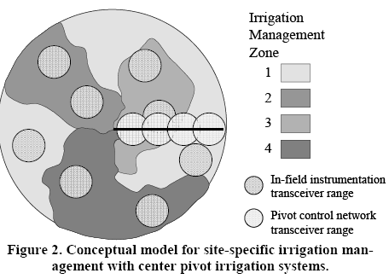
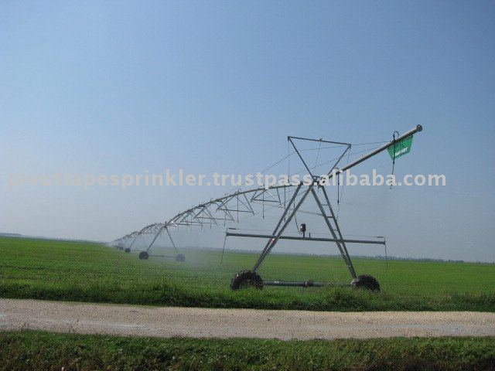
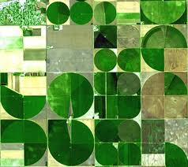
Controlling Pivot Irrigation
Using WSN with GPS, only farmed areas are irrigated with correct amount of water

Slide 10
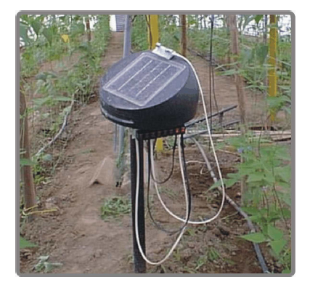
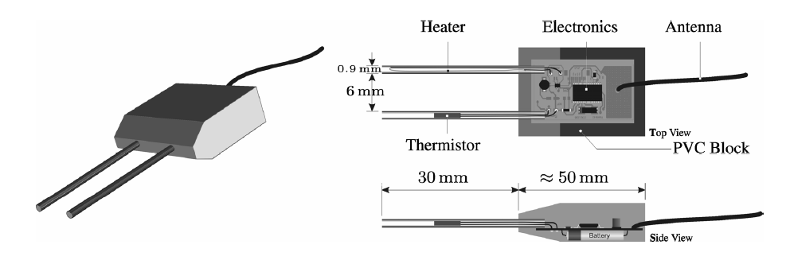
Monitoring of Soil Moisture

Slide 11
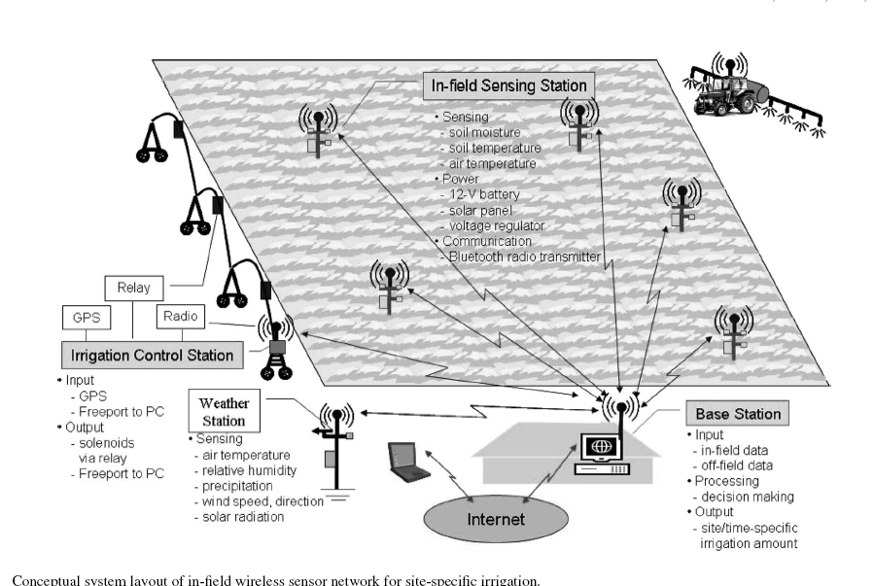
Controlling Sprinklers using Wireless Sensor Networks

Slide 12
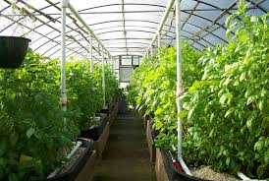
Greenhouse Environmental Control
Temperature
Humidity
Light Intensity
Soil Moisture

Slide 13
Typical Use Case Monitoring Water Level in Irrigation Canals

Slide 14
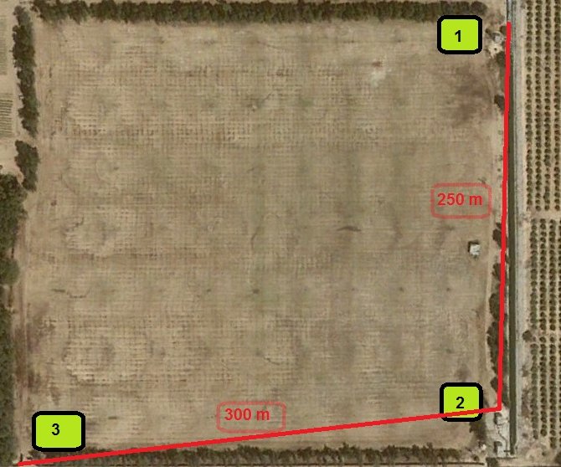
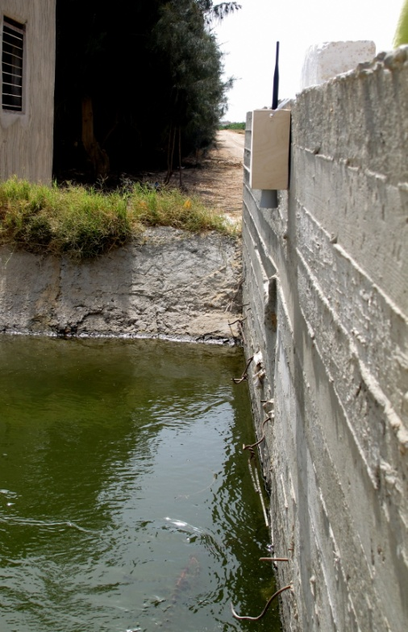
One Canal Prototype Test
Sensor sends signal about the water level in the canal via zigbee, GSM and gateway to laptop.
SMS alerts are being sent if water drops below a certain point or fills up above a certain point, informing the irrigation manager by sms to open or close the gate
The prototype worked well in a once-canal system

Slide 15
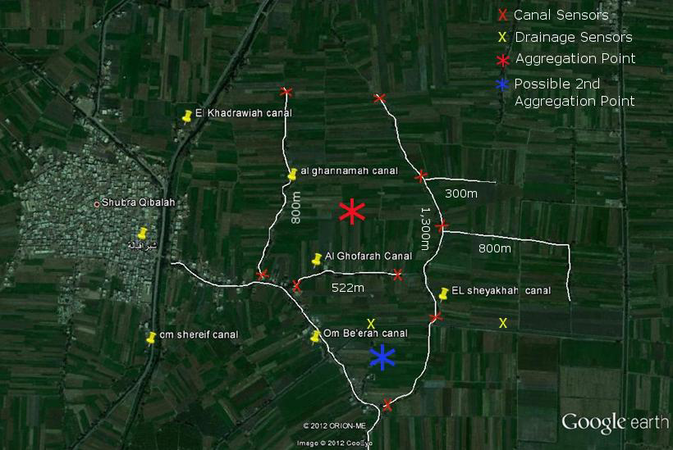
Field Assessments in Shubra Qubala - Menofeya
In March and July 2012, the team:
Walked along the canals of Shubra Qubala in Monufeya to select locations for sensors and aggregation points
Successfully tested water level measurement at one canal at the selected aggregation point
The prototype works using one sensor
The next step is to test multiple sensors

Slide 16
The sensors then send the water level and water flow values to an aggregation point in the center.

Slide 17
A water management database calculates and monitors the water consumption:

Slide 18
Farmers receive sms with information about their consumption, as well as credit points for best practice irrigation behavior

Slide 19
Project Sustainability
This project is not a business proposal, but a system to help communities improve their water management and for Egypt as a means to save its fresh water resources.
The solution is not expensive and would be affordable for government and agricultural associations
Larger-scale implementation by a communication technology provider is targeted to demonstrate a showcase for public authorities

Slide 20
Smart Pipes – Detecting Water Leakage using WSN’s

Slide 21
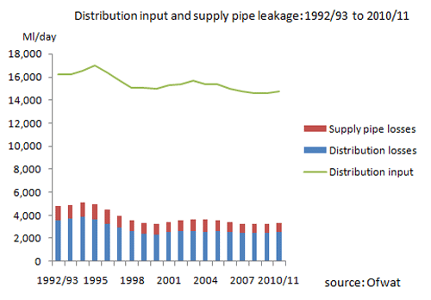
Pipe Leakage Problem
Excess amounts of drinking water are lost due to pipe leaks.
Early detection system will allow for better usage of resources.

Slide 22
Typical Leak losses
Estimated Water loss from Leaking Pipelines
Loss | Location | Source
9-10% of water pumped into the system (Toronto Water staff estimate) | Canada, Toronto | Toronto Star, January 20, 2007 (GTA section, P. B4-B5, article by John Spears)
around 40% due to leaks (estimate, rural and urban), noting that many water pipelines date back to the 1920's. | Italy | U.S. Water News Online, "Dry Faucets Enrage Italians", July 2002.
12.5% (of total water purchases) | Johannesburg (South Africa) | Open letter of Johannesburg Water (Communications and Marketing Dept.) to Sunday Times Newspaper, February 11, 2002
40% water losses due to leakage | Montreal, Canada | Article in London Free Press March 30, 2004: "More water shortages forecast for communities across nation" by Dennis Bueckert, Canadian Press
10% | New York City | EPA***
nearly 50% | two towns on West Coast of Norway, prior to replacement of 35 year old leaking pipes* | attributed to a project manager
20% (corresponding to lost revenues of $150 million per year) | Ontario (a Canadian Province) | Ontario Sewer and Watermain Construction Association - OSWCA(July 10, 2001 General Media Backgrounder)
32 million liters per day (with some pipes dating back to 1809 !) | Portsmouth (UK) | www.portsmouthwater.co.uk
35 % | Seoul, Korea | Seoul Metropolitan governmnet at www.metro.seoul.kr/eng/ smg/agenda/2-3.html
more than 50% | certain states of former Soviet Union | OECD news release**
3.42 billion litres per day though leaking water pipes (equivalent to about two full baths per home per day) | UK (England) | Weekly Telegraph, August 15-21, 2007, p.15 (article by H. Wallop)
up to 30% | Ukraine | www.mama-86.kiev.ua

Slide 23
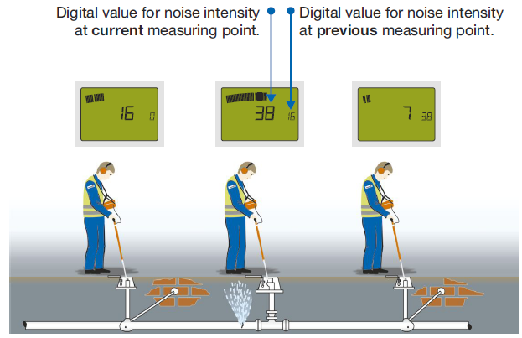
Leak Detection Technologies
Detecting “noise” from pipe cracks

Slide 24
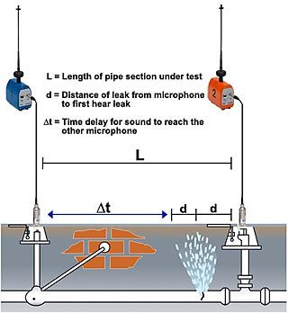
Correlating noise from leaks

Slide 25
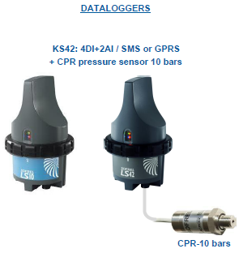
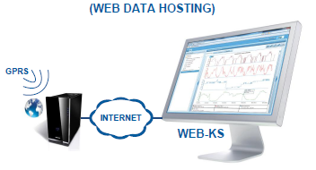
Measuring pipe pressure drop

Slide 26
Orange Lab Roadmap in Water Management
Trying to find business model for irrigation canal monitoring with Mobinil CSR team and irrigation authorities.
Build POC for water leakage detection.
Contacting authorities and offer showcase for leakage detection.
Work for funding to guarantee project sustainability till proper business model is established.

Slide 27
Conclusions and Recommendations
Egypt is a green field for M2M applications for water management.
Public-Private Partnerships is mandatory to define clear business models for M2M.
Mobile operators should scale their network capacity considering expected traffic from M2M and IOT services.

Slide 28
Thank You

