Slide 1




ITU Workshop on
“ICT as an Enabler for Smart Water Management”
(Luxor, Egypt, 14-15 April
Green ICT services in cities
^{Silvia Guzmán Araña}
Corprate Reputation&Sustainability Director
^{Telefónica, S.A}
FG–SSC Chairman

Slide 2
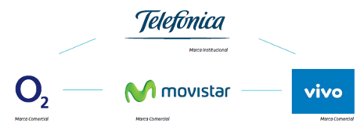


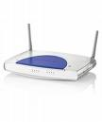





00
The best profile to approach the future
2012
Customers
312 millon customers
Services
Integrated ICT services for customers
Countries
Presence in
26 countries
Employees
Around 285.000 professionals
CO2 &
Energy
Energy: 4,2 TWh€
1,8 mT CO2 e
Notes:
- Central America includes Guatemala, Panama, El Salvador, Nicaragua and Costa Rica
- Total accesses figure includes Narrowband Internet accesses of Terra Brazil and Terra Colombia, and Broadband Internet accesses of Terra Brazil, Telefónica de Argentina, Terra Guatemala and Terra Mexico
Notes:
2
2
Let´s me show a quick overview about Telefonica.
Telefonica is a telecommunication company that offer integrated services. Present in 26 countries and an average of 285,000 professionals. Consolidated revenues of 30,980 million euros and more than 312 million customer at June 2012: more than 243 million mobile phones accesses; more than 40 million fixed telephony accesses; more than 19.34 million Internet and data accesses and 3.3 million pay TV accesses.
Telefónica as a brand will play a corporate and institutional role all over the world with Movistar , O2 and Vivo. The brands under which the commercial offer will be structured in its respective countries are Movistar for Spain and Latin American and O2 in the UK, Ireland, Germany, Czech Republic and Slovakia.

Slide 3
Content
Why resource efficiency is key for sustainable urban development?
1
Telefonica´s Vision and Value of Smartcities
2
Green ICT services in cities.
3
Challenges for greener & smarter cities
4

Slide 4


01
Why resource efficiency is key for sustainable urban development?

Slide 5
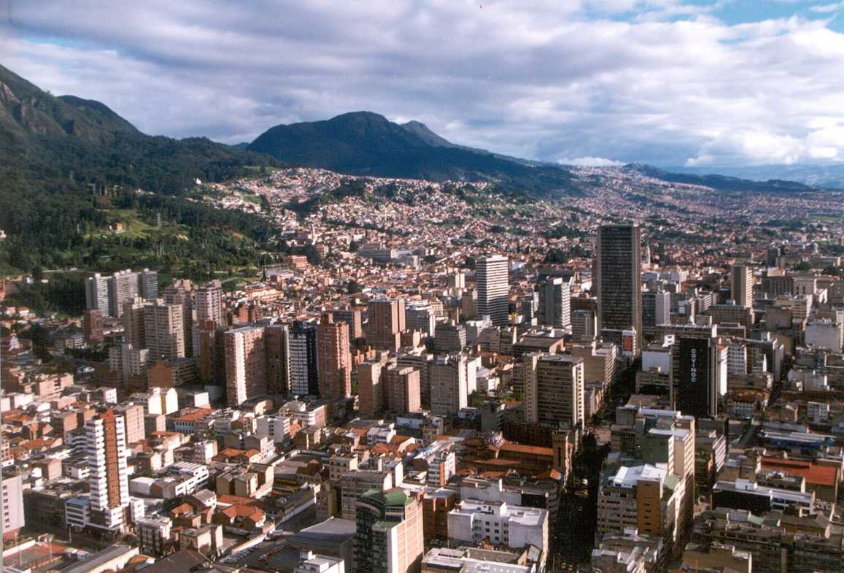


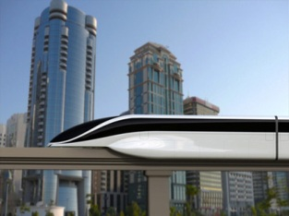


The evolution of cities
01
Population
Energy
CO2 &
Environment
Connectivity
Mobility
In 2050 70% of the population will live in cities. Today more than 50%
Cities consume high amounts of energy. About 75%
80% of emissions of greenhouse gases are generated in cities
In 2020, expect more than 50 billion connected devices.
The transportation Sector is expected to grow more than any other in 2020
Source: International Energy Agency,

Slide 6
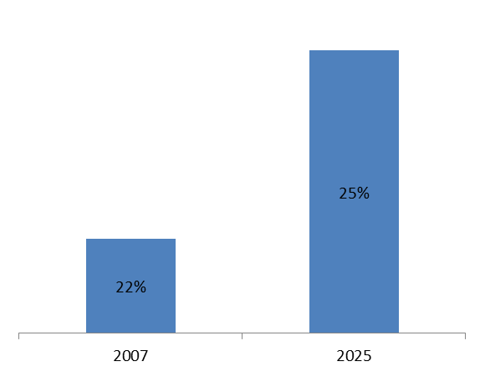
… and wealth distribution is going to be more polarized: 25% of the population in top 600 cities will account for 58% of global GDP, 75% in today’s developing economies
01
Top 600 Cities Population
Top 600 Cities GDP
1.965 million
63,5 trillion
1.484 million
29,7 trillion
1,6%
4,3%
Furthermore, economic growth will be mainly driven by cities…
  2,000 metropolitan areas are expected to contribute 75% of global GDP growth from 2007 to 2025
  Top 600 Cities are expected to contribute 62% of global GDP growth from 2007 to 2.025
  … and by developing countries: in 2,025 almost 75% of top 600 cities will be there
Source: McKinsey Global Institute (MGI), United Nations World Urbanization Prospects
Top 600 World Cities: top 600 cities of the world by GDP, as definced by MGI

Slide 7

In this context it´s necessary to transform of local government model
01
Mejora en los servicios
Eficiencia
Sostenibilidad

Slide 8
Yes, we need Smart Cities! To built a resource effcient cities

Slide 9
02
Telefonica´s Vision and Value of Smartcities

Slide 10







The Smart City is an undefined heterogeneous concept
02
efficient
green
sustainable
Politicians
Ecologists
automated
more humane
IT providers
smart grid
energy efficiency
new businesses
Utilities
enabler
electric vehicle
Consultancy companies
Car Industry

Slide 11
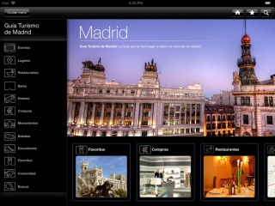
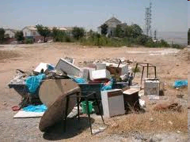



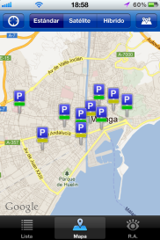

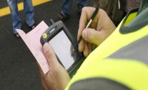


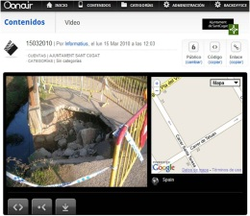


02
Telefonica has identified that cities have different interests…
Waste
Management
Tourism &
cultural
engagement
i.e. Sau Pablo
i.e. Madrid
Traffic & mobility
Management)
Business &
commerce
Cities interests
i.e. Barcelona
i.e. Berlin
Urban planning
Safety
i.e. Brasilia or Santiago de Chile
i.e México City, Rio de Janeiro
Sources: Business units in Telefónica`s Operating Business
Notes:
11
11

Slide 12
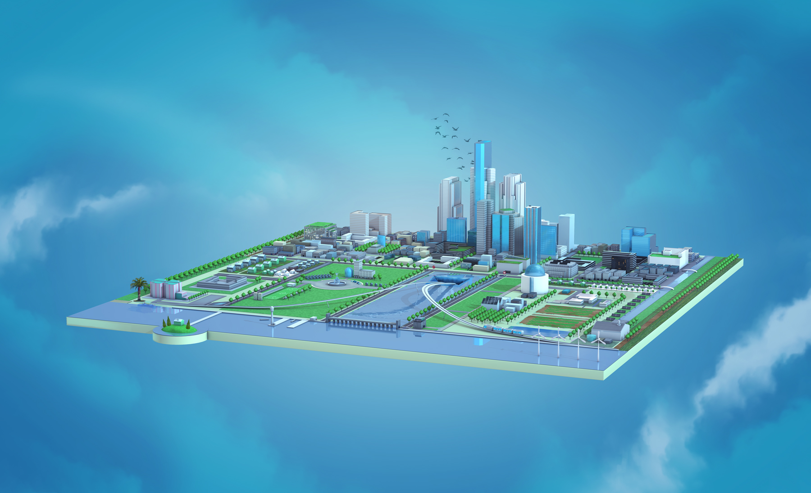
For Telefonica, the Smart City is the intensive use of ICTs to optimize current urban services and enable new businesses
02
City Management
Urban Services
City businesses
Citizens
Technology

Slide 13





It’ll be critical to base any Smart City proposition on a sounded value opportunity
02
Value levers
$
I
Cost reduction & efficiency
Telefonica Smart City
$
II
Increase Income
III
Governance & city planning
VI
Sustainability and quality of life

Slide 14
03
Green ICT Services in cities

Slide 15


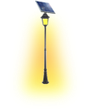


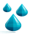










03
Telefónica has an integrated smart city model…
Fleet Management
Smart Building
Smart Mobility
EV Infrastructure
Elec. Smart Meter/Grid
Energy & Environment
Services focused on decreasing city traffic density and citizen driving times, and optimizing public services routes.
Smart Parking
Water Smart Meter
Services to reduce energy consumption (electricity, oil and gas, water, etc.), to better manage waste or to improve environment indicators.
Traffic management
Smart Urban Lighting
Intelligent Transport
Waste Management
Community biking
Energy &
Environment
Watering Manag.
Smart Mobility
Smart Taxi
Noise
detec.
SMART CITY
PLATFORM
SC
Dashboard
City Economy
City Management
NFC Services
Data Collection &
Analysis
Services focused on modernizing how city businesses are performing and enabling city growth
SC Op Center
Services focused on modernizing public administration through IT and mobile solutions to better allocate city resources, prioritize investments thanks to an integrated view of the city.
City Economy
City Management
City maintenance
Digital Signage
M2M Transactions
Open Data
e-Tourism
Others
Security
& e-Health
e-Government, e-Vote, e-Learning
connected universities, cloud,
Virtual hosting, smart
computing
Connected Retailer
Video surveillance
Tele-Health & Tele.Care
Hospital Capacity Tracking
Security & e-Health
Emergency Management
Fire Detection
Services focused either on crime prevention and prosecution and health care system quality and efficiency.

Slide 16
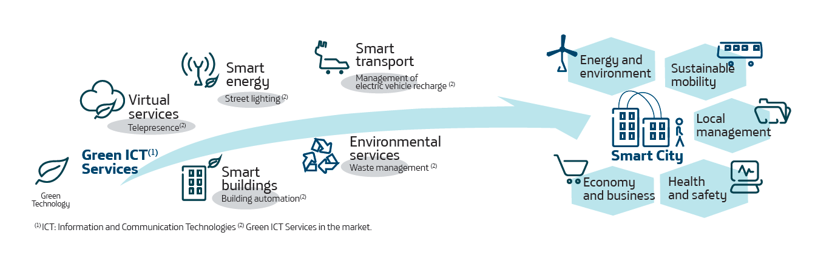
Energy & environment comprises services whose main motivation is to reduce energy consumption (electricity, oil and gas, water, etc.), to better manage waste or to improve environment indicators
03
Energy & environment
Smart building
Smart meter elec / grid
Green ICT services are part of the model
Smart Meter Water
Smart urban lighting
Waste Management
Watering management
Noise detection

Slide 17


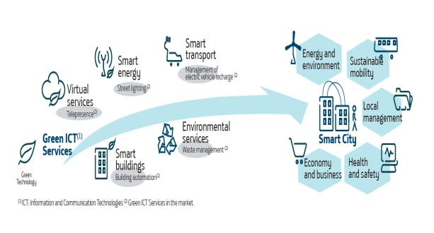




Green Smart Cities are meant to improve sustainability and quality of life
03
Reduce carbon emission with a better traffic management that reduces on-road time, congestions by optimising routes and with tips to improve driving skills.
Optimise the use of limited resources (water, electricity) thanks to a better insight on the consumption, remote control and automated solutions
Reduce carbon emissions
Efficient use of limited resources
SUSTAINABILITY AND QUALITY OF LIFE
Improve environment
indicators
Green Credentials
Provide city councils with a green speech based on sustainability measures already implemented as part of their marketing strategy
Reduce noise levels and improve air quality thanks to a smart traffic systems that reduce congestions,
Optimisation of the use of time
Reduce the time spent in roads thanks to smart traffic systems and smart parking solutions.

Slide 18
04
Challenges for greener & smarter cities

Slide 19
04
Different types of challenges…
Need for accelerating innovation Demand of a Green ICT solutions portfolio Leveraging the interest of customers Demostrate that Green ICT solutions are good business
Increase the sustainability and profitability of the business. Standards to incentivize competition Establish a more simple and balanced distribution
Technology is there, what is required are business models. Lack of standards to assess benefits.
Market Challenges
Regulatory Challenges
Technology
Standards
Notes:
19
19

Slide 20

Notes:
20

Slide 21


Focus Group on
Smart Sustainable Cities

Slide 22
Focus Group on Smart Sustainable Cities
Chairman
- Silvia Guzman, Telefónica
Vice-Chairmen
- Pablo Bilbao, Federation Argentina de Municipios
- Flavio Cucchietti, Telecom Italia
- Sekhar Kondepudi, National University of Singapore
- Nasser Saleh Al Marzouqi, UAE
- Franz Zichy, USA
- Ziqin Sang, Fiberhome Technologies Group
Established at SG5 meeting in Geneva, 29 January to 7 February 2013
As an open platform for smart-city stakeholders
1st meeting to be held on 8 May 2013 in Turin, Italy back to back with 8th Symposium on ICTs, Environment and climate Change (6-7 May 2013)
Notes:
The FG–SSC will to assess the standardization requirements of cities aiming to boost their social, economic and environmental sustainability through the integration of information and communication technologies (ICTs) in their infrastructures and operations.
The FG–SSC will analyze ICT solutions and projects that promote environmental sustainability in smart cities and will identify best practices which could facilitate the implementation of such solutions in cities. It will develop a standardization roadmap taking into consideration the activities currently undertaken by the various standards developing organizations (SDOs) and forums. This “Focus Group on Smart and Sustainable Cities (FG – SSC)” will leverage the role of the ICT sector to foster the growth of smart and sustainable cities worldwide.

Slide 23

Main Tasks and Deliverables
  Defining the role of ICTs in environmentally sustainable smart cities, and identifying the ICT systems necessary to the development of a Smart Sustainable City;
  Collecting and documenting information on existing smart city initiatives and technical specifications, focusing in particular on the identification of standardization gaps;
  Identifying or developing a set of Key Performance Indicators (KPIs) to gauge the success of smart-city ICT deployments;
  Establishing relationships and liaison mechanisms with other bodies engaged in smart-city studies and development;
  Identifying future smart-city standardization projects to be undertaken by its parent group, ITU-T Study Group 5;
  Developing a roadmap for the ICT sector’s contribution to Smart Sustainable Cities, providing cohesion to the development and application of technologies and standards.

Slide 24

Send your input documents to Cristina Bueti: greenstandard@itu.int
More information: http://www.itu.int/en/ITU-T/focusgroups/ssc/Pages/default.aspx

