Slide 1

Securing the Digital Frontier: The Need For Robust Cyber-Security Standards
ITU Workshop on “ICT Security Standardization
for Developing Countries”
(Geneva, Switzerland, 15-16 September 2014)
Dr. Carol Cosgrove-Sacks,
Senior Advisor, International Standards Policy
OASIS Open
carol.cosgrove-sacks@oasis-open.org

Slide 2
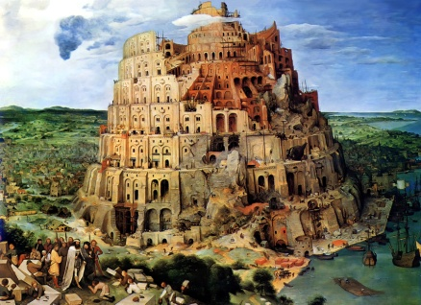
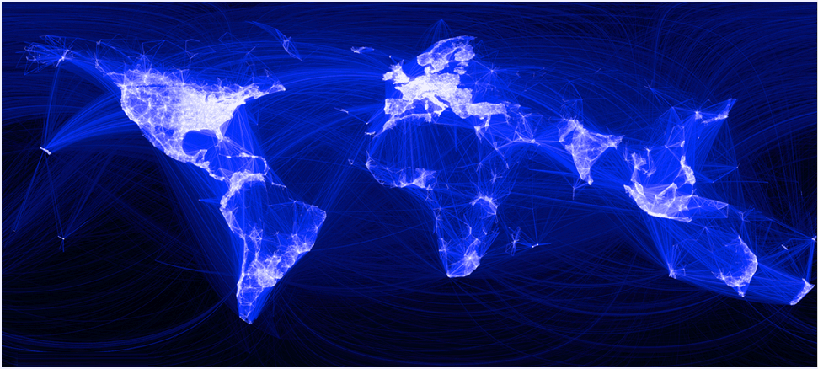
Thanks and Acknowledgments
OASIS is pleased to contribute to the ITU-led debate on ICT Cyber-Security Standardization. OASIS security standards can assist in defending the digital frontier. OASIS works with Governments across the world to promote cyber-security.

Slide 3
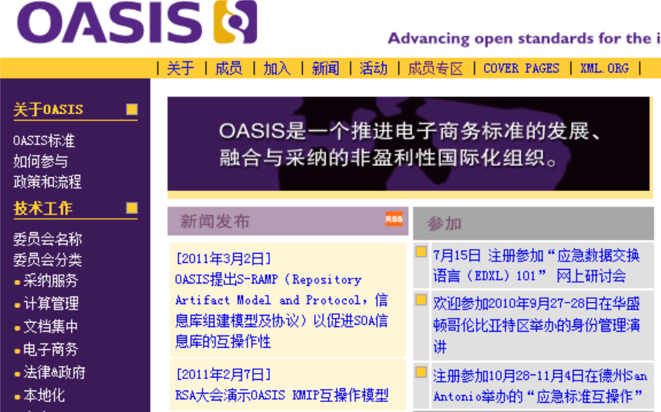

Introduction to OASIS
OASIS Open is a global, not-for-profit consortium that creates market-driven software standards
Founded in 1993 as SGML Open
Over the years, from SGML to XML to multiple methods & models (JSON, XML, UML, ASN.1, custom notations, etc.)
"The largest standards group for electronic commerce on the Web" -

Slide 4
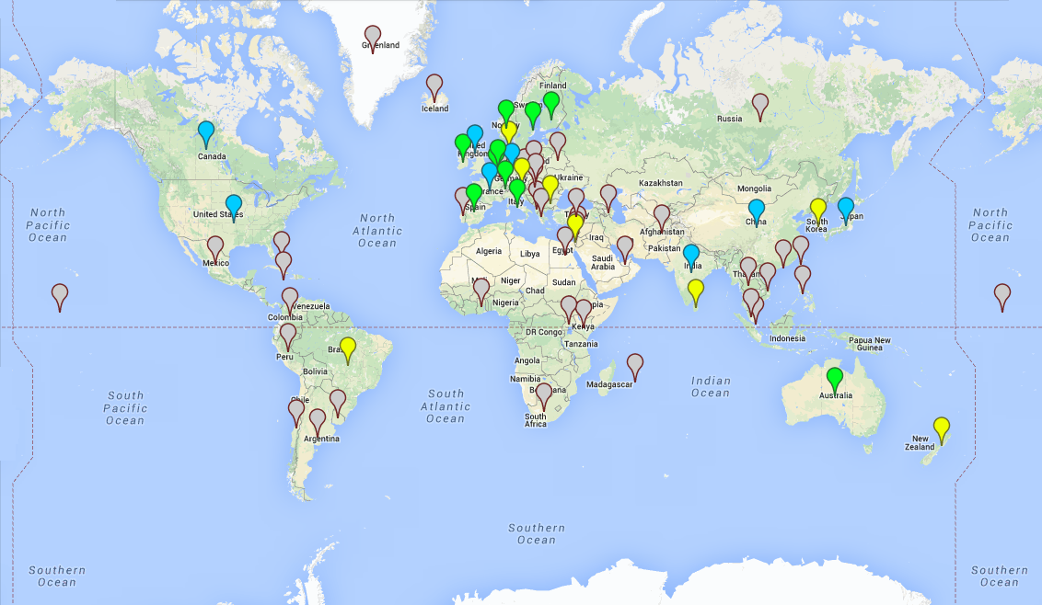

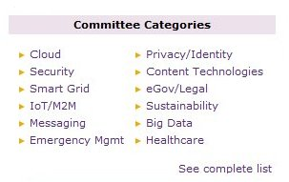
Who is OASIS?
5,000+ participants
600+ organizations & experts
100+ countries
70+ technical committees

Slide 5
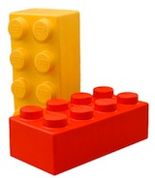
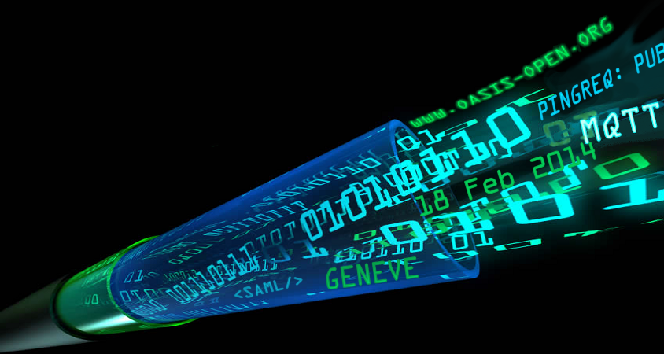
Meeting the Information Challenges of the 21st Century
Key trends:
Traditional Standards are challenged by “disrupters” (Google, Amazon) emphasizing agility, speed and “whatever works”
Steady rise in data breaches, cyber-security attacks and unwanted surveillance
Increasing collision between the "startup economy" (monetizing personal data) and citizen expectations of privacy (regulation)
Societal demands for governments and public administrations to become smarter (Cloud, Smart Cities, sustainability) and more transparent (Opendata, Big Data)

Slide 6
OASIS Standards Projects
INTERNET of THINGS
CYBER-SECURITY
CLOUD and BIG DATA
PUBLIC SECTOR

Slide 7

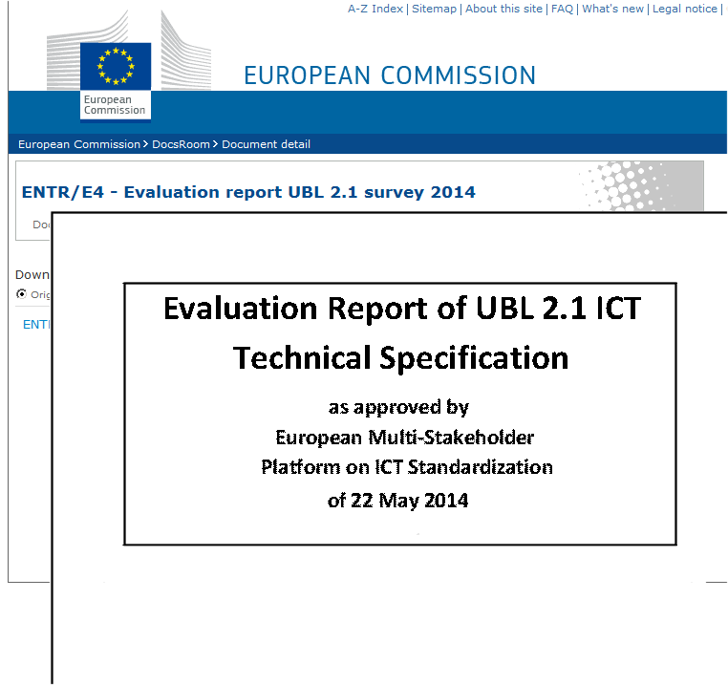
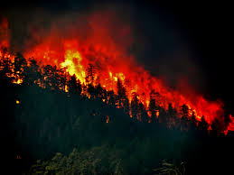
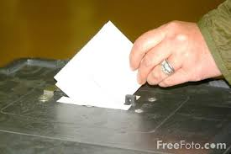
FOUNDATIONAL PUBLIC SECTOR STANDARDS
Oasis public sector standards help governments:
Foster interoperability among departments and constituents
in alignment with policy
Promote efficiency via eProcurement
Contain costs
Protect cyber frontiers
OpenDocument, UBL, LegalXML, ElectionML

Slide 8
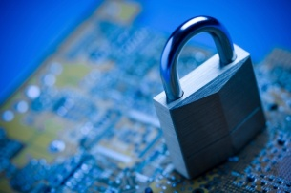

OASIS CYBER-SECURITY STANDARDS
OASIS cyber-security standards help eBusinesses and government
agencies secure their transactions from Identity to Key Management,
while protecting the privacy of users - and now, they do so in the Cloud

Slide 9
CYBER-SECURITY STANDARDS
Security Assertions ML (SAML) http://j.mp/oasisSAML
ITU X.1141: Used globally for identity authorization, including ISO's Livelink
Extensible Access Control ML (XACML) http://j.mp/oasisXACML
ITU X.1142, X.1144: Role-Based Access Control and ID policy; XACML-JSON
Key Management Interop Protocol (KMIP) http://j.mp/oasisKMIP
Interoperable methods for enterprise encryption key management
Cyber-security: http://j.mp/OASIScybersec
14

Slide 10
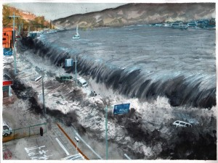
COMMON ALERTING PROTOCOL (AN ITU STANDARD)
  OASIS Emergency Management TC (ITU.X.1303, X.1303bis)
  http://j.mp/oasisEmerg
  Enabling information exchange to advance incident preparedness and response to emergency situations
  EDXL Common Alerting Protocol (EDXL-CAP)
  EDXL Distribution Element (EDXL-DE)
  EDXL Hospital AVailability Exchange (EDXL-HAVE)
  EDXL Resource Messaging (EDXL-RM)
  EDXL Reference Information Model (EDXL-RIM)
  EDXL Situation Reporting (EDXL-SitRep)
  EDXL Tracking Emergency Patients (EDXL-TEP)

Slide 11
CYBER-SECURITY STANDARDS: BIOMETRICS
Biometrics TC http://j.mp/oasisBiom
  Accelerating the use of biometrics through services and
  enhanced interoperability in distributed environments.
IBOPS TC (new) http://j.mp/IBOPS
Identity biometrics function calls and mobile device
biometrics architecture

Slide 12
CYBER-SECURITY STANDARDS: PRIVACY
Privacy Management Reference Model http://j.mp/oasisPMRM
  Standards-based framework + template for business process engineers, IT analysts,
  architects, and developers to implement privacy and security policies in operations.
  Analytical tool for assessing completeness of privacy/security solution
Privacy by Design for Software Engineers http://j.mp/PbDoasis
Privacy rule enforcement, from policy to practices to model to code. 7 principles
  Proactive not Reactive; Preventative Not Remedial
  Privacy as the Default Setting
  Privacy Embedded into Design
  Full Functionality - Positive-Sum, Not Zero-Sum
  End-to-End Security - Full Lifecycle Protection
  Visibility and Transparency - Keep It Open
  Respect for User Privacy - Keep It User-Centric
Privacy & identity: http://j.mp/OASISprivacy

Slide 13
CYBER-SECURITY: CONTRIBUTIONS TO ITAC
Information Technology Advisory Council (ITAC) has been advising
OECD for 3 years on issues ranging from IPv6 to cyber-security and privacy
OASIS is a member (Gershon Janssen)
Report being finalized. Recommendations:
  Implementation of national strategies for digital security risk management
  Education of all stakeholders
  Establishing responsibility and accountability for digital security risk management
  Respect for human rights and fundamental values
  Implementation of cyber-security and privacy standards as a key part of the culture
  of security

Slide 14
CYBER-SECURITY STANDARDS: TRUST
Trust Elevation (EIC-TEM) http://j.mp/trustel
Identity management methods for handling requests to promote
low-level credential data to higher authorization levels
WS-Federation & WS-Trust http://j.mp/oasisWSFed
Metadata & token policy control for message exchange,
with federation and brokered trust capabilities

Slide 15
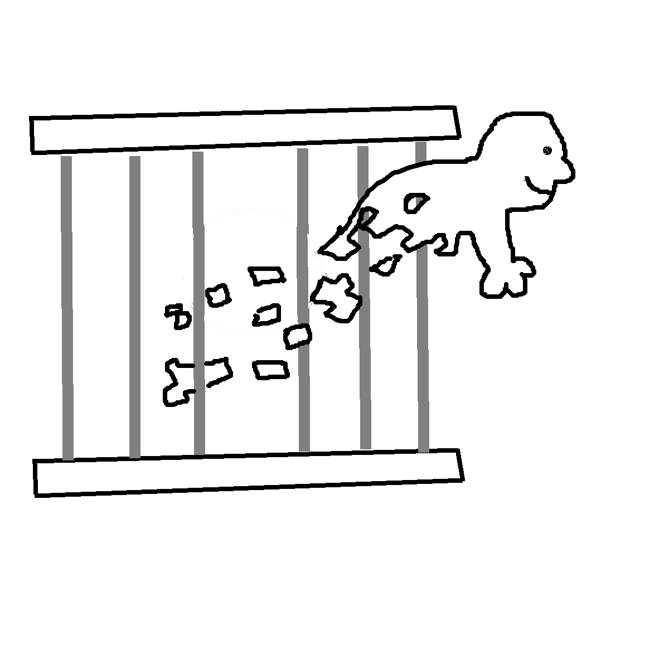

CLOUD and BIG DATA
Advanced Message Queuing Protocol (AMQP) j.mp/oasisAMQP
Topology and Orchestration Specification for Cloud Apps
(TOSCA) http://j.mp/oasisTOSCA
Cloud Application Management for Platforms (CAMP)
http://j.mp/oasisCAMP/
OASIS Open Data Protocol (OData) http://j.mp/oasisOData
Service-Oriented Architecture (SOA) Reference Model
http://j.mp/oasisSOARM
Identity in the Cloud (ID-Cloud) http://j.mp/idcloud
Cloud Authorization (Cloud AuthZ) http://j.mp/CAuthZ
http://j.mp/oasisCloud

Slide 16
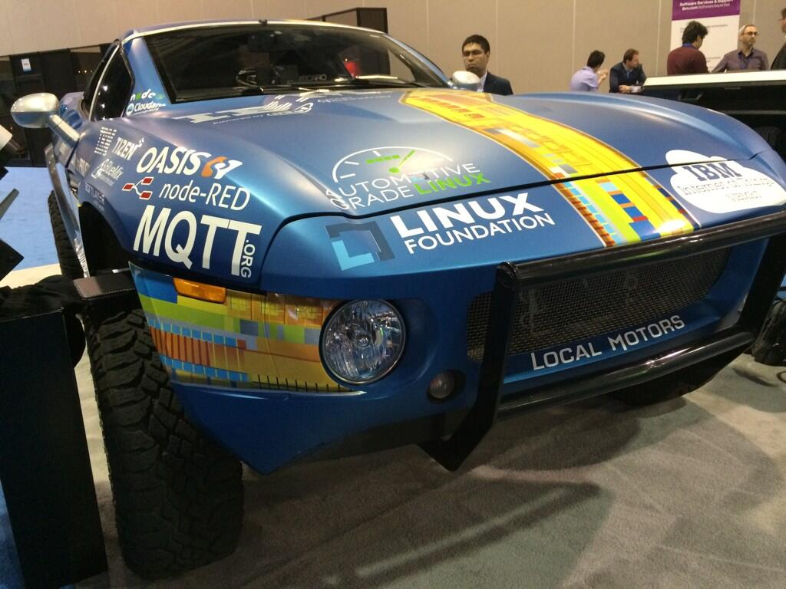
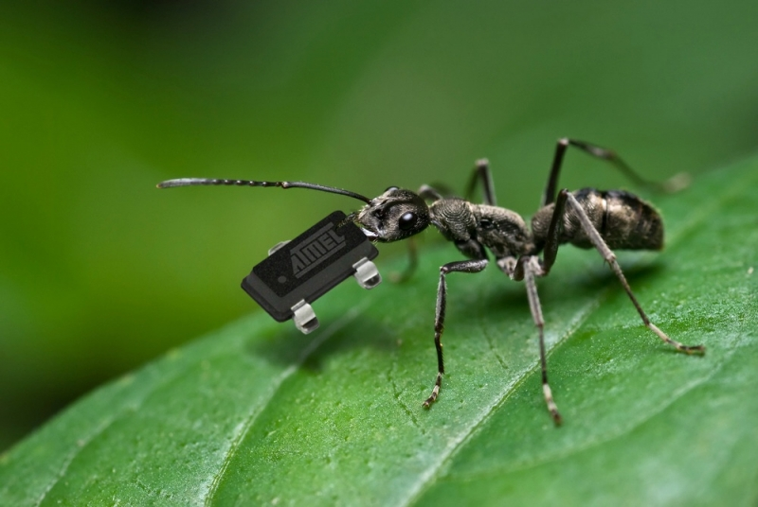
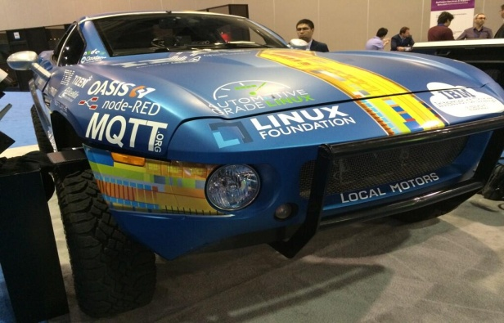
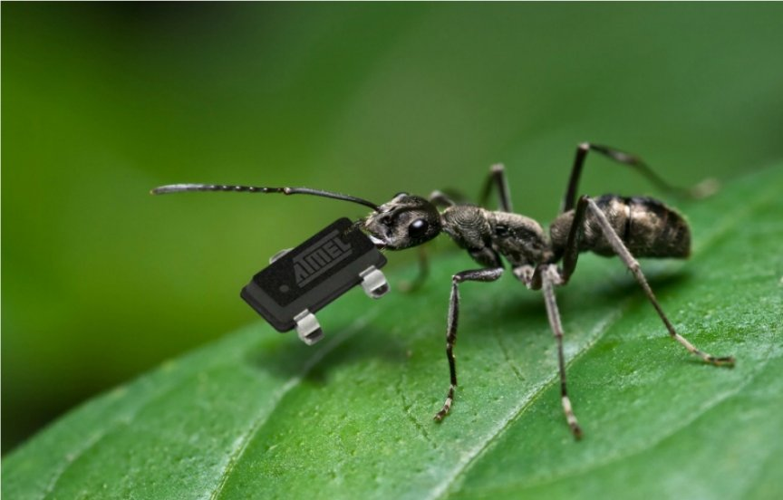
Internet of Things (IoT) and Mobile (M2M)
OASIS IoT and M2M standards at the protocol and transaction level are already helping “things” like cars and buildings to communicate

Slide 17
Internet of Things (IoT) and Mobile (M2M)
Message Queuing Telemetry Transport (MQTT)
http://j.mp/oasisMQTT
Lightweight transactional protocols specifically for devices
OASIS SmartGrid projects http://j.mp/OASISsmartgrid
Device management, transactional control, pricing and time/duration
Open Building Information Exchange (oBIX) TC
http://j.mp/oBIX Building systems and physical security device control
But no one area of standardization
stands alone ...
19

Slide 18

Conclusions
How OASIS will do its part to meet 21st century information society challenges in eGovernment and eBusiness – for the next 20 years:
Forge a new standardization approach where Open Source incorporates open standards at an earlier stage for robustness, security and privacy
Continue to collaborate globally with other SDOs and policy makers such as ITU & ETSI
Contribute to interoperability in the Cloud, Identity Management, Privacy, Security and the Internet of Things
http://www.oasis-open.org

