Slide 1

ITU Workshop on “ICT Security Standardization
for Developing Countries”
(Geneva, Switzerland, 15-16 September 2014)
CYBEX implementation in Japan
MyJVN: JVN Security Content Automation Framework
and CYBEX collaboration
Masato Terada
Hitachi Incident Response Team
masato.terada.rd@hitachi.com

Slide 2
Vulnerability handling framework
in Japan
Information security
early warning partnership
A public-private partnership framework pursuant to the METI (Ministry of Economy, Trade and Industry) Directive #235, 2004, has been established to promote software product and web site security and prevent the damage to spread to the vast range of computers due to computer viruses or unauthorized access.

Slide 3



Information security
early warning partnership
Report vulnerability
Report vulnerability
International
framework
CERT/CC
CPNI
CERT-FI
etc.
Receive vulnerability and analyze (verify vulnerability reports)
Pass vulnerability
Reports
Supporting Analysis
Notification of
vulnerability
information
Coordinate with developers and overseas agencies
Website operators
Verify and implement
countermeasures
Public Disclosure of Vulnerability
information
Software Developers
Vulnerability Countermeasure
Information Portal Site
(Vuln. Handling Coordination DB)
Announce incidents
Involving personal
Information disclosure
System Integrators
Announce
countermeasures

Slide 4
Handling diagram of
software product vulnerability
Finder
1. Report
2. Verification
Receipt Body
4. Identification of affected
vendors from DB
3. Forward
report
International
Framework
Coordination Body
9. Announcement
End User
Notification
Japan Vulnerability Notes
Cooperate
Users
5. Notification of vulnerability related
information - Test suite and validation process
6. Coordination of announcement date
System
Integrators
8. Submission of security
information
ISP
Distributors
7. Investigation and
development of
countermeasures
JP
Vendor1
JP
Vendor2
JP
Vendor3
Notes:
This framework has 2 flows,
Software product vulnerability
Website vulnerability
The IPA serves as a center to which people can direct reports on vulnerabilities.
When a security vulnerability is discovered, it is reported to the IPA. We work closely with the JPCERT/CC and related organizations and groups under the Information security early warning partnership.
We publish information such as what the pertinent products' developers are doing to address the situation and any available countermeasures on the portal site, JVN.

Slide 5
Handling diagram of
software product vulnerability
Vulnerability and counter-measure Information released at the same date
Release Date
Finder
Report
vulnerability
Wait
Disclose
information
IPA
JPCERT/CC
Request
Investigation
Wait
Disclose
information on JVN
Product vendor A
Investigation
& Fix
Wait
Provide
countermeasure
Product vendor B
Investigation
& Fix
Provide
countermeasure
System Integrator
& User
Provide
countermeasure
Vulnerability information is released beforehand
Customer of product vendor A
Deploy
countermeasure
Customer of product Vendor B
Exposed to the threat
of cyber attack
The principle of coordinating the release date among the relative parties.
Notes:
This framework has 2 flows,
Software product vulnerability
Website vulnerability
The IPA serves as a center to which people can direct reports on vulnerabilities.
When a security vulnerability is discovered, it is reported to the IPA. We work closely with the JPCERT/CC and related organizations and groups under the Information security early warning partnership.
We publish information such as what the pertinent products' developers are doing to address the situation and any available countermeasures on the portal site, JVN.

Slide 6
JVN Security Content Automation Framework
( JVN + JVN iPedia ) x MyJVN
= MyJVN framework
To enable application developers to use data through open interface
  Adoption of common enumeration and specifications
To establish global JVN
  Internationalization as vulnerability reference source
  Localization as vulnerability reference source (focus on Japanese region)
  JVN Security Content Automation Framework (aka. MyJVN framework) has adopted CYBEX.
Notes:
This diagram is detail of vulnerability handling of software product.
Finder and discoverer report a vulnerability to IPA.
JPCERT/CC coordinate a handling process of a reported vulnerability with a product vendor.

Slide 7
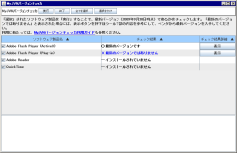
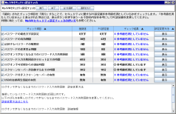
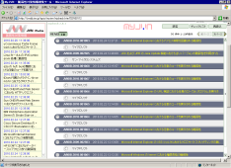


JVN Security Content Automation Framework
(Internationalization + Localization) x Machine readable
MyJVN
Providing vulnerability
countermeasure information via machine readable interface such as Web APIs and Version Checker.
JVN (Vulnerability
Handling Coordination DB)
Providing vulnerability
countermeasure information and Japanese vendor status for vulnerabilities reported through “Information Security Early Warning Partnership”
JVN iPedia (Vulnerability Archiving DB)
Providing countermeasure
information database for covering overall vulnerabilities
MyJVN
Version
Checker
Configuration
Checker
Filtered Security
Information Tool
Overall vulnerabilities
Vulnerabilities,
assigned the CVE number
JVN iPedia
Archiving DB
JVN Coordination DB
Reported vulnerabilities by Information Security Early Warning Partnership
Vulnerabilities of
Domestic products

Slide 8


JVN Security Content Automation Framework
Version
Checker
Configuration
Checker
Filtered Security
Information Tool
MyJVN
Dashboard
ICAT
. . .
Machine readable interface by Web APIs
using CYBEX (CVE, CPE, CWE, CVSS and etc).
JVN(JVN#12345678)
Vulnerability Handling Coordination DB
JVN iPedia(JVNDB-yyyy-0123456)
Vulnerability Archiving DB
Japanese Version
http://jvn.jp/
English Version
http://jvn.jp/en/
Japanese Version
http://jvndb.jvn.jp/
English Version
http://jvndb.jvn.jp/en/
Information
Security
Early Warning
Partnership
From Information
Security Early
Warning Partnership
in Japan
From Information
Security Early
Warning Partnership
in Japan
From JVN
From JVN
Translation
Archiving
CERT/CC
CERT-FI etc.
From CERT/CC,
CERT-FI etc.
Archiving
(Total: 1,022 )
From Japanese
software
developers
From Japanese
software
developers
Japanese
software
developers
Translation
From NVD
(43,422)
NVD
(English)
(64,050 )
Total
(46,860)
2014 2nd Quarter (May. - Jul.)
Notes:
JVN and JVN iPedia became the CVE Reference from Oct 2008.
JVN provides vulnerability countermeasure information by "Information Security Early Warning Partnership.
Identifier is JVN# and 8 number.
JVN iPedia provides countermeasure information database.
Identifier is JVNDB-year-6 number.
Then, you may know JVN# number or JVNDB number.

Slide 9


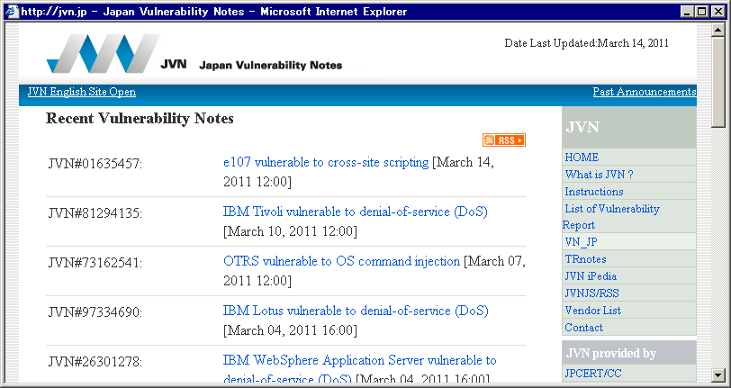
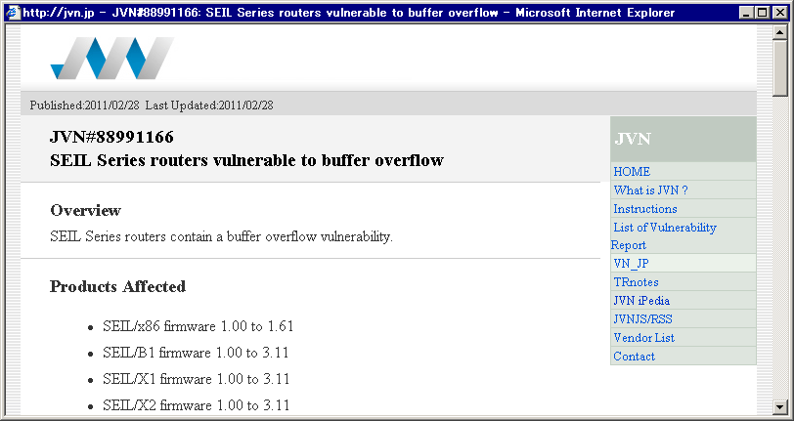
JVN (Japan Vulnerability Notes)
http://jvn.jp/en/
July 2004, "Japan Vulnerability Notes (JVN) (aka. Vulnerability handling coordination DB)" started the portal site of security information of domestic product vendors under the vulnerability information handling framework in Japan.
JVN assists system administrators and software and other products developers enhance security for their products and customers.
X.1520
X.1521

Slide 10


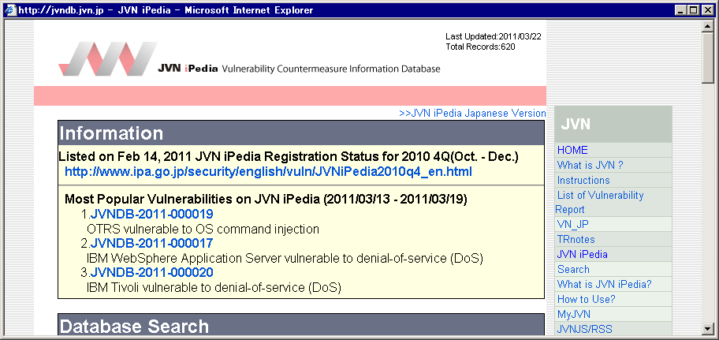
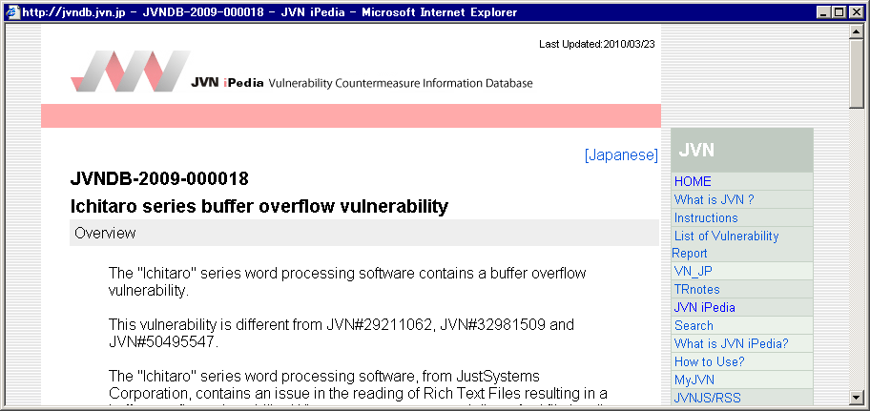
JVN iPedia
http://jvndb.jvn.jp/en/
JVN iPedia (aka. Vulnerability archiving DB) focuses on regional vulnerabilities (which depends on IT market) in Japan.
JVN iPedia stores summary and countermeasure information on vulnerabilities in Japanese software and other products posted on JVN.
X.1520
X.1528
X.1521
X.1524

Slide 11
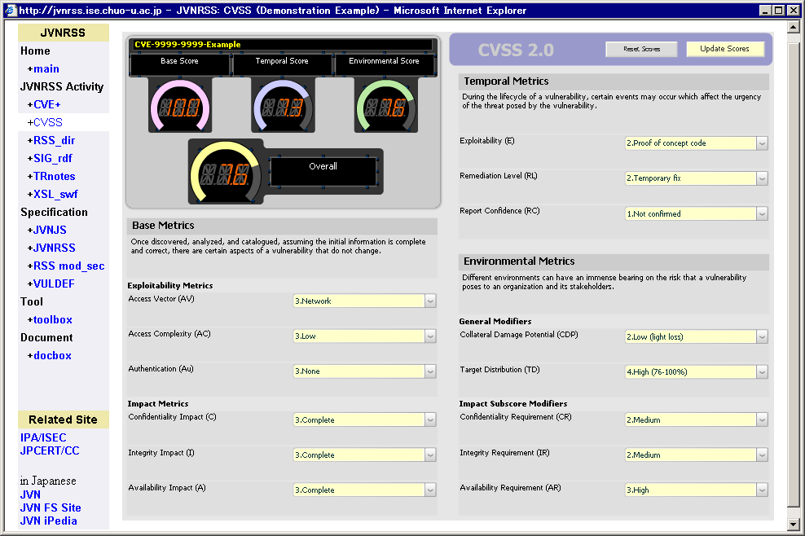
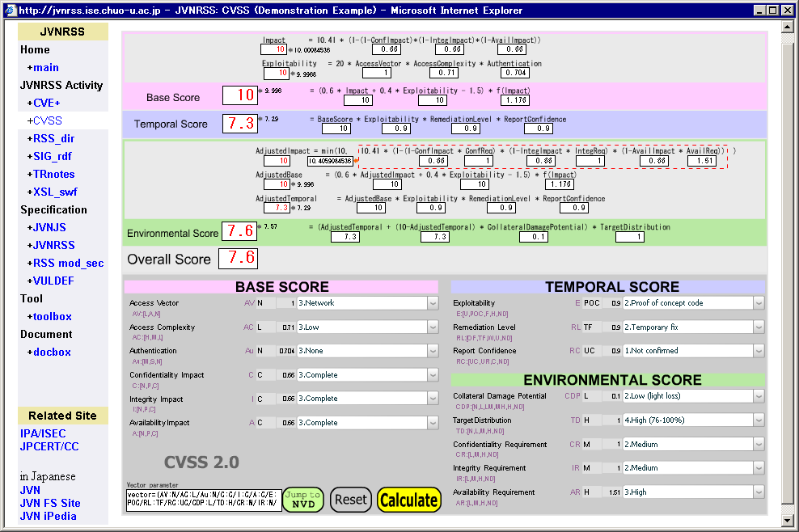
CVSS V2.0 Calculator
http://jvndb.jvn.jp/en/cvss/
Graphical user interface: 5 Themes
Multi languages supported: 10 Languages
[AR][AZ][AZ-CYRL][CN][EN][FR]
[DE][JA][KO][RO][ES]
X.1521

Slide 12



MyJVN
http://jvndb.jvn.jp/en/apis/
Custom applications can access the data in JVN iPedia and various vulnerability management services for efficiently
vulnerability counter-
measure.
X.1520
X.1528
HTML
JVN iPedia (base component)
HTML
module
JVN
DB
X.1521
HTML
Filtered information service API
JPCERT/CC VRDA collaboration
MyJVN Filtered Vulnerability
Countermeasure Information Tool
SCAP collaboration service API
MyJVN Version Checker
MyJVN Security Configuration
Checker
JVNRSS/VULDEF
X.1524
XML
MyJVN ver1
RSS
MyJVN API
module
CPE
DB
X.1526
SWF
ISO/IEC
18180:2013
MyJVN ver2
OVAL
MyJVN API
module
OVAL
DB
JAR
MyJVN API

Slide 13
MyJVN API
http://jvndb.jvn.jp/en/apis/
 | Name | Descriition
Filtered information service API | getVendorList | The vendor list that is filtered by the CPE is acquired in XML format.
 | getProductList | The product list that is filtered by the CPE is acquired in XML format.
 | getVulnOverviewList | The vulnerability overview list that is filtered by the CPE is acquired in JVNRSS (RSS + mod_sec) format.
 | getVulnDetailInfo | The vulnerability detail information is acquired in VULDEF format.
SCAP collaboration service API | getOvalList | The OVAL definition list that is filtered is acquired in XML format.
 | getOvalData | The OVAL definition is acquired in XML format which envelopes OVAL format.
 | getXccdfList | The XCCDF benchmark list that is filtered is acquired in XML format.
 | getXccdfData | The XCCDF benchmark is acquired in XML format which envelopes XCCDF format.
Other | getStatistics | The statistics data that is filtered by the JVNDB/CVSS/CWE is acquired in XML format.
 | getCPEDictionary | The product list of JVN that is filtered by the CPE is acquired in CPE Dictionary format.

Slide 14
MyJVN API
http://jvndb.jvn.jp/en/apis/
Using JVNRSS, an XML format to describe the overview, is an essential point in the security information exchange.
Overview Format
Title
JVNRSS 2.0
= RSS1.0+mod_sec
MyJVN API
getVulnOverviewList
Overview
Overview Format JVNRSS 2.0
xmlns:sec="http://jvn.jp/rss/mod_sec/" xsi:schemaLocation=
"http://jvn.jp/rss/mod_sec/ http://jvndb.jvn.jp/schema/mod_sec_2.0.xsd">
<sec:identifier>Unique identifier assigned by vendor</sec:identifier>
<sec:references>Best reference to a related security information</sec:references>
<sec:cvss score="Overall score"
severity="Severity level (High - Medium - Low)"
vector="Value of each vector in CVSS" version="CVSS version" />
<sec:cpe-item name="CPE Name">
<sec:vname>Vendor Name</sec:vname>
<sec:title>Product Name</sec:title>
</sec:cpe-item>
Affected System
Detail
Format
VULDEF
Impact
Solution
Exploit
Reference
MyJVN API
getVulnDetailInfo

Slide 15
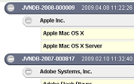
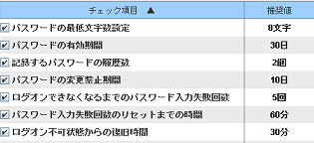
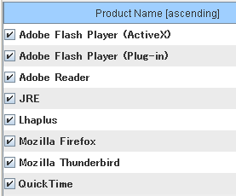
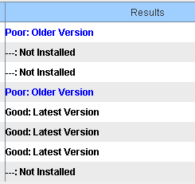
MyJVN tools
http://jvndb.jvn.jp/apis/myjvn/personal.html
Filtered security information for your system
MyJVN Filtered Security Information Tool
Improvement of the keeping
the secure configuration on your PC
MyJVN Configuration Checker
Improvement of the keeping
up-to-date environment on your PC
MyJVN Version Checker

Slide 16
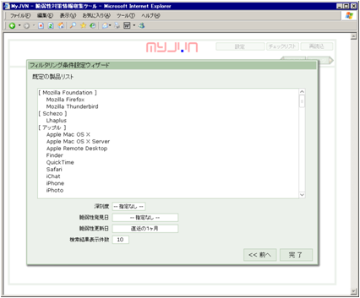
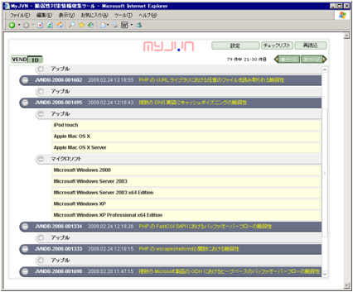
MyJVN
Filtered Security Information Tool
http://jvndb.jvn.jp/en/apis/myjvn/mjcheck.html
MyJVN Filtered Vulnerability Countermeasure Information Tool allows users to efficiently gather only relevant information from the vast quantity of data stored in JVN iPedia.
X.1520
X.1528
X.1521
Setup Panel
Filtered Result Panel
http://jvndb.jvn.jp/myjvn?method=getVulnOverviewList&cpeName=cpe:/*:hitachi:*
&rangeDatePublic=n&rangeDatePublished=n&rangeDateFirstPublished=n&lang=en

Slide 17
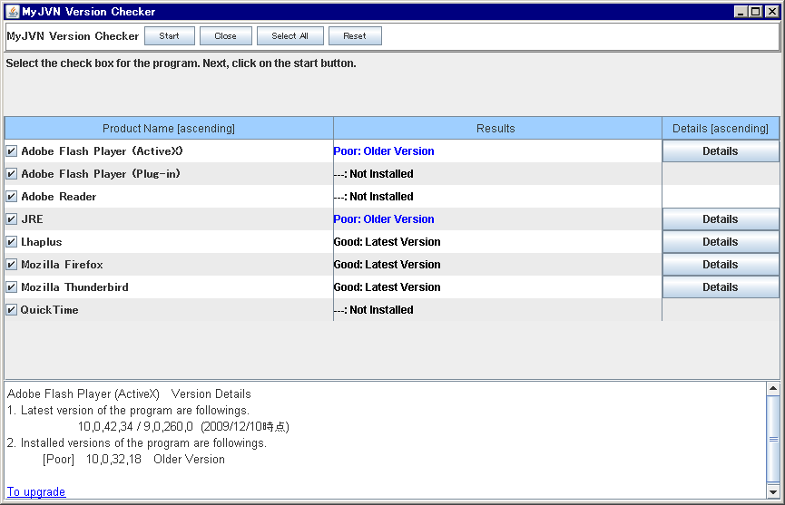
MyJVN
Version Checker
http://jvndb.jvn.jp/apis/myjvn/vccheck.html
MyJVN Version Checker (MyJVN VC) provides improvement of the keeping up-to-date environment.
  Step1: Check phase … MyJVN VC
  Is your PC keeping the latest version ?
  Step 2: Remedy phase
  Let's update the applications and plug-ins on your PC.
X.1528
X.1526
Inside procedures
of MyJVN Version Checker
(1) Generation of checklist table
(2) Version check
ISO/IEC
18180:2013
ARF
Asset Reporting
Format

Slide 18
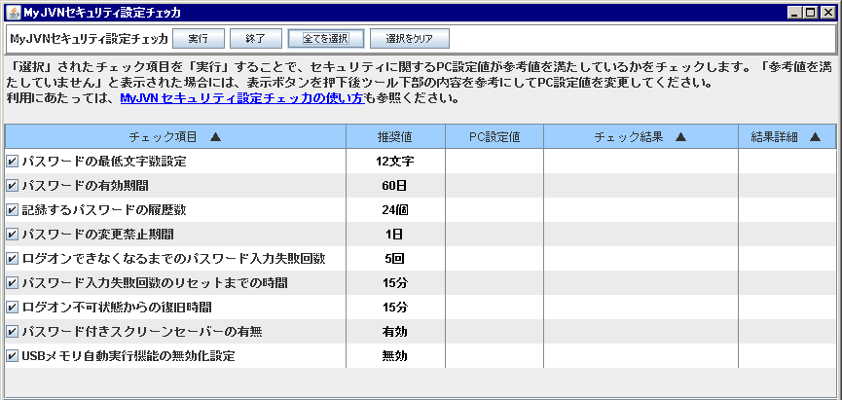
MyJVN
Security Configuration Checker
http://jvndb.jvn.jp/apis/myjvn/sccheck.html
MyJVN Security Configuration Checker (MyJVN SC) provides improvement of the keeping secure configuration.
  Step1: Check phase … MyJVN SC
  Is your PC keeping the secure configuration ?
  Step 2: Remedy phase
  Let's update the configuration on your PC.
X.1526
CCE-2981-9: Minimum Password Length
ISO/IEC
18180:2013
Inside procedures of
MyJVN Security Configuration Checker
(1) Generation of checklist table
(2) Configuration check
CCE-2920-7: Maximum Password Age
CCE-2994-2: Enforce Password History
CCE-2439-8: Minimum Password Age
CCE-2986-8: Account Lockout Threshold
CCE-2466-1: Reset Account Lockout Counter After
CCE-2928-0: Account Lockout Duration
CCE-4500-5: Password protect the screen saver
CCE-2154-3: Disable the Autorun functionality

Slide 19
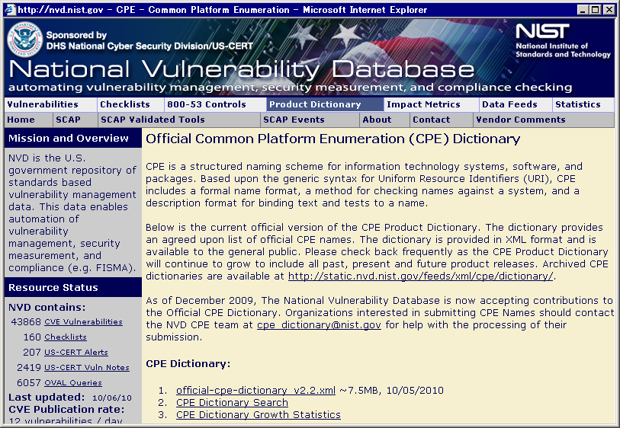
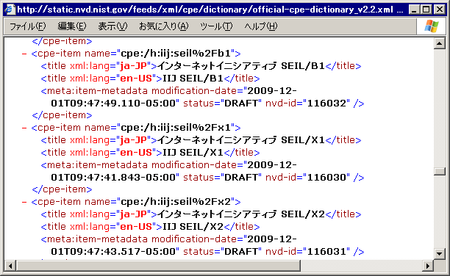
Collaboration possibilities of CPE
http://nvd.nist.gov/cpe.cfm
Registration of Japanese products and titles for keeping consistency between Official CPE dictionary (+ CPE name in NVD ) and MyJVN CPE DB.
X.1528

Slide 20
Summary
MyJVN is the framework of machine readable interface based on the CYBEX common enumeration for a security information sharing and exchanging.
http://jvndb.jvn.jp/en/apis/

Slide 21
Appendix
Activities History
2004
2005
2006
2007
2008
2009
2010
2011
2012
2013
2014 …
Jul 7, 2004: Information Security Early Warning Partnership
Jul 8, 2004: Portal Site, JVN (Vuln. Handling Coordination DB) http://jvn.jp/
Information Security Early Warning Partnership
A public-private partnership framework pursuant to the METI (Ministry of Economy, Trade and Industry) Directive #235, 2004, has been established to promote software product and web site security and prevent the damage to spread to the vast range of computers due to computer viruses or unauthorized access.

Slide 22
Appendix
Activities History
2006
2007
2008
2009
2010
2011
2012
2013
2014
2015 …
Jan 2006: Evaluating CVSS V1.0 for adoption
Sep 2006: CVSS V1.0 Calculator [CN][NL][EN][DE][JA][KO][PT][ES]
Apr 2007: JVN iPedia (Vuln. archiving DB)
http://jvndb.jvn.jp/ (Adopted CVE and CVSS)
Aug 2007: Adopted CVSS V2.0 in JVN iPedia
“Collaboration possibilities between NVD/SCAP and JVN” started.
May 2008: English Versions of JVN and JVN iPedia
Sep 2008: JVN iPedia extension (Adopted CWE)
Sep 2008: JVN iPedia extension (CVE Declaration)
Sep 2008: MyJVN project started
Oct 2008: JVN iPedia extension (Adopted CPE)
Oct 2008: MyJVN Filtered vulnerability information tool (Adopted CPE)
Notes:
This diagram is detail of vulnerability handling of software product.
Finder and discoverer report a vulnerability to IPA.
JPCERT/CC coordinate a handling process of a reported vulnerability with a product vendor.

Slide 23
Appendix
Activities History
2009
2010
2011
2012
2013
2014
2015 …
Deployment of SCAP/CYBEX based tools started.
Nov 2009: MyJVN Version Checker (VC) (Adopted CPE and OVAL)
Dec 2009: MyJVN Security Configuration Checker (SCC)
(Adopted OVAL, CCE and XCCDF)
Jan 2010: JVN, JVN iPedia and MyJVN (CVE-Compatible)
Jan 2010: CVSS V2.0 Calculator [AR][EN][FR][DE][JA][KO][ES]
Feb 2010: MyJVN API
Jun 2010: MyJVN - VRDA collaboration
Mar 2011: Briefing: SCAP activities in Japan
Security Automation Developer Days Winter 2011
Mar 2011: MyJVN VC and MyJVN SCC (OVAL Adopter)

Slide 24

Appendix
Activities History
2012
2013
2014
2015 …
“Collaboration possibilities
for Global Vulnerability Reporting” started .
Nov 2012: Kyoto 2012 FIRST Technical Colloquium (Japan)
Future of Global Vulnerability Reporting Summit
The FIRST Technical Colloquium (TC) event was held in Nov 13-15, 2012 at the Kyoto International Community House in Kyoto, Japan. FIRST Seminar and FIRST Hands-On Classes hosted by FIRST Japan Teams. Summit Days (Future of Global Vulnerability Reporting Summit) hosted by JPCERT/CC and IPA.
May 2013: MyJVN API (OVAL Adopter)
Jun 2013: Launching of FIRST VRDX-SIG
In order to continue with study of "Future of Global Vulnerability Reporting", which was raised at the FIRST Technical Colloquium 2012 Kyoto, we launched a Vulnerability Reporting and Data eXchange SIG (Special Interest Group) inside FIRST.
Jul 2014: CVSS V2.0 Calculator [AR][AZ][AZ-CYRL][CN][EN][FR]
[DE][JA][KO][RO][ES]

Slide 25
Appendix
References
JVN (Vulnerability Handling Coordination DB)
http://jvn.jp/en/
JVN iPedia (Vulnerability Archiving DB)
http://jvndb.jvn.jp/en/
MyJVN
http://jvndb.jvn.jp/en/apis/myjvn/
JVNRSS (JP Vendor Status Notes RSS) Feasibility Study Site
http://jvnrss.ise.chuo-u.ac.jp/jtg/
Information Security Early Warning Partnership
http://www.ipa.go.jp/security/english/quarterlyrep_vuln.html#Partnership

