Slide 1
Mitigating online risk for postal e-services

Slide 3
.post general overview
Active monitoring on .post TLD against Domain name Abuse detection and Mitigation
Internal Policies (e-mail SMTP)
PostID
Test Suite PREM S52 & Functional specifications for SMTP secure e-mail service
ITU and UPU joint project for secure e-mail

Slide 4
.post general overview
is a sponsored top-level domain (sTLD) available exclusively for the postal sector
aims to integrate the physical, financial, and electronic dimensions of postal services to enable and facilitate e-post, e-finance,
e-commerce and e-government services.
Integration of postal services
Interconectivity
Global standarization on e-services

Slide 5
Active monitoring
Monitoring against
Malware
Phishing
Spam
IP monitoring

Slide 6
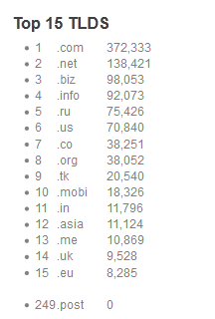
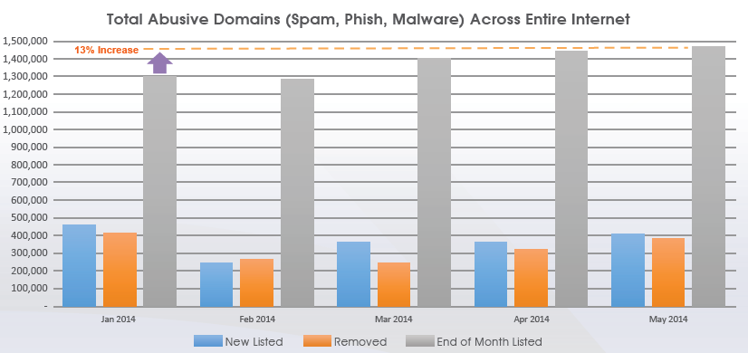
Statistics extracted in August 2014

Slide 7
What else to do?

Slide 8
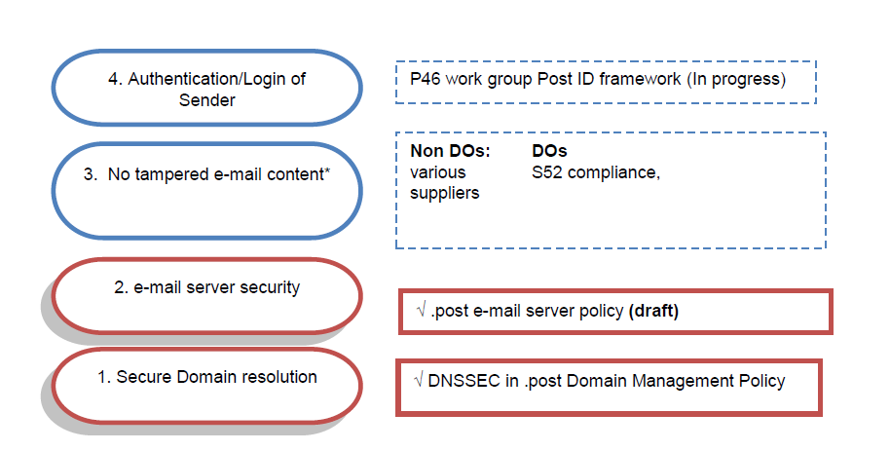
1st Internal policy SMTP
+ Trust via accreditations
+DNSSEC (Domain Name Security Extensions)
+DMP (Domain Management Policy)
Approved during last DPG GA April 2014
Do not use open Relay - enable SMTP authentication
2. Activate Reverse DNS lookup on the e-mail server
3. Enable Domain Keys Identified Mail (DKIM) 1024 bit key signature, if possible in conjunction with Domain-based Message Authentication (DMARC)
4. Implement a Sender Policy Framework (SPF)

Slide 9
Why?
Normal email is not a secure way of communication due to :
Authenticity of sender: Using normal email it is uncertain that the sender of the email is actually the genuine person you think it is; it could be someone else and the receiver probably wouldn’t notice it;
Non-Repudiation: The receiver of normal email can not verify the integrity of the content, have proof who the sender really is; therefore the sender can deny that what you have received is what the sender has sent and/or that the sender has sent that email at all;

Slide 10
Functional specifications for secure e-mail content
Internal (SMTP )
Domestic (SMTP )
Cross border (SMTP )
Worldwide exchange (S52)*
PostID
*S52 test Suite to test compliance with standard available third quarter 2014.

Slide 11
What is post ID and why we are creating it?
Electronic identities is growing which are causing complex interaction for the end-user
Posts are already engaged in postal electronic identity registration/authentication/verification/e-services like:
Real Me NZ Post, Swiss Post Swiss ID and some others.
Separate developments can lead to incoherent solutions
Interconectivity between domestic solutions can be beneficial for the international comunity
UPU aim is to create a federated identity ecosystem
WHY?
In order that the interactions can be based on regulations standards and solutions.

Slide 12
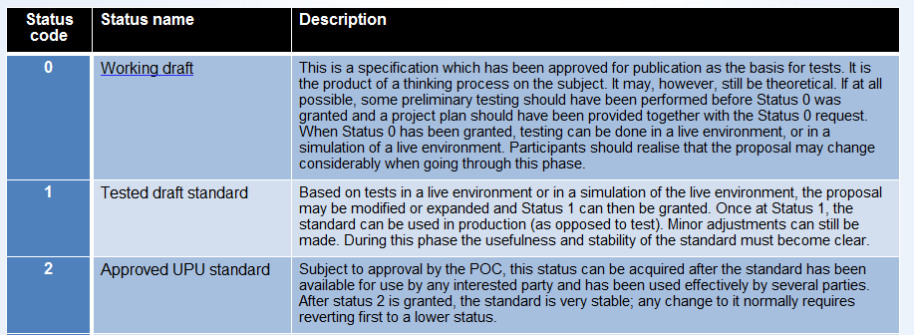
Approved during last POC meeting and currently with status 0.
Include a description of a Trusted network and different levels of assurance

Slide 13
Current work for PostID
What else we need?
Trust frameworks are not technical specifications; they are agreements among members as to which specifications, and at what conditions, will be used to support the S64 standard for postal electronic identity.
The global postal network could create a trust framework for its use, which may be extended to other non-postal use, if desired.

Slide 14
Post ID and .post
.post PostID
Certified cloud services
E-shop
Financial services
Secure register
E-mail
Global postal services
Trusted crossborder e-commerce services
e-government

Slide 15
Next steps?
Complete work on PostID standard
Interconectivity/Capacity building for adoption
Global standarization on e-services

Slide 16
Who is in?
With their 42 .post members and large physical post office Network, the .post Group is studying risks and opportunities of providing a secure email service under .post in 2014.
Since trust and security are keys for success of .post.
email and other e-services used under .post environment should be secure and trusted as well.

Slide 17
Who else?
ITU and UPU joint project
Platform independent
Mobile device compatibility
Two factor authentication
Compatible with business and legal local regulations
Complete control for administration
Posible to use secure cloud services
Together with Implementation of
Preventive controls
Detective controls
Corrective controls

