Slide 1
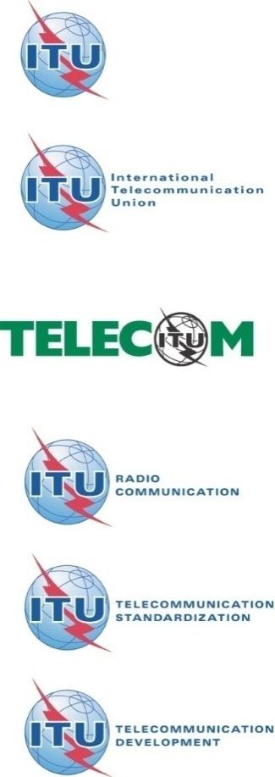
ISO Security Standardization News
ITU Workshop on “ICT Security Standardization
for Developing Countries”
(Geneva, Switzerland, 15-16 September 2014)
Dr. Walter Fumy
Chief Scientist
Bundesdruckerei GmbH, Germany
Walter.Fumy@bdr.de

Slide 2
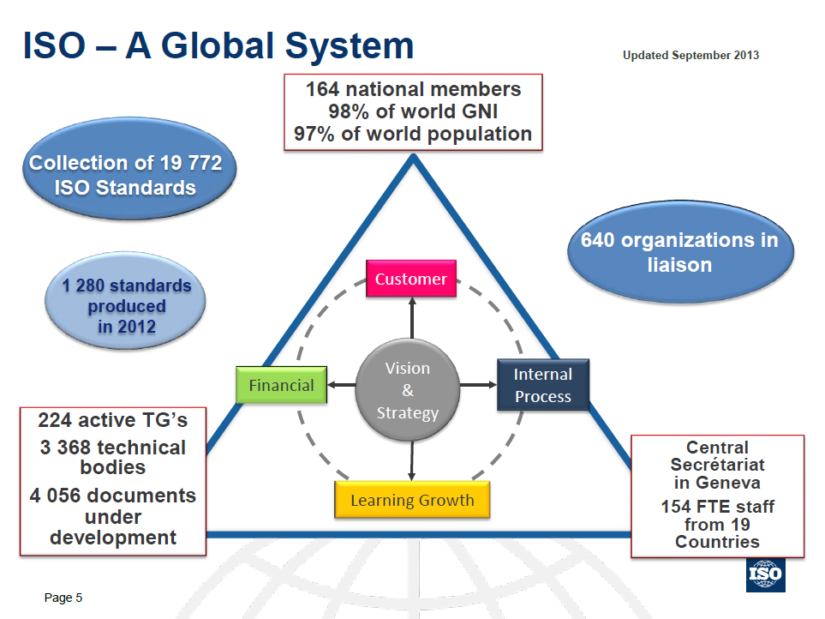
Source: ISO Security Forum, October 2013

Slide 3

Security Related ISO TCs include
TC 68 Financial services
  banking, securities and other financial services
TC 215 Health informatics
  information for health, health ICT
TC 247 Fraud countermeasures and controls
  detection, prevention and control of identity, financial, product and other forms of social and economic fraud
TC 292 Security (2015- )
  JTC 1 Information Technology
Notes:
00177

Slide 4
New ISO TC 292: Security
ISO TMB resolution 68/2014
Scope: Standardization in the field of security, including but not limited to general security management, business continuity management, resilience and emergency management, fraud countermeasures and controls, security services, homeland security.
  Excluded: Sector specific security projects developed in other relevant ISO committees and standards developed in TC 262 and PC 278.
History
In July 2013, the TMB invited ideas for improvement of ISO's work in the security sector. The results of this survey were discussed at a Security Coordination Forum in Geneva, October 29-30, 2013.
In early 2014, a TMB task force reviewed the output of the Security Coordination Forum and prepared a proposal on how to restructure the security sector within ISO ⇒ decision to create TC 292 Security.

Slide 5
New ISO TC 292: Security
ISO TMB resolution 68/2014
Official starting date for TC 292: 2015-01-01
At this date
- ISO/TC 223 Societal security
- ISO/TC 247 Fraud countermeasures and controls
- ISO/PC 284 Management system for quality of private security company (PSC) operations
will be disbanded and their work incorporated into TC 292.
Candidates to host the secretariat of the new TC on Security: Australia, Sweden, UK
Call for participation in the new TC on Security
(P- and O-membership)

Slide 6

Security Related
JTC 1 Sub-committees
  SC 6 Telecommunications and information exchange between systems
  SC 7 Software and systems engineering
  SC 17 Cards and personal identification
  SC 25 Interconnection of information technology equipment
  SC 27 IT Security techniques
  SC 29 Coding of audio, picture, multimedia and hypermedia information
  SC 31 Automatic identification and data capture techniques
  SC 32 Data management and interchange
  SC 36 Information technology for learning, education and training
  SC 37 Biometrics
  SC 38 Distributed application platforms and services (DAPS)
  SC 40 IT Service Management and IT Governance
Notes:
00177

Slide 7
SC 37 Biometrics
Working Groups
  WG 1 Harmonized biometric vocabulary
  WG 2 Biometric technical interfaces
  WG 3 Biometric data interchange formats
  WG 4 Biometric functional architecture and related profiles
  WG 5 Biometric testing and reporting
  WG 6 Cross-Jurisdictional and Societal Aspects of Biometrics
29 participating countries
96 published standards
http://www.iso.org/iso/home/standards_development/list_of_iso_technical_committees/iso_technical_committee.htm?commid=313770

Slide 8
SC 17 Cards and
Personal Identification
Working Groups
  WG 1 Physical characteristics and test methods for ID- cards
  WG 3 Machine readable travel documents
  WG 4 Integrated circuit cards with contacts
  WG 5 Registration Management Group (RMG)
  WG 8 Integrated circuit cards without contacts
  WG 9 Optical memory cards and devices
  WG 10 Motor vehicle driver license and related documents
  WG 11 Application of biometrics to cards and personal identification
34 participating countries, 122 published standards
http://www.iso.org/iso/home/standards_development/list_of_iso_technical_committees/iso_technical_committee.htm?commid=45144

Slide 9


SC 27 Mission
SC 27 is an internationally recognized centre of information and IT security standards expertise serving the needs of business sectors as well as governments. Its work covers the development of standards for the protection of information and ICT.
This includes generic methods, techniques and guidelines to address both security and privacy aspects, such as
  Information Security Management Systems (ISMS), requirements, controls and conformance assessment, accreditation and auditing requirements in the area of information security
  Cryptographic mechanisms
  Security evaluation criteria and methodology
  Security services
  Security aspects of identity management, biometrics and privacy

Slide 10
SC 27 Organization
ISO/IEC JTC 1/SC 27
IT Security techniques
Chair: Mr. W. Fumy
Vice-Chair: Ms. M. De Soete
SC 27 Secretariat
DIN
Ms. K. Passia
Working Group 1
Information security management systems
Convener
Mr. T. Humphreys
Working Group 2
Cryptography and security mechanisms
Convener
Mr. T. Chikazawa
Working Group 3
Security evaluation, testing and specification
Convener
Mr. M. Bañón
Working Group 4
Security controls and services
Convener
Mr. J. Amsenga
Working Group 5
Identity management
and privacy technologies
Convener
Mr. Rannenberg
http://www.jtc1sc27.din.de/en

Slide 11
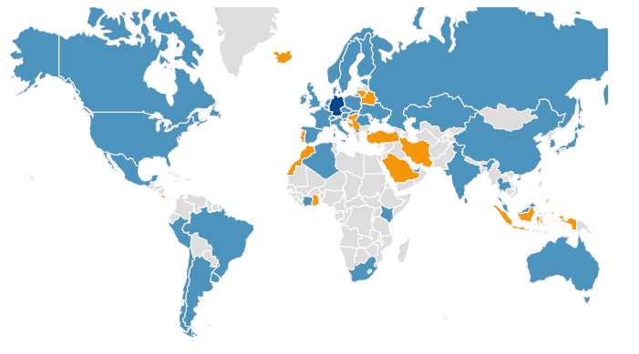
SC 27 Members
P-members (voting)
Algeria, Argentina, Australia, Austria, Belgium, Brazil, Canada, China, Côte-d'Ivoire, Cyprus, Czech Republic, Denmark, Estonia, Finland, France, Germany, India, Italy, Ireland, Israel, Jamaica, Japan, Kazakhstan, Kenya, Rep. of Korea, Luxembourg, Rep. of Macedonia, Malaysia, Mauritius, Mexico, The Netherlands, New Zealand, Norway, Peru, Poland, Romania, Russian Federation, Singapore, Slovakia, Slovenia, South Africa, Spain, Sri Lanka, Sweden, Switzerland, Thailand, Ukraine, United Arab Emirates, United Kingdom, United States of America, Uruguay (total: 52)
O-members (observing)
Belarus, Bosnia and Herzegovina, Costa Rica, El Salvador , Ghana, Hong Kong, Hungary, Iceland, Indonesia, Islamic Rep. of Iran, Lithuania, Morocco, Portugal, Saudi Arabia, Serbia, State of Palestine, Swaziland, Turkey (total: 18)
Notes:
According to the ISO list of developing countries, 34 of the 70 SC 27 members represent developing countries.

Slide 12
Recent Publications include
  ISO/IEC 24759: Test requirements for cryptographic modules (2nd ed.)
  ISO/IEC 27001: Information security management systems – Requirements (2nd ed.)
  ISO/IEC 27002: Code of practice for information security management (2nd ed.)
  ITU-T Recommendation X.1054 | ISO/IEC 27014: Governance of information security
  ISO/IEC 27018: Code of practice for protection of personally identifiable information (PII) in public clouds
  ISO/IEC 27033: Network security
  — Part 4: Securing communications between networks using security gateways
  — Part 5: Securing communications across networks using Virtual Private Networks (VPNs)

Slide 13
Recent Publications
(continued)
  ISO/IEC 20008: Anonymous digital signatures
  — Part 1: General
  — Part 2: Mechanisms using a group public key
  ISO/IEC 20009: Anonymous entity authentication
  — Part 1: General
  — Part 2: Mechanisms based on signatures using a group public key
  ISO/IEC 29192: Lightweight cryptography
  — Part 4: Mechanisms using asymmetric techniques
  ISO/IEC 29101: Privacy architecture framework
  ISO/IEC 29115: Entity authentication assurance framework

Slide 14
Recently Approved
New Projects include
ISO/IEC NP 11770-6: Key management
— Part 6: Key derivation
ISO/IEC NP TR 19249: Catalogue of architectural and design principles for secure products, systems, and applications
ISO/IEC NP 20009-4: Anonymous entity authentication
— Part 4: Mechanisms based on weak secrets
ISO/IEC NP 27009: The use and application of ISO/IEC 27001 for sector/service-specific Third-Party accredited certifications
ISO/IEC NP 27050: Electronic discovery
ISO/IEC NP 29151: Code of practice for the protection of personally identifiable information [ = ITU-T X.gpim]

Slide 15
SC 27 Collaboration with ITU-T
ITU-T SG17 and SC 27 collaborate on many projects in order to progress common or twin text documents and to publish common standards. These include
ITU-T X.1051 | ISO/IEC 27011:2008 – Information security management guidelines for telecommunications organizations based on ISO/IEC 27002
ITU-T X.1054 | ISO/IEC 27014:2013 – Governance of information security
ITU-T X.1085 | ISO/IEC CD 17922: Telebiometric authentication framework using biometric hardware security module
ITU-T X.cc-control | ISO/IEC CD 27017: Code of practice for information security controls for cloud computing services based on ISO/IEC 27002
ITU-T X.gpim | ISO/IEC WD 29151: Code of practice for personally identifiable information (PII) protection

Slide 16
Projects Facts & Figures
Projects
    Total no of projects: 206
    No of active projects: 79 (11 new projects in 2013)
    Published standards: 135 (22 publications in 2013)
Standing Documents
    SD6 Glossary of IT Security terminology (http://www.jtc1sc27.din.de/sbe/SD6)
    SD7 Catalogue of SC 27 Projects and Standards (http://www.jtc1sc27.din.de/sbe/SD7
    SD11 Overview of SC 27 (http://www.jtc1sc27.din.de/sbe/SD11)
    SD12 Assessment of cryptographic algorithms and key lengths (http://www.jtc1sc27.din.de/sbe/SD12)
    http://www.iso.org/iso/home/standards_development/list_of_iso_technical_committees/iso_technical_committee.htm?commid=45306

Slide 17
24 Years of SC 27
… and the tour continues
      April 7-15, 2014
      Hong Kong, China
      (WGs and Plenary)
      Oct 20-24, 2014
      Mexico City, Mexico
      (WGs)
      May 4-12, 2015
      Kuching, Malaysia
      (WGs and Plenary)
      Oct 26-30, 2015
      Jaipur, India
      (WGs)
      https://en.wikipedia.org/wiki/ISO/IEC_JTC_1/SC_27

Slide 18


Final Remarks
50% of the SC 27 members come from developing countries
  participation is steadily increasing
ISO wants to help developing countries make the most out of the benefits International Standards offer and to help them play an active role in their development
  ISO action plan for developing countries
  Twinning relationships
  Training and technical assistance
  ISO award for young professionals in developing countries

Slide 19
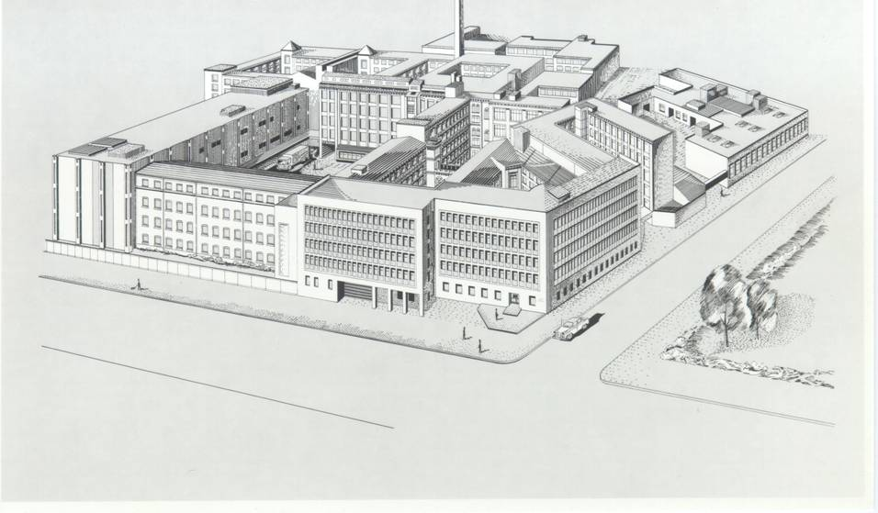

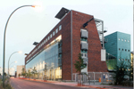

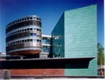
Thank you very much
for your kind attention
  Walter.Fumy@bdr.de

