Slide 1

Security by Design in Smart Grids
A Need to Rethink ICT in Power System Controls
ITU Workshop on “ICT Security Standardization
for Developing Countries”
(Geneva, Switzerland, 15-16 September 2014)
Carsten Strunge,
Senior Development Engineer, Energinet.dk
cas@energinet.dk

Slide 2
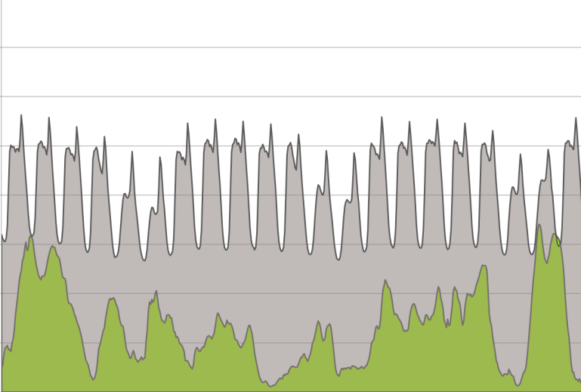
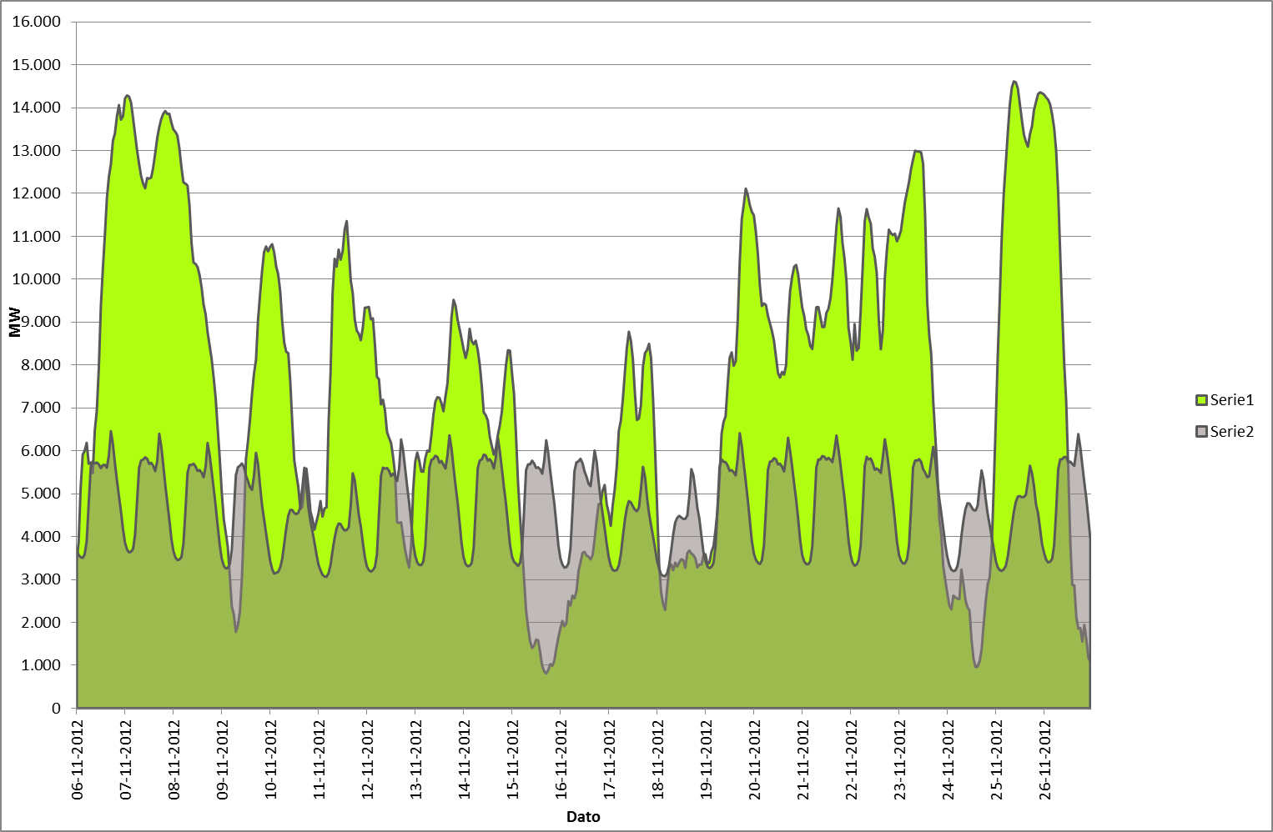
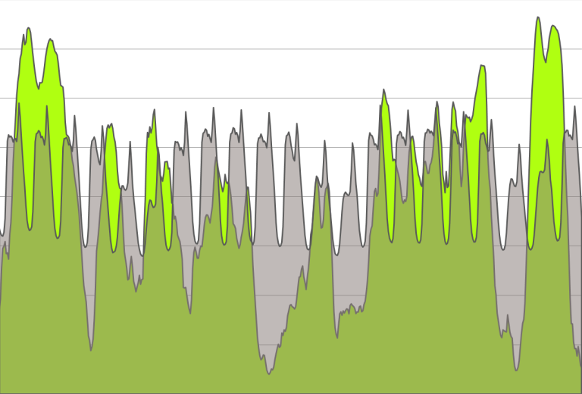
The Challenge of Balancing Wind Power and Electricity Consumption
2012
2050 (scale 1:1)
Approx. 30 pct. of classic demand
2035
Approx. 75 pct. of classic demand
Approx. 140 pct. of classic demand

Slide 3

The Challenge to
Utilization Renewabel Power
New paradigm: → More load must follow production.
Not just locally, but cross boarder
50,5 Hz
50,0 Hz
Power production
Consumption
49,5 Hz
* Local balancing should only be for congestion management.

Slide 4




The Challenge of the Changing Power System
HVDC
NO/SE
HVDC
NL
400 kV
HVAC
SE
HVAC
DE
150 kV
SC
SVC
60 kV
10 kV
0,4 kV

Slide 5
The Generalized Stakeholder and Domain Model (from NIST)

Slide 6
What is the problem?
Internet is chosen as carrier of data (economy)
Internet does no longer offer secure communication
But it can be secured by:
  Ensuring authenticitet (”user identification”)
  Securing data in motion (by encription)
  Securing data at rest (on devices level)
  Building security into control processes
And it is necessary to continuously monitor the entire system (both Electric Power and ICT)

Slide 7
What is Security by Design in Smart Grid?
To have information security thought into the power system control concepts.
Security and robustness in data exchange
  X.509, PKI
  RBAC, IEC61850 and SecureMMS, CIM and “SecureCIM”
Secure and robust data storage
  Access to data at the source
  Roll Based Access Controls (RBAC) at source
Secure and robust data processing
  Semi-offline controls though exchange of schedules
  Distributed controls with clear client-server relations
Secure and robust fall-back schemes
  Detection of abnormal behavior
  Segmentation and isolation of “infected” processes and ICT-networks
  Fall-back concepts

Slide 8
Basic Elements in the Smart Grid Control Loop and Client-Server Relation
Control1
(Client agent)
Control2
(Other clients)
Communication
Communication
Status for availibility
Control box w. RBAC
(Agent or Gateway)
Control and information
data
Sensor
Actuator
(Server)
data
Power System

Slide 9
Elements in the Smart Grid Control Loop - Prosumer Relation
DSO Voltage and
Emergency controls (SCADA)
Market Aktor
Commercial Operation
(Aggregator)
E.g. via AMR/AMI
Communication
(Fiber, PLC, GPRS, ?)
Communication
(Internet)
Status for availibility
Energy og
online power
Control box w. RBAC
(Agent or Gateway)
Control and information
data
Sensor
Meter
Actuator
DER, CHP
HP, EV
etc.
data
Power System

Slide 10
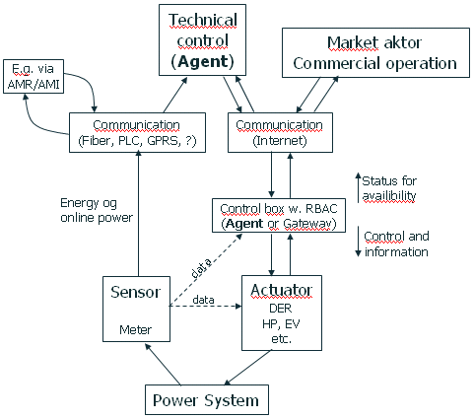


Local Technical VPP and Commercial VPP in Smart Grid
Market actor A
ComVPP
Market actor B
ComVPP
Communication
(Internet)
Control
TekniskVPP
(Agent)
Tech + ComA + ComB
Tech + ComA
Tech + ComA + ComB
Tech + ComA
10/0,4 kV
AMI/AMR

Slide 11







Proof of Concept Demonstration
CHPCOM
CHPCOM
project
Combined Heat and Power Communication
Secure IEC 61850 based Information Exchange in a Danish Context

Slide 12




CHPCOM– is testing standards to make assets Smart Grid Ready
Solar heat
Accumulator
Electric Boiler
District heat
Power Market
TSO

Power buy
CHP plant
Measurement
Supply of services
Balance responsible
Generator
Control
Measurement
~

Market control
Internet
Measurement
Data
Flexibility Market Aggregator
Data
Technical control
Local resources to balance the local grid

Power
sale
International data exchange standard IEC 61850
Secured according to IEC 62351
Measurement
DSO/DNO
New
See: www.chpcom.dk (not yet available in English)

Slide 13
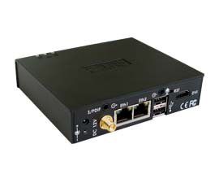


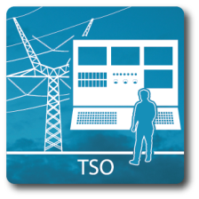



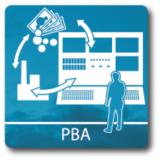

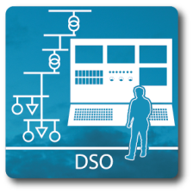

CHPCOM –
Role Based Access Control
CHPCOM RBAC unit
incl. IP-Firewall
IEC62351-4 SecureMMS from SISCO
IEC62351-8 RBAC from EURISCO
Internet

Slide 14
RBAC structure in IEC 62351-8
- Whitelisting, Roles and Rights
Example
Subject
Person/system whitelisted and identified by X.509 based certificate, whishes access to a resource
Egon Olsen
Roles
Roles define basic user rights
BRP Operator
Rights
Rights defines access to specific functions
Start engine #1
Operations
Functions can conduct specific actions at resource
Write
Objects
Resource read or write data
DCIP1.EngCtl.ctlVal
IEC TS 62351-8
IEC 62351-8 also applies to IEC TC57 CIM-standards

Slide 15
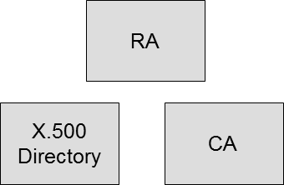

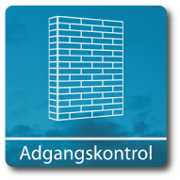
The CHPCOM data flow
SCADA
PKI
Components
SCADA
61850 GW
SCADA frontend
SCADA DB
61850 DB
RTU
MMS
MMS
SecureMMS
Gateway
RBAC
s/MMS
INTERNET
Firewall
s/MMS
s/MMS

Slide 16
CHPCOM Information Security Activities
Implementation of
  PKI-elements
  X.509 certificates with encoded roles
  Automated certificate handling
  SecureMMS
  IEC 62351-8 RBAC gateway
Security Analysis
  PKI policies.
  Clients and Servers policies for installation and secure management.
Standardisation
  Feedback to basic X.509 standard (ITU-T SG17) with specific Smart Grid requirements;
  Feedback to IEC 62351 (TC57 WG15) on SecureMMS and RBAC implementation
Identify legislative needs
  Identify the legislative requirements in Denmark.
  Dialog with key stakeholders.

Slide 17
Conclusions and Recommendations
What we found Smart Grid needs from ITU-T
Automated machine2machine solutions e.g. for certificate renewal
Local certificate whitelists
Strong processes for initial certificate “bootstraping”
Multiple associated parallel PKI
  E.g. Smart Grid-PKI, Smart Meter-PKI, EV-PKI, etc.
And not least a good cooperation between ITU-T and IEC TC57.

