Slide 1

Smart Grid cyber security within IEC TC57 WG15
ITU Workshop on “ICT Security Standardization
for Developing Countries”
(Geneva, Switzerland, 15-16 September 2014)
Fernando Alvarez,
Cyber Security Technical PM
ABB Switzerland
Notes:
Abstract: World utilities provide essential services, such as providing and distributing water, gas and electricity. Governments have recognized the importance to secure utility infrastructures against all kind of attacks. Lately, focus has been on cyber security robustness of the utility grids. A lot has been done and deployed, still there is a lot to be done. This presentation will introduce you to the IEC TC57 WG15 work which develops the standard IEC 62351. IEC 62351 is worldwide accepted as the cyber security standard for the Smart Grid of the future. IEC 62351 standard specifies and standardize the different cyber security technologies to be applied at different levels of the grid.

Slide 2
Topics
Industrial Cyber Security Essentials
Mission and Scope of TC57 WG15
Members
IEC 62351 Parts & Status
IEC 62351 Roadmap
About IEC 62351 Parts 7, 8 and 9
Liaisons and Coordination
Standardization Issues

Slide 3
Cyber Security – Essentials without / before IEC 62351
Physical perimeter protection
Fences, gates, motion sensors, cameras
Electronic perimeter protection
Firewalls, VPN
Antivirus and IDS
Unused ports & services disabled
Debug services, USB ports, etc.
Robustness tested releases
No device crashes due DOS attacks

Slide 4
Cyber Security – Essentials
Is all this enough?

Slide 5
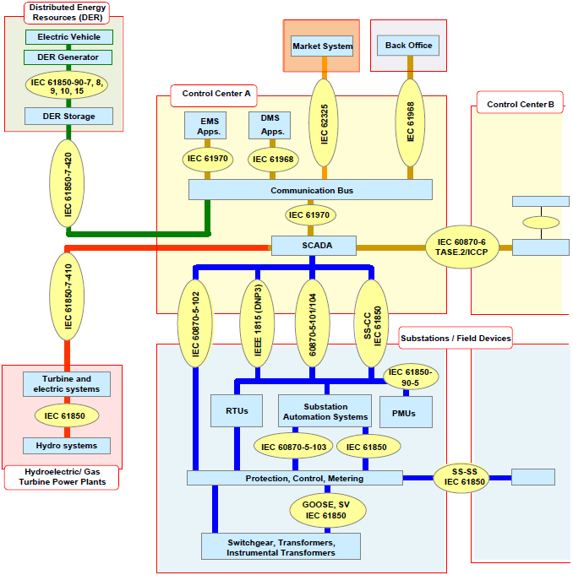
IEC 62351 – Even more essential

Slide 6
IEC 62351 – Even more essential
Secure the protocols w/authentication+

Slide 7
Topics
Industrial Cyber Security Essentials
Mission and Scope of TC57 WG15
Members
IEC 62351 Parts & Status
IEC 62351 Roadmap
About IEC 62351 Parts 7, 8 and 9
Liaisons and Coordination
Standardization Issues

Slide 8
Mission and Scope of
TC57 WG15 on Cyber Security
Undertake the development of standards for security of the communication protocols defined by the IEC TC 57
  Specifically the IEC 60870-5 series, the IEC 60870-6 series, the IEC 61850 series, the IEC 61970 series, and the IEC 61968 series.
Undertake the development of standards
and/or technical reports on
end-to-end security issues.
IEC 62351

Slide 9
Topics
Industrial Cyber Security Essentials
Mission and Scope of TC57 WG15
Members
IEC 62351 Parts & Status
IEC 62351 Roadmap
About IEC 62351 Parts 7, 8 and 9
Liaisons and Coordination
Standardization Issues

Slide 10
TC57 WG15 Members
76 members
Participants from 22 countries
  Argentina
  Canada
  China
  Croatia
  Czech Republic
  Denmark
  Finland
  France
  Germany
  Great Britain
  India
  Japan

Slide 11
Topics
Industrial Cyber Security Essentials
Mission and Scope of TC57 WG15
Members
IEC 62351 Parts & Status
IEC 62351 Roadmap
About IEC 62351 Parts 7, 8 and 9
Liaisons and Coordination
Standardization Issues

Slide 12
Mapping of TC57 Communication Standards to IEC 62351 Security Standards

Slide 13
IEC 62351 Parts & Status
IEC 62351 Part | Released | Activities (by May 2014) | Planned Release
IEC/TS 62351-1: Introduction | 2007 | -
IEC/TS 62351-2: Glossary of terms | 2008 | Review Report pending | Pending
IEC/TS 62351-3: Security for profiles including TCP/IP | 2007 | Ed. 2: Responses to Comments on CDV being developed | Submitted as CDV by Dec 2012, FDIS Dec 2013, IS Ed. 2 by 2014?
IEC/TS 62351-4: Security for profiles including MMS | 2007 | Starting Edition 2 After amendment process was rejected, the decision was made to start Edition 2 | Comments on Q rec’d Dec 2013 Ed. 2: CD 6/2015, CDV 3/2016, FDIS 6/2016, IS Jun 2017
IEC/TS 62351-5: Security for IEC 60870-5 and derivatives | 2009 | Ed. 2 released April 2013 | TS Released April 2013 Possible clarifications
IEC/TS 62351-6: Security for IEC 61850 profiles: GOOSE & SV | 2007 | Ed. 2 planed: Updates underway, based on security requirements in IEC 61850-90-5 | RR to be issued mid-2014, to be released in parallel with Part 4
IEC/TS 62351-7: Objects for Network Management | 2010 | Working on Ed. 2: Responded to comments on RR changing TS to IS | CD 9/2014, CDV 6/2015, FDIS 3/2016, IS 9/2016
IEC/TS 62351-8: Role-Based Access Control : RBAC | 2011 | Working on Ed. 2: Discussions on developing categories of roles | Planning IS in 2014/15 after TR 90-1 issued
IEC/TS 62351-9: Key Management | Pending | Working on Ed. 1: 1st CD issued August 2013; Responses submitted Feb 2014. 2nd CD planned | 2nd CD August 2014, CDV in (early) 2015 and IS in (late) 2015
IEC/TR 62351-10: Security Architecture | 2012 | TR published Oct 2012 No further work planed. | Done
IEC/TS 62351-11: Security for XML Files | Pending | Working on Ed. 1: Developing CD for WG15 review by May 2014 | CD 6/2014, CDV 2/2015, FDIS 12/2015, IS 6/2016
PWI: Resiliency and Security for power systems with DER | DC Pending | Need broader review by WG17 & 21 before submittal as TR as 62351-12 | Review in WG17 and WG21, Circulated in WG19 early 2014
PWI: Conformance Testing for IEC 62351 | NWIP Pending | Pending | Pending
PWI: IEC 62351-90-1: Guidelines for Using Part 8 RBAC | TR Pending | Work in progress | Pending

Slide 14
Topics
Industrial Cyber Security Essentials
Mission and Scope of TC57 WG15
Members
IEC 62351 Parts & Status
IEC 62351 Roadmap
About IEC 62351 Parts 7, 8 and 9
Liaisons and Coordination
Standardization Issues

Slide 15
TC57 Security (IEC 62351) Roadmap
Completed | Updates in Process | Potential New Work
Ed. 1 of Parts: 1, 2, 3, 4, 5, 6, 7, 8, and 10 – finalized as TRs or TS Ed. 2 of Part 5 | Part 2 Glossary: adding amendments probably update in 2014 Part 3 Security using TLS: Submitted as FDIS Dec 2013 as IS by 2014 Part 4 Security for MMS: Edition 2 started Part 6 on IEC 61850: GOOSE & SVs. Updates to equivalent to IEC 61850-90-5 Part 7 Network and System Management: update process to Ed 2 started in 2013 Part 8 developing TR 62351-90-1 as Guidelines for using RBAC Part 9 Key Management: CD issued in August 2013; comments being addressed Part 11 Security for XML Files: in progress Resilience and Security for DER systems and other field devices (collaborate with WG17 and WG21 as appropriate) | Conformance Testing TR Profiles for web services including XMPP (once the requirements are determined in the IEC 61850-8-2 development) Metering (collaborate with TC13) Explore customer premises security issues with WG21

Slide 16
Topics
Industrial Cyber Security Essentials
Mission and Scope of TC57 WG15
Members
IEC 62351 Parts & Status
IEC 62351 Roadmap
About IEC 62351 Parts 7, 8 and 9
Liaisons and Coordination
Standardization Issues

Slide 17
Topics
Industrial Cyber Security Essentials
Mission and Scope of TC57 WG15
Members
IEC 62351 Parts & Status
IEC 62351 Roadmap
About IEC 62351 Parts 7, 8 and 9
Liaisons and Coordination
Standardization Issues

Slide 18
IEC 62351-7 ~ Standardized
Network and System Management
Network and system management (NSM) data object models
Using Simple Network Management Protocol (SNMP)
Coherent status and monitoring data of the power infrastructure/grid
Different grid areas, diff. comm. channels,
network segments, different protocols, etc.

Slide 19
IEC 62351-7 Network and System Management

Slide 20
Topics
Industrial Cyber Security Essentials
Mission and Scope of TC57 WG15
Members
IEC 62351 Parts & Status
IEC 62351 Roadmap
About IEC 62351 Parts 7, 8 and 9
Liaisons and Coordination
Standardization Issues

Slide 21
IEC 62351-8 ~ Standardized
Role-Based Access Control
Standardized Central User Account
Management in the automation, industrial, embedded world
Standardized RBAC (Role Based Access Control)
User tokens : X.509 certificates
User certificates specify user’s roles, roles grouped in AoRs
Pull (e.g. LDAP) &
Push (e.g. SmartCards) methods supported

Slide 22
Topics
Industrial Cyber Security Essentials
Mission and Scope of TC57 WG15
Members
IEC 62351 Parts & Status
IEC 62351 Roadmap
About IEC 62351 Parts 7, 8 and 9
Liaisons and Coordination
Standardization Issues

Slide 23
IEC 62351-9 ~ Standardized
Key Management Methods
Device/user X.509 digital certificates
PKI methods and protocols
Full key life cycle : from
Creation until the end-of-life
GDOI (distribution of symmetrical keys)

Slide 24
Topics
Industrial Cyber Security Essentials
Mission and Scope of TC57 WG15
Members
IEC 62351 Parts & Status
IEC 62351 Roadmap
About IEC 62351 Parts 7, 8 and 9
Liaisons and Coordination
Standardization Issues

Slide 25
Liaisons with Other Security Activities
Liaison with ISO JTC 1 / SC 27 IT Security:
  WG15 has provided lists of Smart Grid security standards & documents to SC27.
  WG15 has reviewed documents of the 270xx series on general cyber security.
  WG15 welcomes the publication of ISO/IEC TR 27019.
  SC27 liaison : SC27 expects to attend additional WG15 meetings
Liaison D with M/490 SGIS:
  WG15 is exchanging information with SGIS
Liaison D with UCAIug:
  Discussions with SG-Security in UCAIug are underway.
Liaison A with IEC TC65C which is standardizing the work of the
ISA SP99 Security Standards.
  Some WG15 members have reviewed and commented on IEC 62443 drafts
Liaison D with the IEEE PES PSCC Security Subcommittee
  Working with IEEE Substations on Cybersecurity Standard IEEE 1686

Slide 26
Coordination with Security Groups
Coordination mostly through common membership:
  NIST’s Smart Grid Interoperability Panel (SGIP) Smart Grid Cybersecurity Committee (SGCC) (used to be called CSWG)
  SGIS
  NERC CIPs
  Cigré D2.34
  MultiSpeak Security / Security for Web Services
  (e.g. WS-Security)
  NESCOR
  IEC TC13
  ITU-T

Slide 27
Topics
Industrial Cyber Security Essentials
Mission and Scope of TC57 WG15
Members
IEC 62351 Parts & Status
IEC 62351 Roadmap
About IEC 62351 Parts 7, 8 and 9
Liaisons and Coordination
Standardization Issues

Slide 28
Cyber Security Standardization Issues
Although we have cybersecurity experts, they are very busy
Cybersecurity is a very dynamic, rapidly changing field which is quite new for the power & automation industries
  Need to coordinate with other industries and standards groups
  Need rapid development of new standards and updates to existing standards
  Need guidelines for end-to-end security, but only for very specific aspects
  Need both standards and technical reports
  Need input from power system domain experts on security requirements
Need conformance and/or interoperability testing for
IEC 62351
  Abstract conformance test cases should be in each Part, with IEC 61850-10 providing specifics for 61850
  Interoperability testing?

Slide 29
Questions? Comments?

Slide 30
Thanks

